Slide 1
Supporting Young Carers in Essex
The future of support for
Young Carers in Essex
Tim Frances, Youth Work Commissioner

Slide 2
Policy Context
The Government commitment to young carers was reaffirmed in October 2014 -
“Children and young people will be protected from inappropriate caring and have the support they need to learn, develop and thrive and to enjoy positive childhoods”.
The Children and Families Act 2014 defines a young carer as
“..a person under 18 who provides or intends to provide care for another person (of any age, except where that care is provided for payment, pursuant to a contract or as voluntary work)”

Slide 3
Policy Context
The Children and Families Act 2014, in conjunction with the Care Act 2014, seeks to make sure young carers get the support they need. Under this Act,
local authorities are expected to take reasonable steps to identify young carers so they can be offered a Statutory Needs Assessment leading to appropriate support.

Slide 4

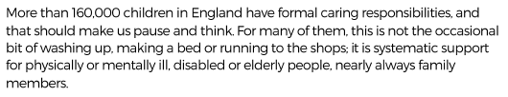
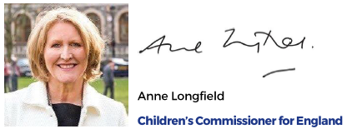

Slide 5
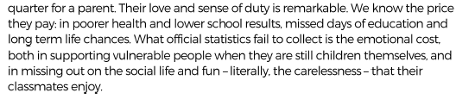

Slide 6
Supporting Young Carers in Essex
It is estimated that there are in excess of 10,000 young carers in Essex who provide care to someone every day, with almost 6,000 providing more than one hour of care a day.

Slide 7
Many young carers suffer consequences that can be serious and long lasting.
1 in 20 misses school because of their caring responsibilities.
Significantly lower educational attainment at GCSE level, equivalent to nine grades lower overall than their peers e.g. the difference between nine B’s and nine C’s.
1.5 times more likely than their peers to be from BAME and 2x as likely to not speak English as their first language.
1.5 times more likely than their peers to have SEN or a disability.
Average annual income for families with a young carer is £5000 less than families who do not have a young carer.
Essex 2015, young adult carers had a NEET rate of 30% - 6x av
Many come from hidden and marginalised groups, including children caring for family members with mental illness or a substance dependency.

Slide 8
Young Carers and Young Adult Carers tell us that……
Many were bullied at school for their caring role
More than 1 day per month was lost at school through lateness or absence due to caring.
50% find college or university difficult due to their caring role
Nearly 90% of young adult carers felt they had not received good career advice at school
Over 50% reported a mental health problem – twice the national average.
SHEU 2016 – “Young carers, pupils receiving free school meals and pupils with special needs in mainstream schools are generally less positive about their lives compared to their peers.”

Slide 9
What we were told….
Nobody understood what I actually did!
This isn’t a role or an obligation, it’s a way of life
I got no help from GP’s
I don’t have a social life, if I get ‘respite’ what do I do?
I felt isolated
I wish I had the opportunity to go to a school better equipped to support me
Facebook gives me seconds of ‘normal’

Slide 10
Specialist workers for Mum as I’m alone
Prom. It made me feel normal for a night
Everyone needs a Julia (support worker)
We are a family, so we care for each other
Make my parent better
My brother helps me but he’s only 7, we don’t get any other support
Can’t remember being happy at an early age, and not being able to be happy because something bad will happen, so I stay sad

Slide 11
Parents don’t like people knowing
Teachers think it’s an excuse, they don’t listen, or don’t ask why I am out of school or behaving badly
There’s no routine, no sleeping pattern
When I go into hospital, that’s when people ask me and listen to me
We need better access to information and services available
Feeling under pressure for not knowing how to cook meals or reach the cooker!
No help to take the burden off, to have a childhood

Slide 12
Key Areas of Improvement identified
Improved identification of young carers/young adult carers
Increase access to statutory assessment of young carers needs
Improved understanding and support in Schools/FE/HE & Employers
Provide personalised and appropriate support when needed
Provide support to ‘cared for’ to reduce inappropriate caring and caring burden where necessary.
Raise awareness and understanding of young carers
Improve access to information for young carers and their families

Slide 13
Action Plan
Provide a network of ‘local’ 1:1 Key Workers for young carers to access when needed.
Key Workers ensure emergency plans in place
Develop a network of ‘Street Nannies’ to provide support with tasks in the home
Improve access to Essex specific web based information + app development /Facebook groups
Increase access to independent assessment
Introduce ‘Healthy Schools Award’ young carers support Benchmarks
Support schools to achieve the National Young Carers in Schools Award
Engage with FE/HE & Employers to better support Young Carers

Slide 14
Action Plan
Improve engagement of GP’s & Health to identify and support young carers in their roles
Engage school nurses and community health workers in providing complimentary support
Improve ‘whole family approach’ to assessment and identification
Improve engagement with BME communities
Provide personal budgets to most in need
Increased access to Specialist services – Mental health
Provide meaningful ‘respite’ opportunities
Support continuation of existing local Groups

Slide 15

https://youngcarersinschools.com/

Slide 16
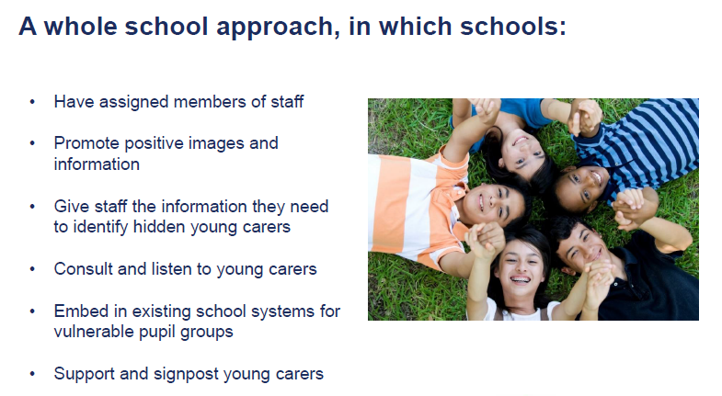

Slide 17
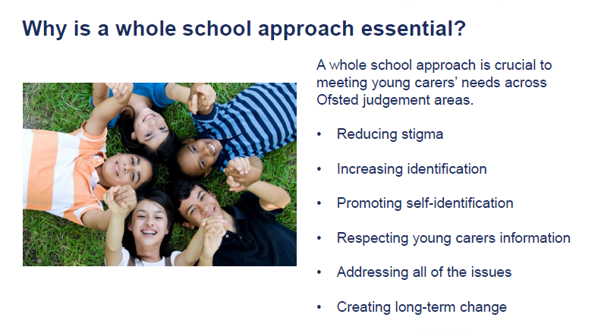
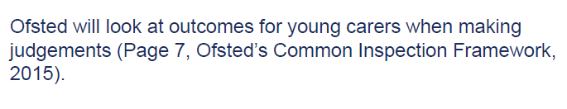

Slide 18
The School Young Carers Group
When it became clear some of our students were having trouble doing their school work because of the care they were giving at home, setting up a Group which could offer support in school for these students seemed a good idea.
The aim is twofold:
To offer support and provide a voice for the students
To raise awareness of the needs
of Young Carers our school
Notes:
So you now have an idea about who young carers are, we’ll explain what Suffolk young carers is. Explain caption and then invite a volunteer up to help demonstrate a young carer juggling everything and the net of support young carers offers. WE CAN SUPPORT BUT WE CAN’T TAKE THE PROBLEMS AWAY.

Slide 19

Support
Social situations
Advocacy – a voice when needed
Recognise the impact of caring on school life
Information
Signposting to other agencies
Support accessing activities
Point of contact within the school at all times
Peer support
Access to talk to local Young Carers Support

Slide 20

Often late or miss days for no apparent reason.
Often/periodically tired or withdrawn.
Have difficulty joining in extra curricular activities. Make excuses not to be involved.
Isolated. This can be either because of the situation in the family or because they lack social skills when with their peers. In contrast, they may be confident with adults.
A victim of bullying
Under- achievement. Homework/coursework may be of poor quality, not submitted on time or not handed in at all.
Expressed anxiety or concern over ill/disabled relative.
Behavioural problems…rudeness, lack of care, etc. as the young person takes out their pent-up frustration or stress at school.
Physical problems such as back pain from lifting an adult.
Over sensitivity to others who are upset, etc. Adopting carers role.
Reluctance to talk about home/relatives.
Identifying a young carer at school

Slide 21

Cope in an emergency
Emotional support
Personal care
Lifting
Caring for a sibling
Medication
Pay bills/finances
Shopping
Housework
Provide extra income
Prepare meals
Cooking
Keeping an eye on someone
Social care
What young carers may do…

Slide 22
Possible effects of caring on school life, (physical and emotional well-being)
Stressed
Poor attendance
Late to school
Difficulties concentrating
Bad back
Struggle to open about home life
Behavioural problems
Poor results
Being bullied
Whoa!
Friendships
Trust
Tiredness
Grief/possible loss
Difficulty in engaging in after school activities

Slide 23
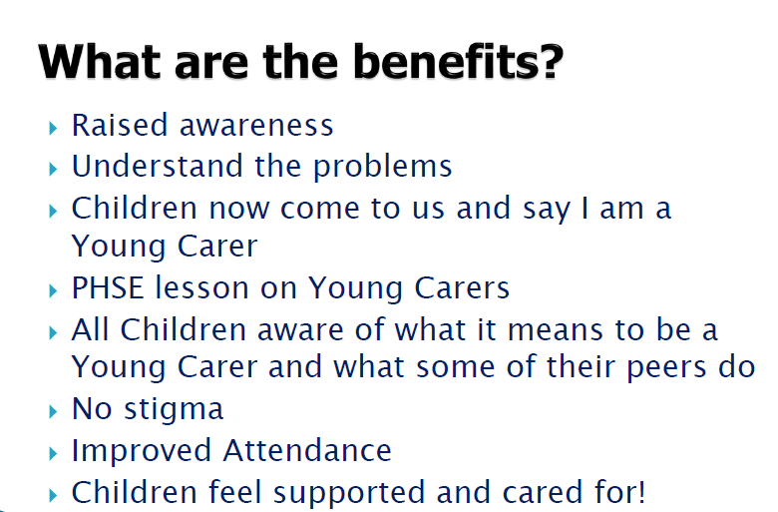
Example – Downs CE Primary in Kent

Slide 24
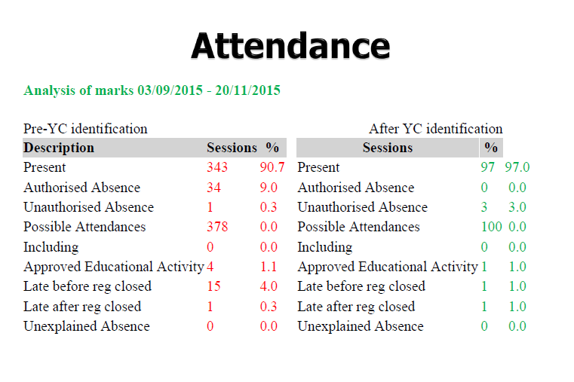
Example – Downs CE Primary in Kent

Slide 25
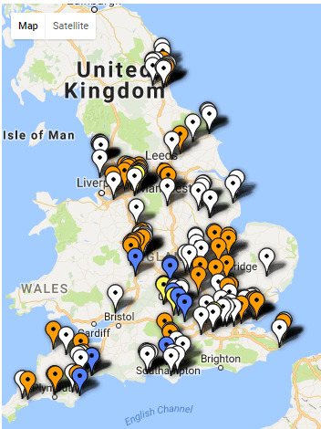
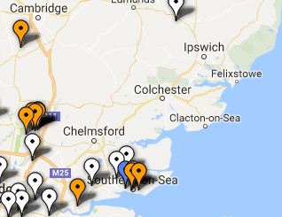
Our 2016/17 data shows 26 Primary Schools in Mid Essex have young carers in their student population.

Slide 26
Young carers referral for assessment – follow link for online referral
http://youth.essex.gov.uk/schools/young-carers-assessment/
Will be independently carried out by
Targeted Youth Advisers (ECC)

Slide 27
Working together with young carers themselves, we must ensure we increase the recognition, identification and support of Young Carers in Essex.

