Slide 1
Working with pupils who present challenging behaviour
Steve Phillips

Slide 2
Notes:
I would be on a yacht.

Slide 3
5 key ideas which seem to make working with challenging behaviour easier.
From visiting schools, reading books and thinking in the car.

Slide 4
1) Staff need a safe space to be curious about behaviour.

Slide 5
“All schools need to create a structured and safe space for staff to get together and think about the behaviour and feelings of the pupils, and of themselves.”
“School staff should be given time to be “curious” about behaviour”
Rita Pearson 2015

Slide 7
Risk Reduction Plan (CHILD)
Name | DOB | Date | Review Date
Photo | Potential triggers and reduction measures
What we want to see | Strategies to maintain
First signs that things are not going well | Strategies to support
Where this behaviour leads next | Strategies needed
What we are trying to avoid | Interventions necessary
Notes:
This format was devised by Harford Manor School in Norfolk. – consistent response plan.
This form can be used to formalise and publicise planned responses
All behaviours and responses should be specific and observable. ( eg. after 10 minutes of being on task we will intervene with the script ‘well done Jason you are working well’ or when he leaves his table we will direct him to the beanbag in the corner for a 3 minute egg timer)
The aim is to develop a range of responses in the early boxes to de-escalate behaviour and prevent the need for high level interventions in response to ‘behaviours we are trying to avoid’
The potential triggers section should acknowledge the experiences, people, places, activities, expectations etc. that will cause unusual escalation in negative feelings for the child. Importantly we should acknowledge what actions should always be implemented by staff to protect the child from their triggers until their coping strategies have been developed.
The What we want to see section should provide specific opportunities to catch the child getting it right and direct staff to a consistent and measurable response to the described behaviours within this section. CATCH THE CHILD GETTING IT RIGHT.
The First signs…. Section should describe behaviours or scripts that may indicate the child has raised anxiety and link these to specific and measurable responses from staff to support or de-escalate. The idea is to return the child to ‘what we want to see’ so we can CATCH THEM GETTING IT RIGHT.
The ‘where this behaviour leads next’ section should describe the behaviours and scripts that suggest the child is close to crisis and link the specific strategies which will support and deescalate. The idea is to return the child to the ‘first signs….’. Stage so we can follow the plan to return the child to the’ What we want to see’ stage so we can CATCH THEM GETTING IT RIGHT.
The ‘what we need to avoid’ section is where the behaviour could arrive without support and should reflect behaviours that justify the use of RPI. A child exhibiting the behaviours within this section has gone beyond our opportunity to use de-escalation alone and the ‘Interventions necessary may include external disciplines such as using RPI (restrictive physical intervention). The whole plan is designed to minimise the need for interventions at this level.
STEPS IS COMMITED TO RESTRAINT REDUCTION AND RESTRAINT ELIMINATION THROUGH THE PLANNING PROCESS.
THE FORM SHOULD ONLY BE USED FOR THE INDIVIDUALS PRESENTING THE HIGHEST LEVEL OF RISK WITHIN ANY SERVICE. The more specialised the service the higher percentage of children are likely to significantly benefit from this level of planning.

Slide 9
2) Understanding what “Positive Behaviour Management” is.

Slide 10
“Positively Managing your own Behaviour”
Notes:
So I look at behaviour.
Use wife as example
Use example of pupil constantly being defiant. - lead into Misdirected Goals.
Again use family examples and kid being frightened.

Slide 11
Behaviour Response Plan.
Step 1
Tactical Ignoring Private/Silent Signal Proximal Praise
Step 2
“We” statements Rule Restatement Use of “How” or “What” statements
Step 3
Give clear choice stating consequence
Step 4
Follow up the consequence
Notes:
A strategic plan in the sense of seeking answers to fundamental questions:
What will I do when …?
How best can I deal with x behaviours?
When is the best time to intervene in a disruption?
What will I do if my first approach is ineffective?
For example what will you do if:
You ask for questions and 5 pupils call out, two without their hands up. What do you do?
You’ve asked 2 pupils to quieten down and get on with their work, one starts to argue. What do you do?
David starts flicking elastic bands at his girl friend. What do you do?
A pupil wanders out of his seat for the fourth time. What do you do?
Kids didn’t seem to know how he wanted them to behave.

Slide 12
In our school, all staff challenge low level poor behaviour by describing the behaviour that we expect to see in the format below:
We start with the child's name then use the term “we”, describe the behaviour we want to see and end in “thanks”
“David, we …………………………….. thanks”
Notes:
Reinforce this by congratulating those doing the behaviour regularly.
This avoids using negative terms.
Also you can evaluate.

Slide 14
Refer to the Rule
Use “We” statements
Tactically Ignore if appropriate
Use Language of Choice
Issue Consequence

Slide 15
3) Distribute attention evenly.

Slide 16
Worst Behaved/ Hard to reach
Biddable Majority/ Midd Class
Perfect Behaved/
The Reliables
Notes:
Using inclusive language helps win over the midd class.
What you want to avoid is directing all of your attention to the worst behaved – you will lose the midd class.
By understanding the reasons why the worst behaved are behaving this way you can plan your responses to them and share your attention evenly across the class.

Slide 17
Basic Needs
Notes:
Star wars
Hunger
Lack of Sleep
Arguments with Parents that morning etc.
A big spot
Talk about how I am feeling. Lack of sex

Slide 18
How do we make sure the children's Physiological needs are met?
What we do
What we could do
Notes:
How do you know what we are doing is working?

Slide 19
How do we make sure the children feel safe?
What we do
What we could do

Slide 20
How do we make sure the children feel like they belong at our school?
What we do
What we could do

Slide 21
How do we make sure the children feel significant / how do we keep their self esteem high?
What we do
What we could do

Slide 22
How do I ensure pupils feel safe? (emotionally and physically) | How do I ensure pupils feel significant / have good self-esteem? | How do I ensure pupils feel like they belong?

Slide 23
CRISIS
Anxiety / Stress
Time
Notes:
De escalation is simply the task of being aware of the experiences and feelings of the individual in order to intervene to either change the experience or change the feelings generated by the experience.
The top line shows a child peaking into crisis twice within a timescale.
The lower line represents exactly the same increases and decreases in anxiety but by how simply lowering the starting anxiety or by lowering anxiety at any presented opportunity we can avoid the peaks into crisis.
Staff should know what creates anxiety for a child and what can reduce anxiety. With this information staff can avoid multiple causes of anxiety with respite and can engineer de-escalating experiences or interventions to prepare the child for the next anxiety raising experience.
Raising anxiety is essential for some elements of education. Without raised anxiety children would not attempt new things or experience new opportunities essential to learn and grow.
STAFF AND ADULTS SHOULD NEVER UNNECESSARILY RAISE A CHILD’S ANXIETY OR MISS AN OPPORTUNITY TO LOWER ANXIETY.

Slide 24
We must also listen…
Notes:
Its about listening aswell.

Slide 25
4) A good understanding of Rewards and sanctions.

Slide 26
Conscious and Subconscious Behaviours
100%
Conscious
100%
Subconscious
Notes:
26
Managing conscious behaviour is based on changing the child’s motivation, managing subconscious behaviour is about managing children’s experiences and feelings.
A child can not choose to change a behaviour that they did not choose to exhibit.
Talk about power seeking girl
Behaviour can be a mixture of both conscious and subconscious.
To be successful we need to deal with both the conscious and sub conscious elements of the behaviour.
To support subconscious elements of the behaviour we may need to differentiate to protect the child from the experience that overwhelms them, prepare them better so the experience does not create the negative feelings or adapt and refocus our differentiation.
To challenge the conscious elements the child needs to be motivated to make another choice, faced with the same set of circumstance, this may be about rewards and sanctions it may be by working on their empathy for others (educational consequence) or it may be about increasing their motivation or engagement.
Managing conscious behaviour is based on changing the child’s motivation, managing subconscious behaviour is about managing children’s experiences and feelings.
A child can not choose to change a behaviour that they did not choose to exhibit.
Talk about power seeking girl

Slide 27
Rude lashes out controlling
Doesn’t try hurts others
Doesn’t concentrate refuses
Smiles helpful tries hard polite respectful listens
Behaviour
Labelled Blamed Shamed
Ignored Humiliated Targeted
Rejected Unimportant Isolated Irrelevant Ignored
Comfortable Respected Included
Safe Motivated Involved
Consulted Rewarded Needed
Inspired Liked Appreciated
Emotions
Exclusion Missing out on stuff
Public Shame Labelled
Blamed Abuse Neglect Poverty
Difference LAC EAL
Experiences
Loved listened to included
Helped supported wanted
Kept safe achieved success
Notes:
Internal Working Model
The easiest way to redress the balance of negative feelings and positive feelings is to take every opportunity to give the child an experience that is associated with positive feelings.

Slide 28
Rude lashes out controlling
Doesn’t try hurts others
Doesn’t concentrate refuses
Smiles helpful tries hard polite respectful listens
Behaviour
Labelled Blamed Shamed
Ignored Humiliated Targeted
Rejected Unimportant Isolated Irrelevant Ignored
Comfortable Respected Included
Safe Motivated Involved
Consulted Rewarded Needed
Inspired Liked Appreciated
Emotions
Exclusion Missing out on stuff
Public Shame Labelled
Blamed Abuse Neglect Poverty
Difference LAC EAL
Experiences
Loved listened to included
Helped supported wanted
Kept safe achieved success
Notes:
Internal Working Model
The easiest way to redress the balance of negative feelings and positive feelings is to take every opportunity to give the child an experience that is associated with positive feelings.

Slide 29
I am … The world is… Adults are…
A safe place
A predictable and consistent place
A caring place
A responsive place
There is a place for me here
Trustworthy
Consistent
Predictable
There
Safe
Responsive
Loved
Lovable
Cared for
Listened to
Worthwhile
Valued
Special
Effective
Important
Positive “Internal Working Model”

Slide 30
Protective Consequences
Removal of a freedom to manage harm
The learning, rehearsing or teaching so the freedom can be returned.
Educational Consequences
Notes:
It is essential that there is always an educational consequence. We must be able to show how we have helped the child develop new skills or new ways of thinking through discussion, debrief activity or rehearsing. Educational consequences provide the child with the skills and incentives to behave differently faced with the same set of circumstances reoccurring.
Sometimes a protective consequence is needed immediately, and until we have been successful with our educational consequences. Protective consequences are solely actions to ensure no further harm occurs in the short term.
A CHILD WHO PLAYS WITH A CRICKET BAT IN A DANGEROUS WAY MAY NEED THE PROTECTIVE CONSEQUENCE OF NOT BEING ALLOWED TO USE THE CRICKET SET AT BREAK TIMES. THE EDUCATIONAL CONSEQUENCE MAY BE DISCUSSION TO UNDERSTAND HOW DANGEROUS A CRICKET BAT COULD BE AND PRACTICE WITH A STAFF MEMBER TO DEVELOP THE SKILLS TO USE THE BAT SAFELY.

Slide 31
Protective Consequences
Increased staff ratio
Limited access to outside space
Escorted in social situations
Differentiated teaching space
Exclusion
Notes:
Participants should be encouraged to provide examples of protective consequences to manage potential harm.

Slide 33
Educational Consequences
Completing tasks
Rehearsing
Assisting with repairs
learning opportunities
Role play
Research
Restorative meetings
Notes:
Participants should be encouraged to provide examples of educational consequences that facilitate new skills or new ways of thinking through discussion, debrief activity or rehearsing.
The question ‘WHAT DOES THE CHILD NEED TO LEARN?’ Should always be followed by the question ‘HOW AM I GOING TO TEACH’

Slide 34
5) A Positive school environment

Slide 35
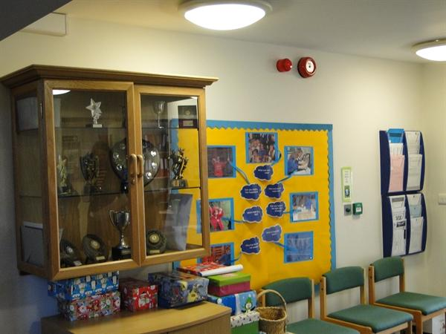
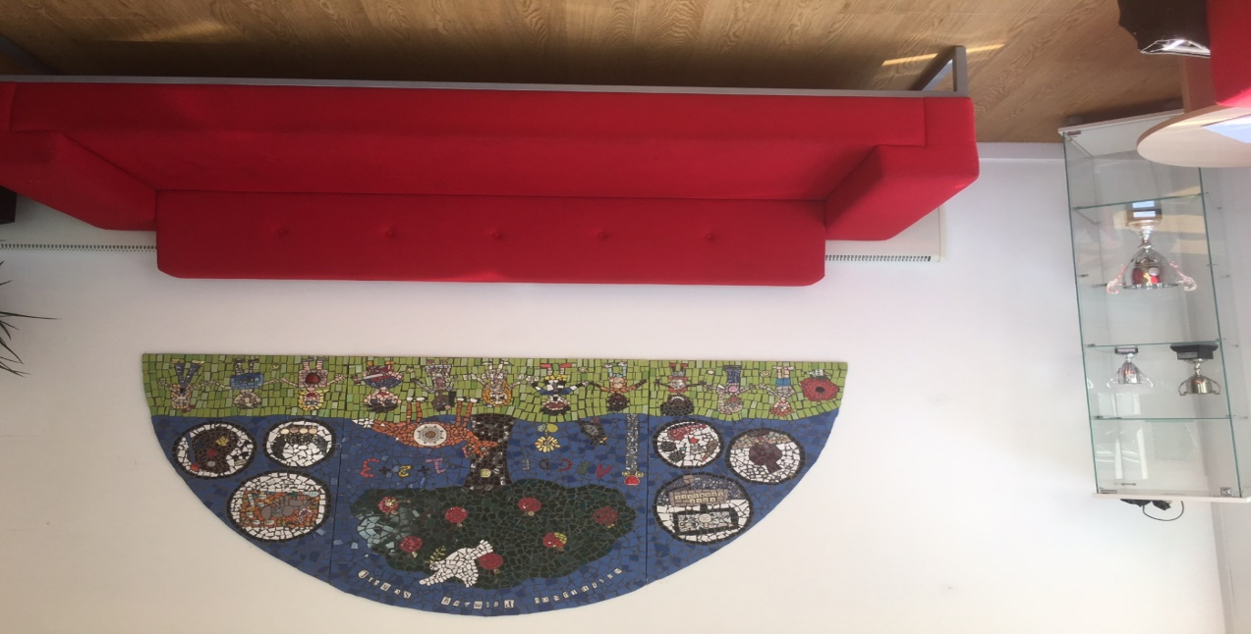
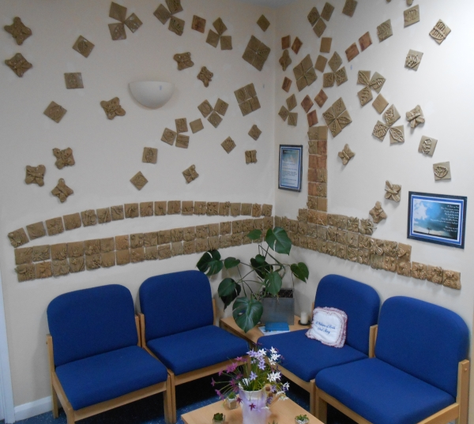
School Receptions
Notes:
I visit a lot of schools as part of my job – I support schools in the south of Essex to work with challenging behaviour.
The vast majority of them are very pleasant places, often with trophies and awards and positive messages from parents and pupils.
I also get offered tea, coffee and broadband access from smiling receptionists.

Slide 36
Notes:
Many of them also have posters or messages on display.
Many of them with motivational or inspirational posters and its become a bit of a hobby of mine to compare them.

Slide 37
Notes:
My current favourite poster is at BCHS – I particularly like how specific it is.
Present yourself smartly
Say please and thank you
They actually have miniatures of the poster available in A5 lamented form at reception.

Slide 38
Notes:
Its even plastered on three sides of the building.
But do the pupils actually take any notice of these messages?
I asked them – they struggled to remember many of them on their own but if I started them off – Try new … Respect yourself ….. Use your ……
So subconsciously they did now the messages – they were actually ingrained into their heads.

Slide 39
TV Commercial Messages
“Happiness is a …
“Beanz, meanz …
“Heineken refreshes the parts …
"Because I'm …
“Ah …”
“I liked it so much …
“Don't just book it.
"No FT,
“The cold
cigar called Hamlet”
Heinz”
other beers cannot reach”
worth it” (L’Oreal)
Bisto!”
I bought the company” (Remington)
Thomas Cook it”
no comment”
never bothered me anyway”
Notes:
So that made me think – what messages are ingrained in us?
So lets look at these famous TV commercials.
But, does knowing these messages influence or change our behaviour in any way? The companies would like to think so as they spend tens of millions of pounds on advertising – on getting these messages into our heads.
Go through a few - If I was going to buy a cigar …
Pepsi challenge

Slide 40
Scrambled-sentence test
Make a four-word sentence as quickly as possible out of each set of five words.
him was worried she always
are from Florida oranges temperature
ball the throw toss silently
shoes give replace old the
he observes occasionally people watches
be will sweat lonely they
sky the seamless grey is
should not withdraw forgetful we
us bingo sing play let
sunlight makes temperature wrinkle raisins
Notes:
Lets look at these words …
Write a number down between 1 - 100
1000’s of people have completed this word test but of course its not a test of grammatical skill.

Slide 41
“Priming is an implicit memory effect in which exposure to one stimulus influences a response to a later stimulus”
“Priming is what we call it when exposure to some thing influences the behaviour of an individual later on, without that individual being aware that the first thing is guiding their behaviour.”
Notes:
The video also gave a definition of priming.
‘implicit memory effect’ - whatever priming is, it is occurring below the surface of conscious thought. ‘exposure to a stimulus’ - this stimulus can be auditory, visual, tactile, etc. and we call it a ‘prime'. ‘influences a response’ - the aforementioned stimulus is affecting later behavior in someway ‘to a later stimulus’ - and it is affecting behavior in a certain environment
Describe other experiments – primed and then waiting to be seen / walking along the corridor / music in wine shops

Slide 43
Notes:
Perception without awareness – free choice
Darren used a range of priming stimuli - here is another example of priming and may explain why I get offered cups of tea and coffee when I visit schools.

Slide 44
Prime pupils by continually telling them how you want them to behave.
Start with the child's name first then “we” and then end in “thanks”
“David, we …………………………….. thanks”
Notes:
Reinforce this by congratulating those doing the behaviour regularly.

Slide 45
Nudging
A behavioural “nudge” is getting you to do something without restraining your freedom of choice or changing incentives.
People do not always act rationally. In fact they act irrationally but in predictable ways.
Because their mistakes tend to be predictable, people can be encouraged to make better choices.
How? by changing their choice architecture and giving them a nudge.
Notes:
Nudging is different to Priming.
Nudging is basically making the right choices for people easier to make without restricting their options.
They nudge people in the right direction.
David Cameron and other members of the conservation party went on Nudging training – this I am told was the first slide they were shown.

Slide 48
What “nudge” could reduce littering?
Notes:
Littering – hand out fines for littering, pay people for putting litter in the bins or place green footsteps on the ground leading people to the nearest bin.

Slide 51
What “nudge” could encourage healthier eating?

Slide 52
The child's behaviour may…
Reject you overtly or make out more subtly that she really doesn’t need you or your help
Leave you feeling de-skilled and worthless because of his own feelings
Make you think that she doesn’t need any support – that she is perfectly fine to get on with things alone
Attempt to shock or frighten you – by trying to take control as he has always felt so ‘out of control’ through abuse, neglect & loss
Push you to your emotional limits
Attempt to get you to behave ‘out of character’, for example to scream or yell at him
Find your vulnerabilities
Turn on you – to communicate how she feels about what she’s experienced in the past
Leave you feeling confused at times
Leave you feeling that you may have gone slightly mad!

Slide 53
You may…
Be in demand from schools, as you are viewed as valuable assets to the school community!
Learn about child development in the process of the child getting stronger and becoming able to negotiate different developmental milestones
Know that you have made a real difference in a child’s life by giving them the opportunity for second chance learning
Become very skilled in getting alongside children with attachment difficulties
Become much stronger and more resilient people

Slide 54
end

