Slide 1
Brook Essex Parents and Carers Brochure
A list of training sessions available for Essex Parents and carers.
Oct 2020-April 2021

Slide 2
Please find a list of RSE at Home with Parents online sessions, all are FREE for Parents and Carers in Essex.
All sessions will be held via Zoom, if you organisation does not permit the use of Zoom, please use personal equipment to join the session.
Invite links will be sent to the email address provided when signing up for an event.
https://www.facebook.com/EssexBrook/

Slide 3
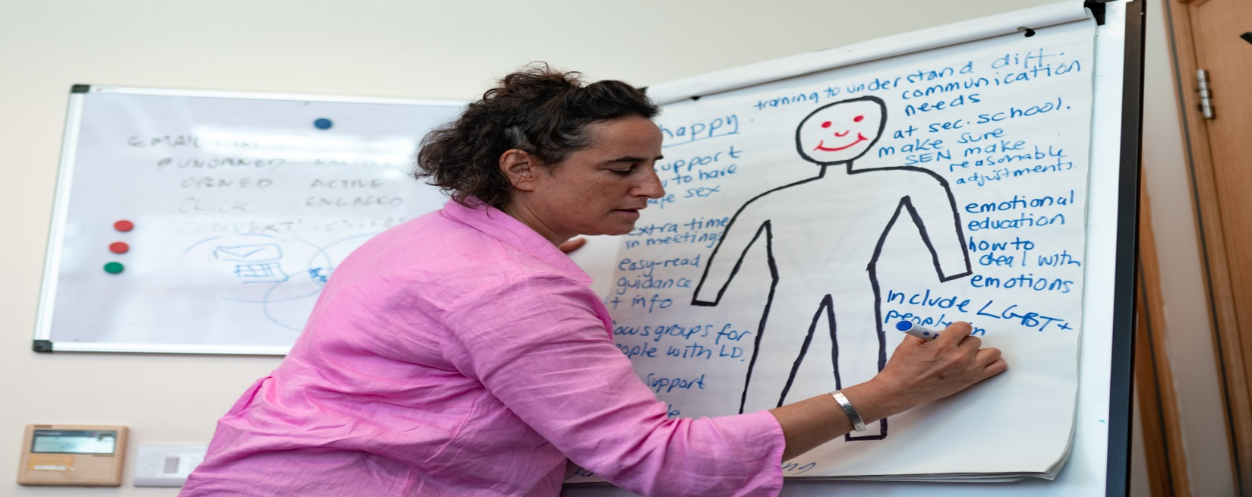
RSE at Home with Parents.
Primary sessions.
https://www.facebook.com/EssexBrook/

Slide 4
RSE at Home: Primary
Relationship and Sex Education workshop created especially for Essex parents and carers, of Primary school aged children.
Talking to young people about their sexual health can be a challenging experience. In this training, we draw on our 55 years of expertise of talking to young people about their sexual health and provide a comprehensive overview of the information that you need to know.
Our Education and Wellbeing Specialists will explore;
• How the new legislation will impact on your child
• What it means for primary school students
• What is taught and why we teach it
• How you can continue those conversations at home.
There will be time reserved for questions and how Brook can provide further support.

Slide 5
Booking details
8th December 2020 6.30pm-7.30pm
https://www.eventbrite.co.uk/e/rse-at-home-with-parents-primary-essex-only-tickets-125348541863
8th January 2021 10.30am-11.30am
https://www.eventbrite.co.uk/e/rse-at-home-with-parents-primary-essex-only-tickets-125349199831
25th February 2021 10.00am-11.00am
https://www.eventbrite.co.uk/e/rse-at-home-with-parents-primary-essex-only-tickets-125349572947
19th March 2021 6.30pm-7.30pm
https://www.eventbrite.co.uk/e/rse-at-home-with-parents-primary-essex-only-tickets-125350527803
https://www.facebook.com/EssexBrook/

Slide 6
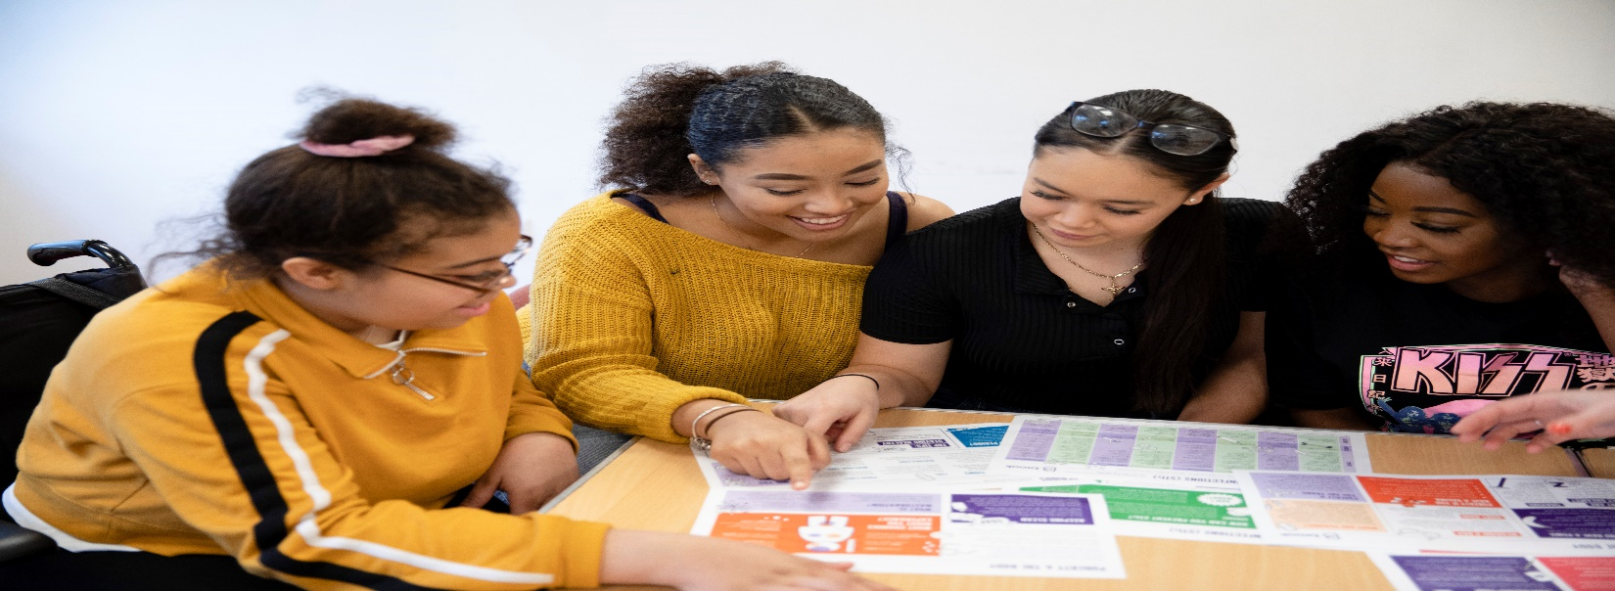
RSE at Home with Parents.
Secondary sessions.
https://www.facebook.com/EssexBrook/

Slide 7
RSE at Home: Secondary
Relationship and Sex Education workshop created especially for Essex parents and carers, of Secondary school aged children and young people.
Talking to young people about their sexual health can be a challenging experience. In this training, we draw on over 55 years of expertise of talking to young people about their sexual health and provide a comprehensive overview of the information that you need to know.
Our Education and Wellbeing Specialists will explore;
• How the new legislation will impact on your young person
• What it means for secondary school students
• What is taught and why we teach it
• How you can continue those conversations at home.
There will be time reserved for questions and how Brook can provide further support.

Slide 8
Booking details
10th December 2020 6.30pm-7.30pm
https://www.eventbrite.co.uk/e/rse-at-home-with-parents-secondary-essex-only-tickets-125443616233
8th January 2021 12noon- 1pm https://www.eventbrite.co.uk/e/rse-at-home-with-parents-secondary-essex-only-tickets-125443937193
25th February 2021 12noon-1pm
https://www.eventbrite.co.uk/e/rse-at-home-with-parents-secondary-essex-only-tickets-125444208003
26th March 2021 6.30pm-7.30pm
https://www.eventbrite.co.uk/e/rse-at-home-with-parents-secondary-essex-only-tickets-125444492855
https://www.facebook.com/EssexBrook/

Slide 9
If you would like more information, please contact joanne.quinn@brook.org.uk
https://www.facebook.com/EssexBrook/

