Slide 1

What is the PSTT?
www.pstt.org.uk
The Primary Science Teaching Trust is a UK charity that promotes science in primary schools.
PSTT has been at the forefront of primary science teaching for over 25 years.
Our vision is to see excellent teaching of science in every primary classroom in the UK.

Slide 2
What does PSTT have to offer you?
FREE downloadable resources for teachers
Visit www.pstt.org.uk
Support & training for subject leads and class teachers
Webinars
Conferences
Network meetings
Science lessons
Bespoke support

Slide 3
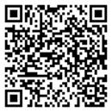
Primary Science Leader Network Meetings
£25
Termly
Online, 4pm-5pm
Supportive community
Tailored to needs of teachers
Signposting – teaching resources, local enrichment events, CPD and funding opportunities
East of England
23 October 2025
4 February 2026
19 May 2026

Slide 4

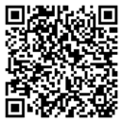
Primary Science Conference - Essex
Small changes, big impact in science provision
Developing children’s scientific vocabulary and oracy
Teaching children to plan effective science enquiries
Assessment of ‘working scientifically’ skills
How to effectively link science and maths
Developing science in Early Years
Strategies to support SEND/Inclusion
Free high-quality resources
Venue: Chelmsford
Date: 20 November 2025

Slide 5

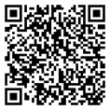
Science Days for British Science Week
Whole school
4 live lessons online - EYFS / KS1 / LKS2 / UKS2
Delivered by PSTT’s award-winning teachers
Introduce science investigations to children
Guidance pack for class teachers
Opportunity to share findings with other schools
In 2025, teachers said:
The children were all very highly motivated and engaged with the event.
Year 6 stayed in at break because they didn't want to stop!

Slide 6


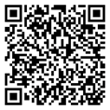
Festive Science – whole school
4 recorded lessons: EYFS / KS1 / LKS2 / UKS2
Introduced by award-winning teachers
Guidance pack for class teachers
Available: 24 Nov – 19 Dec

Slide 7

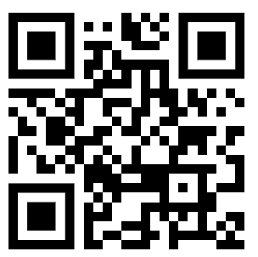
ECT Webinar Series
FREE
FREE six-part webinar series covering:
Good science pedagogy
Health and safety (with CLEAPSS)
Lesson planning
Working scientifically
Enquiry types
Assessment
Search ‘PSTT Events’ or scan to find out more:
Notes:
https://pstt.beaconforms.com/form/50d51206

Slide 8

Bespoke Support & Training
Tailored to your individual needs, in-person/online
1-2-1 Science Leader support
Curriculum development
Planning support
Model teaching
Ground audits
Support applying for grants
Network meetings
Staff training (including TAs) – staff meeting / INSET
Complete our form - https://pstt.org.uk/support/
Or email us – alison.trew@pstt.org.uk
tom.holloway@pstt.org.uk

Slide 9
What are the costs?
Charges for MATs and other groups of 2 or more schools:
Up to 90 minutes £150 + travel expenses
Half day (up to 3 hours) £250 + travel expenses
Full day (up to 6 hours) £450 + travel expenses
50% off above prices for the rest of this academic year

Slide 10
What are the costs?
Individual school
Staff training session (up to 90 minutes) - £150 + travel expenses
Half-day - £250 + travel expenses (can include whole school staff training session)
Full-day - £450 + travel expenses (can include whole school staff training session + science assembly)
50% off above prices for the rest of this academic year

Slide 11
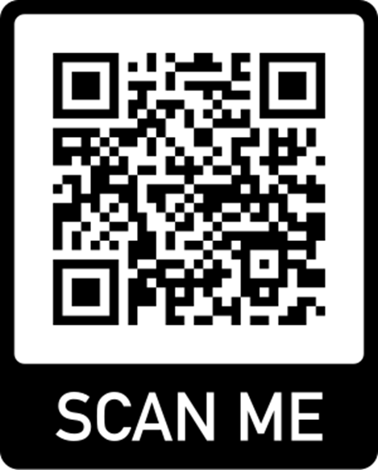




How are we different to other providers?
Bespoke CPD (free 1-hour consultation, pre-support surveys)
CPD delivered by award-winning primary teachers
Local
Mentoring
Long-term
Established links with other organisations in primary science sector
FREE regional newsletter – news & updates on local and national CPD opportunities, new resources, available grants

Slide 12
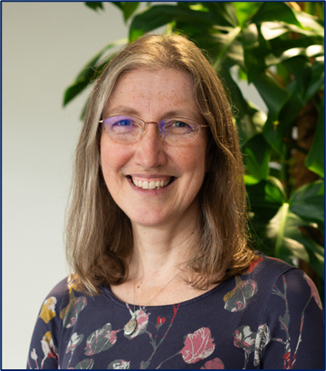
Testimonials
I just wanted to say a huge thank you for your time and excellent presentation and facilitation skills – the informal feedback from the group was amazing!
Cheryl Allard, Director of Primary Education, Bridge Academy Trust, Essex (June 2024)
Thank you so much for yesterday, I honestly mean it was the best INSET I have attended in 20 years.
I also feel that everyone came away buzzing with ideas and with some reassurance.
Ravi Chagger, Trust Assistant Headteacher, Osborne Co-operative Academy Trust (October 2024)

Slide 13
Emails: info@pstt.org.uk
alison.trew@pstt.org.uk

