Slide 1
Primary Improvement
Nicola Woolf, Lead Primary Commissioner - West

Slide 2
Primary Overview for 2016
Early Years and Key Stage 1 | Essex | England
EYFS GLD | 72% | 69%
Year 1 Phonics (required level) | 81% | 81%
KS1 Reading - at least expected standard | 77% | 74%
KS1 Writing - at least expected standard | 68% | 65%
KS1 Maths - at least expected standard | 74% | 73%
KS1 RWM - at least expected standard | 63%
Key Stage 2 | Essex | England
KS2 RWM – at least expected standard | 56% | 53%
KS2 Reading - at least expected standard | 67% | 66%
KS2 Writing - at least expected standard | 76% | 73%
KS2 Maths - at least expected standard | 71% | 70%
KS1-2 Progress score - Reading | -0.22 | 0
KS1-2 Progress score - Writing | 0.41 | 0
KS1-2 Progress score - Maths | 0.04 | 0
Notes:
Very pleased with outcomes in 2015 – EY now in top quartile ranked 35 (up 17 places)
Phonics rank 58 up 6
Read KS1 Rank 29 Wr Rank 43 and maths rank 55
Ks2 RWM rank 42 R rank 57, GPS rank 48 Maths rank 57
Ranking -

Slide 3
What was achieved in Primary school inspections last year….
7 new outstanding schools, of which 2 were previously judged Requiring Improvement
36 new good schools – of which 2 were previously inadequate
However…
6 schools judged inadequate (3 previously good schools)
1 school judged Requiring Improvement, (previously good)
Notes:
This represents all Essex schools inspected

Slide 4
Inspections in West Essex since April 16
7 Inspections to date - 86% good or better
6 good schools of which 4 were previously requiring improvement
1 school requiring improvement
Notes:
This relates purely to West

Slide 5
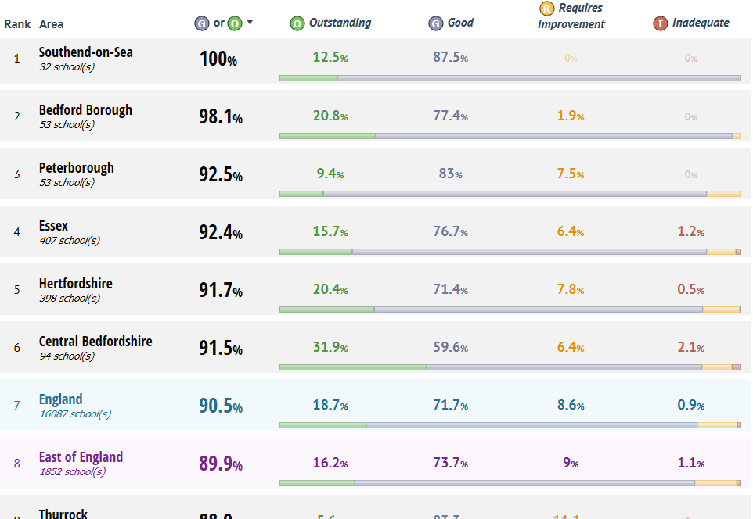
Ofsted overview – Primary schools to 14 November 16
Notes:
When I last shared the data early June we were 88% in 2012 we were 64%, now 2% above national!
Challenge now is for more Outstanding schools

Slide 6
Inspections in Essex since September 16
Key implications:
Greater focus on the most able: Ensure sufficient challenge and depth to teacher subject knowledge to ensure higher standards across the curriculum, including the foundation subjects.
Teachers and leaders to make more regular and effective checks on the progress of pupils, including the disadvantaged, from their varying starting points, ensuring teachers’ feedback is precise about what a pupil needs to do to improve
Equipping middle leaders with the strategies and skills to enable them to fulfil their responsibilities of monitoring and improving the school’s work in the areas for which they are accountable
Safeguarding - establishing rigorous procedures through which governors monitor the work of leaders to ensure that the school’s own safeguarding systems and processes are robustly in line with current statutory guidelines.
Notes:
These are some of the areas for improvement from recent inspections – these specifically relate to schools dropping a grade from good and RI schools. 3 schools this term have dropped to RI or SW as a result of safeguarding.
For schools on the cusp of outstanding, one of the common themes relates to standards in the Foundation Subjects which are not as high as English and maths

Slide 7
Excellence in Essex Primary Schools
Revised version includes alignment with DfE Schools Causing Concern Statutory Guidance (SCC) - Intervening in failing, under performing and coasting schools (March 2016) and
DfE Primary School Accountability in 2016 (October 2016)
Includes Coasting Schools, National Floor Standards and
An Essex threshold setting out what we consider is ‘unacceptable low standards’.
Challenge the effectiveness of governing bodies in holding leaders and themselves to account for improved performance.
Notes:
Excellence in Essex will be on Infolink by Friday and an article in Education in Essex on Monday

Slide 8
Based on provisional KS2 data
11 Essex schools will fall within the coasting schools definition based on the recent confirmed progress thresholds for 2016
13 Essex school’s data places the school below the National Floor Standard
126 congratulations letters sent to schools
No school will be confirmed as being below the floor or coasting until December 2016 when schools’ performance tables are published.
Notes:
Essex ranked 48 as 3% of schools nationally 5%
11 Letters of concern
126 congratulation letters

Slide 9
RAG process – Autumn term
For a small number of schools, where there are previous indicators of concern or a significant inconsistency between subjects, the RAG will have changed this term. The 2016 data is not being compared with 2015 outcomes.
Data has been scrutinised and, where there is cause for concern, the school’s SEC will arrange a visit to discuss data and determine whether additional action should be taken. The pragmatic reason for changing any school’s RAG rating mid-term is to enable additional support from the Standards and Excellence team
At the end of the Autumn term there will be a RAG review of all schools using the revised criteria approved at the EPHA Executive on 6 October.
Schools will be notified of the RAG in January. Where there
is a change, the SEC will initially contact the school, a
letter will be sent to each school.
Notes:
RAG criteria simplified – schools should be able to identify the RAG for their school using the criteria
We do not RAG academies or BEP/HEP schools – all other schools will get the RAG letter

Slide 10
Commissioned support and pattern of visits as a result of a school’s RAG rating .
Notes:
SEC workplan – back page of Excellence in Essex – provides details of SEC support – revised allocations to free up time to dedicate days to recognised partnerships, hence green schools only get one half day visit per year which will include a focus on school standards and a conversation about the school’s trajectory to outstanding.

Slide 11
Log in to Perspective Lite at
https://perspective.angelsolutions.co.uk/
Notes:
Next few slides are purely to remind heads of the increasing amount of documents and datafiles on Perspective Lite and where located, beneficial to new headteachers .

Slide 12
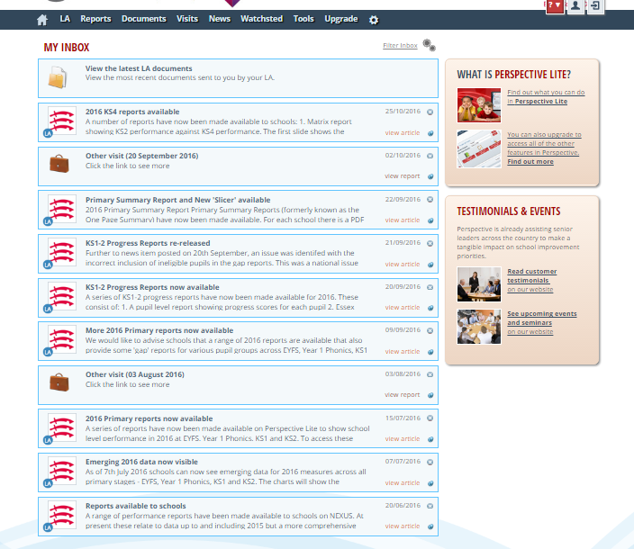
Click here and go to Document Pool

Slide 13
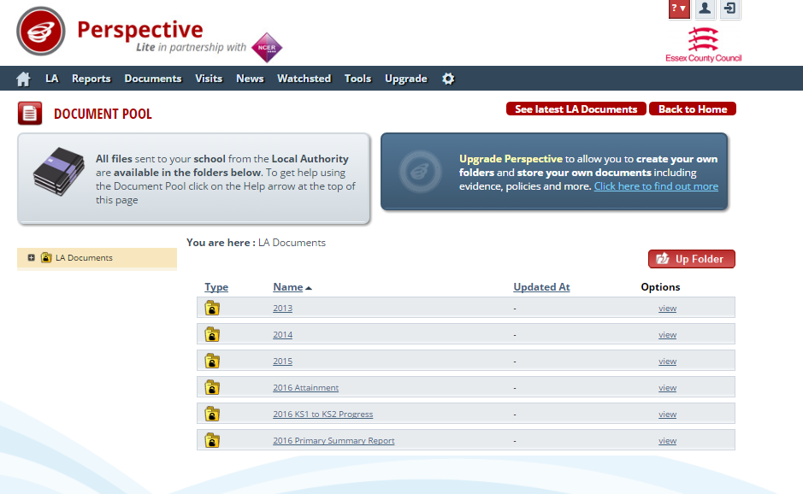
Select what you want

Slide 14
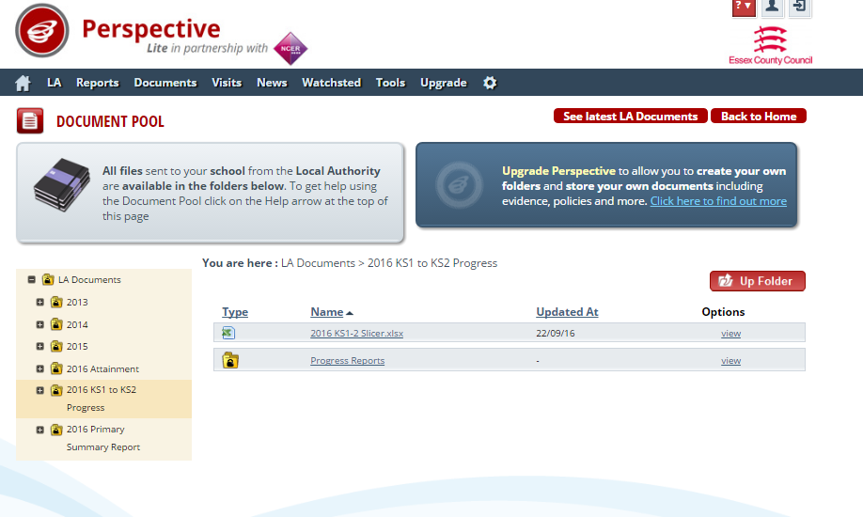
If you select 2016 KS1 to KS2 Progress you will get to your progress reports but also the
2016 KS1-2 Slicer
This is new this year

Slide 15
If you want the Primary Summary Support you will get all schools as an excel file and yours as a PDF
(old One Page Summary)

Slide 16
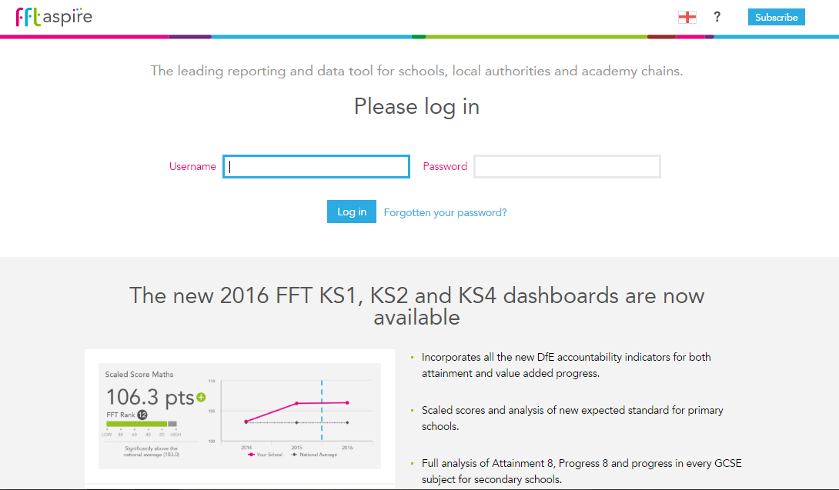
Log in to FFT
https://fftaspire.org/
Notes:
FFTAspire subscription information available from Infolink
Infants and small Primary schools (under 80 pupils) - £80
Primary schools (over 80 pupils) - £125
The link to the FFT Infolink page is http://schools.essex.gov.uk/data/collections/EducationData/Pages/Fischer-Family-Trust-(FFT).aspx – there is a section about the subscription which has the prices and the subscription form.

Slide 17
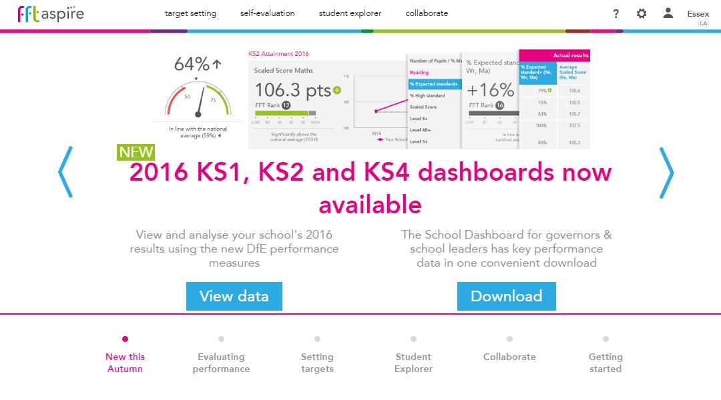
Notes:
Dashboards support Self-evaluation , one key tool worth the money alone is student explorer

Slide 18
Notes:
We have set all recognised partnerships as FFT collaborate groups – feedback has been positive. Only FFT subscribers can access FFT collaborate – may need to influence schools in your partnership to take up subscription
Infants and small Primary schools (under 80 pupils) - £80
Primary schools (over 80 pupils) - £125

Slide 19
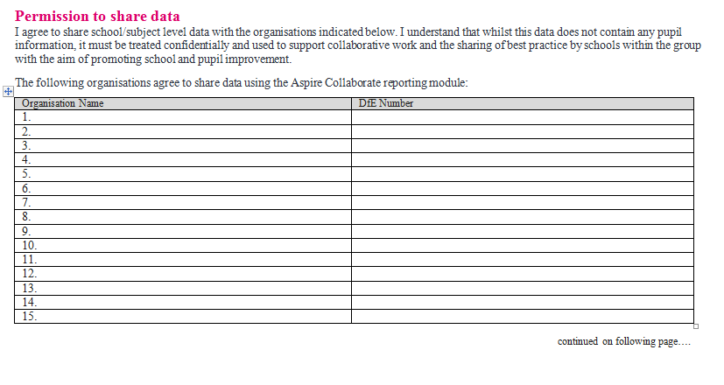
Notes:
Advise that data sharing protocols should be agreed

Slide 20
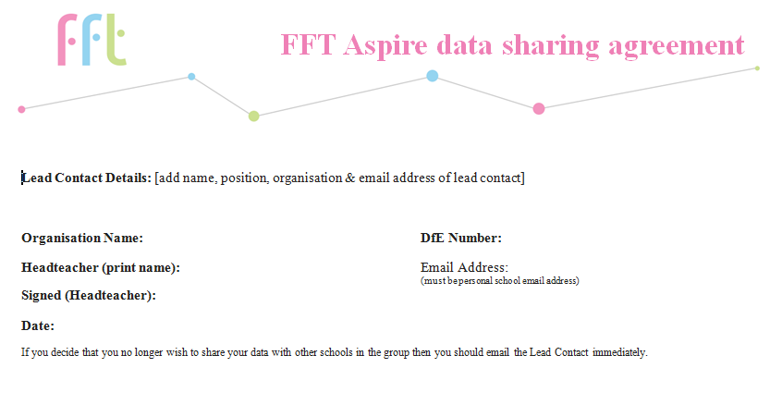

Slide 21
Raise the achievement of all disadvantaged children

Slide 22
Support for school self evaluation
Project 1 - Maximising the use of the Essex toolkit – to promote the use of the toolkit to support school’s developing their own approaches to self-evaluation of their pupil premium strategy.
NORTH-EAST – Monday 5th December at 1:15 p.m.
Venue: Willow Brook Primary School, Colchester
SOUTH – Monday 28th November at 1:15 p.m. Venue: Lee Chapel Teaching School
Project 2 – Ongoing support for a pupil premium strategy – to provide additional support for identified schools who may be Ofsted good, but gaps are stubborn and therefore differences in achievement are not diminishing.
Project 3 – Disseminating knowledge from research findings to improve life chances for disadvantaged pupils.
.
Notes:
Steve Mellors – working with Marc Rowland (NET) working on 3 projects this year. Already had a West Project 1 in saffron Walden before halfterm
Project 1 -This will be aimed Pupil Premium champions and school governors – included breakfast meetings, additional support from SECs, support to meeting new requirements in relation to publication of pupil premium information on school websites.
Project 2 Aimed at schools leaders, to include identification of schools where gaps are stubborn, discussion of school self-evaluation, mini pupil premium reviews.
It was stressed that school’s own understanding and self-evaluation of the impact of chosen strategies is absolutely critical – plenty of schools implement a range of strategies, but are not so good at evaluating the impact and effectiveness of those strategies.
Project 3 Half day conference aimed at school representatives and school governors, which will include a focus on metacognition – late Spring

Slide 23
What does Ofsted inspect?
The level of pupil premium funding received by the school in the current academic year and levels of funding received in previous years
How leaders and governors have spent the pupil premium, their rationale for this spending and their intended impact
Any differences made to the learning and progress of disadvantaged pupils as shown by outcomes data and inspection evidence.
‘Leaders and governors focus consistently improving outcomes for all pupils, but especially for disadvantaged pupils. They are uncompromising in their ambition’
Outstanding statement for leadership and management

Slide 24
Checking school reporting
School websites should report the following:
In the previous academic year 2015/2016:
How the pupil premium allocation was spent
The impact of the expenditure on eligible and other pupils.
Remember that information on the website is for parents and carers so should be presented in a form that they will find accessible.

Slide 25
Checking school reporting
In the current year 2016/2017:
your school’s pupil premium grant allocation amount
a summary of the main barriers to educational achievement faced by eligible pupils
how you’ll spend the pupil premium to address those barriers and the reasons for that approach
how you’ll measure the impact of the pupil premium
the date of the next review of the school’s pupil premium strategy.

Slide 26
External accountability review
Should include:
A clear rationale for a school’s pupil premium strategy, identifying key barriers but aspirational and shared by all
Quality first teaching is at the heart of raising achievement
Carefully targeted activities that promote good learning and readiness
Understanding of school information linked to robust tracking, monitoring and evaluation
Impact improves outcomes for disadvantaged pupils
Notes:
Steve developing approaches with schools and partnerships will disseminate with schools

Slide 27
2016 EYFS - % pupils achieving a Good Level of Development
District/Area | Disadvantaged |  | Other |  | Disadvantaged/Other Gap
 | Cohort | % GLD | Cohort | % GLD
Essex | 2125 | 55% | 14730 | 75% | 20%
Mid | 498 | 53% | 3879 | 75% | 23%
North East | 590 | 52% | 3163 | 72% | 20%
South | 637 | 57% | 4403 | 75% | 18%
West | 400 | 58% | 3285 | 75% | 17%
Epping Forest | 175 | 55% | 1214 | 74% | 19%
Harlow | 170 | 59% | 1080 | 72% | 14%
Uttlesford | 55 | 64% | 991 | 80% | 16%
Notes:
Next set of slides shared with governors recently at the Director’s briefings
Governors asked about interventions which have the greatest impact, reminded of their roles in holding themselves and leaders to account for effective use of the PPG, not just about closing gaps but raising standards for all so that differences diminish.

Slide 28
2016 Year 1 Phonics - % pupils working at the required level
District/Area | Disadvantaged |  | Other |  | Disadvantaged/Other Gap
 | Cohort | % req level | Cohort | % req level
Essex | 2857 | 69% | 13904 | 84% | 15%
Mid | 619 | 65% | 3801 | 83% | 18%
North East | 770 | 69% | 2942 | 83% | 14%
South | 959 | 71% | 4082 | 84% | 13%
West | 509 | 72% | 3079 | 85% | 13%
Epping Forest | 181 | 71% | 1143 | 84% | 14%
Harlow | 248 | 73% | 977 | 86% | 13%
Uttlesford | 80 | 69% | 959 | 85% | 16%

Slide 29
2016 Key Stage 1 - % pupils achieving at least the expected standard
District/ Area | Cohort |  | Reading |  |  | Writing |  |  | Maths
 | Disad | Other | Disad | Other | Gap | Disad | Other | Gap | Disad | Other | Gap
 | 3312 | 13161 | 63% | 80% | 17% | 51% | 72% | 21% | 60% | 78% | 18%
Mid | 744 | 3504 | 59% | 80% | 21% | 47% | 72% | 25% | 58% | 78% | 20%
North East | 942 | 2745 | 64% | 79% | 14% | 52% | 70% | 18% | 61% | 76% | 15%
South | 1034 | 3956 | 64% | 81% | 18% | 54% | 74% | 19% | 61% | 79% | 18%
West | 592 | 2956 | 64% | 80% | 16% | 51% | 72% | 21% | 58% | 78% | 20%
Epping Forest | 210 | 1128 | 57% | 78% | 21% | 44% | 69% | 25% | 53% | 76% | 23%
Harlow | 301 | 932 | 66% | 80% | 13% | 52% | 73% | 20% | 59% | 78% | 19%
Uttlesford | 81 | 896 | 74% | 83% | 9% | 60% | 75% | 15% | 65% | 80% | 15%

Slide 30
2016 Key Stage 2 - % pupils achieving at least the expected standard
District/Area | RWM
 | Cohort |  | Performance
 | Disad. | Other | Disad. | Other | Gap
Essex | 3879 | 11347 | 38% | 62% | 24%
Mid | 910 | 3275 | 39% | 63% | 24%
North East | 1022 | 2240 | 38% | 61% | 23%
South | 1174 | 3517 | 37% | 62% | 24%
West | 773 | 2315 | 39% | 60% | 21%
Epping Forest | 282 | 893 | 32% | 57% | 25%
Harlow | 374 | 648 | 44% | 59% | 15%
Uttlesford | 117 | 774 | 43% | 64% | 22%

Slide 31
2016 Key Stage 1-2 Progress - average scores
District/ Area | Reading |  |  |  |  | Writing |  |  |  |  | Maths
 | Cohort |  | Average Score |  |  | Cohort |  | Average Score |  |  | Cohort |  | Average Score
 | Disad. | Other | Disad. | Other | Gap | Disad. | Other | Disad. | Other | Gap | Disad. | Other | Disad. | Other | Gap
Essex | 3691 | 10889 | -1.33 | 0.15 | 1.48 | 3741 | 10915 | -0.27 | 0.64 | 0.91 | 3724 | 10923 | -0.85 | 0.34 | 1.18
Mid | 873 | 3142 | -0.83 | 0.40 | 1.23 | 883 | 3166 | -0.47 | 0.48 | 0.95 | 876 | 3148 | -0.80 | 0.38 | 1.18
North East | 971 | 2146 | -1.79 | 0.51 | 2.30 | 980 | 2142 | 0.20 | 1.32 | 1.12 | 982 | 2155 | -1.23 | 0.28 | 1.51
South | 1117 | 3394 | -1.58 | -0.21 | 1.37 | 1136 | 3391 | -0.43 | 0.71 | 1.14 | 1128 | 3407 | -0.74 | 0.34 | 1.07
West | 730 | 2207 | -0.94 | -0.01 | 0.93 | 742 | 2216 | -0.44 | 0.10 | 0.53 | 738 | 2213 | -0.55 | 0.33 | 0.89
Epping Forest | 270 | 853 | -2.19 | -0.93 | 1.26 | 275 | 860 | -2.24 | -0.91 | 1.33 | 275 | 859 | -1.42 | -0.13 | 1.29
Harlow | 351 | 623 | 0.13 | 0.11 | -0.02 | 357 | 625 | 1.14 | 1.45 | 0.31 | 353 | 622 | 0.53 | 1.19 | 0.66
Uttlesford | 109 | 731 | -1.27 | 0.96 | 2.24 | 110 | 731 | -1.05 | 0.13 | 1.17 | 110 | 732 | -1.84 | 0.15 | 2.00

