Slide 1
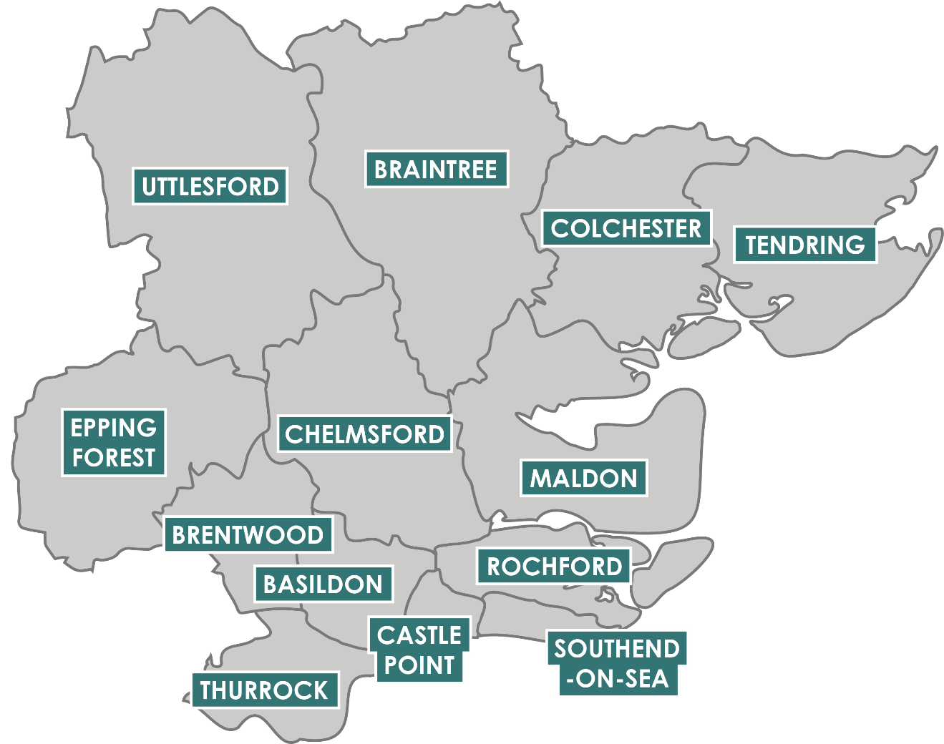
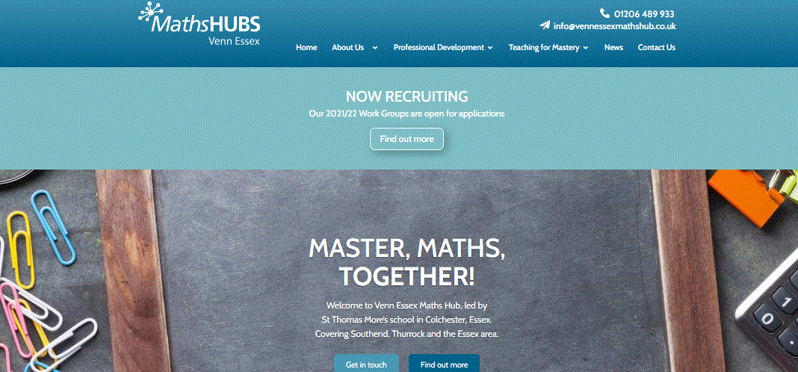
Venn Essex Maths Hub offers a range of different professional development opportunities. The projects cover mathematical subject knowledge and pedagogy in all educational phases.
Express your interest here ...

Slide 2
Primary School Opportunities 2021/22
working with
Create transformative
Workingtogether to create an indispensablecommunity for maths staff
leadership and culture that throughcollaborationand high-quality training.
promotes a mastery approach
to primary mathematics teaching and learning
Embed a Teaching for Mastery approach across the school
Deepen subject knowledge in the teaching and learning of primary mathematics for:
EYFS Teachers
KS1/2 Teachers
TAs
Early Career Teachers
Subject Knowledge Enhancement
Mastery Readiness
Mastery Development
Embedding Mastery
Sustaining Mastery
Year 5 to 8 Continuity
Develop aconsistent approach for Key Stage 2 and 3 teaching and learning
All Work Groups are free to attend, with Development and Embedding offering additional funding for schools
Develop teachers' mathematical and pedagogical knowledge of amastery approach in the primary classroom
Secure a whole school approach to sustained change in mathematics
Secure firm foundations in additive relationships and the development of good number sense for all children from Reception through
to Year 1 and Year 2 (more details to follow)
EYFS and KS1 Mastering Number
W: vennessexmathshub.co.uk | E: info@vennessexmathshub.co.uk| T: 01206 489933 | Express your interest click here

