Slide 1
Department for Education
Transforming Children and Young People’s Mental Health Provision
Alfred Bandakpara-Taylor
Senior Commissioning Manager Mental Health & LD Commissioning
Basildon and Brentwood Clinical Commissioning Group
Clare Burrell
Head of Strategic Commissioning Children and Families
Essex County Council

Slide 2
Link is One of several central government initiatives relating to transformation plans which include; - Teaching about mental wellbeing (2020) - Mental health Support Teams working with schools and colleges (2023) - Training for senior designated mental health leads in schools (2025) Funded by DFE supported by NHS England, Link is led by Anna Freud National Centre for Children and Families Roll out over next four years to all schools and colleges in England Coordinated by local Clinical Commissioning Groups (CCGs) supported by Local Authorities
Link

Slide 3
Link brings together schools/colleges with their mental health services to improve the local system of support for children and young people. Aim is to ensure so that children and young people can get the help they need, when they need it. Working together on system confidence to deliver early intervention for children and young people experiencing emotional health and wellbeing issues.
Link Objectives

Slide 4
South Essex Link
Each school/college to nominate a senior emotional health and wellbeing lead for 2 x day long workshops, approximately 6-8 weeks apart
School leaders, local EMWHS senior service leads, CCGs and LA Colleagues with early help leads e.g. Team Around the Family Officers
Roll out February 2020 to December 2020
Delivered within CCG Areas in groups of schools

Slide 5
South Essex Dates
Locations | Dates
 | 1st session | 2nd session
Basildon and Brentwood Workshops
Basildon Town | Wed 11 March 2020 | Wed 22 April 2020
Brentwood | Friday 27 March 2020 | Friday 22 May 2020
Billericay and Wickford | Friday 06 March 2020 | Friday 24 April 2020
Castle Point and Rochford Workshops
Castle Point | Wed 29 April 2020 | Wed 10 June 2020
Rochford | Wed 06 May 2020 | Tuesday 23 June 2020
*It is very important the same people attend both workshops in the same cohort*
Further details and information, including venues, will be circulated before the end of term

Slide 6
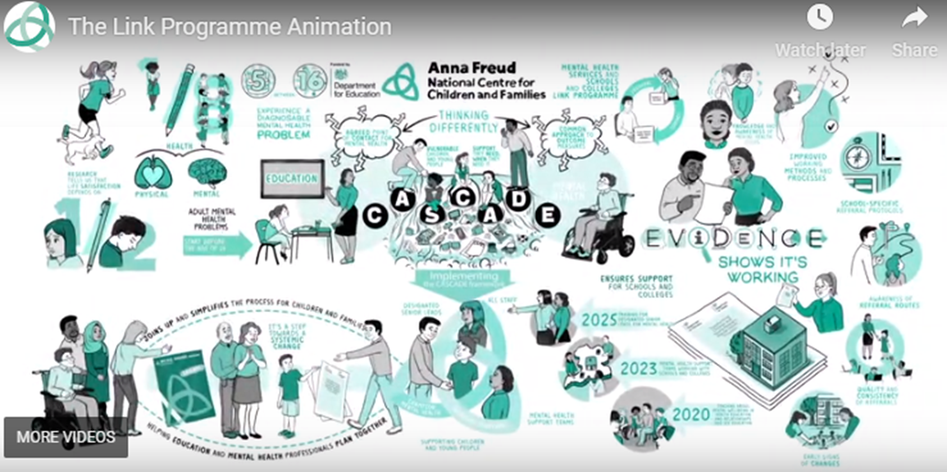
For more information https://www.annafreud.org/what-we-do/schools-in-mind/our-work-with-schools/the-link-programme/

