Slide 1
Early Career Framework
National Roll Out
Recruitment begins March 2021
Programme begins September 2021

Slide 2
Contents
Introduction
National Roll-Out
Delivery of the ECF
What will the ECF look like?
The Role of the Appropriate Body
Mentoring
The Five Core Areas
‘Learn that…’ and ‘Learn how to…’
Education Development Trust Programme
Trust Programme
Actions
Further Reading and Resources

Slide 3
Introduction
The NQT year is changing – it’s becoming two years.
Why?
Surveys show that by one in six new teachers leave the profession after only one year; one in three have left within five years of qualifying.
The learning curve is steepest during the early years of teaching so the plan is to provide improved support for Early Career Teachers (ECTs).
The DfE references the training that is undertaken in other ‘esteemed professions’ (e.g. medicine and law) and the support that those seeking a career in those areas receive in order to become a professional.
“The Early Career Framework (ECF) underpins an entitlement to a fully-funded, two-year package of structured training and support for early career teachers linked to the best available research evidence. The package of reforms will ensure new teachers have dedicated time set aside to focus on their development.
Our vision is for the ECF to build on high-quality Initial Teacher Training (ITT) and become the cornerstone of a successful career in teaching.” *
*Early Career Framework, January 2019
Contents

Slide 4
National Roll-Out
Reforms to the ECF will roll out nationally from September 2021.
Changes to statutory induction arrangements from September 2021
ECTs will undertake 2 years of extended support and training, supported by the Appropriate Body and HT.
ECTs in their second year of teaching will be entitled to 5% of time away from the classroom.
ECTS who have started but not completed induction on 1 September 2021 will have until September 2023 to complete a one-year induction period. After this point, these teachers will still be able to complete induction, but will need to complete a full 2-year period.
Qualified Teacher Status (QTS) will continue to be awarded:
at the end of Initial Teacher Training
before the start of statutory induction (minus assessment only route exemptions)
Contents

Slide 5
Delivery of the ECF
All early career teachers will access a programme of training based on the Early Career Framework. Every Head Teacher and Appropriate Body providing statutory induction will need to ensure they meet these new requirements.
There will be 3 approaches available to enable the delivery of an Early Career Framework-based induction. The approaches are:
a funded provider-led programme offering high-quality training for early career teachers and their mentors alongside the professional development materials
schools drawing on the content of the high-quality professional development materials to deliver their own early career teacher and mentor support
schools designing and delivering their own Early Career Framework-based induction programme, based on the Early Career Framework
Action: Decide on your delivery model for an Early Career Framework-based training programme. Note: approaches 2 and 3 are validated by the Appropriate Body
Contents

Slide 6
What will the ECF look like?
There are 5 key elements to the ECF:
1
2 years of new, funded, high quality training for ECTs and mentors
2
freely available high quality development materials based on the early career framework
3
additional funding for 5% time away from the classroom for teachers in their second year
4
a dedicated mentor and support for these mentors
5
funding to cover mentors’ time with the mentee in the second year of teaching
Contents

Slide 7
The Role of the Appropriate Body
The appropriate body will continue to play an important role in Early Career Teachers’ inductions.
Appropriate Body Roles:
compliance checks to ensure statutory induction entitlements of early career teachers are met assessment verification based on individual headteachers’ recommendations ensure that all Early Career Teachers have access to an ECF-based induction
Appropriate Body Status will be held by:
Teaching School Hubs
Local Authorities
Action:
Register your ECT(s) with an Appropriate Body to fulfil statutory induction requirements.
Contents

Slide 8
Mentoring
All early career teachers will be entitled to a dedicated mentor, who will share their expertise. Mentors will be trained and have access to resources developed by the ECF providers. This role should be separate to that of the induction tutor.
Mentors will receive:
Funded training over the two-year induction period of the ECF; support through high-quality resources; funded release time to work with the early career teacher during their second year of teaching.
If a mentor has more than one early career teacher to supervise, their training allocation can be used by a prospective mentor, with a view to building mentor capacity in the school.
Action:
Identify potential mentors from the existing staff of your school. Who has the skills and experience necessary for this role?
Contents

Slide 9
The Five Core Areas of the ECF
The ECF has been designed to support Early Career Teacher development in five core areas. These relate to the Teachers’ Standards, but are not exactly the same.
Behaviour Management
High Expectations (S1)
Managing Behaviour (S7)
Pedagogy
How Pupils Learn (S2)
Classroom Practice (S4)
Adaptive Teaching (S5)
Curriculum
Curriculum (S3)
Assessment
Assessment (S6)
Professional Behaviours
Professional Behaviours (S8)
The ECF should not be used as an assessment framework, and assessment should only be made against the Teachers’ Standards.
Contents

Slide 10
‘Learn that…’ and ‘Learn how to…’
Each learning section is split into two in the ECF.
The first part is labelled ‘Learn that…’ and asks that teachers new to the profession expand their knowledge and experience of each area.
The second part is labelled ‘Learn how to…’ and details tasks that are designed to be more actionable.
An example is shown on the next slide.
‘Learn that…’ statements are informed by the best available educational research, with references and further reading provided.
‘Learn how to…’statements are drawn from the wider evidence base including both academic research and additional guidance from expert practitioners.
Contents

Slide 11
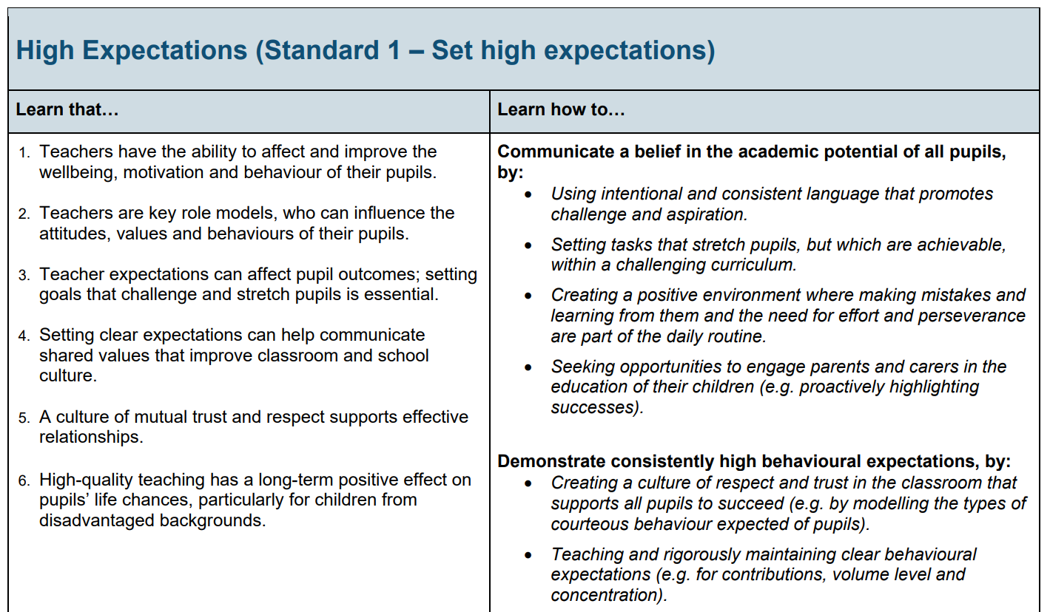
Contents

Slide 12
Working in partnership with Education Development Trust, one of the Early Roll Out ECF accredited providers,
Saffron Teaching School Hub has worked in 2020/2021 to deliver the Early Career Framework as a one year expansion programme available to NQTs whose ITT year was severely disrupted.
As part of the National Roll Out, STSH will be reviewing the six accredited providers’ programmes and will be a delivery partner for one or more of these. A team of 14 facilitators will deliver the programme across the five LADs.
Action:
Identify potential facilitators from the existing staff of your school. Who has the skills and experience necessary for this role?
Apply to STSH.
Contents

Slide 13
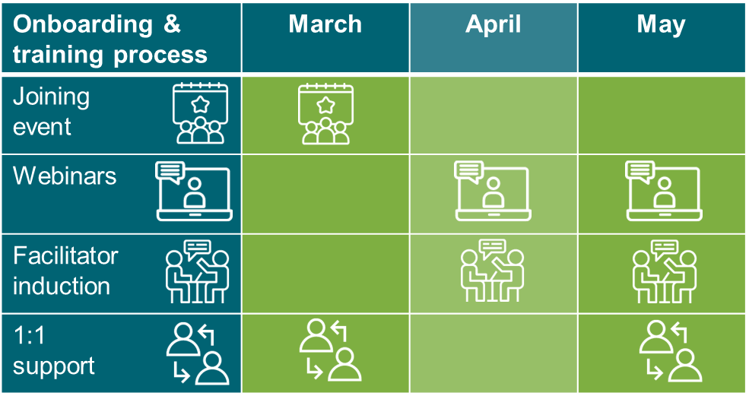
The following slides detail the EDT programme to give an example of what might be expected.
Contents

Slide 14
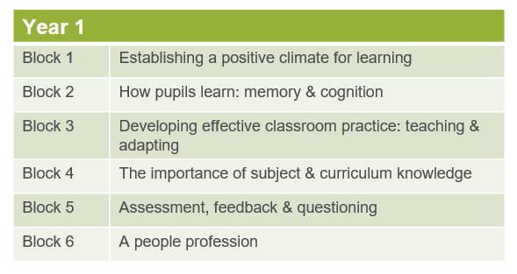
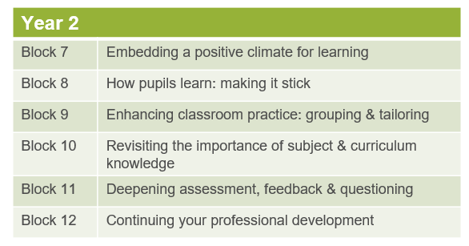
What is the EDT core content, and how is it structured?
12 ‘Blocks’ (modules), with each Block designed to take one half-term to complete.
ECF content is structured into a curriculum based on the principles of interleaving and spaced practice for knowledge retention and recall.
Blocks in Y2 build on the foundations encountered in Y1, to develop mastery.
Contents

Slide 15
How is the Programme content delivered?
There are a number of Programme components, as summarised here:
The next two slides show the delivery models for ECTs and Mentors respectively.
The Self-directed study materials (called ‘Reading & Reflection’ for Mentors) are all hosted online, along with a wealth of additional resources, including videos, blogs and podcasts.
Contents

Slide 16
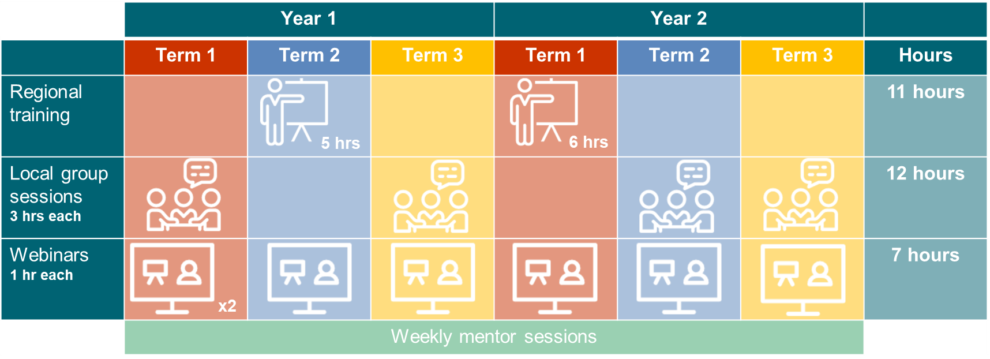
What does the delivery model look like for ECTs?
Contents

Slide 17
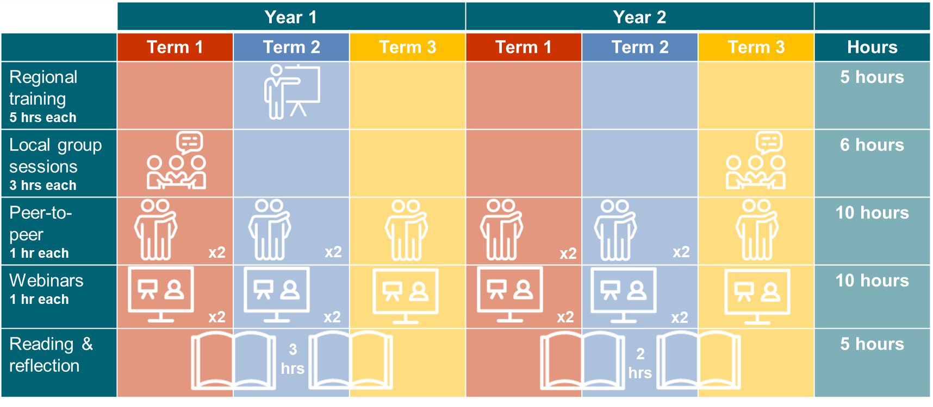
What does the delivery model look like for mentors?
Contents

Slide 18
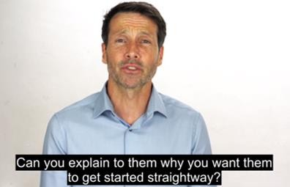
What do the online resources look like?
These are subject to change for NRO, but illustrative.
Contents

Slide 19
What else is part of the Saffron Teaching School Hub Early Career Development offer?
Subject Knowledge Enhancement for Primary Teachers
Recognising the vast subject knowledge requirement for primary teachers, we will offer a series of optional twilights for ECTs to gain further development.
We also aim to be responsive and create training opportunities subject to demand.
Half-termly surgeries with our facilitators for mentors
Half-termly surgeries with our facilitators for ECTs
Contents

Slide 20
Actions
1
Register your ECT(s) with the Appropriate Body to fulfil statutory induction requirements.
2
Decide on your delivery model for an Early Career Framework-based training programme.
3
Register your ECT(s) with the STSH/EDT Programme
Register your school with the core induction Programme from one of the accredited providers
Design your own Programme
4
Identify potential mentors from the existing staff of your school. Who has the skills and experience necessary for this role?
5
Identify potential facilitators from the existing staff of your school. Who has the skills and experience necessary for this role?
Apply to STSH.
Contents

Slide 21
Further Reading and Resources
1
Early Career Framework
2
Early career framework reforms: overview
3
Education Development Trust Induction Programme
Contents

