Slide 1
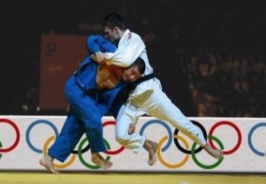
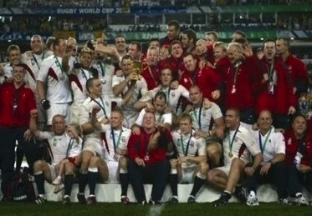
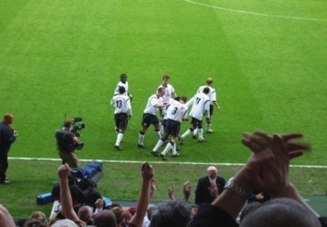
Humphrey Walters
“Winning Really Matters
Humphrey@humphreywalters.com
Winning really matters—it’s a game of inches—100 things 1% better
1

Slide 2
Winners checklist
1. understand who you have
2. understand the basics
3. Teamship rules
4. Winning language
5. Establish your cause

Slide 3
How to work with me
For best results please…
You will know I am disengaged when…
3

Slide 4
Common Characteristics
Blast from the past
Self doubt
Think in Ink—ruthless simplicity - set mini targets
High pride to be the best
High degree of self responsibility
Unpredictability is opportunity
4

Slide 5
Establish The basics
Sail shortest distance
Keep people in and water out
Don’t break the boat
Football - speed- possession - space
Rugby - territory – possession – pace
Long jump – speed – accuracy - height

Slide 6
Established 6 Followers’ Duties
Punctuality
Empathy
Scuttlebutt
Tell me once
Leave on “Wave behind”
Sort it by next watch
6

Slide 7
Winning Language
What winning language should we use ?
We can
This is a suggestion
Can I help
What outcome do we seek
What’s going for us
Lets keep it simple
Agree to disagree- agreeably

Slide 8
What’s our cause?
“People will fight for a right—but— Die for a cause”
8

Slide 9
Three Critical Factors
1
What’s our cause?
Our identity—pride in the badge?
How do we operate as a team?
2
3
9

