Slide 1

Ensuring Every Child Learns
Outstanding Behaviour
WEPHA – 16.05.25

Slide 2

Training Outline
Training Session | Theme of Session
1 | Background and Thoughts
2 | Whole School Culture
3 | Behaviour Curriculum & The Three ‘R’s Low Level Disruption
4 | Strategic Strategies for Challenging Children
5 | Getting Ofsted Ready
Notes:
Outline the sessions that will be covered during the training and state that they will vary in length.

Slide 3
Why have you graded behaviour and attitudes as exemplary?

Slide 4

Session 1
Background and Musings
Notes:
Session 2 will look at the roles and responsibilities of subject leaders.

Slide 5


Heart of the Matter…
Children will follow people before they follow rules.

Slide 6
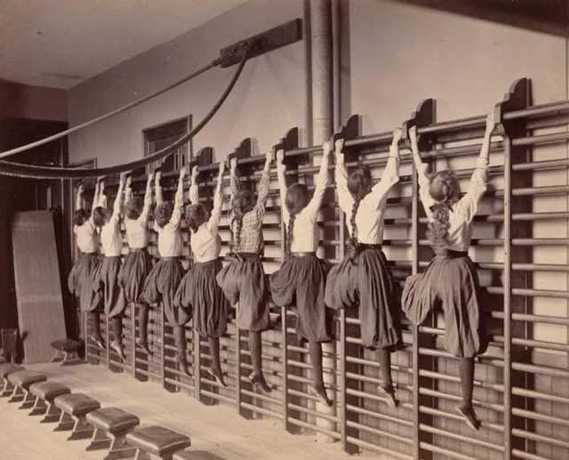
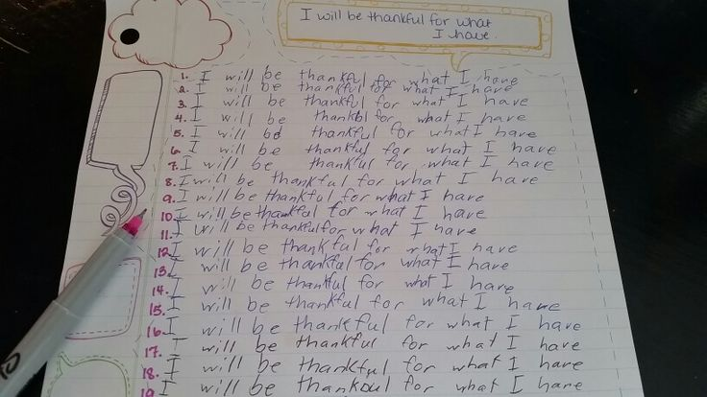
What can you remember about behaviour management when you were at school?

Slide 7
The management of behaviour in schools is one of the elements that keeps SLT and teachers awake at night.
Most believe that it is the handful of ‘very challenging’ children that are going to make or break any inspection or accountability process.
This is not necessarily the case!
Your schools ability to create a purposeful learning environment with behaviour and attitudes ‘conducive to learning’ will make the difference. Low level disruption will trump the management of the ‘most challenging children’ any day of the week.

Slide 8
Where are we today?
Support and training for teachers who struggle with behaviour is lamentable from teacher training institutions through to schools themselves.
I would like to point out that in most cases I am not blaming schools in the slightest, but over the past few decades schools have been hammered by Ofsted, performance, standards and politicians who want to be seen to get ‘tough’ on behaviour in schools.
Pastoral care went out of the window as soon as children became viewed as a percentage or statistic.

Slide 9
Where are we today?
Teachers are leaving the profession citing one of the main reasons as behaviour of the children. Training for Behaviour is very rare!
Significant gap in training in teacher training institutions and in schools.
Many behaviours cannot be solved with strategies – name on board, house points, stickers do jos
PASTORAL CARE
What happened to pastoral care

Slide 10
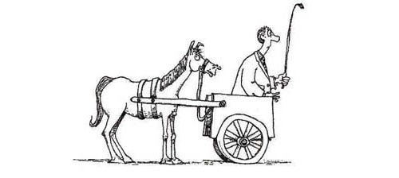
Priority Order for Schools
Behaviour
Curriculum
Teaching
Priority Order for Ofsted/Gov
Progress, standards attainment
Winning the next election
Making ourselves look ‘good and tough ’ to the electorate

Slide 11
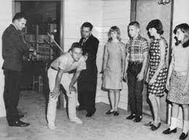
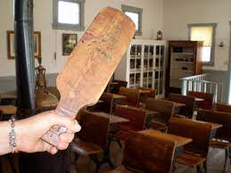
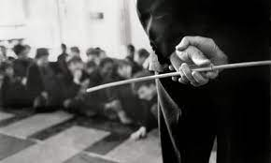
What was acceptable 30 years ago?
How will isolation rooms and detentions be viewed in 30 years?

Slide 12

Lunchtime detentions leads to children only behaving well when adults watching. Why do schools decide to crush bad behaviours with punishment when the alternative is to grow positive behaviours with kindness and love?
Visible/tangible consistency with visible kindness allows exceptional behaviour however the missing link in most schools is - consistencey between adults.
Behaviour management is a team sport, discipline and there must be no gaps between adults on what matters.

Slide 13

Society, children, parents are changing in terms of values and expectations…
The punishment brigade are beginning to lose the argument and children are less tolerant of what they perceive ‘unfair’ punishments and parents want more than simply detentions.
In 20 years time what will we think about exclusion rooms?
The esteem our society, parents, politicians hold of our teachers reflected in eyes of children.
Teachers deserve our respect, admiration, but is all they are receiving is more and more severe problems parked at their door.

Slide 14

5% of teachers are very poor behaviour managers and their behaviour can be just as corrosive as Chantal's constant swearing
Some teachers bounce through all sanctions, talk down to them, sneer at positive behaviour management, heavy with the stick but with no hint of carrot.
Values relating to behaviour can be tricky – own experiences, parenting, political beliefs
Appeal to the greater good!!
Poor behaviour management has repercussions for whole school and takes up a lot of precious time and resources.

Slide 15
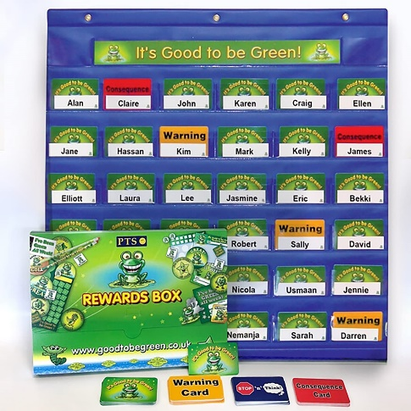

Behaviour management is not…
A set of techniques from a toolkit or skills led
It is nothing to do with magic behaviour systems data tracking software
So what is the solution…

Slide 16

So, what is outstanding behaviour management all about…
Culture – the right people eats strategies for breakfast

Slide 17

Culture set by the way adults behave

Slide 18
CERTAINTY – expected, respected and unquestioned, not strictness or being tough/assertive

Slide 19
Sending Children Out of Class
Passing up hierarchy works against certainty you create telling the child and everybody who sees it that you cannot deal with this.
Asking someone else to pick up your tab means you are undermining your relationship and authority with the children. Alternative is not to suffer appalling behaviour
If I send a pupil to a colleague, it is not to discuss behaviour before you.
If I need support, I would like my colleague to stand alongside me, so the child sees a united front
Sending children to have the fear put into them is not rational and the fall out can last for a very long time. Most damaged children need the most certainty.

Slide 20
For effective behaviour management you have to:
Leave your ego at the door, focus not on your feelings attitude – focus is on the children.
Remember your certainty might be the only certainty they get
Bad behaviour managers have:
Bad routines
Over emotional response
Anger addiction
Lack of empathy
Nothing to do with age or gender

Slide 21

Culture is pivotal
Once you get the culture right strategies used become less important

Slide 22


The culture in any school is set by…
How the adults behave!
Awkward and difficult conversations

Slide 23
Your most important job is how how you manage adults who default on agreements or refuse to change their ways.
I started at a new school and threw out the green and red frogs – good to be green. Hated me until it started working!
What you MUST do is confront bad teacher behaviour!!
Brass neck to challenge bad behaviour - not nice unless you are a psychopath!

Slide 24
Whole School Culture
Notes:
Session 2 will look at the roles and responsibilities of subject leaders.

Slide 25


What would you class as a stormy day in your school?
What would you class as a great day in your school?

Slide 26
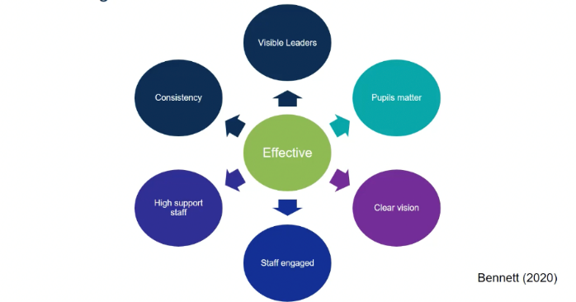

Characteristics of effective schools
Strong and visible leadership
Clear culture and vision
All staff and attributes, dispositions, empathy
Clear high expectations/routines
Consistently applies
How does the school ensure consistent management of behaviour?

Slide 27

Do school policies make any difference?

Slide 28

The ones that should…
Behaviour
Teaching and Learning
Safeguarding

Slide 29
The best Behaviour Policy starts with a blank piece of paper.
Then includes the following:
Culture/Aims
School systems and social norms
Pupil transition – around school
Pupil support – challenging behaviour
Staff induction, development and support
This is how everybody does it here…

Slide 30


Back at the Ranch - Policy Writing
Section 1 Culture – Record the key aims for adults and childrens behaviour in your school.
Adults' behaviour
Children’s Behaviour

Slide 31
Top Tip to Achieve Outstanding
Include behaviour targets on your SIP.
Have examples ready of support/training you have provided for staff.
Write your behaviour policy with staff, starting from scratch.

Slide 32

Session 3
Behaviour Curriculum & The Three R’s
Social Behaviour & Learning Behaviours
Notes:
Session 2 will look at the roles and responsibilities of subject leaders.

Slide 33

Rules, rules, rules…
What are your school rules?
Every interaction on behaviour!

Slide 34
Do you know them?
Do the children know them?
Do you have too many?
Kind – Creative – Brave
Ready – Respect - Safe

Slide 35
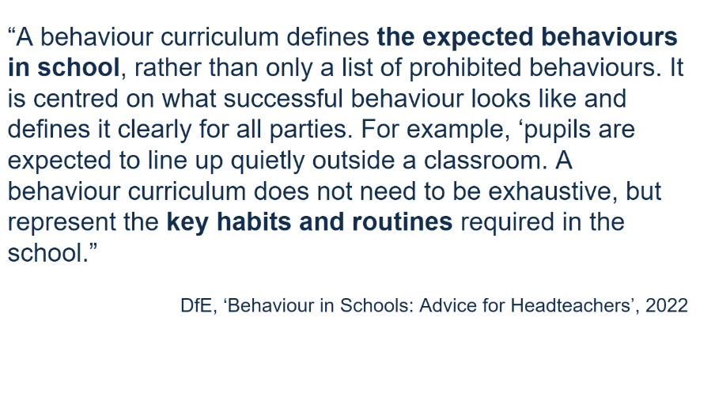


Slide 36

Behaviour Management is NOT…
Simplistic checklists, tokenistic reward systems
Outstanding behaviour is not skills led
It is not about magic systems or data tracking software
It must involve frequent training updated regularly and children following adults before they follow rules.

Slide 37
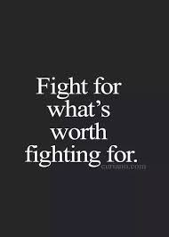
The effectiveness of any behaviour policy or strategy dependson the ability of adults to deliver simple, highly effective and utterly consistent behaviour management.
It is the most important consistency every member of the SLT and staff must believe is worth fighting for – great parents' same response, boundaries, mantras. Consistency palpable, planned and safe.
Some schools have big push weeks on ties, or punctuality which many staff teams vies as grand gestures which ultimately become futile futile. Taking a zero tolerance leads to confrontations and after a few days staff feel that it is way too much hassle.

Slide 38
If you want to move your school towards an outstanding behavioural culture Chaos to calm – solid base rooted in kindness not in zero tolerance.
In schools where behaviour is breaking down, siege mentality tally charts in staffrooms. Tally charts how many children they made cry, adult hostility borders on abusive. Cruel and completely unnecessary.

Slide 39

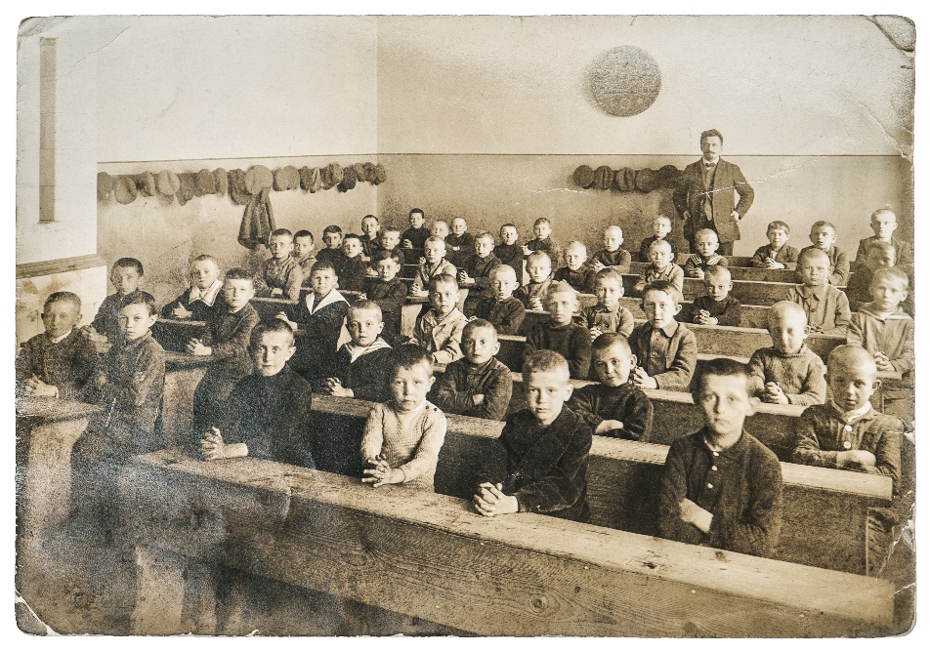
Do you want your teachers to go free style?

Slide 40


SLT need absolute clarity about…
Routines - high expectations of classroom routines.I would like all students/teachers to do – standardising routines
What do I want the children to believe about themselves, each other, the school?
What learning behaviours do children need to be successful?
What steps have been taken to improve pupils’ behaviour and learning?

Slide 41

Routines must be…
Chosen carefully – any process that happens regularly in lessons that involves a teacher having to deliver multiple instructions
Taught explicitly – repetitive and it will take time
Modelling – knowing what it looks like
Check for understanding – in the same way we do about learning

Slide 42
Key Routines
Getting the class silent and ready for instruction - eyes on Me - instructions best chance to be followed
Setting the class to work – what you say and order is critical mention get into groups too early listen to nothing. Trogs – time and task R – resources what they will need. O – what you want to see at end of time G – grouping specify pairs seating arrangements S – Stop signal
Reflective Questioning – key moments in any lesson when its critical to pause to see how far we have come and to think about direction of travel – maximum twice during a lesson (not mini plenaries)
Eliciting success criteria – drawing out with children the success criteria, empowerment of behaviour and learning. Goals they set themselves – which one you can achieve, challenge – self differentiate
Routines for students – teach in 3’s – balance to be struck between school wide consistency and the classroom needs – people like repetition

Slide 43

SLT need to communicate:
Routines – high expectations of classroom routines
Responses - strategies and interventions for de-escalation, confrontation, reacting with proportionality
Relationships – building positive relationships from the start, understanding personal triggers, how SEND affects behaviour. Knowing your children!

Slide 44

SLT need to communicate:
Routines – entering class, corridors, transition, end of play – some will be the same such as moving around the school
Responses – kindness, your philosophy about student removal, sanctions
Relationships – they have to care enough to do this!

Slide 45

Kindness – Consistency
Meeting and greeting in morning
Walking around the school
Dealing with challenging children
Grinding out Consistency

Slide 46

What is low level disruption?

Slide 47
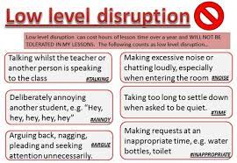

Slide 48

Low Level Disruption
Talking unnecessarily or chatting
Calling out without permission
Being slow to start work or follow instructions
Showing a lack of respect for eachother and staff
Not bringing the right equipment
Using mobile devices inappropriately

Slide 49
Low Level Disruption
Make your expectations very clear and rigorously check they are being implemented consistently.

Slide 50
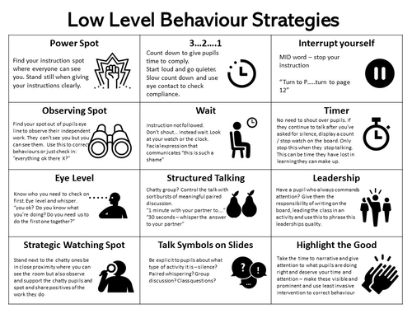

Slide 51
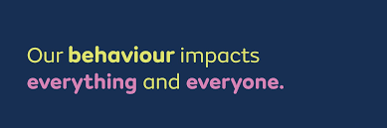
Innovative teaching and learning and curriculums cannot take place without good behaviour.

Slide 52
Back at the Ranch - Policy Writing
Write down you expectations for routines at your school.
Entering classroom
What do children do when they enter classroom
Corridors
Lining Up
Hands up
Transition

Slide 53
Day to Day Behavioural Issues

Slide 54

What is instinctive often makes situations worse, humiliating and shouting at children crushes and shames them in the short term, but often fuels their anger. It does not teach improved future behaviour
Know you counter Intuitive and work against your instinct. There are times we all want to scream, just do the b*****y work but it does not work, regardless of how loudly you screamed it.
Emotionally led responses should always be resisted. Great teachers recognise counter intuitive to achieve great outcomes – how you behave will have a massive impact on improving the child’s behaviour.
When a child misbehaves give them the opposite to what they are expecting – a cool calculated emotionless response. Save your excitement for when good things happen.

Slide 55
Behaviour Must be Taught - Explicitly
The best schools teach and re-teach expected behaviours. In primary school flash points such as time between activities behaviour must be retaught until it becomes habit. In a lot of classes children play guessing games which leads to a lot of wasted time
Ferocious punishment – drives poor behaviour underground. What is important is the immediacy of response. 2 minutes at end of lesson is inconvenient for them to take notice, fast enough to let them know they have stepped over the line and the child has the inconvenience being last out. That is often sufficient to deal with minor issues rather than a detention in a week, which they will have forgotten all about.
When a child misbehaves give them the opposite to what they are expecting – a cool calculated emotionless response. Save your excitement for when good things happen.

Slide 56

I care about you, I care about this lesson and I am not going away

Slide 57
Ofsted Q’s and A’s
What actions have you taken to improve behaviour?
Routines
Responses
Relationships
Policy
Low level disruption

Slide 58
Consistent Language - Teaching

Slide 59
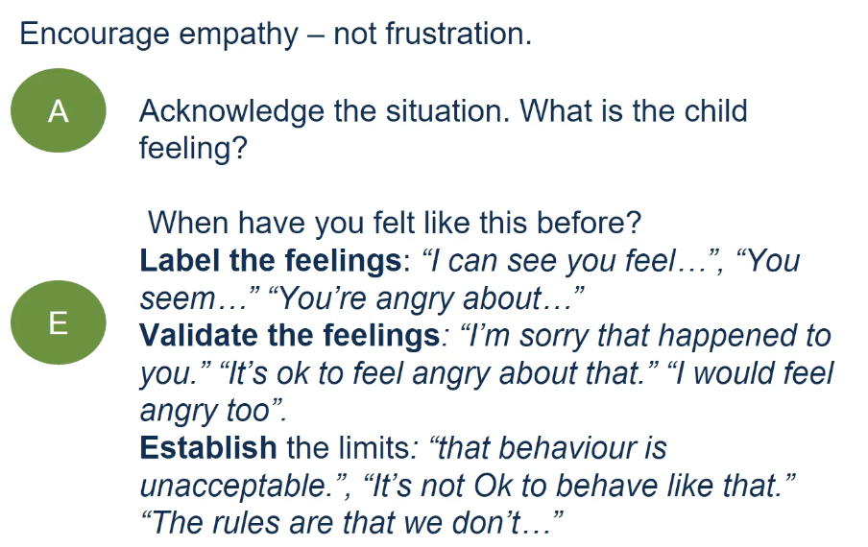

Slide 60
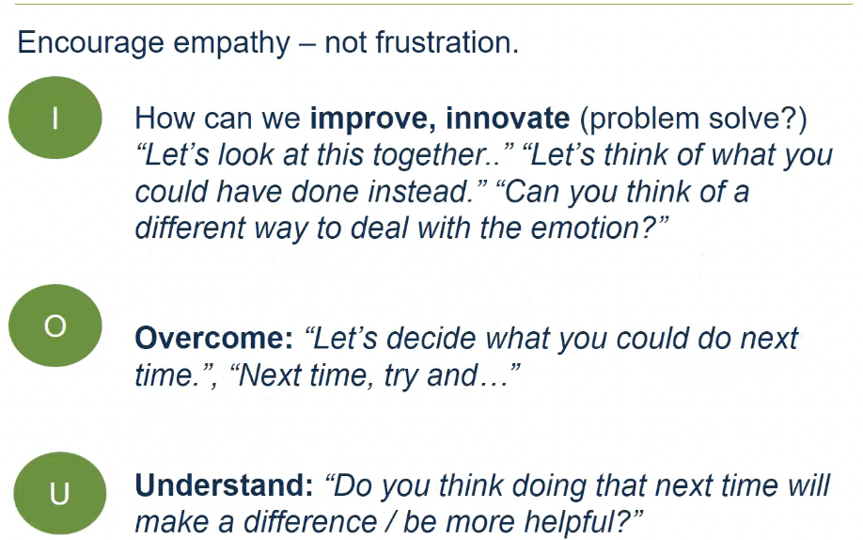

Slide 61

Look Carefully at Your Steps
C1 - reminder
C2 reminder
C3 - verbal warning
C4 - warning on board
C5 - Move in room
C6 - Move with support teacher
C7 – Leave the room
C8 - detention

Slide 62

Simple but Good
Reminder
Caution
Last Chance
2 Minutes
Repair

Slide 63
What rewards sanctions do you currently use?

Slide 64

Name and Shame
Name on board behaviour technique is used in many schools in many different formats. In one school the amount of ticks placed indicated the level of punishment, traffic lights steps to heaven, ladder hell. Name on board feeds poor behaviour and resentment because children being shamed in public
Where did you learn this technique?
Research?
How long used for?
Some children love being famous and revel in the naming and faming. Shortcut to being famous is mis-behaving. Change this round to private word with them instead of naming and shaming which simply reconfirms poor self-image, low expectation and provides a perverse incentive for children who want to be famous.

Slide 65

Recognition Board
Recognition Board – shift the culture in your school by changing it to a Recognition Board.
Behaviour of one child is not everybody's business, advertising poor behaviour doesn’t help.
On the board:
Behaviour focusing on today -
one voice
Speak politely
Accurate peer feedback
When you see children demonstrating behaviour well write their name on the board. The aim is for everyone to get their names on the board. Even children who have been sanctioned can still be on the board.

Slide 66

Token Economies
Token economies are very often not consistent, and it is only the highest achievers or worst behaved, so the most visible children who get rewarded.
Some teachers are too generous and devalue the currency whilst others are so tight when they do hand out a token it passes into legend. Children know how subvert the system by being caught at the right time, making behaviour a game – Platinum, diamond, kryptonite
Sincere well done – round of applause for well done
Just be very careful!

Slide 67

Children are crying out for stability and resilience from adults around them. Often they ask for it in destructive ways leading some schools to constantly award minimum standards. Instead schools should praise and reward children for going over and above. This should become your schools mantra and sets out that you exepect more than bare minimum and gives the children something to achieve and reach for.

Slide 68
Strategies should be agreed with all staff.
Great teachers build emotional currency with their pupils to be spent later – smiley face, newspaper article you might like this, the disco you stay late for.
Positive messages to the child’s home such as a note stating sincere recognition for over and above. This can be an excellent tactical move because it marks the movement for the child and gives them and their parents pride in childs achievements. Home is not stable or kind?
Proprotionately – other polite children looking on in resentment
`Hot chocolate Friday’ – simple idea sending out mugs and hot chocolate over and above 15 minutes out of the week targets at children who behave impeccably but too easily forgotten.

Slide 69
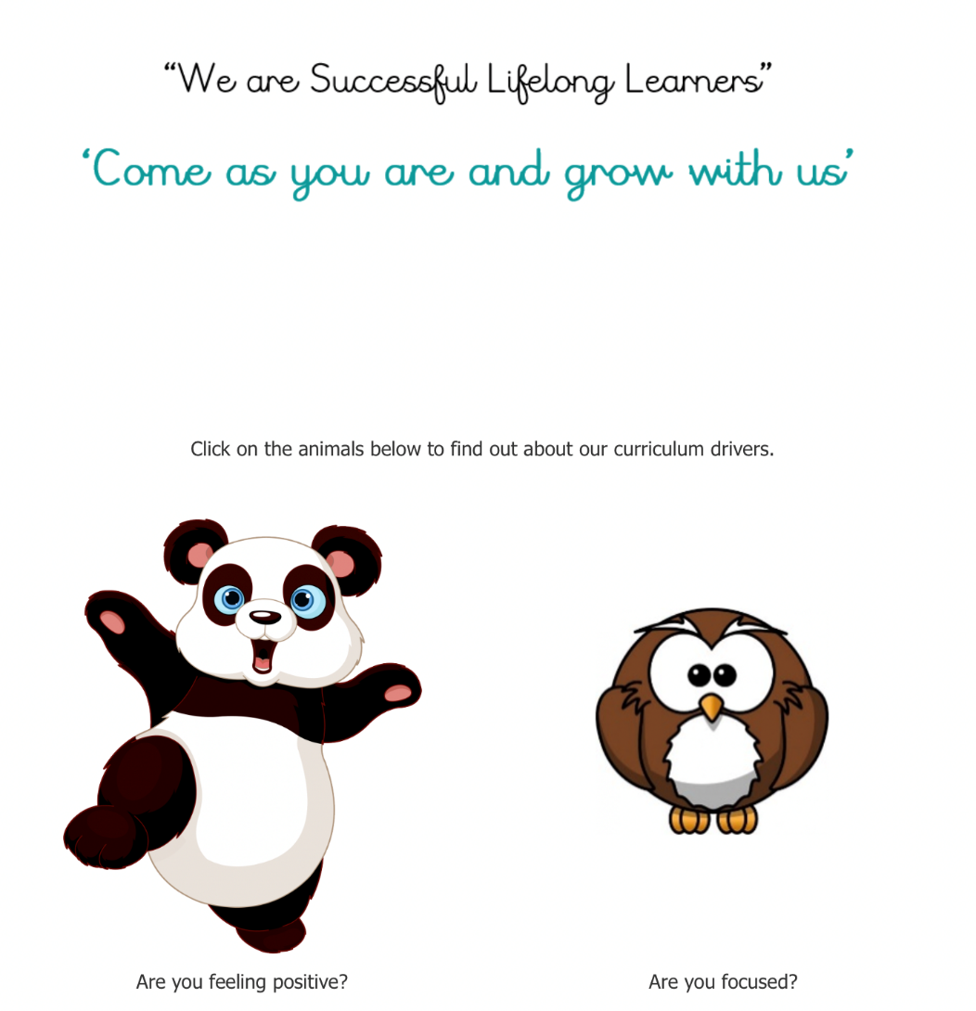
Whole School Approach

Slide 70

Whole School Approach

Slide 71
Back at the Ranch- Policy Writing
Whole School Approach
Steps
Rewards
Sanctions
Learning Behaviours

Slide 72
Ofsted Q’s and A’s
How are you improving learning behaviours and attitudes and ensuring consistency across the school?
Policy
Explicit teaching
Consistency across school
Case samples

Slide 73
Session 4
Strategic Strategies for Very Challenging Children
Notes:
Session 2 will look at the roles and responsibilities of subject leaders.

Slide 74
Really Challenging Behavioural Issues

Slide 75

What reasons do children present with challenging behaviour?

Slide 76
Are they doing it on purpose?

Slide 77
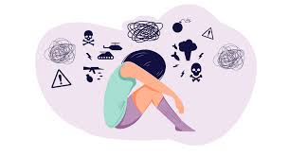
Always consider/rule out trauma…
The child may struggle with self-regulation (i.e., knowing how to calm down) and may lack impulse control or the ability to think through consequences before acting. As a result, complexly traumatized children may behave in ways that appear unpredictable, oppositional, volatile, and extreme.

Slide 78
Babies are born with billions of brain cells
Through engagement, these cells make connections or synapses
This is brain development = progress

Slide 79
Synapse density is greatest by the age of 3
Early experiences (from birth to 3) have great potential to affect brain development.
So children are especially vulnerable during this period.

Slide 80
What happens when it goes wrong…

Slide 81
These scans are extreme but it shows how crucial the early years are for brain development.

Slide 82
Implications of Research Findings
If young children are bored, passive and quiet with low level engagement and few interactions, then their brains will not develop to their full potential.
The areas of the brain associated with empathy and social skills must be developed in the first few years. Areas of the brain with literacy and numeracy remain ‘plastic’ and able to be developed for much longer.

Slide 83
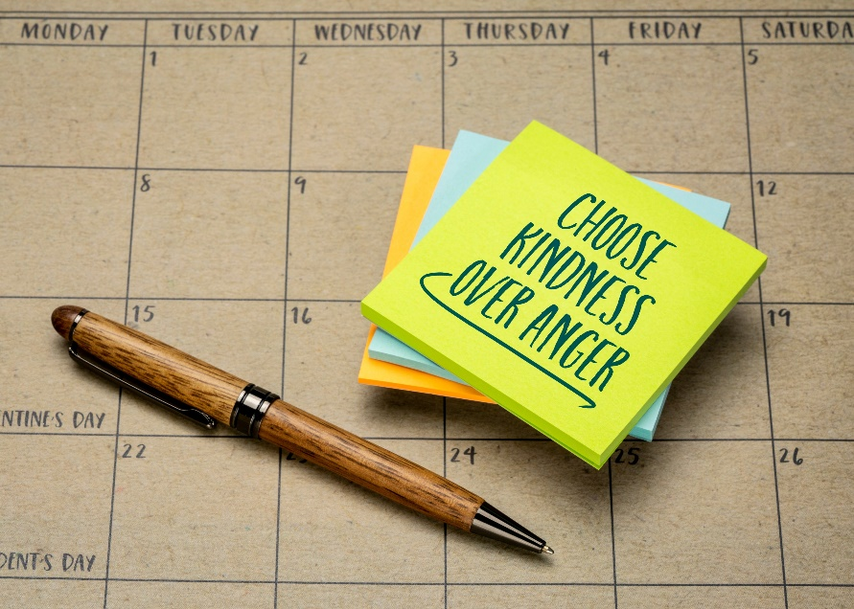
Conflict and Confrontation
Do the counter-intuitive!
Meet anger with kindness

Slide 84

Aaron the Cash Till, the Roof and the Bike…
Please take your coat off and hang it on your peg.
Classroom daily routine, issue a few threats and leave. The support I received was don’t worry he does that with everyone but I went into teaching to make an impact not hide behind low expectations.
What did I do?
Offer of a hand, unconditional and will not be withdrawn trouble is adults get frustrated and take hand away too quickly – best teachers never take their hand away – he wants to know who will remove their hand and at that point he will take your hand and learn anything from you
People first – come to him with kindness, commitment, patience eventually follow you anywhere.

Slide 85
What do you think should happen to challenging children as a sanction?

Slide 86

Taking Your Hand Away
Children will be constantly testing you to see if you will take your hand away.
I care about you, I care about this lesson
The best teachers keep their hand there forever!

Slide 87

First Principle
Manage own response!
Predictable
Consistent
Empathetic

Slide 88

Give children the script
I can choose to walk away
I can stop myself
I am ok
I can choose to be calm
I have bigger fights that this

Slide 89

Give yourself a script
Plan your response and perform dull formal predictable voice that rewards nobody – children do not like it – predictable response teacher is in control
Save finest performance for when children do the right thing!
Not what you say but the way that you say it. Pace, body language, and volume are all interpreted.
Warm in the face of escalating confrontation what can happen can be amazing.

Slide 90

Angry Children
Angry children will follow people first then rules. Small kindness in pressured situations go along way.
Avoid power plays – divert, avoid, or re-direct. Letting them know you are listening; you care and understand. I understand that you are angry, I need you to come with me to resolve this properly

Slide 91
2. Kill the ’celebrity’ culture – 1950’s humiliation was behaviour tool. Today fame and celebrity and attention is a commodity. Colour coded behaviour reports. When do the grey children get their ‘fame’. Like and Subscribe

Slide 92
3. Stop the churn – children need stability, let down by everybody, learning to trust is most difficult. Small consistent teams of teachers, mentors so they are around long enough to build relationships.

Slide 93
4. Be ‘unshockable’ – show your shock you are immediately judging. Listen but do not react, control your face particularly your eyes. Poker face…

Slide 94
5. Hide Your Anxiety – anxious adults transmit their anxiety with every step and breath. Great teachers perform throughout the working day. Exhausting dealing with children who have experienced trauma.

Slide 95
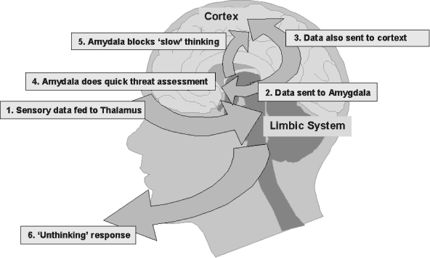
6. Understand more about the amygdala (uh.mig.duh.luh) - is the part of the brain responsible for this reaction. When a person feels stressed or afraid, the amygdala releases stress hormones that prepare the body to fight the threat or flee from the danger. Common emotions that trigger this response include fear, anger, anxiety, and aggression. Is your behaviour triggering their amygdalas or yours?
Pru’s – therapeutic approach

Slide 96
30 Second Response
In – acknowledge behaviour, explain why it is not helpful.
Explain how the child can put it right.
Explaining any more time will be made up in their own time.
Walk away
Ignore secondary behaviours
Clean slate – no grudges

Slide 97
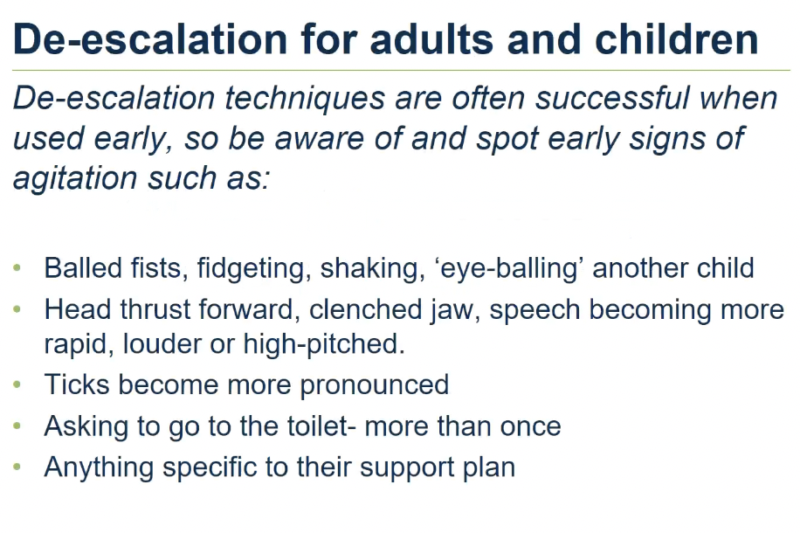


Slide 98
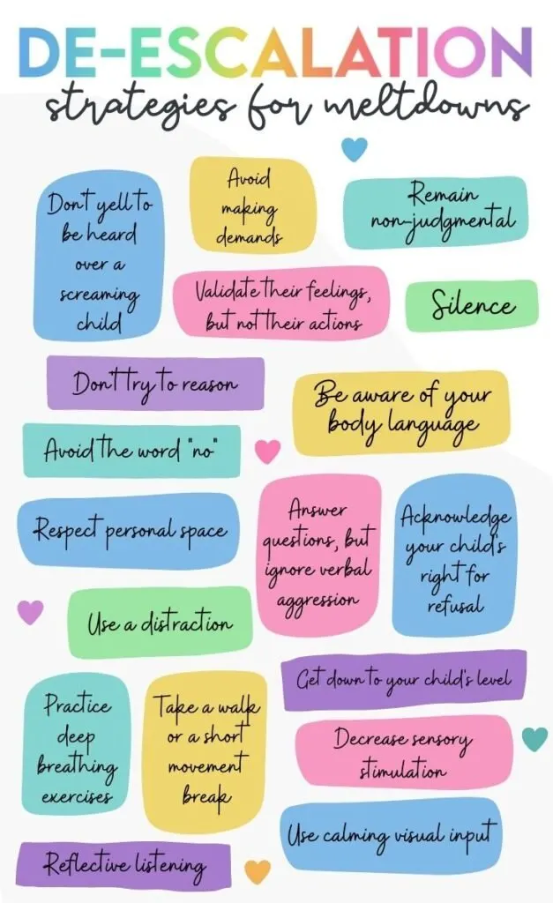

Slide 99
Back at the Ranch - Policy Writing
Challenging Children
Removal?
Sanctions?
De-Escalation
Routine/pay back

Slide 100
Ofsted Q’s and A’s
What steps have been taken to improve pupils behaviour and learning?
Visible staffing
Communicating expectations
Maximum learning time
Learning behaviours/attitudes
Pupil involvement

Slide 101
Ofsted Q’s and A’s
How do you manage pupils with challenging behaviour?
Policy
Staff training
SLT back up
Relationships
Consistency
4. Whole school language
5. De-escalation

Slide 102
Why have you graded behaviour and attitudes as exemplary?
Whole school culture
Policy consistently applied
Routines
Behaviour curriculum
Strategies for challenging children

Slide 103
Session 5
Preparing for Accountability
Notes:
Session 2 will look at the roles and responsibilities of subject leaders.

Slide 104
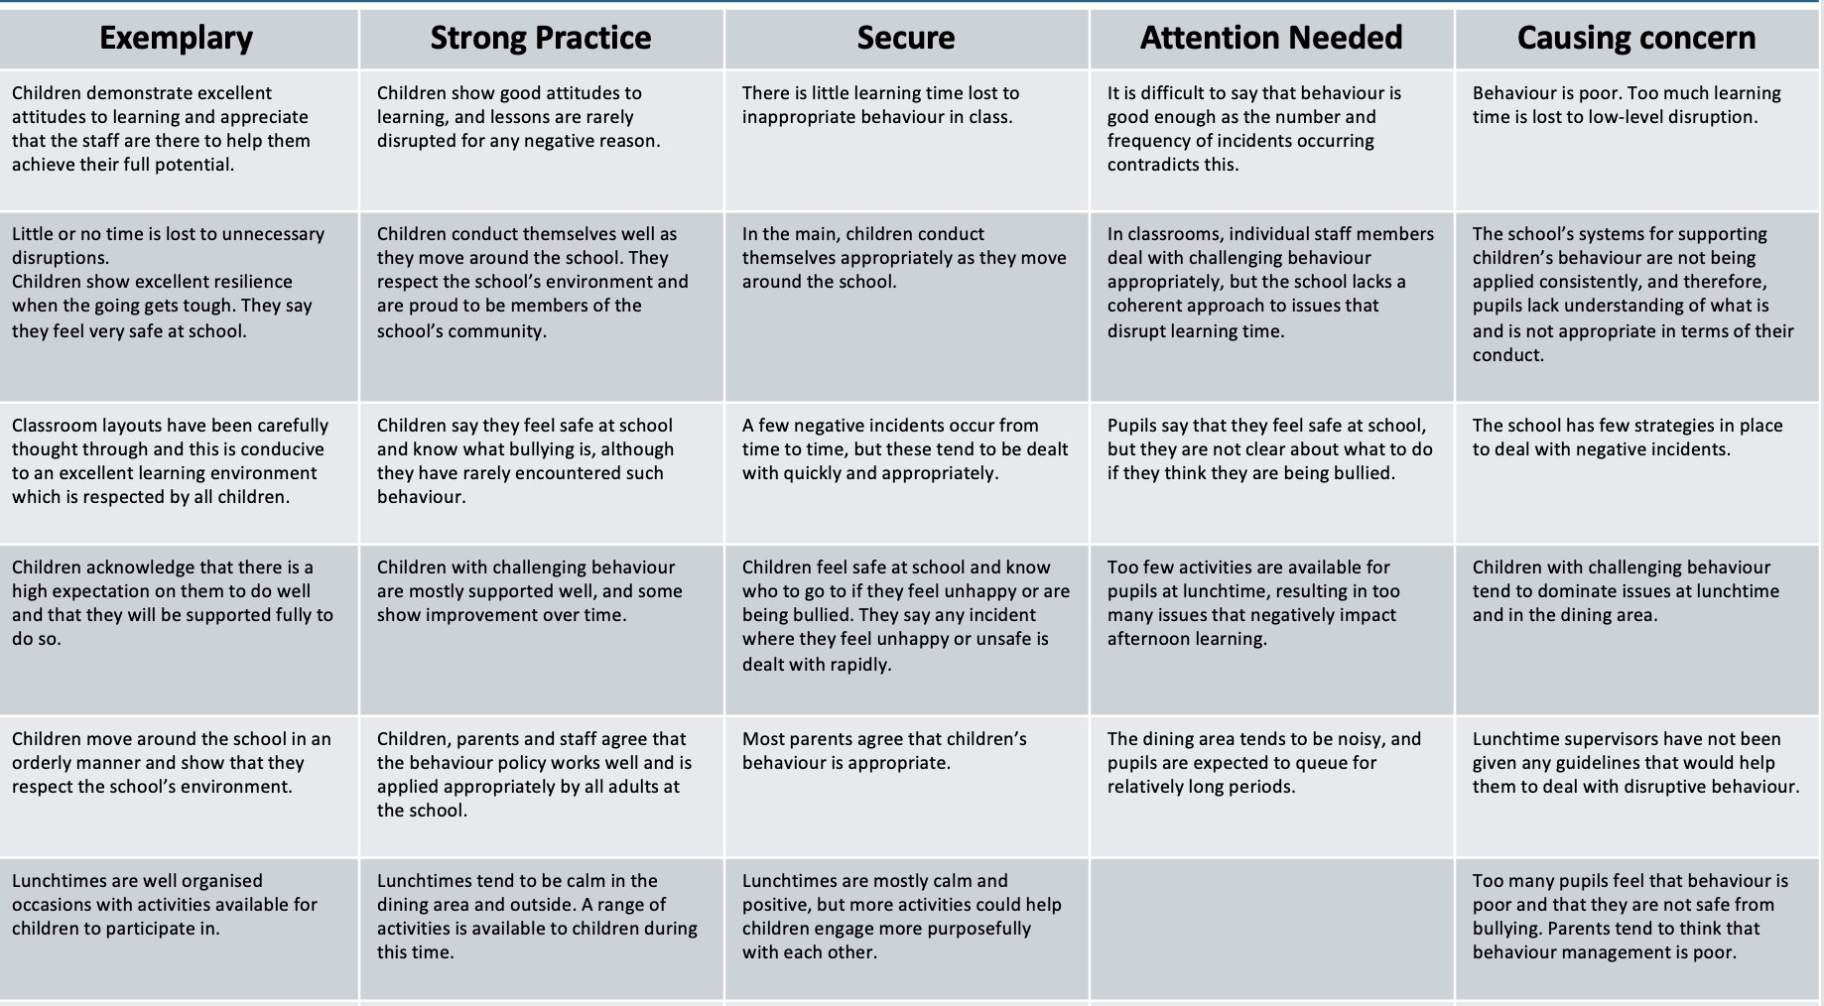

Slide 105
Ofsted Q’s and A’s
How good is behaviour in your school?
Policy
Culture
Day to Day
Consistency
4. Challenging children

Slide 106
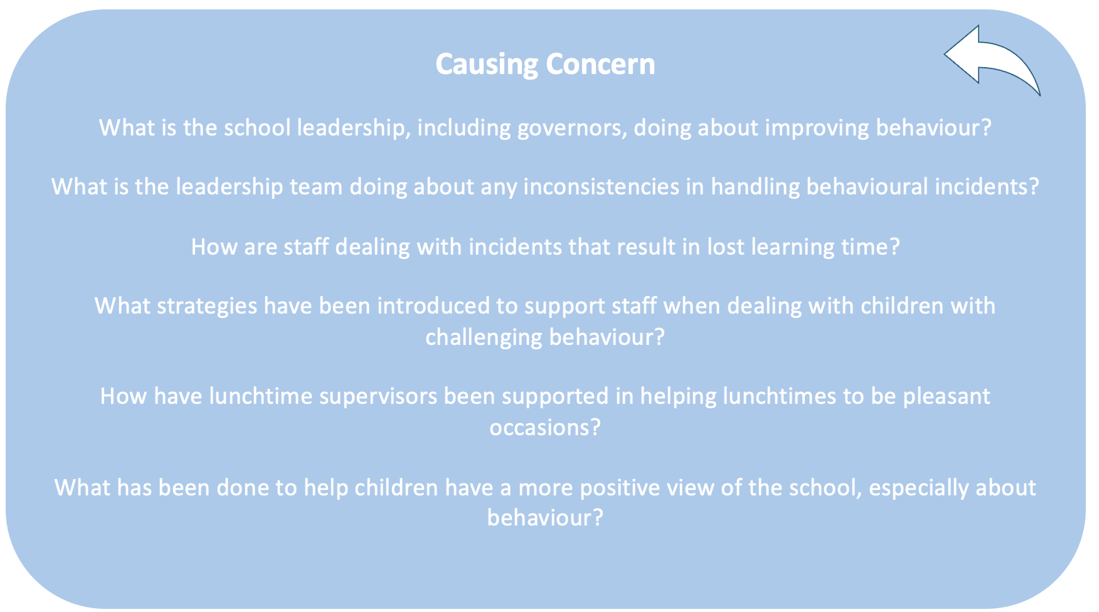

Slide 107
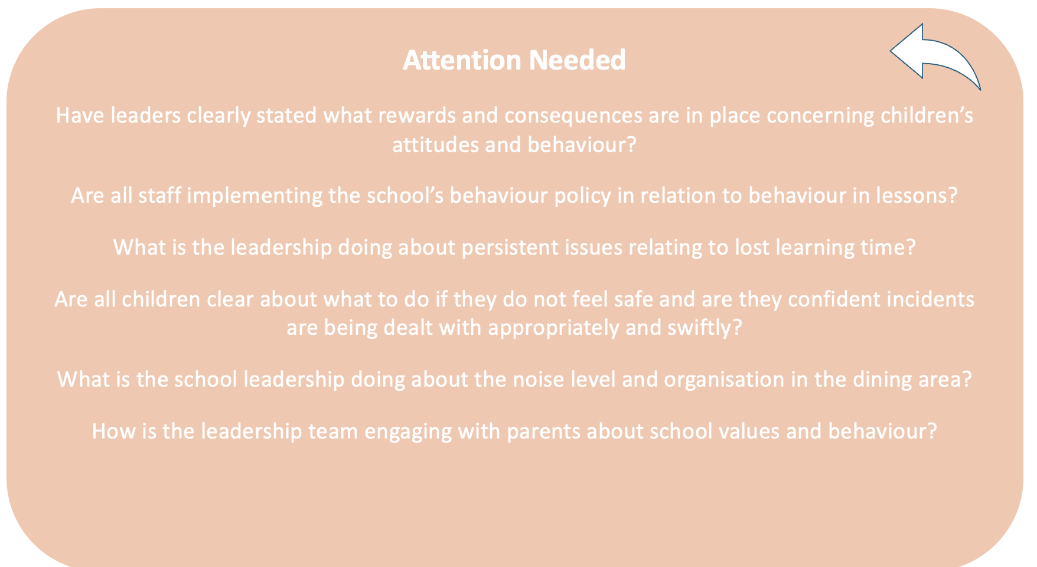

Slide 108
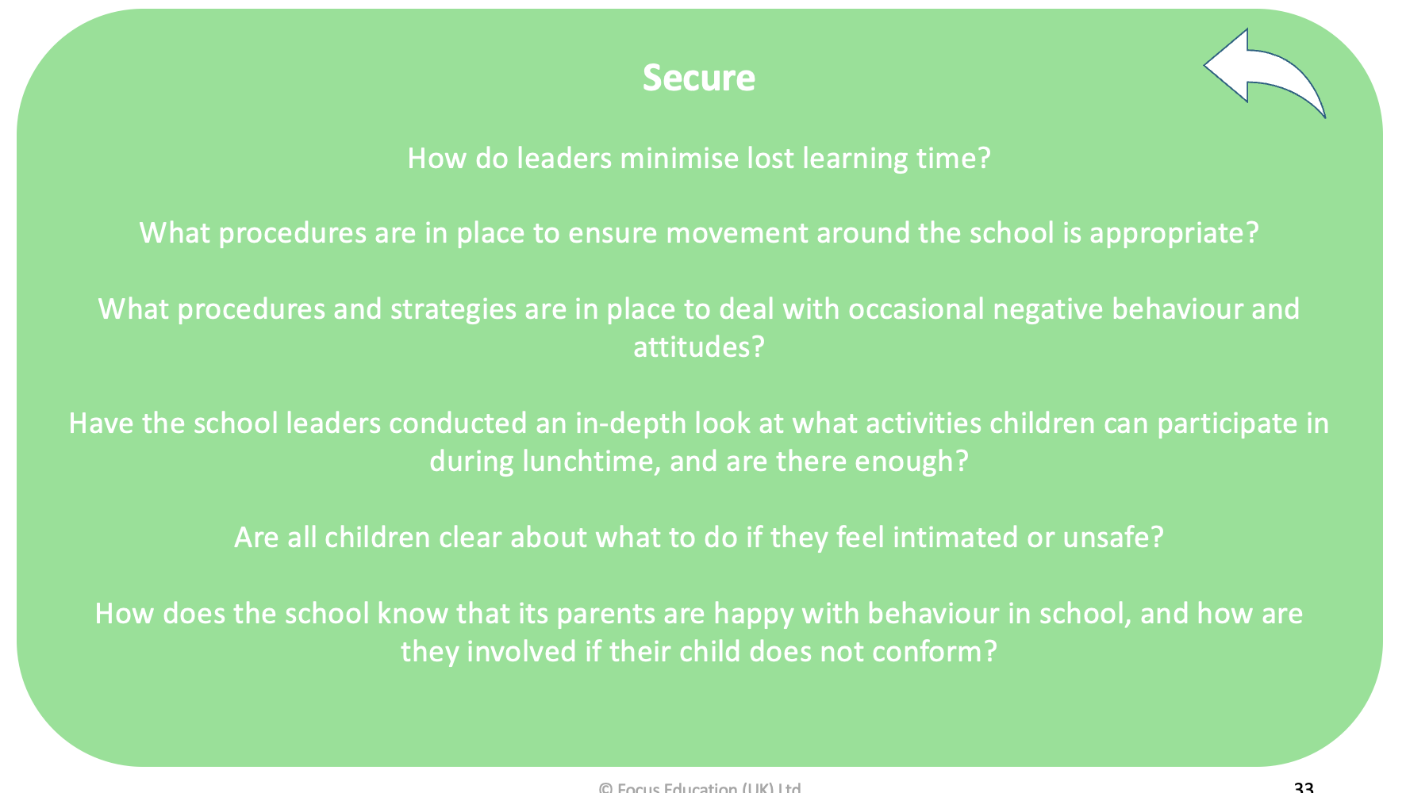

Slide 109
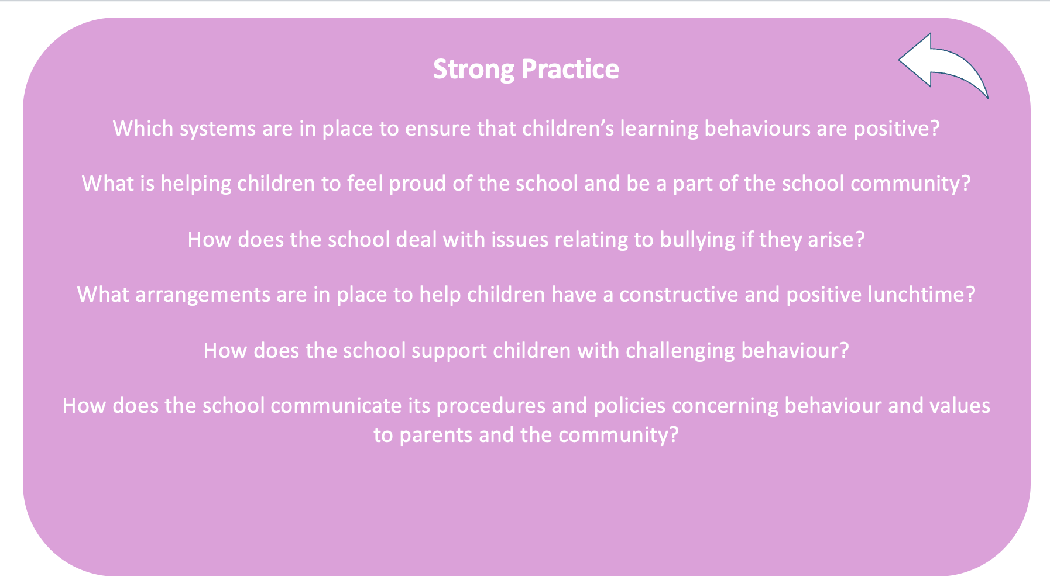

Slide 110
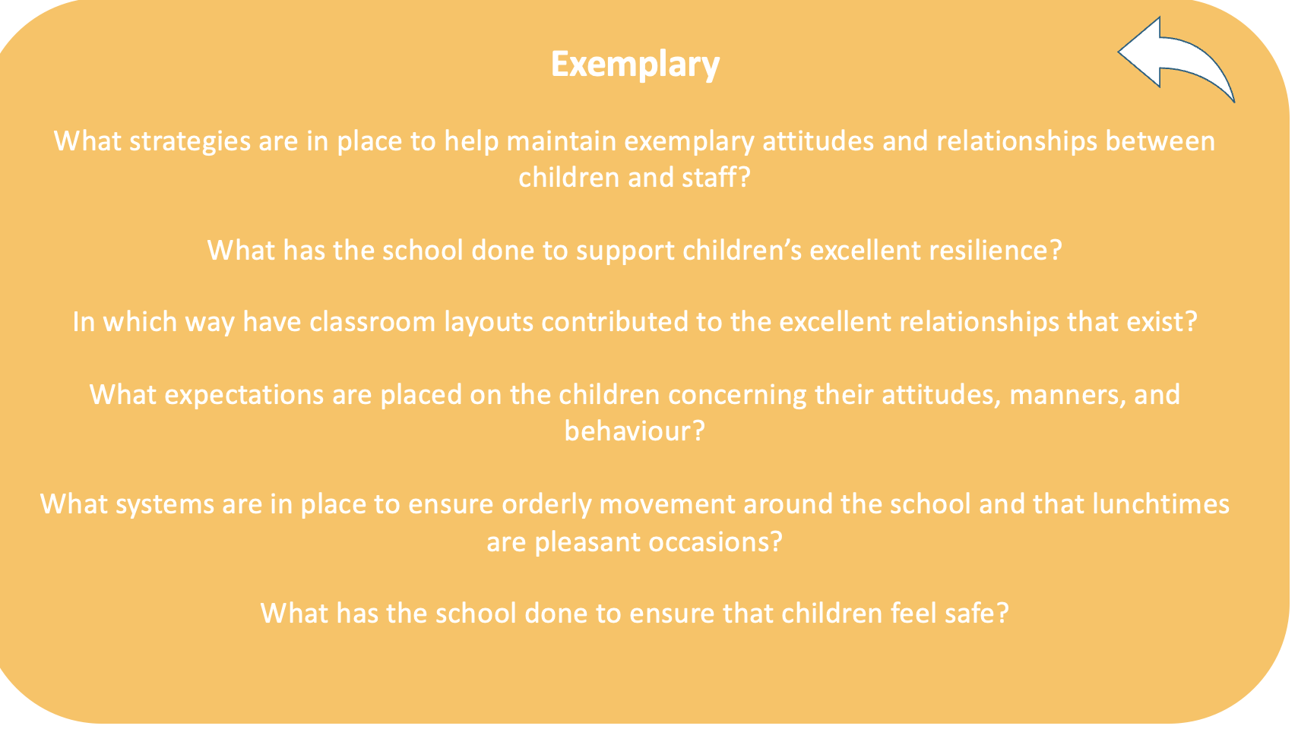

Slide 111
Common Inspection Pitfalls

Slide 112
Ofsted Research
Expectations – teachers given a list of who would bloom…and they did (Rosenthal and Jacobsen) Expectations have been found to be related to ethnicity, gender and background. Know your groups, ambitious curriculum
Attendance and attainment link
Behaviour and attainment – maximising time on task, minimising bullying, disciplined environment. Whole school behaviour policy - in school behaviour but behaviours outside of school as well e.g social media, school culture, leadership and pupil teacher behaviours.
Consistency…fairness 2017 DfE study – visible school leaders, expectations communicated, consistency, staff and parental commitment, leaders supporting staff, attention to detail. Exclusions last resort.. Impact on child
Bullying and discrimination – particularly affect pupils with affected characteristics. No evidence that bullying has negative impact on attainment. Schools DO have an impact on bullying. Class size is not a factor. Bullying can be linked to school and classoom culture.
How do you ensure behaviour is conducive to learning?

Slide 113
Ofsted Q’s and A’s
How are you developing ‘character’ and personal skills such as resilience?
Expectations
Attendance
Behaviour
Consistency
Bullying and discrimination

Slide 114
Common Inspection Pitfalls

Slide 115
Inspectors will hold discussions with pupils and staff to collate evidence concerning all aspects of pupils’ behaviour. Inspectors will select the staff who are likely to be most affected by challenging behaviour, e.g. NQTs, to assess the support your school provides.
Pupils chosen for interviews will come from a variety of backgrounds, providing a range of evidence concerning your school’s approach to behaviour. If any pupils have been referred to the LA, the experience of these pupils will be evaluated – a small sample will be investigated to analyse the thoroughness of follow-up procedures.
Pupils with SEND, LAC, pupils with medical needs and pupils with mental health needs will also be sampled to investigate how your school works alongside multi-agency groups, to establish whether pupils are receiving effective support. Inspectors will also check whether you consistently follow the Equality Act 2010 and the SEND code of practice.

Slide 116
Common Inspection Pitfalls

Slide 117

Pupils and staff will be interviewed regarding their general opinions on the school environment, safeguarding, behaviour and discipline, and bullying. Following these interviews, inspectors will discuss the findings with school leaders.
What do children, parents and staff say about behaviour?

Slide 118
Common Inspection Pitfalls

Slide 119
What will they do…
Observing pupils’ behaviour throughout the day looking for how consistently the behaviour policy is applied.
Observing pupils’ behaviour during break and lunch times, in between classes, at before- and after-school clubs, and in their engagement with staff – Consistency – non negotiables
Assessing the punctuality of pupils arriving at school and at lessons. Observing whether pupils display good manners and respect towards each other and members of staff, and whether they take pride both in themselves and the school. Consistency – non negotiables

Slide 120
Common Inspection Pitfalls

Slide 121
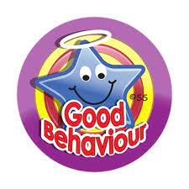
Behaviour Strategy 2022
1. Create a positive behaviour culture
2. Teach pupils what ‘good’ behaviour looks like
3. Proactively support all pupils to meet the behaviour standard
4. Respond predictably, promptly and assertively to misbehaviour
5. How to support pupils following a sanction
What actions have you taken in response to the behaviour strategy?

Slide 122
Common Inspection Pitfalls

Slide 123
Attendance and Punctuality
Published data, plus schools’ own data so far for this year – trends v blips?
Groups?
Impact of school’s initiatives and involvement of EWO etc.
Observe entrance/s after the start of school – what happens to any late arrivals? Documentation? Policies? Any implications for safety?
Time between lessons – is punctuality good between lessons so no time is wasted?
How has the pandemic affected the school? How did you achieve best possible attendance? March 2020 to March 2021 will not form part of any judgement.
How do you ensure attendance is in line with national averages?
How do you support disadvantaged children to improve their attendance?

Slide 124
Ofsted Q’s and A’s
What are the attendance and persistent absence figures for the current cohort of pupils? (By group)
Data analysis – key points
Monitoring
Partnership with Parents
Working with other agencies
Positive school environment

Slide 125
Common Inspection Pitfalls

Slide 126
Bullying
Policies and practice: does evidence (including views of stakeholders) match school policy and self-evaluation?
Records – any trends or apparent issues?
Pupil awareness, linked to SMSCD?
Impact of PSHE and e-safety lessons?
Consistency, checking back?
Governance (L&M)?
What is your approach to bullying?
What do you know about bullying in your school – trends?
Have you recognised/identified potentially vulnerable pupils?

Slide 127
Ofsted Q’s and A’s
How does the school assist pupils in combatting harassment and bullying?
Pupil voice
Dealing with incidents
Zero tolerace – caution!
Monitoring
Bullying – preventative curriculum

Slide 128
Common Inspection Pitfalls

Slide 129
Harmful Sexual Behaviour
Following Ofsted's review of sexual abuse in schools and colleges Ofsted has added a new section on harmful sexual behaviour. Harmful sexual behaviour includes sexual harassment, online sexual abuse, sexual violence and sexualised language.
Ofsted will consider how you address it in your school:
Inspectors will consider how you handle allegations and instances.
They will also check that: Policy/Systems – Staff Training/Challenge -- Curriculum
You have appropriate school-wide policies and sanctions in place
Your policies are reflected in your curriculum RSE
Your staff have appropriate knowledge of part 5 of the government’s ‘Keeping Children Safe In Education’ guidance
You support all pupils to report concerns about harmful sexual behaviour freely
Your school takes concerns seriously and deals with them swiftly and appropriately, and pupils are confident this is the case
You keep comprehensive records of all allegations
Alert to factors which make children more vulnerable

Slide 130
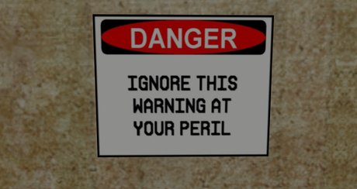
Harmful Sexualised Behaviours
Develop a culture where all kinds of sexual harassment are recognised and not tolerated
You should act as though sexual harassment and online sexual abuse are happening, even if there aren’t specific reports, and put in place a whole-school approach to address them.
You need to create an environment where staff model respectful and appropriate behaviour, where children and young people are clear about what is acceptable and unacceptable behaviour, and where they are confident to ask for help and support when they need it.
This should include:
A carefully sequenced RSHE curriculum, based on the Department for Education’s statutory guidance. This should include:
  Sexual harassment and sexual violence, including online
  Time for open discussion of topics that children and young people told Ofsted they find particularly difficult, such as consent and the sending of ‘nudes’

Slide 131
High-quality training for teachers delivering RSHE
Routine record-keeping and analysis of sexual harassment and sexual violence, including online, to identify patterns and intervene early to prevent abuse
A behavioural approach, including sanctions when appropriate, to reinforce a culture where sexual harassment and online sexual abuse are not tolerated
Working closely with LSPs in the area where the school or college is located so leaders are aware of the range of support available to children and young people who are victims or who perpetrate harmful sexual behaviour
Support for DSLs, such as protected time in timetables to engage with LSPs

Slide 132
Childnet International has an online safety PSHE toolkit with films and lesson plans exploring issues such as:
Cyber-bullying
Sexting
Peer pressure
Self-esteem
The National Society for the Prevention of Cruelty to Children (NSPCC) has a range of safeguarding teaching resources including lesson plans on personal safety, healthy relationships and online bullying. Its 'Speak out Stay safe' programme also includes interactive assemblies and workshops on safeguarding for pupils in KS1 and
The PSHE Association’s programme of study for Key Stages (KS) 1 to 5 also suggests what you should cover when teaching about relationships in personal, social, health and economic (PSHE) education.

Slide 133
Ofsted Q’s and A’s
How are you ensuring pupils are protected from harmful sexualized behaviour?
Policy
Systems/procedures
Staff training
Preventative curriculum
Case samples!

Slide 134
Common Inspection Pitfalls

Slide 135

You have not got a clear policy and agreement about adults and childrens behavior that is rigorously and consistently applied and monitored.

Slide 136

High profile launch - letter to parents explaining simplification
Rules not just in behaviour language, but woven through key interactions, on lanyards, prominent on website.
Don’t give up…
Behaviour takes time to change and a little longer to embed properly. It might get worse before it gets better.

Slide 137
Common Inspection Pitfalls

Slide 138

Recruitment is Essential
Job Specification
Emotionally mature, flexible enough to change, patient and kind.
Calm and build rapport with children.
Never drop expectations
Always in control of themselves before they try to control others

Slide 139
Common Inspection Pitfalls

Slide 140
Ofsted Q’s and A’s
Can you tell me about the way the school uses home-school links to imprive attendance, behaviour and performance?
Partnership with parents
Home school agreement
Raising concerns
Case sampling
Bullying – preventative curriculum

Slide 141
Common Inspection Pitfalls

Slide 142

Exclusion and Part-time
If you have pupils on part time timetables do not hide the fact!
Make sure you have your story straight.
Route to part time, length of time reduced timetable, route out to full time.

Slide 143
Ofsted Q’s and A’s
What are the current exclusion rates for the school by year group/year group? Do you have any pupils on part-time timetables?
Data analysis – key messages
Group analysis
Monitoring
Case sampling
Bullying – preventative curriculum

Slide 144
Ofsted Q’s and A’s
How and where does the school monitor and evaluate pupils’ preparation for life in modern Britain?
Subject leaders
Assembly/collective worship
Behaviour records
Feedback

Slide 145

30 Day Challenge

Slide 146

30 Day Pledges
Meet and greet
Use positive notes
Recognition boards
Simplify Rules
Refuse to shout
First attention to those doing the right thing
Take fame out of being badly behaved
Recognise and praise behaviour that goes over and above.
30 second interventions
Have some scripts ready

Slide 147
Why have you graded behaviour and attitudes as exemplary?
Whole school culture
Policy consistently applied
Routines
Behaviour curriculum
Strategies for challenging children

Slide 148
We don’t get to decide if we have challenging behaviour in our classrooms. We do get to choose how we respond. Tomlinson
Queries about course resources – info@helenyoungman.co.uk
Contact Helen directly – helenyoungman73@gmail.com
Notes:
ny c

