Slide 1
Getting the most from FundEd
Richard Manville
Founder and MD – Community Inspired

Slide 2
FundEd - for all your needs
Get started
Find a grant
Build a strategy
Access support
Get inspiration
Save Time
Develop NEW skills

Slide 3
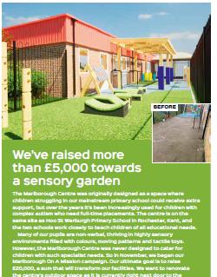
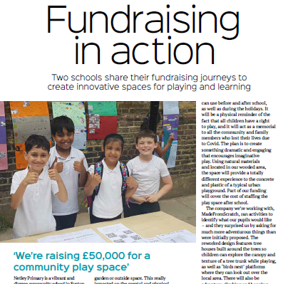
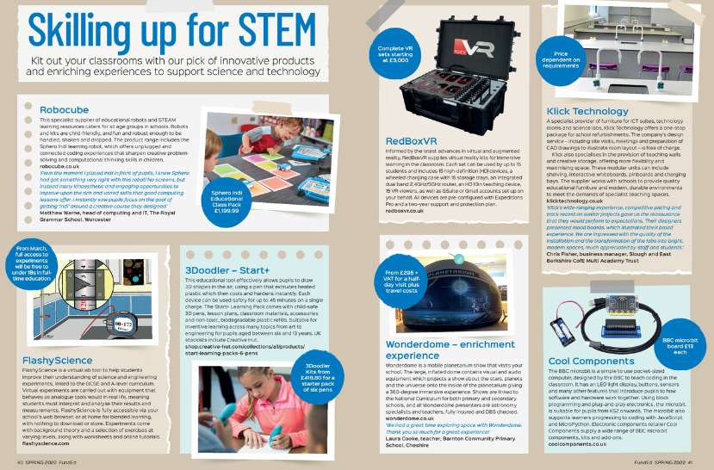
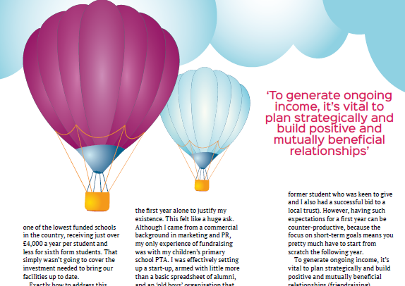
Inspire and Inform

Slide 4
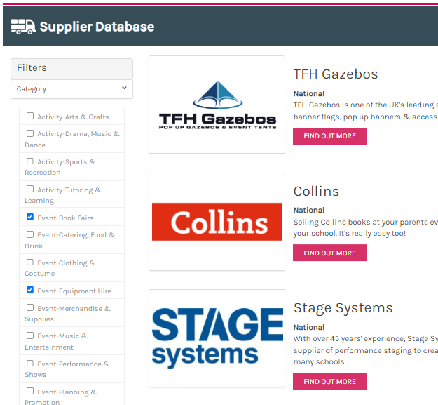

Slide 6
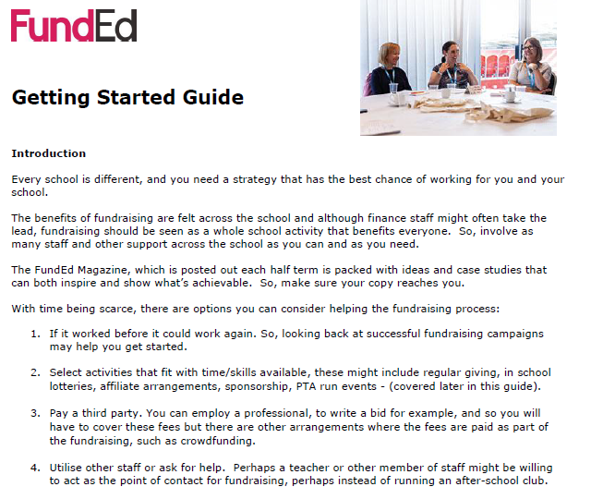
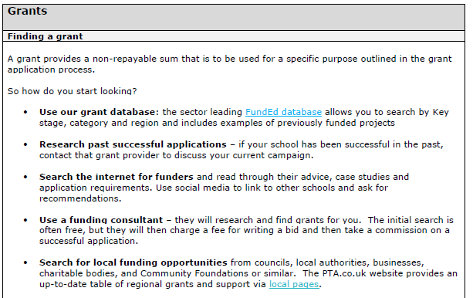
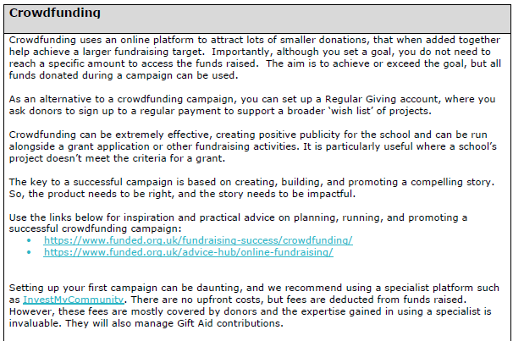
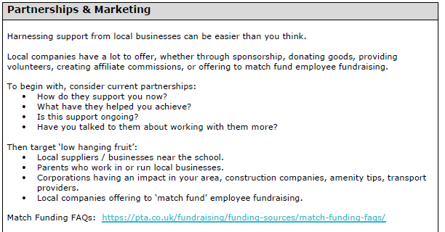

Slide 7
Every school is unique
Size, location, situation, levels of support, available resources.
Schools need to use fundraising activities that work for them in their unique situation and for what they are buying.
FundEd can help you find a strategy that will work for you.

Slide 8
Educate & Support

Slide 9
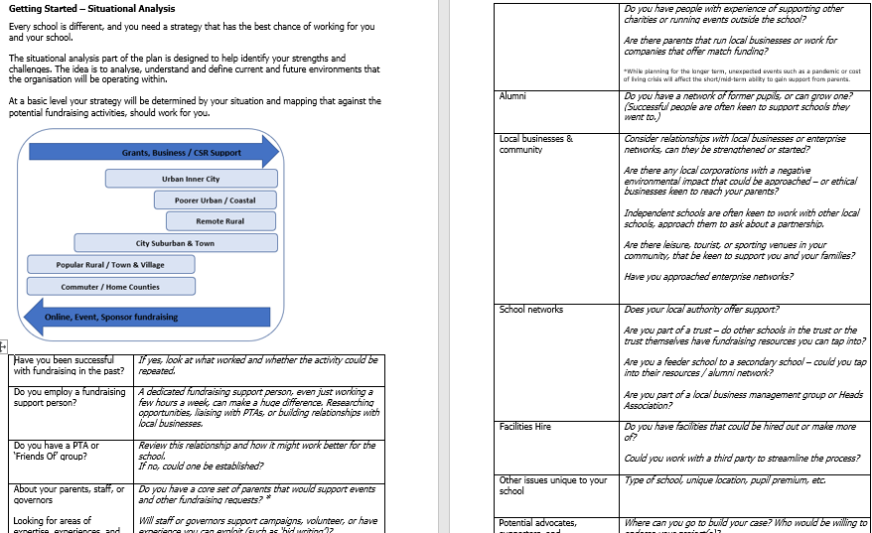
FundEd Support Framework
1. Strategy Support

Slide 10
The strategy work will help you focus in on the fundraising that could work for you

Slide 11
Things to consider
If it worked before it could work again
Research previous successful bids
Paying a third party
Ask for help & PTAs
Link up with a larger school or group of schools
Select activities that fit with time/skills available

Slide 12
Fundraising Activity Fit

Slide 13
Finding a grant

Slide 15
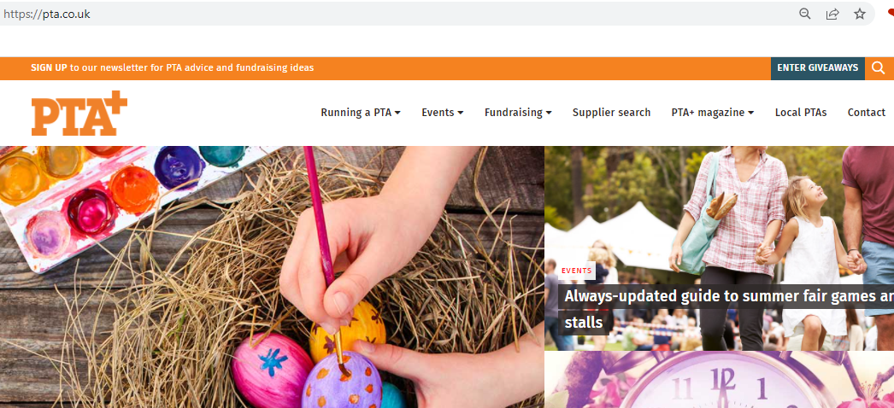
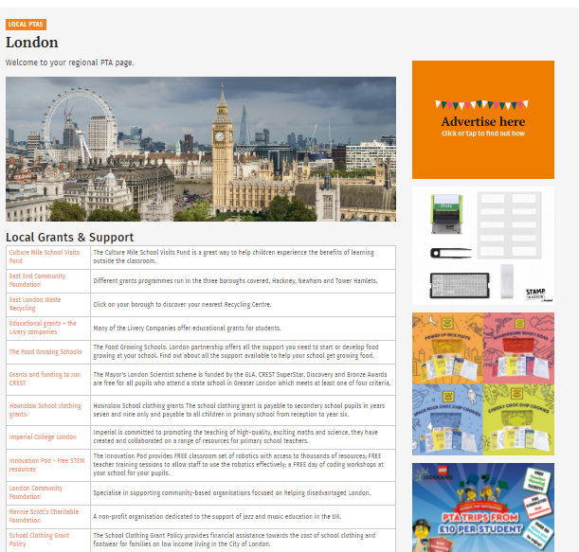
Local and regional grants

Slide 16
Next Steps
Once you find a grant:
Confirm that you fit the criteria.
Check the deadlines for application carefully.
Contact the grant provider, if possible, to discuss your project.
Research other successful school bids
Also……
Ask for help – you might find a supportive parent, governor, or another member of staff with experience of writing bids or applying for grants.

Slide 18
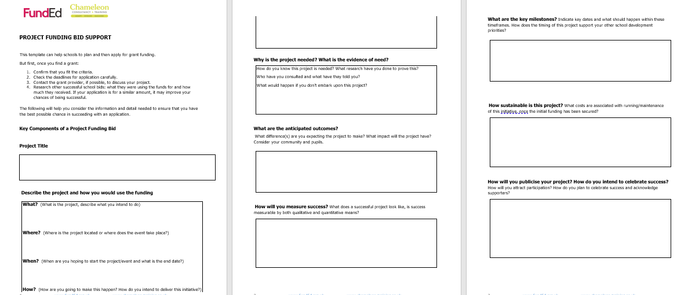
FundEd Support Framework 2. Bid Writing Support

Slide 19
Online Fundraising

Slide 20
www.investmycommunity.com

Slide 21
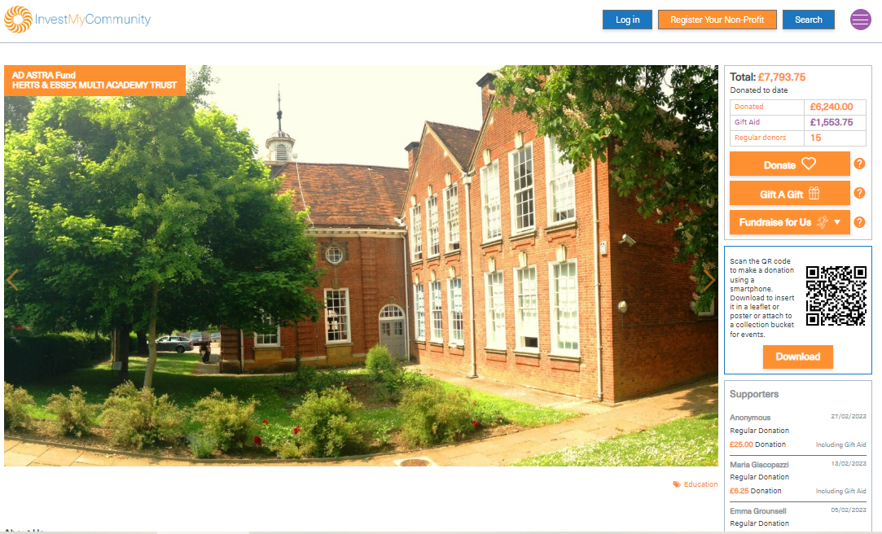
Regular Giving

Slide 22
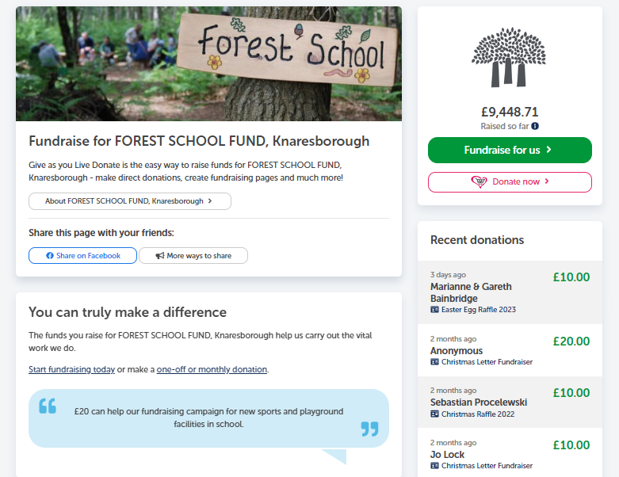
Fundraising Pages

Slide 23
Businesses Support
Many businesses want to work with schools – they just don’t always know how, or what type of support schools require.
Target ‘low hanging fruit’:
Local suppliers / businesses
Parents who work in or run local businesses
Corporations having an impact in your area
BE BOLD!
Contact a decision maker and outline your campaigns
Show that you offer good value for money
Give them options
Demonstrate impact!

Slide 24
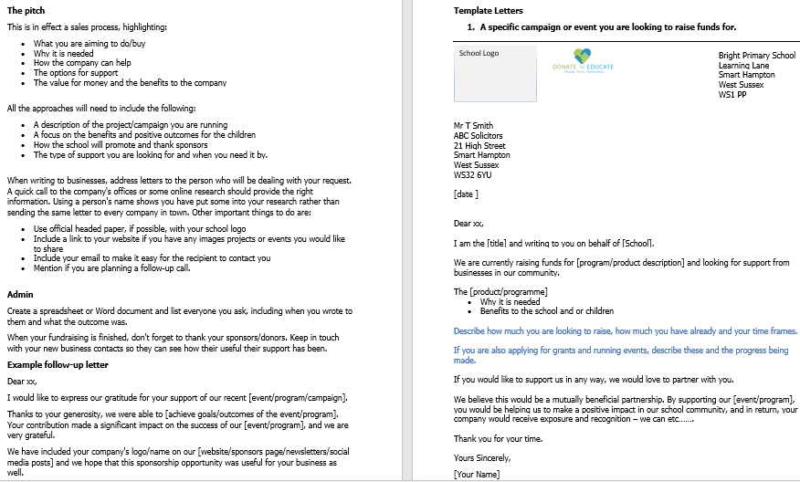
FundEd Support Framework
3. Business Sponsorship Support

Slide 25
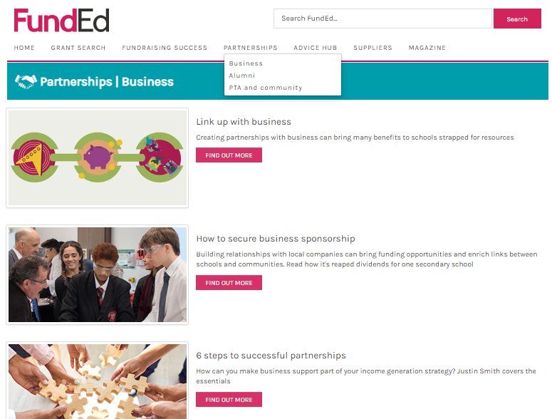

Slide 26
Alumni & Past Pupils
New supporter base
Successful peoples remember their schools with fondness
Work with other schools

Slide 27
PTA or Friends Groups
PTAs can:
Support and help run school led campaigns and events
Develop community partnerships
Help engage ‘hard to reach’ parents
Audit parents for useful skill sets
Contact and liaise with potential suppliers
Help create memorable, high profile events

Slide 28
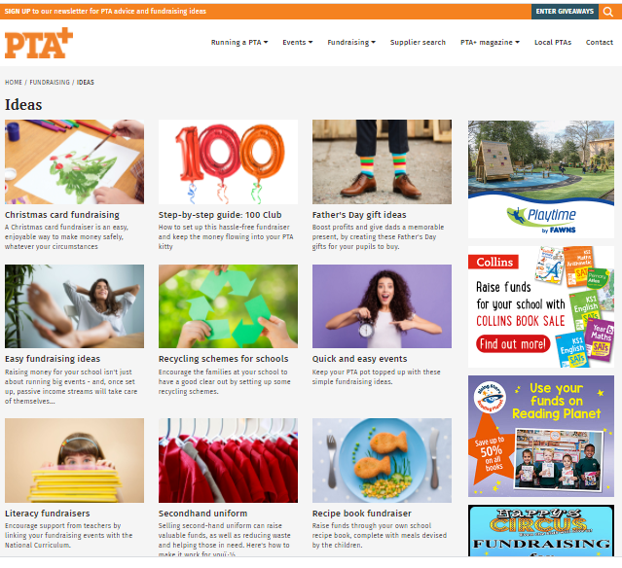
Inspire and Inform
Notes:
PTA.co.uk

Slide 29
Event fundraising
Music festival
Colour run
Zorbing at a summer fair
Open air theatre

Slide 30
General Fundraising
Printed products - Popular examples include: Tea towels, Cook Books, Leavers Gifts, Mugs, Calendars & Christmas Cards.
Toys and Merchandise – these can be sold at events and used as raffle or competition prizes.
Recycling
Setting up a lottery is easy to manage and can generate repeating income.
Shopping affiliate or reward schemes

Slide 31
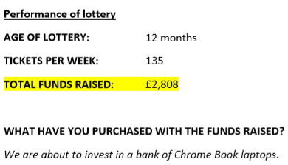
Case Study
Chase Terrace Community College

Slide 33
Fundraising Support Staff
The benefits of employing a school Fundraising Support Staff
What does the role of fundraiser entail
How to find a fundraiser
Options – volunteer, part time, full time

Slide 34
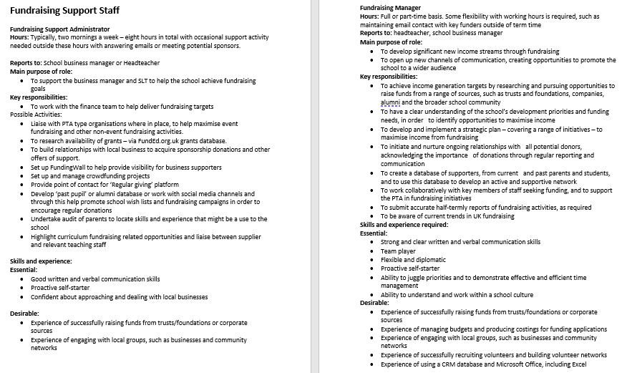

Slide 35
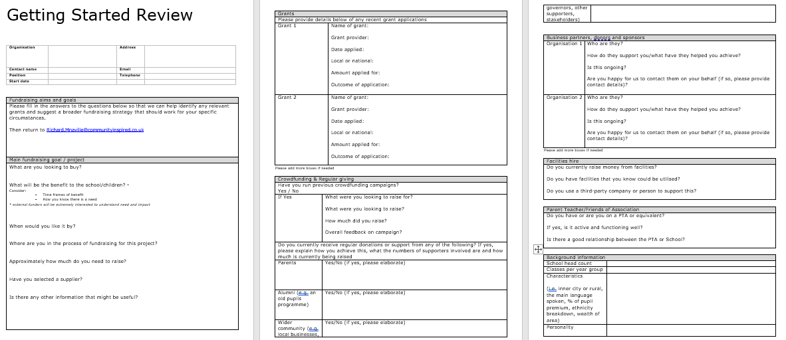
FundEd – ongoing support
ask@funded.org.uk

