Slide 2
EPHA – June 2023
Gareth Honeyford – ECC
Ian Fisher - ECC
Natalie Banthorpe – Venn Maths Hub

Slide 3

Essex Year of Reading – Successes
Multiple cross council initiatives delivered including:
Library card for every child (150K cards delivered)
Large range of author visits including Michael Rosen (1000 children at MR event)
Parent ambassadors in conjunction with ACL (2 Ambassadors, 60 volunteers, 600 parents onto courses etc),
Dementia/memory cafes alongside library children’s events
Literacy corner in every library (74 libraries)
Year of Reading app including stories, teaching materials and signposts to other resources
Intergenerational poetry publication
Keeping it REAL/Phonological awareness in Early Years

Slide 4
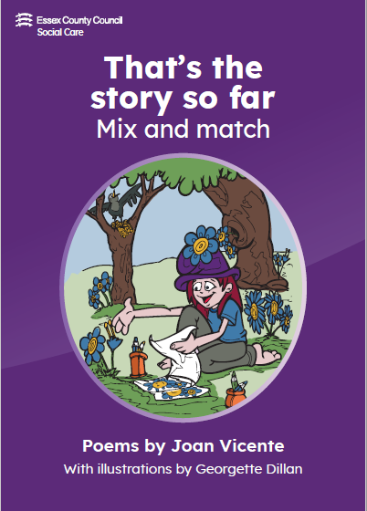


Not just one book….
Notes:
Amazingly the YoR has seen the publication of 3 books (or four if you include our support for ‘New House for Little Mouse)
Firstly we have Joan’s poetry book – Joan was a poet and in later life developed Alzheimer’s, now living in an Essex care home. She wanted to publish her final poetry collection and YoR supported this both in paper and on the App.
The Year of Reading supported the publishing of the works of Children in Care.
And finally, hot off the press - seeing the light of day for the first time today - we have published Essex Reads: an anthology celebrating the YoR

Slide 5

Essex Year of Reading – Teacher CPD Impact
Extensive programme of teacher CPD:
Reading fluency – 4 trainers trained, Year 1, 96 schools trained so far impacting approx. 600 pupils and will be ongoing (2 more cohorts of teachers will be trained by close of YoR)
KS2 – average comprehension age increase was 2 years and 2 months, average fluency age increase was 1 year 2 months
KS3 – average comprehension age increase was 1 year and 1 month, average fluency age increase was 10 months

Slide 6

Legacy and looking forward
New partnerships well established (Libraries, Schools, ACL, Adult social care, publishers, authors…)
Ongoing teacher CPD – Primary and EY
Trained teachers continuing to work with targeted pupils
Library cards at point of school offer
Ongoing focus on love of reading
Additional focus on numbers…Numbers are the new words!
Essex.yearofreading@essex.gov.uk

Slide 7
Why a Year of Numbers?

Slide 8

The problem
The KS2 and KS4 grade gap for disadvantaged children in Essex is wider than the national average.¹
  In Early Years, Essex is marginally better than the national average – in 2019 the Essex gap was 4.5 months compared with 4.6 months as the national average
  For KS2, the Essex gap shows children finishing 10.1 months behind their non-disadvantaged peers. This is 0.8 months wider than the national average of 9.3 months
  The KS4 gap in Essex stood at 19.8 months, compared with the national average of 18.1 months
Data for 2019 shows that of the 36% of pupils do not achieve grade four or higher in Maths and English (see comment). Within this, 58% of disadvantaged pupils did not achieve this compared to 30% of non-disadvantaged pupils.
All the research shows that low adult numeracy increases vulnerability to debt, unemployment, fraud, even poor health and the poor outcomes continue on and on.²
Low adult numeracy is estimated to cost as much as 25 billion pounds in lost earnings for everybody across the across the country, every year.²
* 1 EPI Report
*2 Sam Simms, National Numeracy
2019 data is newest available, slide will be updated when new data published.

Slide 9
The Research Shows…
Children who enter school with high levels of numeracy skills tend to maintain this advantage*.
Early numeracy and mathematics achievement across development, predicts future financial success, the ability to make good decisions regarding oneself, and generally overall life success*.
Early numeracy is more complex than it appears simply because it involves many skills and engagement with parents and Early Years colleagues is critical*.
Parents being positive about mathematics has the biggest impact of pupils’ successes *²
A lot of educators lack confidence with maths, so we need to pay much more attention to supporting them to boost their own competence and skills.*³
Confidence is the key to improving skills *³
*University of Loughborough, *² Charlie Stripp from (MEI/NCETM) *³ Sam Sims, (National Numeracy)

Slide 10

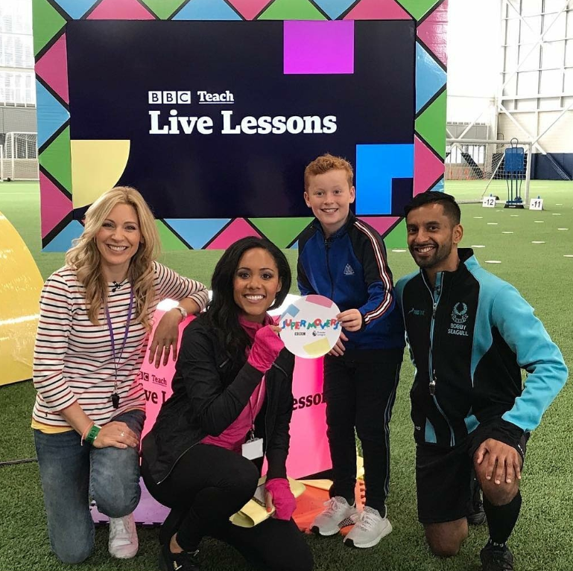
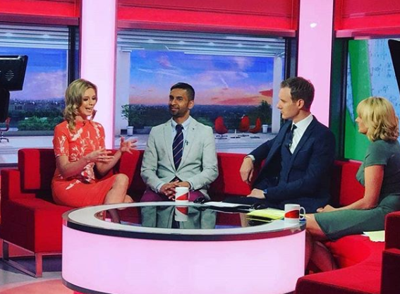




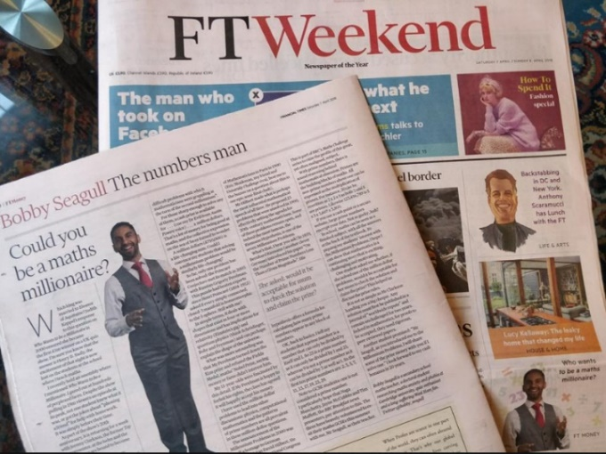
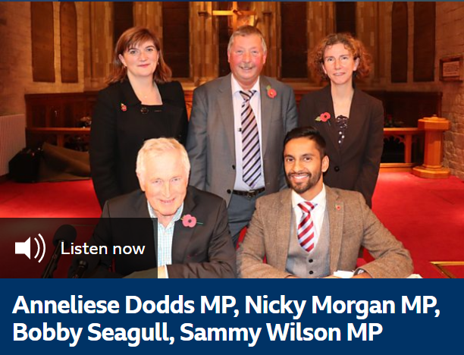


My Mission to Make The Nation Enjoy Numbers

Slide 11
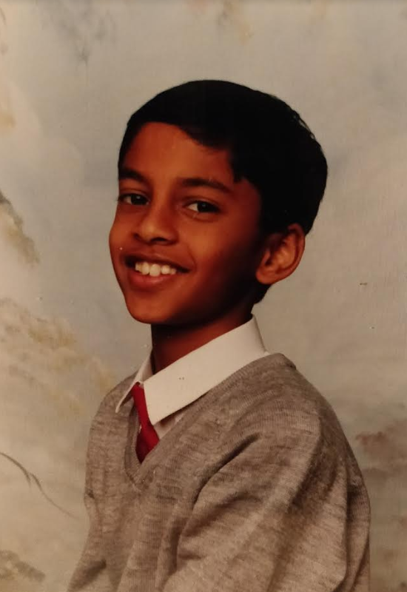
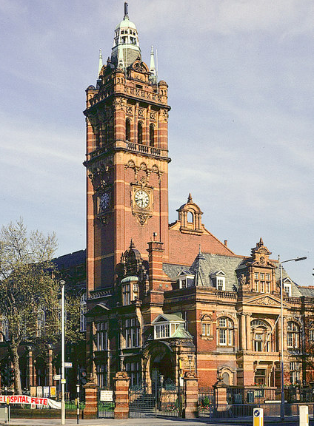
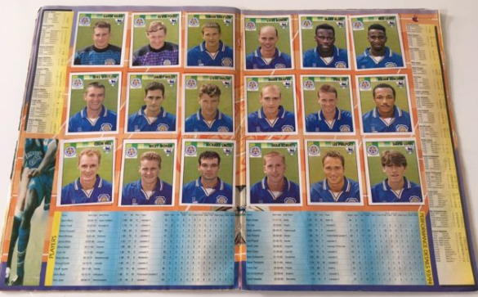
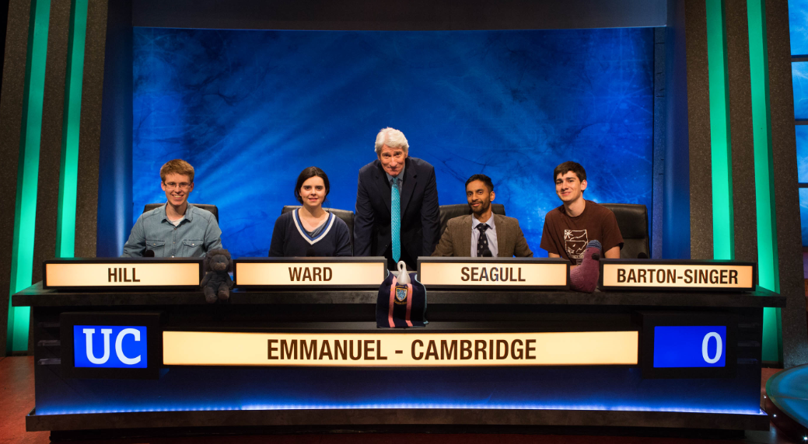

Slide 12
What’s already planned?

Slide 13

Maths Populism
Numeracy and Maths Skills
Teachers
TAs
Parents
Multiply
Speakers
Events
Trails
All Sectors
ACL
Parent Ambassadors
Numeracy, Maths and Industry
Employers
Green industries
Financial services

Slide 14
What’s already happening?
Seconded teachers and CPD
Number stacks
EY working group
Multiply
Libraries
Country parks
Inter-generational activities
Virtual school
App Stuff
Educational Psychologists
Maths Hubs
Microsoft (Minecraft +)
MOD (RAF – Lego)
HSBC
LCEPs
Colchester Mercury outreach
Essex Music Service
Local ideas?

Slide 15
Questions & a question?

Slide 16
The Year of Numbers
Essex.yearofnumbers@essex.gov.uk
http://www.essexyearofnumbers.co.uk

