Slide 1
Essex Primary Headteachers Meeting
ECC Education Directorate
14th June
West Quadrant
Clare Kershaw
Director of Education

Slide 2

Today’s agenda
Policy updates
Essex Transformation 2030
LA Strategic Priorities 2023-2024
School Communications update
School Improvement and Traded Offer 2023-2024
SEMH Update

Slide 3

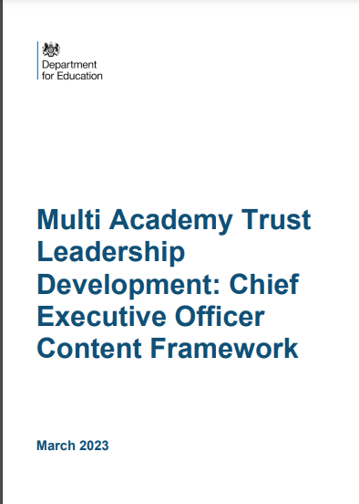
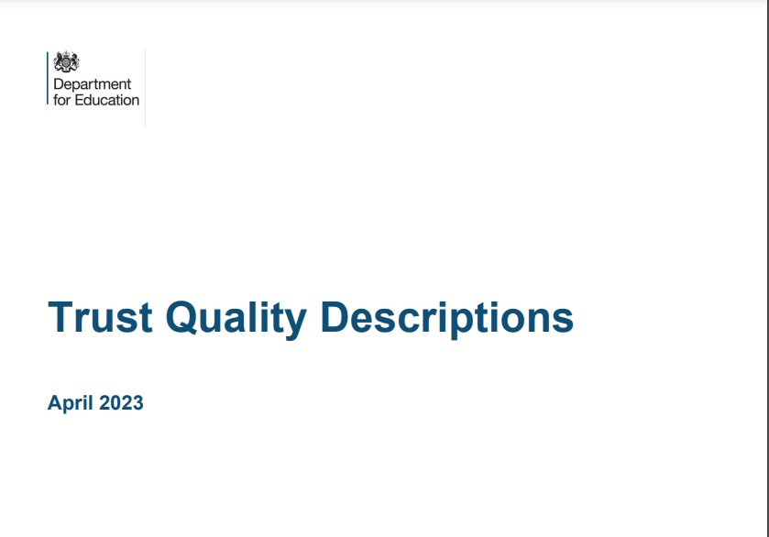

DfE Policy update – Trust Quality Descriptions & MAT Leadership Development: CEO Framework
https://www.gov.uk/government/publications/multi-academy-trust-leadership-development-ceo-content-framework
https://assets.publishing.service.gov.uk/government/uploads/system/uploads/attachment_data/file/1152301/Trust_Quality_Descriptions.pdf

Slide 4
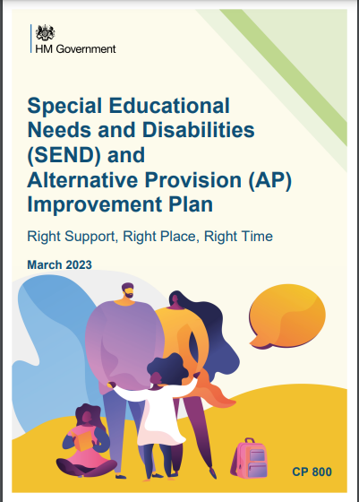
DfE Policy update – SEND and Alternative Provision Improvement Plan
https://assets.publishing.service.gov.uk/government/uploads/system/uploads/attachment_data/file/1139561/SEND_and_alternative_provision_improvement_plan.pdf

Slide 5

OfSTED inspections Update
Recently, Ofsted have announced changes to the inspection process– press release available here: Changes made to school inspections - GOV.UK (www.gov.uk)
Changes to inspection processes, a revised complaints procedure and new wellbeing investment from government, are part of a package of measures being announced following a wide-ranging debate about the impact of school inspections.
Revisions to school inspections will see inspectors return more quickly to schools graded inadequate where this is only due to ineffective safeguarding
Proposed changes to Ofsted’s complaints process will increase transparency and make it easier for schools to raise concerns.
The Department for Education (DfE) already funds the charity Education Support, to provide wellbeing help for school leaders, and that programme will now be doubled in size to support an additional 500 heads by March 2024. In the longer term, the DfE commits to further expand its mental health and wellbeing offer beyond March 2024.

Slide 6
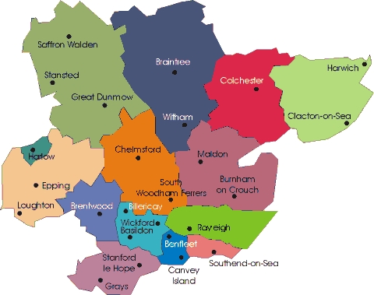
Essex Transformation 2030

Slide 7
Outcomes - Education
By 2030, ECC will be the ‘Champion of Children’, driving and enabling an inclusive, safe and equitable education system across Essex. We will have clearly defined partner roles and responsibilities across the whole education system, enabling our strategies in collaboration with all providers - from EY settings to Post 16 providers. By 2030, all young people in Essex will be prepared for adulthood and have equitable access to the employment and independence opportunities of the future. We will ensure feedback from our young people and families is constantly contributing to improved lived experience of our services. By 2030, we will deliver a high quality continuous professional development offer – promoting a workforce that is skilled, competent, diverse; one with the resilience and agility necessary to service the increasing demand and complexities of all children in our education settings, especially the most vulnerable. By 2030, we will ensure that the directorate is optimising all feasible technological developments - in terms of processes, systems and communication tools; with a clearly informed and defined corporate commitment, to enable the directorate to drive forward our core approach to inclusion, safety and equity in the education system.

Slide 8
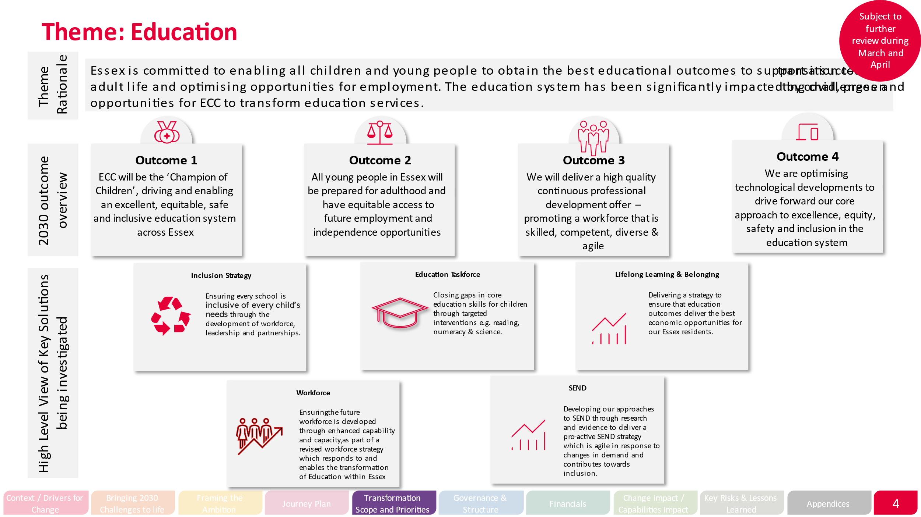

Slide 9
Equity and excellence- an inclusion strategy for Essex

Slide 10
The position (1)
    The need for inclusive, high-quality education in Essex is greater than ever.
    In 2022, our pupils’ overall progress and attainment was too low. In addition, there have been stark increases in pupils’ overall absence and persistent absence. The number of pupils being suspended or permanently excluded has risen significantly, as has the number of pupils being withdrawn from schools to be home educated. Concerns over pupils’ social, emotional, and mental health are rising, while the needs of pupils within our school communities are both increasing and becoming increasingly complex.
    Underpinning these headlines are the continuing socio-economic effects of the pandemic, real term reductions in education funding (that often disproportionately impact the most inclusive schools), increasing recruitment challenges, staffing shortages, and consequent rising pressure on school staff. Mental health and Social Care services continue to face unprecedented demand, while there are also significant rises in requests for SEND support, statutory assessment, and access to both Alternative Provision and Special School places.
    Although most Essex schools and their leaders are fully committed to supporting the inclusion and success of all pupils, many are finding the landscape an increasingly difficult one to navigate.

Slide 11
The position (2)
    The challenges of the current context are acknowledged locally and nationally, including in or by:
    the DfE SEND and alternative provision Green Paper
    the DfE SEND and alternative provision improvement plan
    the DfE Trust Quality Descriptions
    the DfE Multi Academy Trust Leadership Development: Chief Executive Officer Content Framework
    the Essex Education Taskforce
    the Headteachers’ ‘Roundtable’
    the DfE paper, Research into how local authorities are ensuring sufficient places and supporting vulnerable children
    The education system must work together, and work differently, to ensure inclusivity throughout schools and settings, prioritising compassion, kindness, hope, connection, and belonging for all stakeholders.
    Inclusion is a crucial priority for Essex County Council, and we are fully committed to working collaboratively with schools, trusts, dioceses, parents, the DFE and other local partners, using evidenced-informed inclusive practices, to support the success of all pupils. We will work in partnership to level-up educational outcomes across Essex and, by doing so, we will support the lifelong learning and belonging of our children and young people.

Slide 12
Our vision
    Our vision for Essex schools is that:
    positive, mutually respectful relationships underpin and support the inclusion of all pupils and their families, and promote equality and diversity
    the wellbeing of all members of school communities is well-supported
    all pupils enjoy school and have high levels of attendance
    all pupils are empowered and eager to participate in all aspects of school life
    an equitable, high-quality curriculum supports all pupils to achieve well, from their different starting points
    all pupils are well-supported to move on to appropriate next steps
    To achieve this vision, we need:
    an incisive understanding of school contexts and pupil cohorts that inform the development and implementation of inclusive practices
    inclusive practices that are grounded in, and influenced by, the views and experiences of stakeholders
    appropriate resources to support system-wide initiatives and improvements
    strategies to support inclusion that are appropriate and evidence-informed
    to provide access to high quality, evidence informed CPD
    to maintain a ‘spotlight’ on the outcomes for children and young people with SEND and/or who are disadvantaged
    to work collaboratively with schools, trusts, dioceses, parents, the DFE and other local partners

Slide 13
Alignment between the ECC vision for inclusion and the DfE Descriptions for High quality and Inclusive Education, taken from the Trust Quality Descriptions
Theme | Description | ECC link
Culture | Creates a culture in all its schools that is motivating and ambitious for all, including disadvantaged children and children with SEND, so that students can achieve their full potential. | a-k
Curriculum | Oversees the design and implementation of ambitious, broad, well-sequenced and knowledge-rich curricula in all of its schools. | e
Student outcomes | Achieves good outcomes for all its students by delivering education that is both high quality and inclusive. | e
Accessible to all | Operates fair access. Welcomes and effectively teaches disadvantaged children and children with SEND from their local areas. | j
Inclusive pastoral support | Supports students and schools to address issues so students can stay in mainstream school where possible. Supports students to re-join mainstream education when they have spent time in Alternative Provision. | a, b
Enrichment | Enables children to take part in sport, music and cultural opportunities that enrich the curricula and support children’s wider development. | d
Behaviour & attendance | Ensures its schools are places where all students attend regularly, are kept safe, feel calm and supported, and are able to actively participate and progress. | a, c
Destinations | Ensures all children leave its schools well prepared for the next stage of education, employment or training and prepared to become confident citizens. | f
Collaboration | Works collaboratively with schools, trusts, local authorities, dioceses, parents and other civic partners to ensure the delivery of statutory functions and acts in the wider interests of the local community. | k

Slide 14
Our commitments
    Essex County Council is committed to supporting schools to plan, implement, and review inclusion strategies that are evidence-informed and tailored to their cohorts and contexts.
    In addition, we will review and support:
      the extent to which positive relationships and children's* wellbeing is prioritised
      children’s* attendance and participation
      children’s* achievement and the extent to which they move-on to appropriate destinations
    *all children, with a spotlight on disadvantaged and SEND

Slide 15
What have we done so far?
    Developed a draft strategy, including:
      a position statement (with links to the local and national context)
      our vision for an inclusive system
      our response (commitments)
    Revised and updated the draft position, vision and commitments in collaboration with Andrew Smith and Andy Hodgkinson
    In conjunction with Marc Rowland, incorporated the Disadvantaged Strategy within the Inclusion Strategy
    Developed and piloted Inclusion Reviews (aligned to the vision)
    Currently aligning the Inclusion Framework to the vision

Slide 16
A word on inclusion reviews
  Development
    Developed form the original first section of the Ordinarily Available
    Phase 1 pilots completed during Autumn 2022
    Phase 2 pilots (revised on feedback from the initial pilots and grounded in: TPP; Ordinarily Available; Inclusion Framework; Multi-Schools Council; Disadvantage Strategy; SEND Strategy) completed during Spring 2023
    Phase 3 pilots (with further revisions and developed for different size schools) ongoing
    Schools that have been part of the pilots: Clacton Coastal Academy, Helena Romanes School, William de Ferrers, Chelmer Valley, Maltings Academy
      Review foci
    Culture, values, and ethos
    Pillar 1: relationships and wellbeing
    Pillar 2: attending and participating
    Pillar 3: achieving and moving-on
      Broader system join-up
    As well as being strongly inclusive in focus, it also tightly aligns to Ofsted’s Education Inspection Framework and the DfE Descriptions for High quality and Inclusive Education.

Slide 17
Bringing it together…
Equity and excellence for all
(with a spotlight on SEND and Disadvantage)
Relationships and
wellbeing
Attending and
participating
Understanding of
contexts and cohorts
Achieving and
moving-on
Enablers:
Inclusion Framework
Inclusion Reviews
Coordinated offer of support for schools
Directorate-driven delivery plans for each commitment
Vision
Ordinarily Available
TPP
Disadvantage Strategy

Slide 18

SCHOOL COMMUNICATIONS UPDATE
At the EPHA Executive meeting on 24 May it was agreed that:
  Internal ECC teams would be reminded about the protocol of including any generic all school wide communications via the weekly Monday director email, and not directly to schools
  EPHA and schools will work with the Local Authority to discuss examples with Shamsun Noor where this practice is not being followed

Slide 19
SCHOOL COMMUNICATIONS UPDATE (Contd.)
ECC Schools Communications will work with services to try and establish an internal calendar of key milestone asks of schools e.g. census returns, budget closure etc
This is with the purpose of trying to avoid other less critical asks of schools at the same time as statutory returns, as if multiple asks are made at the same time, this adds additional pressure onto schools and can mean that opportunities to participate in surveys etc are limited

Slide 20
School Improvement and Traded Offer 2023-2024

Slide 21
Overview – School Improvement services 2023-2024
ECC’s School Effectiveness team will be making changes to the way its school improvement service to schools will be offered from September 2023.
Maintained schools will continue to have a core offer of support provided to them through their School Effectiveness Partner. This core offer will continue to be linked to the level of support they receive. Additional support will also come through a core partnership model. There will also be the option to select additional support from a traded services menu.
Academies will no longer have access to a core support offer from September 2023. Academies will retain a named SEP for immediate contact purposes. School Improvement services will be available through the traded services menu. The core partnership model will retain some support that will be available to all Essex schools.
The Traded Offer to schools will retain prices that remain highly competitive.
ECC remains committed to providing a best-in-class service to all schools through its new bespoke offer.

Slide 22
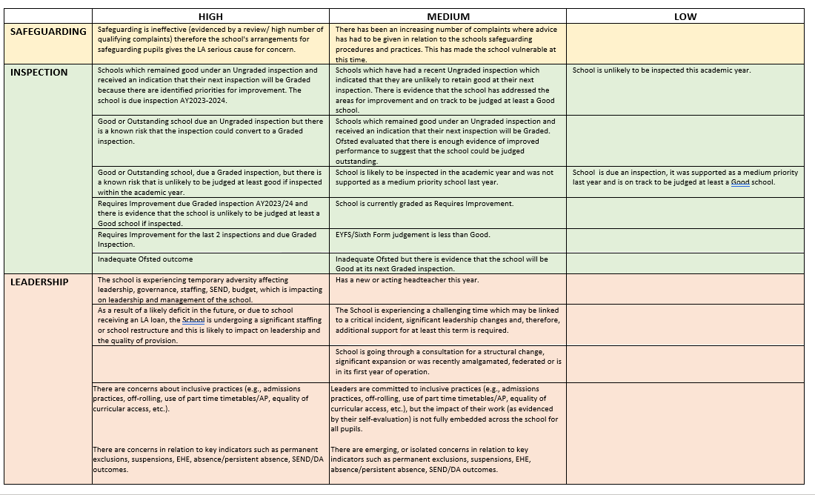
Prioritisation of maintained schools
All maintained schools will be allocated their core offer based on the level of prioritisation awarded to them.
Schools are currently familiar with this model and it has been communicated that this is the intended mechanism by which schools will continue to be prioritised.
Maintained schools will continue to be monitored through the Standards and Intervention Board for moderation of prioritisation as well as any decision making that may need to be taken if a school is causing significant concern.

Slide 23
Traded Offer
Schools will be able to access the school improvement services brochure and booking form via Schools Info Link which details the type of support available to schools and to governing bodies. Alternatively, schools may wish to speak to their named School Effectiveness Partner about any school improvement support they require.
Within the school improvement services brochure, schools will be able to browse the pen portraits of the school improvement team, which gives an overview of some of their key specialisms.
Also contained within the brochure is the detail of one off training dates and costs for some specific activity e.g. training support for teachers to effectively carry out statutory assessment processes.
Examples of some of the type of school improvement support available:
Headteacher performance management with/without a mid-year review
Bespoke reviews – E.g. Curriculum/RSE/Inclusion/Disadvantaged/Governance
Self-evaluation sustainable schools’ toolkit
Early Reading and Phonics
Middle and senior leadership development
Bespoke Governor training and support
Assessment and Moderation
Statutory assessment support (administration of KS1 and KS2 stat test, phonic screening check, KS1 & 2 assessment writing clinics, moderation health checks)
Sixth sense (Bespoke 6th Form support for schools and colleges)
Flying start (new headteacher support)
Data packages available to schools
N.B: All traded activities are inclusive of report-writing time and costs such as travel

Slide 24
Indicative Pricing Model
The model will allow all schools to benefit from an Early Bird discount model where days of support are purchased in advance of Friday 20th October 2023.
In addition to this, the traded model will have a further discount applied to prices linked to the number of days a school purchases.
All days purchased will have to be used within the academic year or they will be lost.
Early Bird Discount - 5% off package if this is purchased before 20th October 2023.
Packages
Any school purchasing more than 4 days support will automatically receive these at a discounted rate of £585.00 per day.
Nb: There will also be a menu of one off purchasing of key products that can be made by schools e.g. data packages of support.
Package | Cost | Number of days | Equivalent day rate
Bronze | £650 | Individual days | £650
Silver | £1240 | 2 days | £620
Gold | £2340 | 4 days | £585

Slide 25
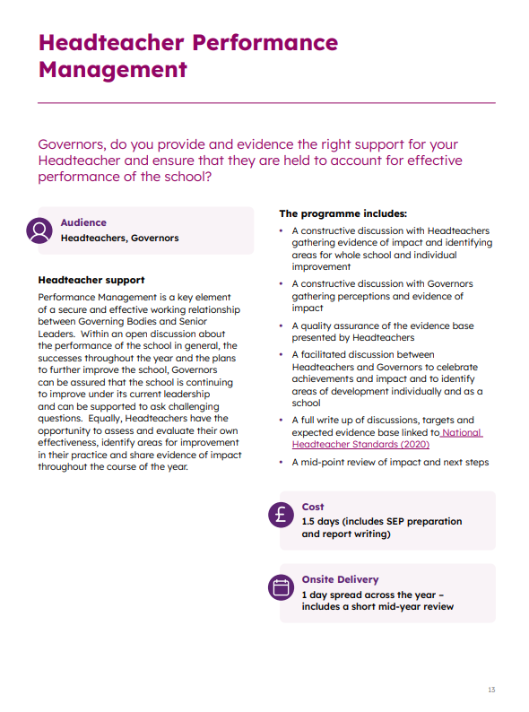
Traded Activities catalogue
Programme title
Prompts to help determine if programme meets needs
Intended audience
Cost of programme in days
Programme overview
Approximate onsite duration
CATALOGUE LINK

Slide 26
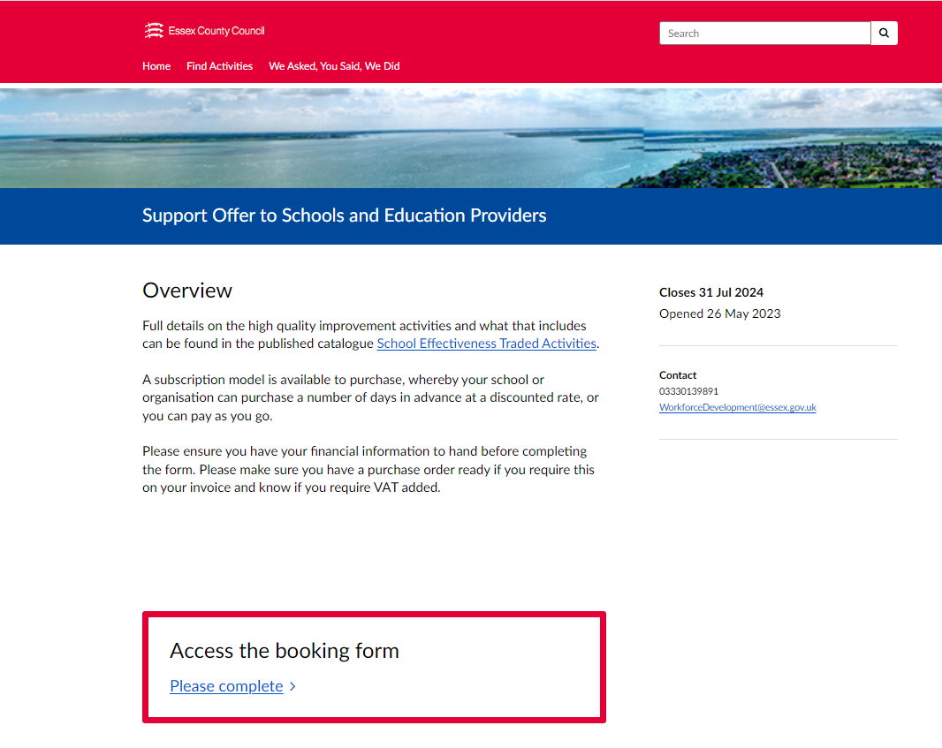
Online booking form
Click to access online traded programmes catalogue
Click to access online booking form
CLICK TO ACCESS TRADED SUPPORT OFFER BOOKING LINK

Slide 27
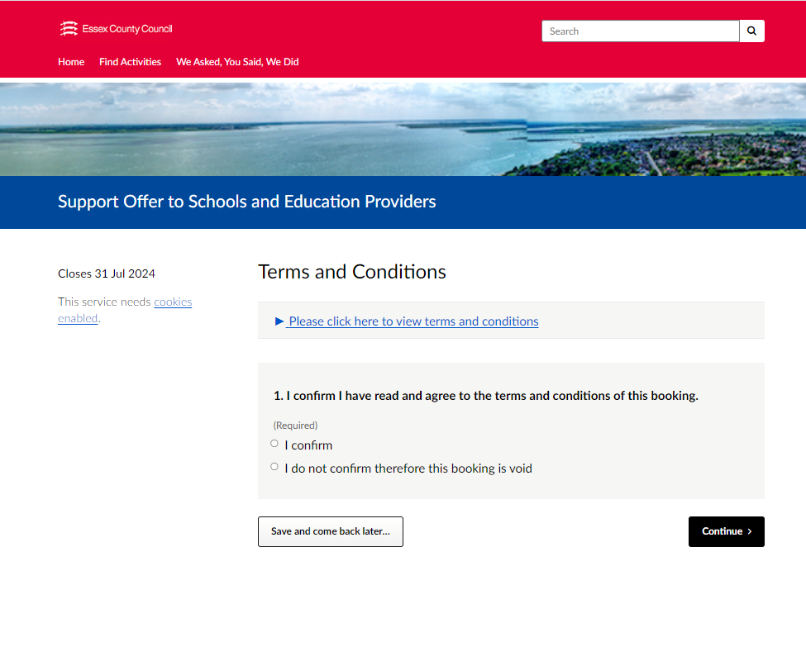

Online booking form
Opportunity to purchase a Gold/ Silver subscription or pay-as-you-go Bronze days
Terms and conditions can be accessed here
https://consultations.essex.gov.uk/workforce-development-1/6ca1baba

Slide 28
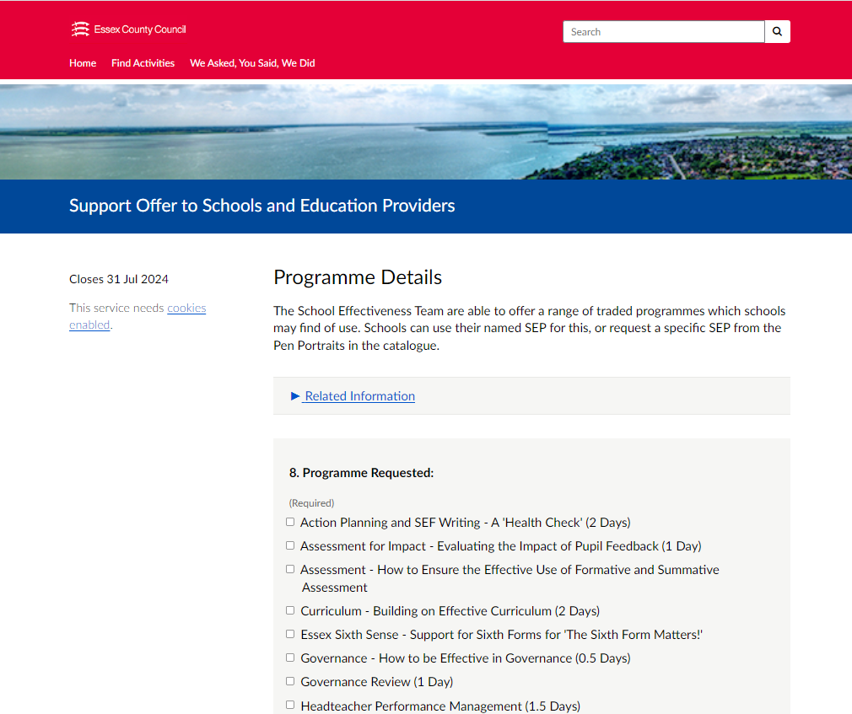
Online booking form
Click on the programmes you wish to access
https://consultations.essex.gov.uk/workforce-development-1/6ca1baba

Slide 29
Core offer to all schools via the partnership model
School Partnerships refers to all types of partnerships, including local authority-maintained school partnerships and multi-academy trusts (MATs) and mixed partnerships of maintained and academy schools.
Up to 4 days LA SEP/ Head of Education support across the year which will include:
SEP will arrange a termly meeting with partnership Lead/MAT CEO or steering / management group - this will depend on size of partnership and the relationship and knowledge of the partnership. This meeting will include how collaborative working can improve curriculum equity and opportunity for all pupils with a focus on Disadvantage and SEND Support outcomes.
SEP support for collaborative working in and between partnerships so that Partnerships can be accelerators of school improvement.
Support for Peer review if requested:
  Facilitating/Quality assuring peer review
  Assessing the Impact of Peer review
  Capacity training for Peer Review
Support with Partnership Meeting agenda planning.
Support and training for Partnership Evaluation and Development Tool and outputs where requested.
County Partnership Leads meetings.
Support and attendance at Quadrant meetings.
Support with analysis and resulting actions of partnership data pack if purchased.
Support for Quadrant chairs in their role.
Support with identification of additional traded work to support the partnership agreed priorities.

Slide 30
SEMH Strategy
Striving to provide the right support
Steve Whitfield
Strategy Lead

Slide 31

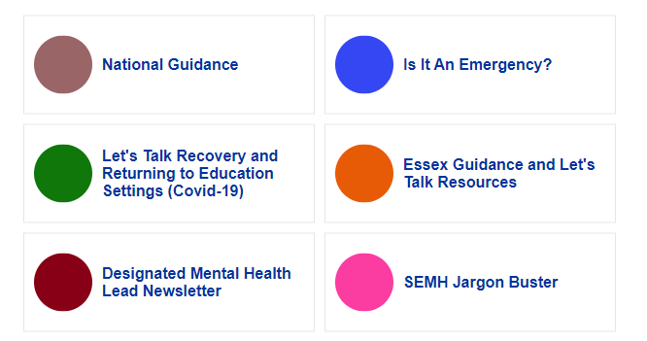
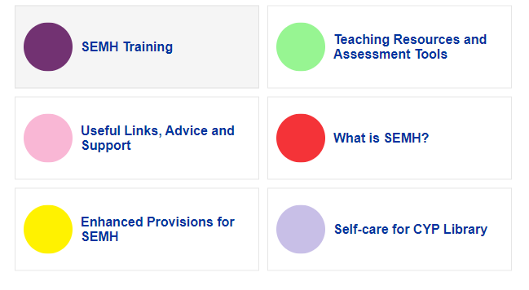
SEMH Infolink Portal
https://schools.essex.gov.uk/pupils/social_emotional_mental_health_portal_for_schools/Pages/default.aspx

Slide 32
SEMH Support
semhstrategy@essex.gov.uk
22 supported so far this year
(43 last year)
Critical Incident
Designated Mental Health Lead
EPs in
SET CAMHS
140 receive newsletter
94 consultations this year (29 last year)
schoolscommunication@essex.gov.uk
educationalpsychologyCAMHS@essex.gov.uk

Slide 33
Designated Mental Health Lead
68% of all Essex schools have accessed the training
England average (62%) and East of England average (59%).
Primary schools Essex is 66%
England average is 59%
Do let us know when you have someone and they can be added to our newsletters and our networking events.
Email: semhstrategy@essex.gov.uk

Slide 34
Summer Term newsletter contents
Newsletter Items:
DMHL First Network Meeting – Book your place!
Mental Health Awareness Week
Trauma Perceptive Practice (TPP) Information Updates
SEMH.co.uk
Early Years specific guidance, resource and CPD opportunities
Primary age phase specific guidance, resource and CPD opportunities
Secondary age phase specific guidance, resource and CPD opportunities
Whole-school Approach
Parent/Carers Support
Staff Training & CPD
School/Settings: projects, pilots & other opportunities of interest
Self-care resource for CYP
Staff wellbeing
Mental Health & Emotional Wellbeing Campaign Days – Calendar
Designated Mental Health Lead Feedback

Slide 35
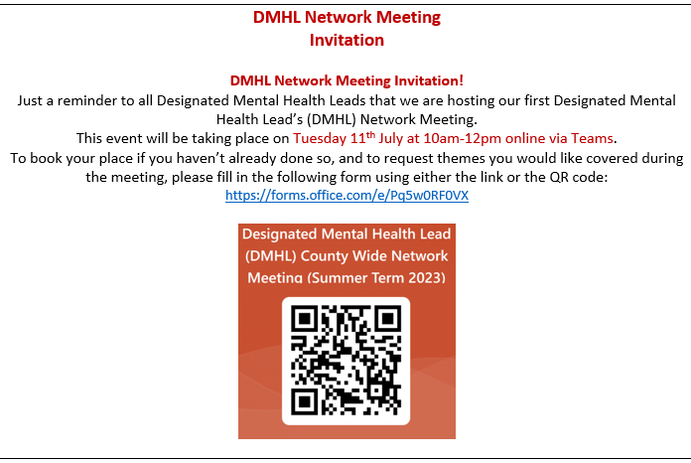

Slide 36

TPP Hive Platform is where all the training material and the resources are shared
Spring term there were 23,000 active views of the content on Hive
The TPP of families is a new offer : 42 schools who have been trained in this. Only available to those who have completed – 70% of those completed have gone to do the families offer.
6 Core Strengths Assessment tool will have a – curriculum component next academic year
2nd Edition of TPP Manual autumn release

Slide 37
TPP Best Practice Submission
Complementary training
ECC Partnership with PRICE for Restrictive Physical Intervention
Active Essex – physical activity for emotional wellbeing
Essex YOS – restorative practices
Resilience programme (SEMH info link and Hive)
ADHD (EP and IP)
Selective Mutism (IP or EP)

Slide 38
Our SEMH primary enhanced provisions
Request for Support Process
  HTs as part of the panel
Increasing our number of provisions in out lying areas
  Harwich – Spring Meadow
  Woodham- St Mary’s
  Two further secondary provisions- mid- Chelmsford, south- Wickford
Ofsted are satisfied that these are not unregistered/unlawful provisions – value the strong partnership that is evidenced
  Make contact with the provision to discuss the child
  Will visit the provision if the host school is inspected

Slide 39


Other news
Let’s talk ….we miss you. Guidance for School Attendance Difficulties including emotionally based school avoidance (EBSA)
An Emotional Wellbeing and Mental Health conference: 6th July 2023 at the Chelmsford Race Course
The Education Policy Institute (EPI) Pupil Wellbeing Survey
Brook Traffic Light Tool training

Slide 40

Mental Health Support Teams
North East MIND- WARMS: Clacton, Colchester and Harwich
West Essex- Mind: Epping, Harlow and Uttlesford
For Mid and South Essex NEFLT
https://www.nelft.nhs.uk/essex-mental-health-support-teams---find-your-school/

Slide 41
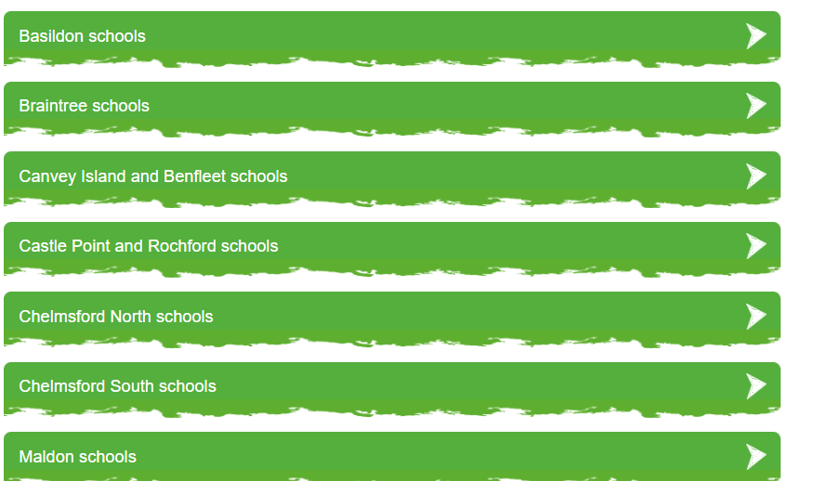
Wave 9 teams coming- Billericay and Brentwood
Wave 10 – west Essex and NE Essex

Slide 42
NHS System pressures
Young mental health patients 'at risk' in child wards - BBC News

Slide 43
System partners:
Acute Hospitals
Children admitted to children’s general health wards whilst waiting for Inpatient bed or a Social Care placement for prolonged periods due to limited availability of these resources. National shortage.
Staff not suitably trained to provide mental health support as general nurses. Do not have the capacity to provide level of observation and support required for individual young people. Having to bring additional staff in to support.
Environment not conducive to the needs of highly anxious, suicidal or emotionally dysregulated young people often experiencing sensory issues. Noisy, lots of changes of people.
Young people’s behaviour escalating due to uncertainty about where they will be moving onto. Limited access to stimulation/activities/education.

Slide 44
Families:
Frightened parents. - rise in young people suicide. Social media. Worried that cannot keep them safe.
Parental mental health
Family pressures cost of living. Pressure to work long hours. Unable to support intensive support packages at home.
Limited availability of extended family to offer support.
Impact on siblings-trying to continue on with their lives amongst high family anxiety

Slide 45

State of the nation 2022: children and young people’s wellbeing - GOV.UK (www.gov.uk)

Slide 46
State of the Nation 2022: Key findings
Overall, the findings presented in this report suggest an inconsistent recovery of children and young people’s wellbeing and mental health towards pre-pandemic levels by the end of the 2021/22 academic year.
those who feel safe in school, enjoy coming to school, and that they belong in school were less likely to have a mental disorder, and report greater subjective wellbeing.
unable to establish the causal relationships between these feelings and experiences, they highlight importance of a supportive school environment in the mental health and wellbeing of many children and young people.
around 7 in 10 children and young people agreed or strongly agreed that adults at their school were interested in their wellbeing, that there was at least one adult at their school who they could talk to about how they were feeling, and that young people in their school got on well together.

Slide 47
Need something more from the SEMH Strategy Team?
We will endeavour to provide support when you need it
semhstrategy@essex.gov.uk
Beth, Deb, Lianne and Steve
SEMH Strategy Team

Slide 48
LA Strategic Priorities 2023-2024

Slide 49
LA Strategic Priorities 2023-2024
Continued SEND Improvement including SEND Sufficiency Plan, Transformation Plan and development of an outreach offer (to bring to the Autumn term)
SEND Mitigation work re. rise in EHCPNAs and EHCP completion rates
Maturing the School Partnership system to ensure all partnerships are enablers and accelerators of school improvement
Emotional Wellbeing and Mental Health of pupils, staff and communities
Sufficiency of school places plus school sustainability
Refugee placement and support
Essex 2030 Transformation work
Children not in education (EHE / CME / Levels of attendance)
Recruitment and Retention with the Teaching School Hubs / HT Wellbeing

Slide 50
Bringing it together…
Equity and excellence for all
(with a spotlight on SEND and Disadvantage)
Relationships and
wellbeing
Attending and
participating
Understanding of
contexts and cohorts
Achieving and
moving-on
Enablers:
  Inclusion Framework
  Inclusion Reviews
  Coordinated offer of support for schools
  Directorate-driven delivery plans for each commitment
Vision
Ordinarily Available
TPP
Disadvantage Strategy

Slide 51

LA Strategic Priorities 2023-2024
On your tables, please discuss the LA’s strategic priorities proposed for 2023-2024 and capture on post-it notes:
Is there anything you would want the Local Authority to include as an enabler to ongoing school improvement?
What would you want to see more/ less of?

Slide 52


Michelle Hayden-Pepper
Director of Local Delivery for West Essex Children’s Social Care

