Slide 1
EPHA LA Termly Meetings
- Spring 2018
“Inclusive Essex: Every School for Every Child”
Clare Kershaw, Director of Education
Ruth Sturdy, Lead School Effectiveness - Inclusion
Lisa Fergus, Lead School Effectiveness - South

Slide 2
Agenda
Education Restructure
School-led SEND: the developing mainstream strategy
Updates:
  Small Schools Strategy
  EMAT
  FFT school and partnership subscriptions

Slide 3
Education Restructure
Clare Kershaw

Slide 4
Recruitment Update
Notes:
Kim – will cut and past the structure chart with the new appointees in here

Slide 5
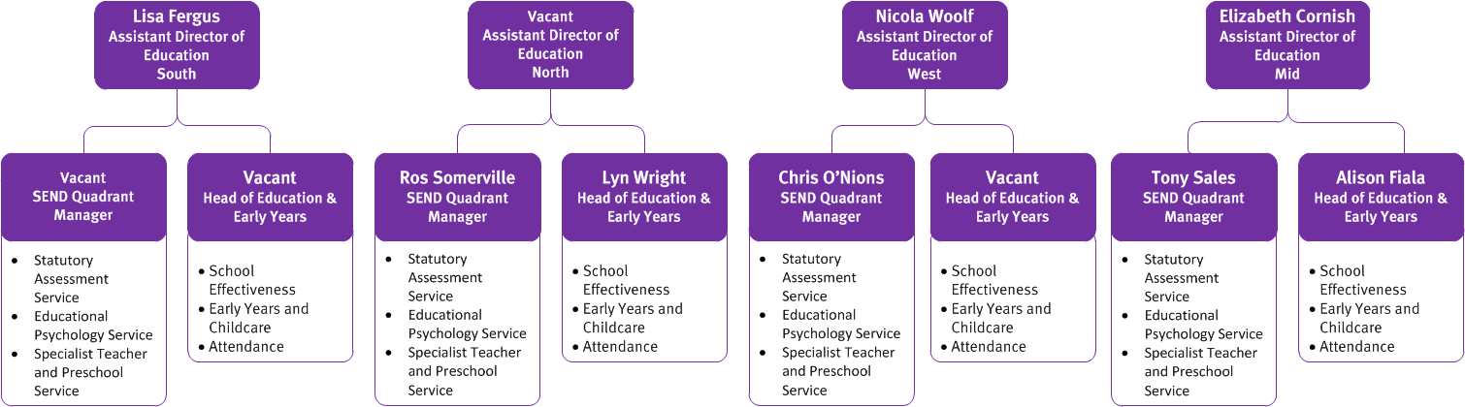
Recruitment Update

Slide 6
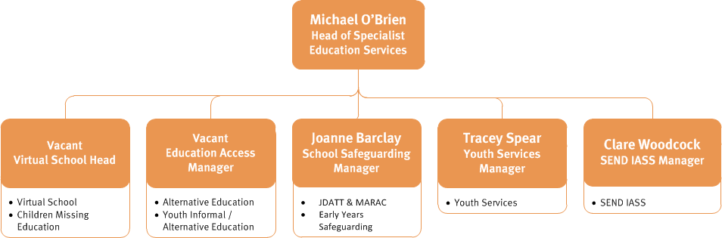
Recruitment Update

Slide 7
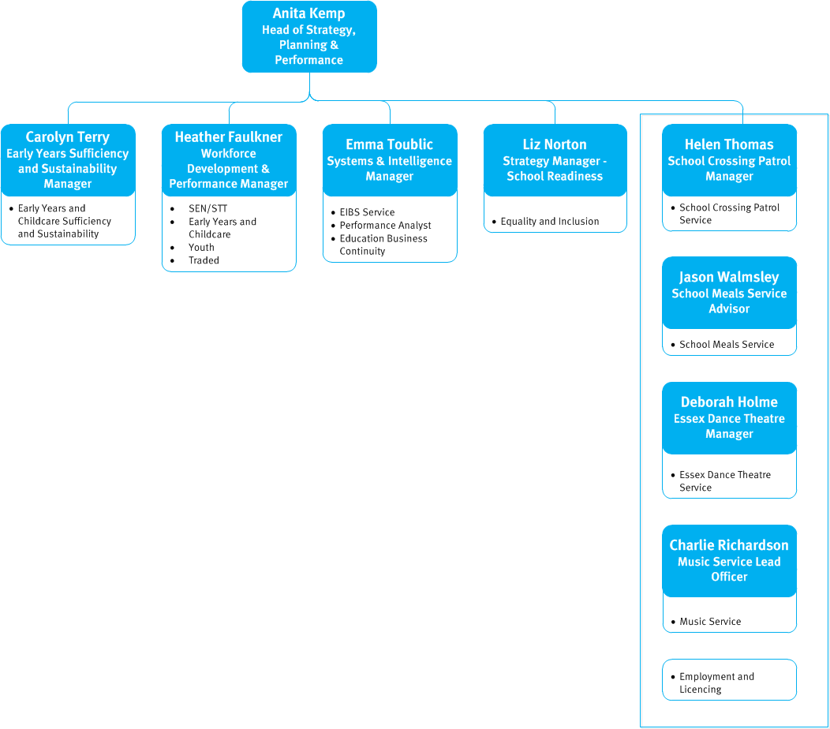
Recruitment Update

Slide 8
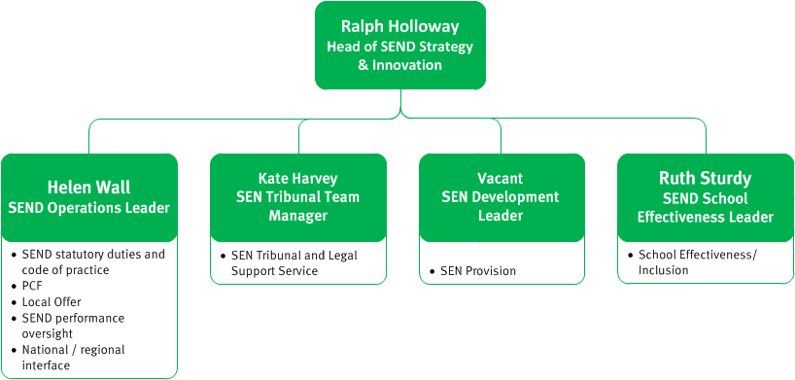
Recruitment Update

Slide 9
EMAT- Update
Essex County Council, in partnership with the Diocese of Chelmsford and schools, is preparing to submit an application to the Regional Headteacher Board on 15th March 2018 seeking approval to establish a new multi academy trust in Essex which will be called EMAT.
EMAT - a unique offer to the MAT landscape across Essex, initiated by ECC it would stand completely independent of the Council and operate in the same way as any other MAT does in Essex.
As a ‘mixed’ MAT it will provide greater choice for schools opting to convert to academy status with local partner schools, all phases and special schools.
Rationale for EMAT:
There are a number of maintained schools and standalone academies in Essex that would wholly benefit from joining a MAT but are unable to find the right MAT which offers them a sustainable and accountable partnership to maintain the highest quality of education to children and young people residing in Essex.
A number of schools have indicated they would welcome joining a MAT that has the values and ethos of the Local Authority and the Diocese as part of its origins and maintain the authentic relationship which has long been established and trusted.
Notes:
Some schools require a long term sustainable and accountable partnership to ensure that they continue to deliver the highest quality of education to children and young people residing in Essex. Currently the quality of these schools remains the responsibility of the local authority and in many cases these schools are also church schools.
With the reduction in the resources available to local authorities to support schools, in the long term, it will become increasingly more difficult for these schools to cope with turbulence in the system without a strong partnership base around them.
In addition, there are also very strong schools that believe in the values and ethos of the local authority and the diocese but also want to provide mutual support to schools within a strong governance framework.

Slide 10
EMAT- Proposals
The proposal is to establish EMAT with a minimum of 3 strong good or outstanding schools to ensure there is sufficient school improvement capacity within the MAT before looking to support more vulnerable schools through the sponsorship route.
The MAT can also broker support from expertise within the LA, the Diocese and system leaders across theTSAs in Essex where appropriate.
The MAT will grow incrementally as all MATs do but we envisage a hub model developing as it grows over the medium to long term.
In the short term (the first 2 years), we are seeking to grow the MAT to about six schools and from there develop a hub model aligned to geographical quadrants across Essex.
In the medium to long term we are aspiring to create four hubs of between 4-6 schools to ensure that we sustain and maintain the distinctiveness and uniqueness of the proposed model.
Essex County Council has been very clear that its priority is focussed on long term self-sustaining school improvement regardless of whether schools are academies or remain maintained.
Notes:
In creating EMAT, Essex County Council, working with the Diocese of Chelmsford and founding schools would like to create a MAT which brings together the strength of these partnership arrangements to provide greater choice for schools and partnerships of schools within the MAT landscape.
ECC has been and continues to be very supportive of all schools, MATs and TSAs across the county. We strongly believe that there is a place for EMAT within the school-led system for maintained schools who want to join due to the trusted and valued relationships with the LA and Diocese.
Once established, EMAT will provide a unique option for schools requiring sponsorship through harnessing the strengths of each school so that all EMAT schools improve and more children and young people attend schools in Essex that are good or better.

Slide 11
Proposed EMAT Structure
Secretary of State
Directors of the company are also Trustees of the charity
Funding Agreement
One Member is a Director
1
6 Members
Scheme of Delegation
One Director will be linked to each LGB
1
8 Directors/Trustees
This model allows for a federation of Infant/Junior or 2 schools
Scheme of Delegation
Local Governing Body
Local Governing Body
Local Governing Body
Local Governing Body
School
School
School
School
School
Notes:
Proposed EMAT structure for short term, a hub model is also being created
Members and Directors will be determined by the skills and expertise needed to provide strong governance over the range of schools.
25% of Members and 25% of Directors will be approved by the Diocese. The LA will appoint1 Member (Cllr Gooding) and 1 Director
.

Slide 12
EMAT
If your school wants to find out more, please contact
      Alison Fiala, Lead School Effectiveness Partner
      Email: Alison.fiala@essex.gov.uk
      Mobile; 07768537487
Notes:
With the reduction in the resources available to local authorities to support schools, in the long term it will become increasingly more difficult for these schools to cope with turbulence in the system without a strong partnership base around them.
In addition, there are also very strong schools that believe in the values and ethos of the local authority and the diocese but also want to provide mutual support to schools within a strong governance framework.

Slide 13
School-led Improvement System Update
Quadrant Meetings are being established with Leads of Partnerships and TSAs
Invitations have been emailed to Leads of Partnerships and TSAs
North East - 21st March - Priory TSA - 2pm
West - 26th March Harlow Study Centre 2pm
South - 19th April – Lee Chapel – 10.00am
Mid – 11th May – Chelmer Valley – 9.00am
Meetings will also be attended by representatives from
LA
EPHA
ASHE
INCLUSION
Peer Review Case Studies
Leads of Partnerships have been emailed about the opportunity to share their partnerships good practice in Peer Review across the county by writing a short case study for which there is £2000 available
Notes:
Peer Review Case Study
As you will be aware over the last couple of years we have rolled out training in Peer Review which we believe and research has shown has a very positive impact on school improvement. We know from our work with partnerships that there is much good practice happening in terms of Peer Review across the county, examples of which we would like to capture in order to promote peer review as a useful approach to collaborative school improvement and to show how peer review can be most effective to those who are engaged but not yet showing impact. It is these examples we would then wish to share across the county.
We have asked Leads of Partnerships to express an interest in writing them and then we will let the know partnerships know which ones we will fund on 2nd March

Slide 14
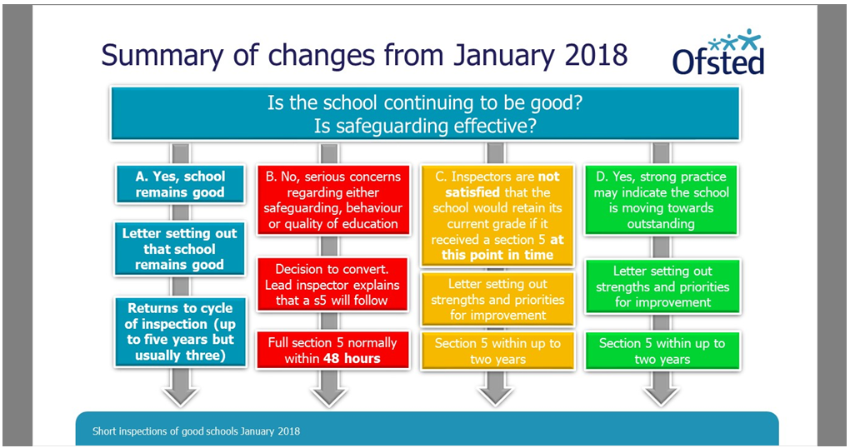

Slide 15
School-led SEND: the developing mainstream strategy
Ruth Sturdy

Slide 16
Updates:
- Small Schools Strategy
- EMAT
- FFT School Subscriptions

Slide 17
Small Schools in Essex – A strategy to sustain small schools serving communities across Essex
Initial recommendations included:
Carry out a risk assessment of schools using budget projections and pupil numbers
Pilot school based reviews with a subset of small schools to inform ECC and the Diocese on the specific issues facing the schools in the next 2 years and make recommendations to support schools to be sustainable in the future
Produce an options paper summarising structured solutions and, where no sustainable options exist, the process for consultation on closure (as last resort).
Provide a process map for each option with implications for ECC, the school and the wider community
Communicate the review findings with all schools and send a letter to the LA maintained schools in the review.
In January five representative headteachers (from faith and non-faith schools) joined the strategy group to add to the make further recommendations
Notes:
This side is a reminder from last term
Strategy group includes a headteacher from each quadrant
Rod Lane – ESGA and Schools Forum
Nicki Harris - HR
Tim Elbourne – Diocese
Nigel Hookway – EPHA
Jpseph Chell – school Planning and Organisation
Yannick Stupples- Whyley – Schools Finance and Schools Forum

Slide 18
Key messages arising from the school based reviews:
The financial and census data held by the Local Authority was, in most cases, out of date. The LA was able to have a more accurate picture of the school’s financial position and numbers on roll following the school based meeting.
Some schools have inherited unworkable PANs (eg 11 or 19) schools were reminded how to amend this.
Recruitment is very difficult for most of the schools, as teachers are often unwilling to teach mixed-age classes, sometimes spanning key stages, and take on several leadership roles.
Catchment areas can be fluid attracting, in some schools, a higher proportion out of catchment than their own catchment. This works both ways, however makes future sustainability a vulnerability.
Small schools often have a lack of good pre-school local provision, this can impact on parental choice, they may be in the catchment, but as the pre-school was out of catchment, the children went to the school attached to the pre-school.
There is an issue around publicity and awareness of small schools in all pre-school providers for parents to hear about the benefits of educating their child at the local school.
All schools commented on the increase in the number of children with SEND and EHCP, the crippling costs of finding the first £6000 for each and the lack of expertise within the staff to meet their needs, including an accredited SENCO.
Notes:
As a result of the meetings with small school headteachers, it was recognised that the financial and census data held by the Local Authority was, in most cases, out of date. In some cases the data predicted a deficit, but the schools had anticipated this and had made appropriate savings; in the event, only 2 of the 6 schools are likely to have a deficit.

Slide 19
Key messages arising from the school based reviews:
One strength identified was that of governance, with many committed and determined governors supporting their schools.
Many of the schools are using creative strategies to protect and sustain their funding. They had made efficiencies but were concerned about the NFF proposals to reduce the lump sum. There are some excellent staff in these schools, including the headteacher, but often teaching staff at a higher cost as they often have long service.
Some of the schools visited have been unable to access grants that should help their financial positon. 2 schools were supported with how to get instant help.
For many of the reviews, the discussion about sustainability and options for a structural change was a welcomed part of the meeting. All said they benefit from their local SLIS partnerships, however questioned sustainability without funding.
One solution , which is on the increase in Essex and other LAs, is federation. sometimes initially ‘soft’ to test out the partnership arrangements and more formally would be a ‘hard’ federation. The vision in Essex is Schools-led School Improvement and collaborative partnership, but not necessarily through joining a Multi Academy Trust – indeed, some small schools reported they are unable to find a MAT that they can join because of financial risk.
A major concern is the increasing workload when, for example, an Executive Headteacher is appointed to lead two or more schools and the impact on all staff.
Notes:
Essex has retained the £150k lump sum for the next two financial years, which will help small schools with their budgets
All schools agreed that the SLIS partnerships added a great deal to the professional development, moderation etc, but not all can access the offer due to costs of supply. Most found that the ‘historic’ small schools partnerships are more relevant than the larger partnerships, some are in both
All headteachers visited had a teaching commitment – ranging from 1 day to 3 days a week

Slide 20
Small Schools in Essex – A strategy to sustain small schools serving communities across Essex
Recommendations:
Offer a school based review to any small school who would welcome a discussion about sustainability
Schools above 120 pupils are also vulnerable in terms of sustainability and have recruitment issues, so offer a review to schools under 200 pupils
Produce case studies of schools which federated and provide some context so that schools can feel more informed
Update the database with the latest census data and financial returns following month 9 to revise the ‘alerts’ ratings
Make available the options paper and toolkit on Infolink, so that governors and schools can have access before hand, including details of all the local MATs and federations
Share the review findings with Members and Local Councillors so they are more aware of the challenges facing small schools and the solutions they are engaging with
Arrange a conference to disseminate findings, invite out of Essex examples of how schools are facing the challenges, including SLIS partnerships across Essex

Slide 21
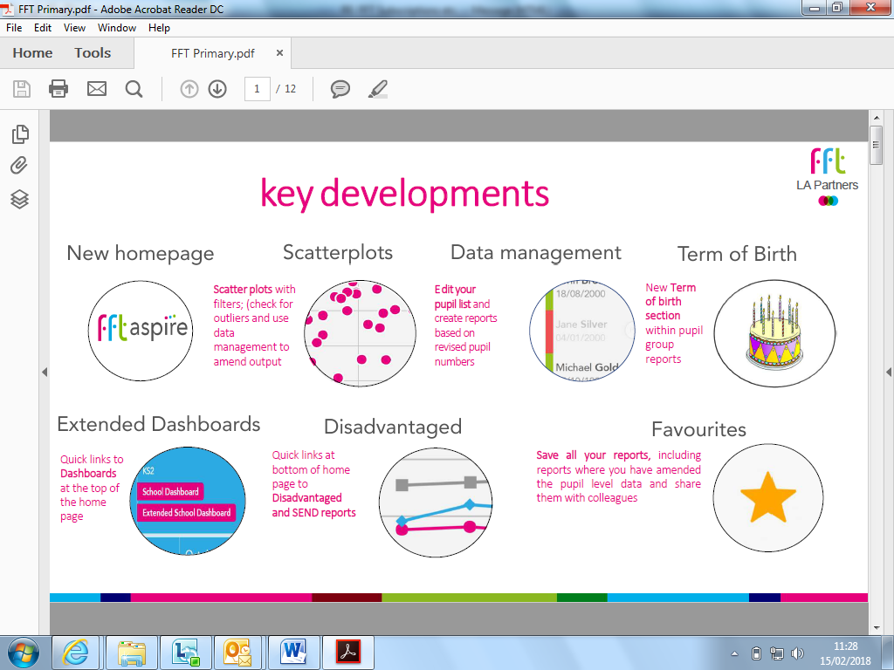
FFT – School and Partnerships Subscription
Notes:
There has been a 4% increase, a significant number of new features have been included eg SEND reports analysis of disadvantaged outcomes, self evaluation reports
LA intends to buy the subscription for all schools on the basis schools pay towards this.
Majority of secondary schools buy this subscription from the LA, buying from FFT is approx £1000 for a large primary and £1750 for a secondary school
We will offer reduced rates to all partnerships of schools including MATs
Ideally we need to know whether schools will buy back the subscription – a leaflet summarising the offer will be in Education Essex next week and on Infolink.
WORTH it for student explore alone

Slide 22
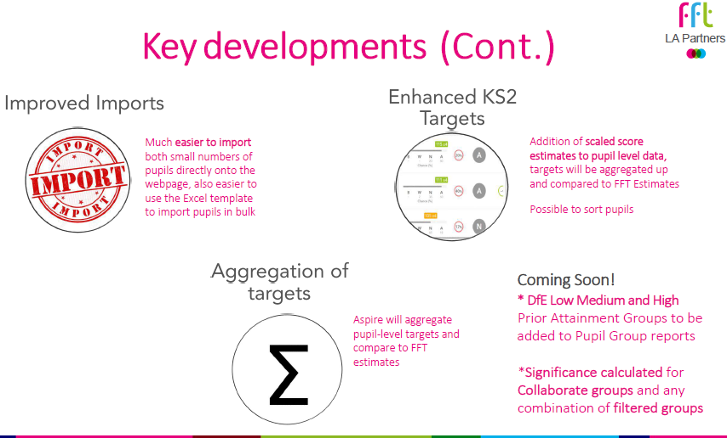
Notes:
Future - worth mentioning PAG will be the same as ASP/Ofsted
More functionality for collaborate and partnerships , including reports about disadvantaged/ SEND outcomes across the partnership
Useful tool for cross phase working

