Slide 1
Saffron Teaching School Hub
The Golden Thread:
Programme Review

Slide 2
The Golden Thread – Programme Review
Saffron AB Services – Supporting delivery of ECF
Initial Teacher Training – A School Led System
Early Career Programme – Engagement Opportunities
National Professional Qualifications – Investing in Excellence
Wider Engagement – Curriculum Hub Offers

Slide 3
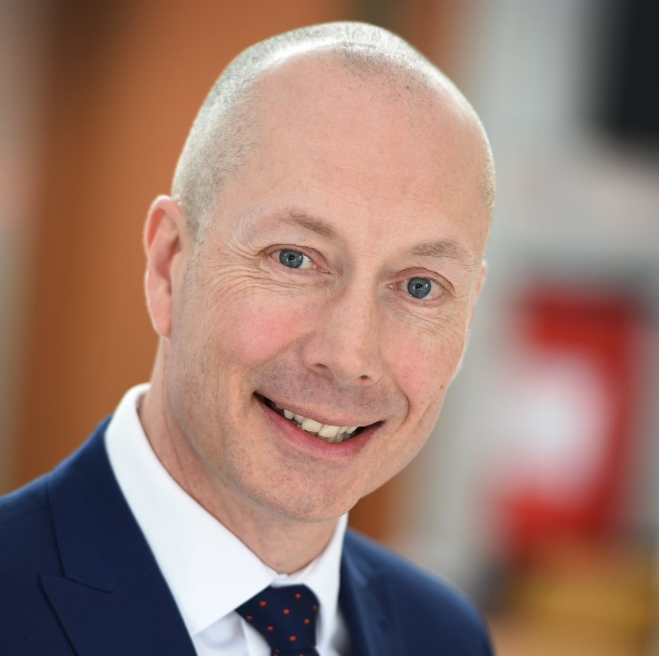
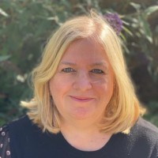
Saffron Teaching School Hub – Key Contacts
Doug Brechin
Saffron TSH Director:
Governance & Partnerships
dougbrechin@swchs.net
Angela Cass
Saffron TSH Deputy Director: AB & ECF
angelacass@saffron.academy
Kerrie McGivern
Saffron TSH Deputy Director: ITT & NPQ
kerriemcgivern@saffron.academy

Slide 4
Saffron Appropriate Body
Our Role:
Quality assure the statutory induction of Early Career Teachers
Support extends to Schools, Mentors and Induction Tutors
Provide guidance to Headteachers, Induction Tutors, Mentors& ECTs
Review and approve all Progress and Assessment Reports for ECTs
Key Message:
All ECTs must be registered with an Appropriate Body
This is separate to DfE and Early Career programme registration
Current Foci:
Quality Assurance Visits: New and Existing Schools – Signposting & sharing best practice
Developing Exemplars to support schools: Action Plans, Progress Reports, Assessment Reviews

Slide 5
Saffron Appropriate Body
Get Involved:
Saffron AB Case Studies: Share your success stories: Making the ECF Programme work for you
ECT Recruitment: Speak to Saffron AB regarding planned induction of any new ECTs
Advice & Support: Arrange a visit from us if you are concerned about progress
Training: Attend our upcoming training session: Effective Action and Support Plans, 19th March

Slide 6
Initial Teacher Training
Our Role:
Market and Promote opportunities for ITT across the sector
Increase capacity and partner schools across the region
Support ITT programme development and delivery
Collaborate with Eastern Region TSHs to develop ECTs and Mentors
Key Message
Current Foci:
Connecting with schools following DfE Audit
Developing Pathways to Engagement – A School Led System

Slide 7
Initial Teacher Training
Get Involved:
Impartial discussion: connect with Saffron TSH to explore pathways to engagement in ITT
Promotion
Host a ‘Get Into Teaching’ event in your setting
Placements
Offer a Trainee Teacher Placement
Mentorship
Senior Teachers and/ or Leaders offer Lead Mentor capacity to support trainees
Training
Share and post ITT messages across your networks
Offer a Trainee Teacher Contrast Placement
Offer ‘Experience Days’
Subject Specialists deliver face to face training in related specialisms
ITaP Hosting: Host an Intensive Training and Practice Session within your setting

Slide 8
Early Career Framework
Our Role:
Lead Delivery Partner for ECF Programmes across STSH Region
Deliver training and support to ECTs and Mentors through local and regional conferences
Train and develop facilitators to run Regional and Local Conferences
Represent interests of schools at TSH AB Advisory Board
Current Foci:
Delivery of Face-to-Face conferences and training for Mentors and ECTs
Development of training materials to reflect the needs of our region

Slide 9
Early Career Framework
Get Involved:
Join our team of Saffron Facilitators delivering Regional and Local training to ECTs and Mentors

Slide 10
National Professional Qualifications
Our Role:
Lead Delivery Partner Teach First offering the full suite of Specialist and Leadership NPQs
Recruit and train expert facilitators for hybrid seminar and conference delivery
Monitor and manage engagement & quality assure implementation
Drive uptake of the ‘Golden Thread’ at all levels across the TSH region
Current Foci:
Onboarding our 3B Cohort – 160 applications across the suite
Facilitator Recruitment & Training – Widening our pool of expertise and experience
Promoting NPQ Suite for October 2024 – Including new NPQSEND Programme

Slide 11
National Professional Qualifications
Get Involved:
Consider Career Pathways and development opportunities using the NPQ Framework
Register your interest: for NPQSEND and other programmes beginning in October 2024
Explore NPQ Programme Facilitation:
Bring evidence based CPD into your schools
Generate income of up to £1,000

Slide 12
Curriculum Hub – Wider Opportunities
New Vision English Hub:
Opportunities for up to £6,000 of accelerated funding for SSP
Wealth of expert support in selecting and implementing a new SSP
Wider CPD for developing reading, writing and phonics within settings
Venn Maths Hub:
Applications are open for fully funded, Primary Mastery Specialist & Professional Development Lead programmes (Starting September 2024)
https://www.ncetm.org.uk/maths-hubs-projects/primary-mastery-specialists/
Mastering Number – EYFS & KS1: Applications for 2024-25:
https://share.hsforms.com/1xXJh2dTNRIid-iZCEUkkGAbnpph
Mastering Number – KS2: Applications for 2024-25:
https://share.hsforms.com/1oM7DNkLPQoSKqF5iDBF2mAbnpph

Slide 13
Let’s Connect
www.saffronteachingschoolhub.net
X @SaffronTSHub
Facebook @SaffronTSHub
Instagram @saffronteachingschoolhub
LinkedIn Saffron Teaching School Hub
Sign up to our Newsletter: STSH News

Slide 14
Thank you for listening…
Kerrie McGivern
Director of Primary Improvement - Saffron Academy Trust
Deputy Director - Saffron Teaching School Hub
01799 513030 ext 1270
kerriemcgiven@saffron.academy

