Slide 1
EPHA – PE & School Sport presentation.
Brian Shaw
Strategic Lead for Education & Skills; Active Essex
Brian.shaw@essex.gov.uk - 07879116366
Dawn Catley
Education Engagement Lead.
Dawn.catley@activeessex.org - 07894964327

Slide 2
Government Sporting Policy.

Slide 3
Primary PE & Sport Premium.
The high level changes are that from September 2017:
Schools with 16 or fewer eligible pupils receive £1000 per pupil;
Schools with 17 or more eligible pupils receive £16,000 and an additional payment of £10 per pupil
This is a straight doubling of the current formula and will mean that all schools will be able to deliver further improvements to their PE and Sport provision. The mechanism for payment will remain the same, with schools receiving 7/12ths of funding in Oct/Nov and the remaining 5/12ths in April/May.

Slide 4
Primary PE & Sport Premium.
Schools must use the funding to make additional and sustainable improvements to the quality of PE and sport you offer. This means that you should use the premium to:
•develop or add to the PE and sport activities that your school already offers
•build capacity and capability within the school to ensure that improvements made now will benefit pupils joining the school in future years
There are 5 key indicators that schools should expect to see improvement across:
•the engagement of all pupils in regular physical activity - the Chief Medical Officer guidelines recommend that all children and young people aged 5 to 18 engage in at least 60 minutes of physical activity a day, of which 30 minutes should be in school
•the profile of PE and sport is raised across the school as a tool for whole-school improvement
•increased confidence, knowledge and skills of all staff in teaching PE and sport
•broader experience of a range of sports and activities offered to all pupils
•increased participation in competitive sport

Slide 5
Online Reporting.
You must publish details of how you spend your PE and sport premium funding. This must include:
•the amount of premium received.
•a full breakdown of how it has been spent (or will be spent).
•the impact the school has seen on pupils’ PE and sport participation and attainment.
•how the improvements will be sustainable in the future.

Slide 6
Online Reporting - Swimming.
For the 2017 to 2018 academic year, there is a new condition requiring schools to;
publish how many pupils within their year 6 cohort are meeting the national curriculum requirement to swim competently, confidently and proficiently over a distance of at least 25 metres, use a range of strokes effectively and perform safe self-rescue in different water-based situations.

Slide 7
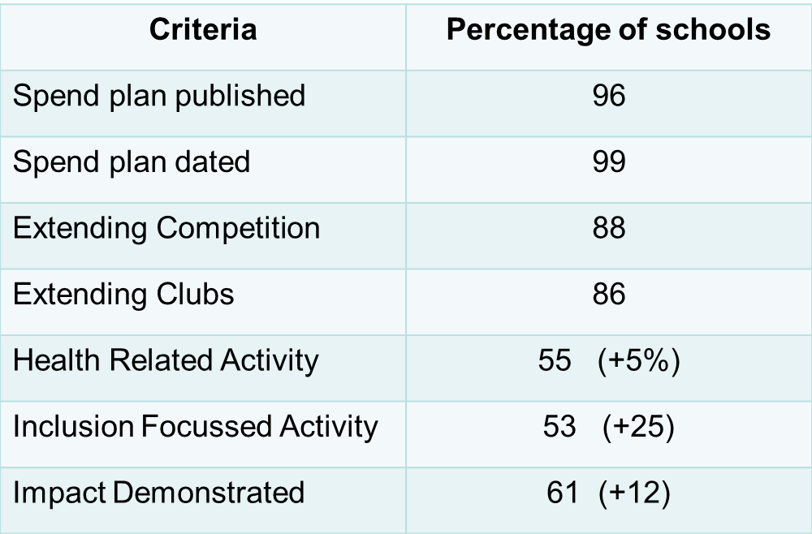
Essex website trawl results May 2017.

Slide 8
Evidencing Impact.

Slide 9
Website & Bulletin.

Slide 10
Active Lives Survey.
Active Essex is working alongside Sport England to deliver the Active Lives: Children and Young People survey, which measures participation in sport and physical activity among children and young people in
Years 1 to 11. The information that we collect will help Sport
England to decide where and how to invest in opportunities for
children and young people to take part in and benefit from sport and
physical activity.
108 schools across Greater Essex will be requested to undertake the Survey
between January and April 2017. This survey will be in place for the lifetime
of the Active Lives general survey
Each term following that a similar number of different schools will be asked to undertake the survey.

Slide 11
What does the school have to do?
3 classes from each year group Yr1 and Yr6 within the school complete a confidential online survey. The school is informed which year groups the classes should be from.
Each class has a distinct URL to access and complete the survey.
Each class teacher is also asked to complete the a survey.
Where Yr1 or Yr2 are taking the survey parents of these
classes are also given the opportunity to complete the survey.

Slide 12
Why should a school get involved?
Up to a £500 payment for completion of the survey.
Access to a detailed report of the schools outcomes on Physical Activity and Health & Wellbeing.
Insight which will be useful in OFSTED Health & Wellbeing reports.
Support for reporting impact of the Primary PE & Sport Premium.
Support for the Healthy Schools Award in Essex.

