Slide 1
LA / EPHA Summer Term Meeting
Mid Essex
21st June 2018

Slide 2
AGENDA – Session 1
The New Structure
Update on the School Led Improvement System
The future of the School Meals Service
Inclusion - The draft Essex Statement and Exclusion discussion
Schools Broadband

Slide 3
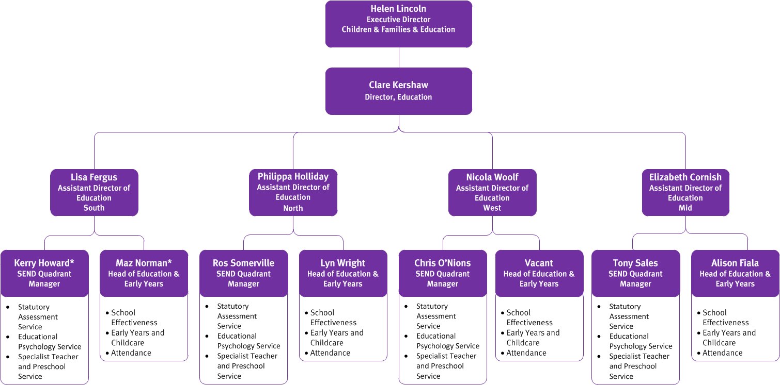

Slide 4
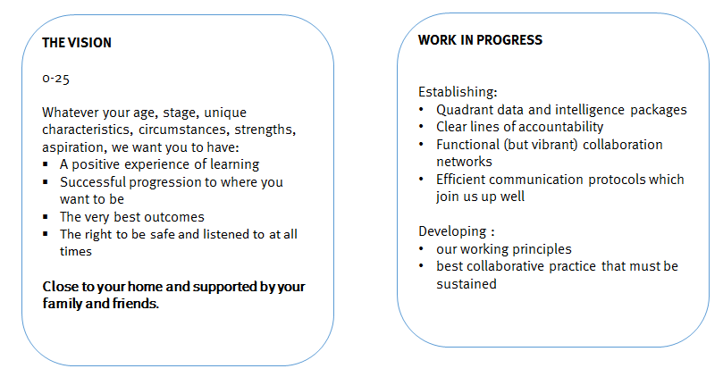
Vision and Ambition

Slide 5
Mid Key Characteristics
Mid Districts: Chelmsford – Maldon - Braintree
EYFS Chelmsford 80 PVI settings; 96% good/outstanding 131 childminders 97% good/outstanding | Braintree 70 PVI settings; 97% good/outstanding 113 childminders 96% good/outstanding | Maldon 32 PVI settings; 100 % good/outstanding 24 childminders 100% good/outstanding
Mid Schools
53685 pupils in 154 schools and settings
5 special schools, 1 CSS, 126 primary, 18 secondary
SEN Support 9.4% (5031 Pupils)
EHCP 3.8% (2066 Pupils)
FSM6 18.3%, Looked After 0.4%, Adopted 0.6%, Disadvantaged 19%
Multi-Academy Trusts MATs | School Led Improvement System SLIS Partnerships | Teaching School Alliances (TSAs)
Academies Enterprise Trust (AET) The Kemnal Academy Trust (TKAT) Vine – Chelmsford Diocese Eveleigh LINK Academy Trust South Essex Academy Trust Ormiston Academies Trust Connected Learning Trust The Seax Trust Loxford School Trust Fennwood Academy Trust Learning Partnership Trust Attain MAT All Saints MAT Perryfields Enterprise MAT CHANGE Partnership The Chelmsford Learning Partnership (CLP) Bridge Academy Trust Notley High Academy Trust HERA Academy Trust | Chelmsford Education Network Chelmsford Learning Partnership Braintree and Villages Partnership Blackwater Partnership Colne Valley NE Braintree Partnership River Chelmer Partnership Dengie Partnership Witham and District Partnership Woodham Ferrers Partnership Danbury and Sandon Partnership CHEC Chelmsford District/Tanglewood Schools Partnership Notley Family of schools | Professional Learning Network PLN (Lyons Hall) The Chelmsford Teaching Schools Alliance CTSA (Newlands Spring) New Essex Teaching School (Powers Hall) Saffron Alliance (straddles North West and some Braintree areas )
Mid School Ofsted Outcomes
19% outstanding
73% Good
7% Requires Improvement
1% Inadequate
Enhanced Provisions:
2 HI, 4 Speech and Language + ASC Hub
Most prevalent primary needs type for SEND (after MLD) SEMH, ASC and SLCN
NEET 2.21% (179 young people) – England 2.80%

Slide 6
Attendance Service

Slide 7
SLIS Survey
Thank you to those of you that returned this. The Project Board and Leads of Partnerships are using the outcome to plan next steps in terms of ensuring the sustainability and developing maturity of the partnerships
School-led Improvement System Update – Summer 2018
Project Board
Terms of reference , minutes and priorities all on info link
Delighted to say that for the summer term meeting the 4 new SLIS quadrant chairs will be on the board
SLIS Quadrant Meeting Chairs
Chair of West Quadrant meeting
Colin Raraty, Head of Rodings School
Chair of South Quadrant meeting
Sue Jackson, Headteacher of Lee Chapel
Peter Malcolm, Headteacher of Rayleigh Primary offered to be the Vice-Chair
Chair of North-East Quadrant meeting
Nicola Sirett. Headteacher Mersea Island School
Chair of Mid meeting
Lisa Feldman. Headteacher Finchingfield Primary School
Peer Review Case Studies
We have 12 just in the process of being finalised. These will be then be shared through the partnerships and on info link. Great practice and examples that partnerships will be able to draw on
LA SEP time for Partnerships 18/19 (proposal)
8 Core days per partnership –Universal offer
May be able to submit an expression of interest for extra days
Quotes from Ofsted Inspections
Notes:
Partnership Leads meeting 7th June
All of these will be discussed in more detail
SLIS Survey – on info link
SLIS quadrant meetings:
Eg of agenda items for next meeting - all before summer except mid
School Improvement Priorities from partnerships
Sharing Good Practice and Projects
How SEP days have been used
Partnership strengths, challenges, sharing effective practice that is having a positive impact in more than one school
Autumn Term: Sharing Partnership priorities action plans linked to data
TSAs - What is on Offer now and in the future, How it can be accessed
TSA Activities eg SSIF bids and Centres of Excellence work
SEND input from Ruth re partnership working and SEND
System leadership within the partnerships/quadrants
Governor Involvement in Partnership working
Recruitment and Retention strategies
West 19th June
North-East 21st June
South 22nd June
Mid 16th October
Chairs will be able to feed into Project Board following these meetings
Idea – Partnerships will meet, then quadrant meetings then the Project Board so that there is an effective communication channel
Proposal
Each partnership to have a set number of core days 8 per partnership to be used for the universal offer
Data
Partnership Evaluation Development Tool /Self Evaluation of the partnership
Support for new heads
Transition including early years
Support for partnership Governance
Progress of pupils with SEND and Disadvantaged
Schools due Ofsted
Work with Governors across the Partnership
Notional number of days for ‘green’ school visits should intelligence confirm there are some concerns
Termly meeting with SEP to discuss ‘Health’ of Partnership/schools
Partnerships may be able to submit an expression of interest for extra days
Peer Review Case Studies – Partnerships received £2000 to write them – been QAd and Partnerships have all agreed that they will disseminate these and talk about their work in this area as well as putting them in info link
12 from
Colchester Partnership
Epping Schools
Notley
Chelmsford Education Network
Colchester Priory Street
Saffron Walden
South Essex Teaching Institute (SETI)
CHEC
Dunmow
Harwich Education partnership
Chelmsford – Tanglewood Partnership
12. Tiptree and Stanway
Quotes – from Ofsted reports on table
7

Slide 8
Peer Review Case Studies
Colchester Partnership | Richard Potter, Home Farm Primary School
Epping Schools Partnership - SLIS | Veronica Wallace, Staples Road Primary School
Notley Family of Schools, Braintree District Partnership | Jacky Wragg (independent chair)
Chelmsford Education Network Partnership | Marie Staley, Moulsham Junior School
Colchester Priory Street | Bridget Harris, St Thomas More's Catholic Primary School
Saffron Walden Partnership | Mary-Jo Hall, St Thomas More Catholic Primary School Academy
South Essex Teaching Institute (SETI) | Melissa Heatherson, Hockley Primary School
CHEC | Sarah Donnelly, Richard de Clare Community Primary School
Dunmow Excellence in Education Partnership - SLIS | Colin Raraty, Rodings Primary School
Harwich Education Partnership | Julie O’Mara, Chase Lane Primary School
Chelmsford District Tanglewood Partnership | Helen Hutchings, Highwood Primary School
Tiptree and Stanway Primary Schools Consortium Partnership | Nicola Sirett Mersea Island School
Notes:
8

Slide 9
School Meals Support Service Review and Offer Geraldine Smith Senior School Meals Support Manager

Slide 10
The Service
The School Meals Support Service is a non-statutory ,chargeable, ECC service providing compliance support to 67% of Essex Schools.
The budget for the service is currently top sliced from the Essex LA maintained schools, via the Schools Forum or provided to academies as a traded offer
Schools Forum decided in November 2017 to:
De-delegate the funding for the service from April 2018 – July 2018
To move the service into fully traded service from September 2018.
For a number of reasons we are not ready to launch a fully traded service from September 2018 and therefore have agreed with EPHA to continue to run the service between September 2018 – March 2019. This will be part funded by ECC but we are seeking a contribution of £200 per school towards the costs.
We have continued to work on the development of a fully traded service in consultation with schools

Slide 11
Consultation: You said…
What schools valued:
Compliance: Support was critical
Training: The highest add-on preference
Relationships: You valued the professional support
What schools preferred:
Pick and mix
To chose the number of visits
To design their own package of services
What was holding schools back:
Cost for smaller schools
Detail of add-ons
Financial start dates

Slide 12
What does compliance mean for you…?
All schools have a legal duty to ensure the food they prepare and serve, meets the necessary standards to protect consumers.
Schools are legally bound to provide meals to all Key stage 1 children (UIFSM) and other Free Meals Pupils (based upon pupil premium data).
Legislation in place that schools must work to is:
The Food Hygiene (England) Regulations, 2006.
EU Regulation No. 852/2004 on the Hygiene of Foodstuffs
The Food Safety Act 1990
The School Food Plan (School Food Standards 2015)
Health and Safety at Work Act 1974

Slide 13
Without support, schools must manage…
Effective and efficient service delivery
Compliance (audit, record and review)
Training by a competent trained person
Changes to legislation
Menu planning and food presentation
Continuous service development and innovation
Catering team development and performance
Developing and driving meal uptake
Business planning and financial efficiencies
Supplier price negotiation and sourcing
Kitchen design and development

Slide 14
March 2019 - Our proposed offer …
Pupils on roll | Under 100 on roll | 101-210 on roll | 211-315 on roll | 316-420 on roll | 421-525 on roll | 526+ on roll | Secondary School | Servery
Charge per annum | £400 | £700 | £1000 | £1450 | £1750 | £2000 | £1600 | £300
What is included: Coordinated site visits per year Support manager with industry experience and knowledge Annual compliance audit Annual service health check Annual Statutory Training Controlled copy procedures manual (HACCP) Twice yearly Nutritionally Compliant Menu Pack Discounted pricing framework for food purchasing Financial controls system/audit Access to Statutory Training Courses Benchmarking data for best practice modelling Annual report to Governors FAQ’s for self service Industry updates with required responses Healthy Schools lead and advice Governor Training Invitation to Manager Inspiration and Networking Events Also available: Hands on training Recruitment advice and support PMR support and objectives Business plan School Food Policy and development | 3 visits ● ● ● ● ● ● ● ● ● ● ● ● ● ● ● ● ● | 4 visits ● ● ● ● ● ● ● ● ● ● ● ● ● ● ● ● ● | 4 visits ● ● ● ● ● ● ● ● ● ● ● ● ● ● ● ● ● | 5 visits ● ● ● ● ● ● ● ● ● ● ● ● ● ● ● ● ● | 5 visits ● ● ● ● ● ● ● ● ● ● ● ● ● ● ● ● ● | 5 visits ● ● ● ● ● ● ● ● ● ● ● ● ● ● ● ● ● | 5 visits ● ● ● ● ● - ● ● - ­● - ● ● ● ● ● ● | 2 visits ● ● ● ● ● ­- - - ● ● ● ● ● ● ● ● ●

Slide 15
What we need from you is…
Your feedback
An indication of your intention.
Your commitment to support this service post March 2019

Slide 16
Schools Broadband Sean Russo Commercial and Traded Development Team

Slide 17
Inclusion Ruth Sturdy SEND School Effectiveness Leader

Slide 18
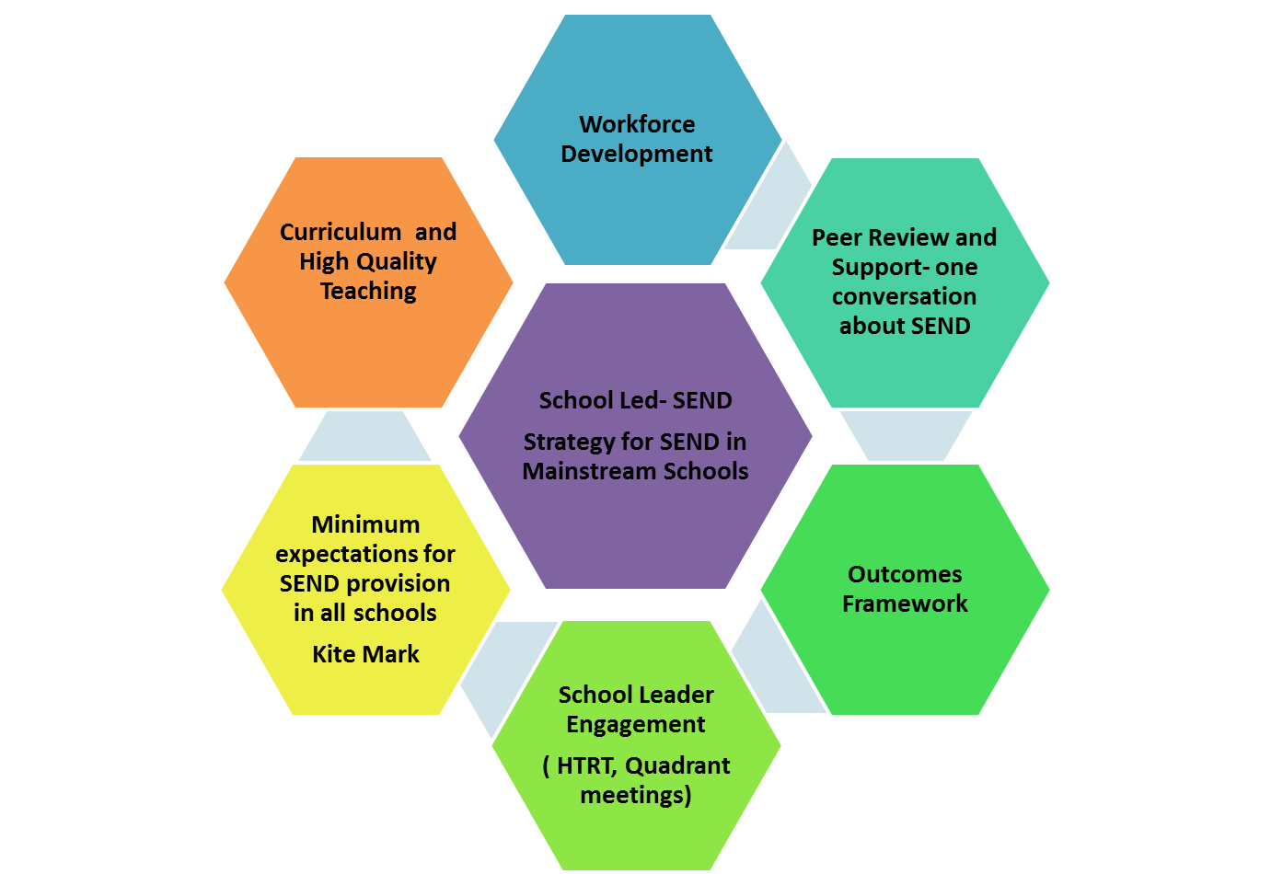

Slide 19
Key elements
Developing a shared language and understanding
Developing communities of professional practice
Capturing the expertise
Ensuring the best outcomes
Local projects

Slide 20
Progress …
Inclusion Position Statement now complete
Universal provision expectations ( minimum expectations) work beginning- linked to SEND strategy and using the current SEND provision guidance as a starting point
Outcomes Framework initial version complete and training programme being developed ready for roll out in September
Partnership SENCOs identified- space for more
SEND Peer Review – the one conversation about SEND- first training completed led by David Bartram OBE, pilot reviews taking place by the end of term. Next training September
Discussion about exclusions with ASHE and the start of a conversation with EPHA at EPHA exec.

Slide 21
The Exclusion discussion so far…
Proposals are
Develop a managed move protocol across the County including when they are appropriate, when they can be terminated, when pupils transfer to their new schools
Protocol for when elective home educated children return to school
Seek a commitment from schools to admit a pupil returning from a PRU, managed move or PR1’s every time they use permanent exclusion
Ensure county- wide data is made available at each EPHA meeting from the LA.
There is a need to address social factors which are leading to exclusions – gangs, county lines, drugs, knives
Develop an expanded offer from PRUs – outreach and short-turn around provision
We need to review the arrangements for anxious school refusers and pupils with mental health needs
We need transition plans for primary pupils in PRUs, GROW or those at risk of disengagement in Yr 7
Look at other models to learn from them and adapt them to our needs

Slide 22
Steve Whitfield Admissions to GROW Emma Prince EVOLVE Intervetion

Slide 23
Admissions to

Slide 24
Learning over the last 6 years
Challenges and tensions about referrals
high demand and how to prioritise; school and LA referrals
what happens when there is no space- waiting lists don’t seem to work
how do we really know a referral is appropriate
how to engage in meaningful partnership and maintain parental confidence in the partnership
How to create a system that
is fit for purpose
has a flow through it
is fair and transparent
How to attract the staff to join the teams
this is work that demands special qualities
supported thorough training and effective support
providing a career path for these people

Slide 25
Working in partnership with North East Essex Cooperative Academy (NEECA)
Why?
the children often have the same profiles and same needs
peer support and review
to increase capacity
to create and enable flow through the system; enabling and preparing children to find a way back into their own communities
to enable children to have a roll status

Slide 26
Where from?
Creates capacity and enables local reconnection
Provides a solution other than OOA or LA directing
GROW
NEECA
Wells Park
School referral
SAS
Creates capacity and enables local reconnection
Enables and supports inclusion provides staff support /training

Slide 27
Referrals from schools
All referrals are part of a partnership
Completion of the referral form- available on the website
Submit to the provision
Head of Provision will phone once received informing you of the likelihood of support

Slide 28
Capacity within GROW in the Mid
The provisions
Mainstream Teams
Braintree GROW- Lyons Hall
Chelmsford GROW- Newlands Spring

Slide 29
Where do the children move on to?
Referrals from mainstream are always within a partnership- the child will remain on roll and will return to the school
Referrals from NEECA always need an exit at commencement- we thus need willing partners to give the children another chance
Referrals from Wells Park normal exit is the mainstream secondary but not always
Referrals from LA SAS normal exit is the GROW mainstream provision

Slide 30
How it can work- child F
family moved to Colchester (Nov 2016) – child Yr. 1 with EHCP
- complex and multiple needs
GROW intensive (Colchester)
placed into LA care (Jan 2017)
long term carer found in Braintree (March 2017)
GROW Braintree in (April 2017)
commenced transition to local mainstream (Jan 2018)
on role of mainstream (March 2018)

Slide 31
How it can work- child D
Referral to GROW (Chelmsford) September 2016 – Yr. 1
GROW Chelmsford in (Jan 2017)
commenced transition to local mainstream (Sept 2017)
Now back at the school full time

Slide 32
GROW
is not only the name of a provision but it is an evidenced based model and now importantly it is also practice based evidence.
is underpinned by research from neuroscience and trauma informed research.
As such
Schools can
use the model for enhancing their own provision providing
they use it as designed
John Bunyan –Braintree
SEAT MAT in Basildon and Chelmsford
have training and support for their staff

Slide 33
Going forward
I know we are not there yet
I can assure you that we are trying to do the best we can
I am always willing to listen to how better to support schools.
Please feel free to email me with any thoughts
stephen.whitfield@essex.gov.uk

Slide 34
Coffee

