Slide 1
EPHA Area Meeting Essex County Council South Quadrant Clare Kershaw – Director for Education and Lifelong Learning Lisa Fergus – Assistant Director Maz Norman – Head of Education and Early Years Thursday 6th November 2025

Slide 2

Agenda
9:10am - 9.40am | Director’s LA Updates | Clare Kershaw (Director for Education)
9.40am - 10am | Attendance Table Discussion | Maz Norman/ Clare Kershaw
10am – 11am | Strategic Update: Ofsted’s Renewed Inspection Framework | Peter Stonier (Senior HMI, Ofsted)

Slide 3
2025 ATTAINMENT OUTCOMES District & Cohort Focus

Slide 4
Caveats and data information
EYFS & Year 1 Phonics data – 2025 outcomes collected from schools this summer. Data has not been formally published by DfE but is not expected to change from that used in this pack.
KS2 data – 2025 outcomes are based on the provisional dataset supplied by DfE in July 2025. Revised data not available until December 2025 but any changes likely to be minimal.
KS4 data – the 2025 data collection from schools is incomplete and as such must be treated with some caution. It only uses data from mainstream schools and is purely based upon aggregated figures submitted by schools on results day in August. Official DfE data not available until October 2025.
KS1-2 progress scores – there will be no data for 2025. This is due to there being no KS1 data for the pandemic years of 2020 and 2021 against which KS2 performance can be mapped.
Pupil groups data – to aid visual interpretation of these tabs, a colour scheme is used to denote the highest and lowest performing districts.

Slide 5
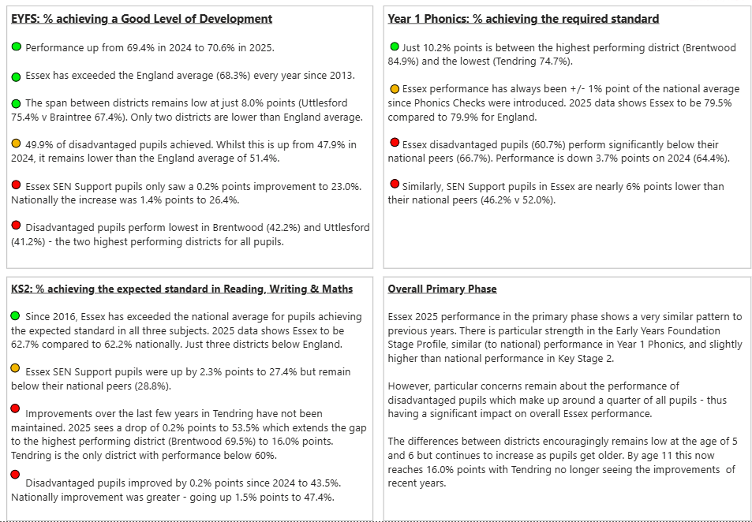
Key Messages for 2025 attainment outcomes

Slide 6
EYFS - % pupils achieving a Good Level of Development

Slide 7
EYFS - % pupils achieving a Good Level of Development

Slide 8
Year 1 Phonics - % pupils achieving the expected standard

Slide 9
Year 1 Phonics - % pupils achieving the expected standard

Slide 10
KS2 - % pupils achieving the expected standard in RWM

Slide 11
KS2 - % pupils achieving the expected standard in RWM

Slide 12

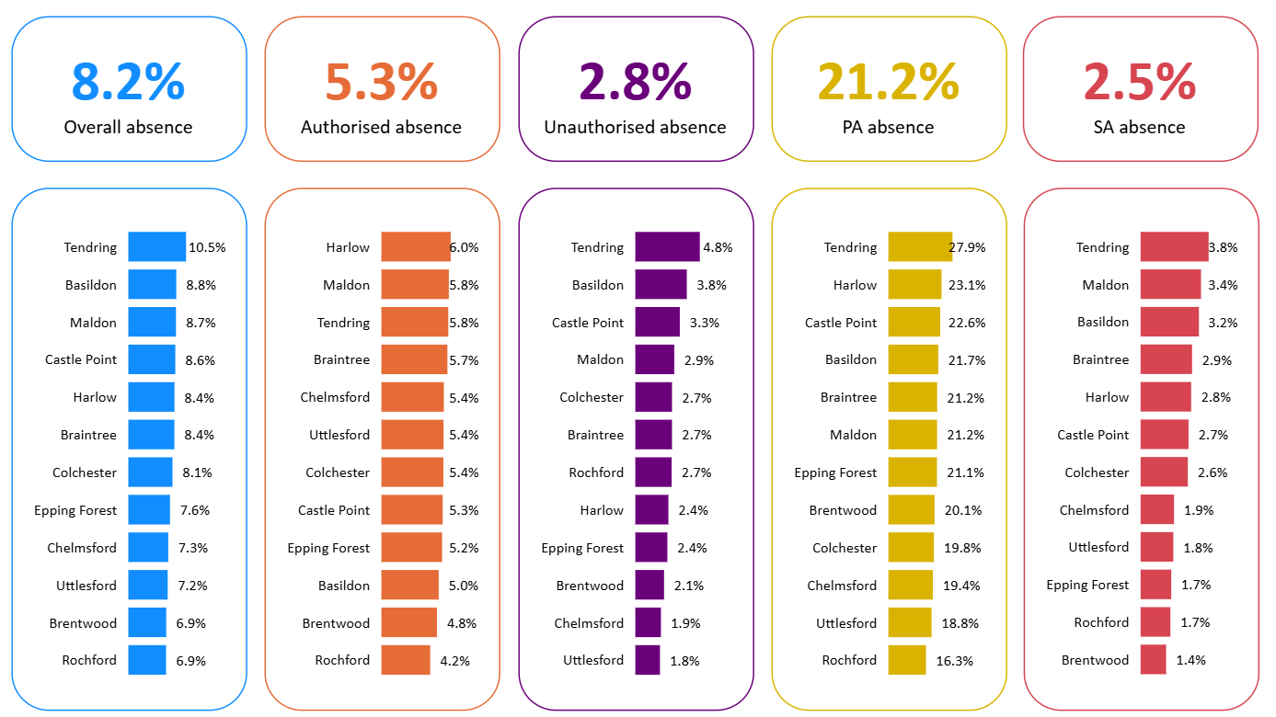

Attendance
Essex
15th Sept:
the DfE published an update that school attendance data will be shared with Ofsted from November 2025.

Slide 13
Essex priorities
Ongoing development of strong partnerships and promotion of collaborative working across all schools
SEND – ongoing improvement of the system.
Inclusion Strategy incl.
Attendance
Ordinarily Available Inclusive teaching framework
Inclusion Conference
Inclusion Reviews
Essex Year of Opportunity
School place planning

Slide 14


The Ordinarily Available
A pupil has SEN where their learning difficulty or disability calls for special educational provision, namely provision different from or additional to that normally available to pupils of the same age. Making higher quality teaching normally available to the whole class is likely to mean that fewer pupils will require such support. Such improvements in whole-class provision tend to be more cost effective and sustainable.
SEND Code of Practice 6.15
Ordinarily Available: Targeted Support
for some pupils
“provision different from or additional to”
delivered by Early Years practitioners, classroom teachers, pastoral and SEND teams, overseen by SENCO
Specialist
Targeted
Universal
Ordinarily Available: Inclusive Teaching Framework
for all pupils
“whole class provision”
delivered by classroom teachers and subject teachers, overseen by curriculum lead for teaching and learning
Specialist
Targeted
Universal
Self-evaluation audit tool available on Infolink

Slide 15
Education Health Care Needs Assessments
Recruitment and retention of Educational Psychologists
Commissioning of an agency to deliver EP assessments
Developing our approach to using ‘virtual assessments’ where appropriate - led by Essex CC on behalf of the East of England
Increasing our associate EP pool, which is our workforce that supports the central EP team.
Invested additional funding to expand our teams
Work to improve parental confidence in the offer from some mainstream schools which is driving both requests for assessment and requests for special school places.
Special schools being full or over capacity - additional challenges for the SEND teams.

Slide 16
SEND headlines - provision
2015 to 2023 – 53% increase in Essex pupils in maintained special schools in the county
Since 2015 four new special schools have opened in Essex (Chatten, Greenwell, Grove House and Hawthorns) with Sir Geoff Hurst in construction and a consultation open for a new special school in Rayleigh.
Investment in expansions and improved facilities at Cedar Hall, Glenwood, Harlow Fields, Kingswode Hoe, Langham Oaks, Lexden Springs, Market Field, Oak View, Ramsden Hall and Southview.
Development of Market Field Farm – a unique and innovative new provision funded via a developer’s enabling contribution.

Slide 17
(cont.) SEND headlines - provision
New PRU builds in North-East and South with Mid PRU in development (the first time there has been investment in our provision for children and young people who have been excluded or medically unable to attend school).
Investment in specialist provision in mainstream schools (Grow/SEMH provision, autism support centres, new provision for children with severe learning difficulties).
An overall capital investment of over £110 million and rising.

Slide 18
Wider Continuous Improvement
This Transformation Programme will sit on solid foundations of service improvement. The service lead continuous improvement has already delivered:
Improved quality One Planning – leading to high quality EHCNAs and a low refusal rate
High quality EHCPs, assured through a multi-agency quality assurance process
Streamlined and consistent decision making
Updated guidance, training and process improvements for Annual Reviews
Improvements to Early Years oversight, One Planning and funding
Improved oversight of children and young people receiving education other than in school (EOTIS)
Ordinarily Available framework
Support for mainstream schools with children awaiting specialist provision

Slide 19

Education Access
Medical team: key responsibilities
Arrange suitable alternative education where the section 19 statutory duty is met
Attend planning & review meetings with schools, families and other professionals
Plan and support a child’s return to school where appropriate
Key contacts: Vicky Young, Melissa Brooker & Eloisa Dellas
Exclusion team: key responsibilities
Support schools with CYP on the cusp of exclusion to consider suitable alternatives
Fulfil the LA statutory duty to provide education from day six following notification of permanent exclusion
Review alternative provision to ensure it remains suitable to the CYP needs.
Provide advice and guidance to schools on exclusion process.
Triage all requests for support- supportive intervention for CYP who would benefit from a time limited intervention placement in AP.
Key contacts: Diane Kirsh & Deborah Barnard

Slide 20
Education Access
Section 19 ‘otherwise’ team: key responsibilities
Consider all referrals for CYP who are not attending school under the LA wider section 19 ‘otherwise’ duty.
Represent the Education Access team at the S19 panel- multiagency meeting to consider all cases where it is unclear whether our statutory duty has been met.
Monitor all children on reduced timetables.
Support children accessing non-school alternative provision, who are not on a school roll to find a suitable school place, where they have been identified as ready to reintegrate.
Represent the Education Access team at MACE
Represent the Education Access team at Behaviour & Attendance Partnership meetings.
Key contacts: Ross Thompson & Sharon Bryan
QA team: key responsibilities
Monitor daily attendance for all children who are not on a school roll accessing unregistered alt ed.
Monitor all safeguarding and child protection matters for the not on roll cohort.
FSM checks for not on roll children- issue weekly supermarket vouchers to eligible families.
Quality Assurance including quality visits for providers on the IPES framework.
Oversee the Essex Online school.
Key contacts: Megan Keeble & Anna Wightman

Slide 21

Alternative Education provision
89 AV1s
Registered alternative provision schools
IPES Framework
Online school
Support the child to access their classroom. Can also be used to supplement an AP offer.
Four registered alternative provision schools in Essex:
Mid Essex Cooperative Academy (MECA)- mid Essex
North Essex Cooperative Academy (NEECA) – N/E Essex
Beckmead Moundwood Academy- west Essex
Children’s Support Service (CSS)- south Essex & west Essex for medical support
Often commissioned where registered AP school is at capacity or unable to meet need. IPES framework is divided into four lots:
Lot 1: Tuition
Lot 2: Vocational
Lot 3: Online
Lot 4: Mentoring
Essex Online school is delivered by Tute education. The online school is often used to provide interim support whilst longer term options are being considered.

Slide 22

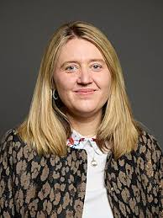
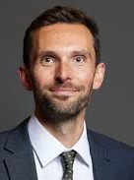
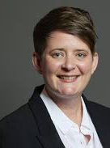
Government updates
Minister for School Standards:
Georgia Gould MP
Minister of State
The RISE programme (7 schools in Essex in targeted intervention)
Best Start in Life Strategy published (Essex has received a GLD 78.4% by August 2028 (2025 71% GLD)
Ofsted revised framework
Curriculum and assessment final report due
Schools White Paper
DfE Accountability reforms
Outlines DfE will move forward with school report cards
Minister for Children and Families:
Josh MacAlister OBE MP Parliamentary Under-Secretary of State
Minister for Early Education: Olivia Bailey MP Parliamentary Under-Secretary of State

Slide 23




Universal offer – national priorities
The government’s Opportunity Mission is focused on breaking down barriers to opportunity. In the DfE our mission priorities are:
Best start in life | Every child achieving and thriving | Skills for opportunity and growth | Family security
High-quality early education; early-child health; home-learning environment; family support | High school standards with a broad curriculum; focus on school belonging; excellent teachers and targeted interventions; mental health support; access to arts, culture and sport; youth services and provision | A strong skills offer; pathways into work – youth guarantee, work experience, careers advice | Removing underlying barriers to opportunity, including: Tackling child poverty and improving housing Keeping children safe
The mission priorities inform the four national priorities for RISE universal support – all focused on raising standards and removing barriers to learning
Better Attendance
Attainment with a focus on English and maths
Reception Year quality
Inclusive mainstream

Slide 24



RISE Teams: Objectives
The goal of RISE teams is to raise standards for all schools, as part of the government’s Opportunity Mission.
There are three broad strands of work:
Targeted Intervention: Schools facing particular challenges (‘stuck schools’) improve rapidly through bespoke targeted intervention for 12-24 months.
Universal Service: Ensuring all schools can access high quality school improvement through improved signposting to hubs and best practice, facilitating connections, and promoting peer review and networking.
Regional Planning: ensuring every part of the country has a coherent plan to deliver the RISE national priorities.

Slide 25

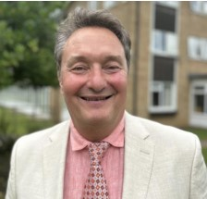
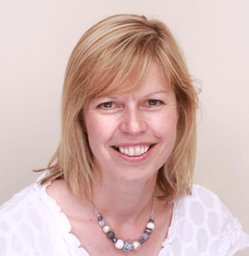



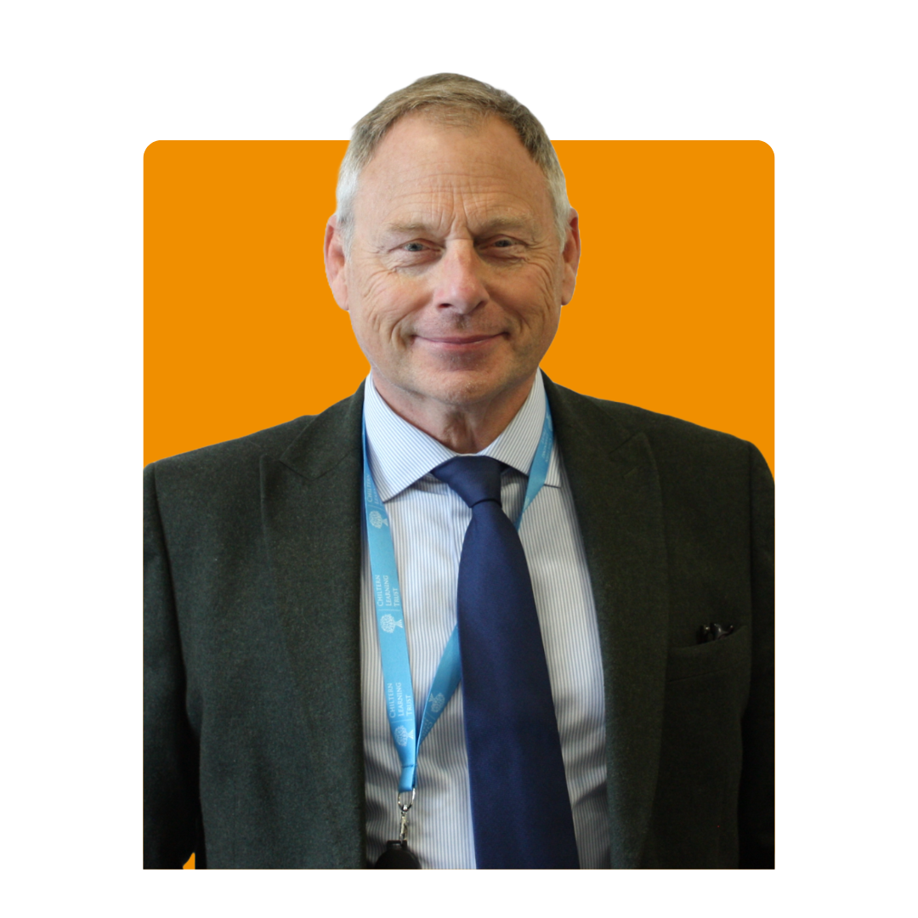

Our EoE RISE advisers
Our EoE RISE advisers
Jonathan Taylor – CEO, Sapientia Education Trust
Lesley Birch – Deputy CEO, Meridian Trust
Lucie Calow – Director of SEND, Unity Schools Partnership
Clare Flintoff – Previously the CEO of ASSET Education
Lucy Scott – CEO, Eastern Learning Alliance
Julian Axford – Director of School Improvement, Chiltern Learning Trust

Slide 26
How LGR and Devolution Work Together
The Devolution Priority Programme and Local Government Reform (LGR) are interconnected, forming two sides of the same transformation coin in England’s governance landscape
Devolution transfers new powers to Greater Essex from Westminster with control over functions essential for business growth; skills, transport and housing.
Local Government Reform (LGR) supports effective implementation of these services: streamlined structures and stronger councils working with the Mayor to drive growth.
Three Unitaries align with economic corridors, making joint planning and delivery simpler.
Without change, the Mayor inherits a fragmented system – slower decisions, weaker growth outcomes.
With change, Essex can move faster and with more certainty through streamlined & larger unitary councils better positioned to receive and manage powers with the Mayoral Combined Authority.

Slide 27
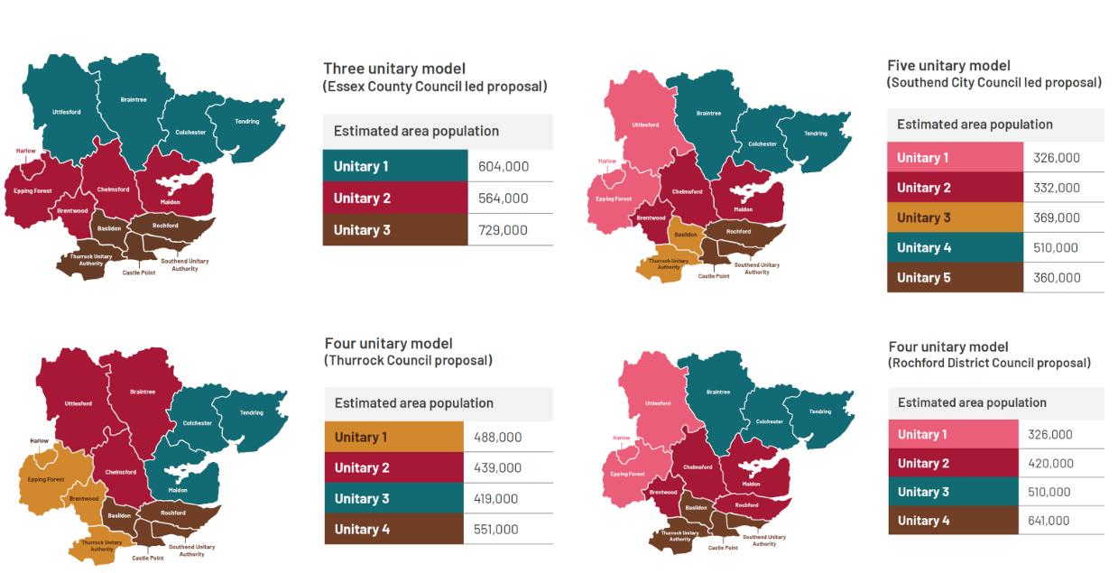
Four business case options from Greater Essex

Slide 28
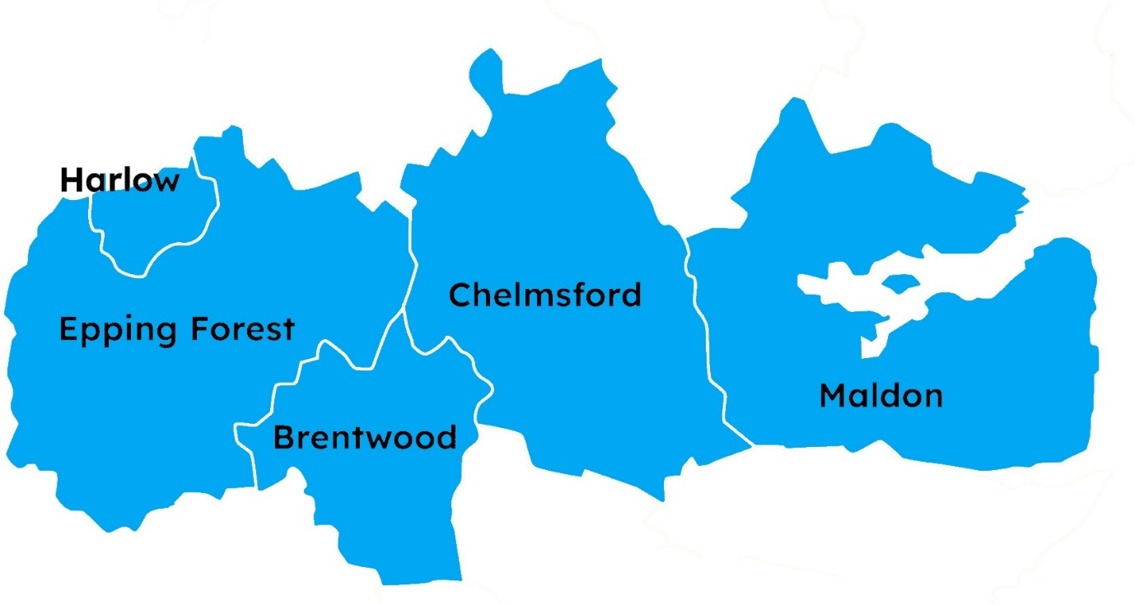
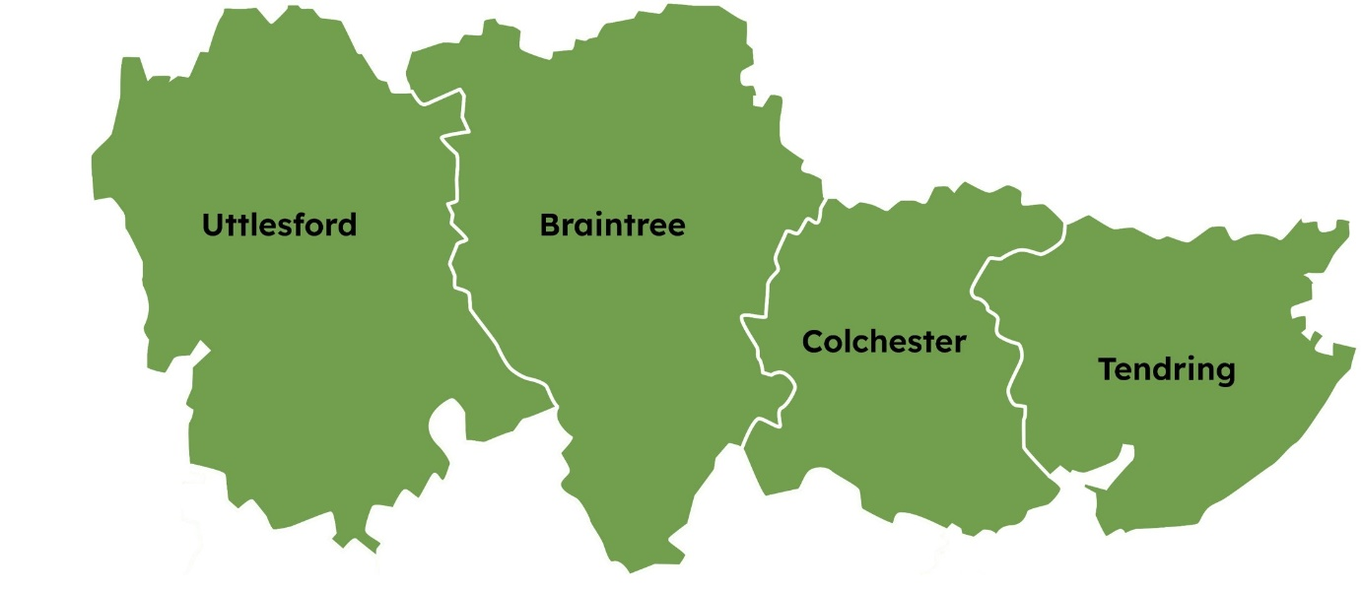

Our proposal: Three New Councils for Greater Essex
North Essex Unitary
Mid Essex Unitary
South Essex Unitary
Geography: Brentwood, Chelmsford, Epping Forest, Harlow, and Maldon.
Population: 564,000; projected 4% growth by 2040
Economy: £17.6bn GVA; 259,000 jobs.
Transport links: A12 and M11 corridors and Great Eastern Main Line.
Sector strengths: Life sciences, professional & financial services, construction, digital technology.
Key growth sites: Chelmsford Garden Community, Harlow Gilston Garden Town.
Additional homes needed by 2040: 67,000
Geography: Basildon, Castle Point, Rochford, Southend, and Thurrock.
Population: 729,000; projected 10% growth by 2040
Economy: £19.1bn GVA; 317,000 jobs.
Transport links: Thames Freeport, Southend Airport, A127, the A13 and the Essex Thameside rail corridor.
Sector strengths: Logistics, construction, clean energy, advanced manufacturing.
Key growth sites: Dunton Hills Garden Village .
Additional homes needed by 2040: 77,000
Geography: Braintree, Colchester, Tendring, and Uttlesford.
Population: 604,000; projected 10% growth by 2040
Economy: £14.2bn GVA; 249,000 jobs.
Transport links: A120, A12, Stansted Airport, Harwich Port.
Sector strengths: clean energy, life sciences, digital tech, manufacturing, logistics, tourism.
Key growth sites: Tendring-Colchester Garden Community
Additional homes needed by 2040: 64,000

Slide 29
Why Three Unitary Councils?
Aligned to real economic geographies (North, Mid, South Essex)
Balanced size, strength & resilience
£387m savings by 2040 – payback in 2.7 years
Less disruption, lower risk, quicker transition
Any more than three unitaries…
Higher costs, diluted capacity
More complexity, slower growth
Mayor works with a fragmented, unstable system

Slide 30
High-level timelines (LGR & Devolution)
Local Government Reform | Date |  | Devolution | Date
Submission of formal unitary proposals submitted | 26 September 2025 |  | Final Greater Essex proposals submitted to Government | September 2025
Statutory consultation on Governments preferred option | November 2025 – January 2026 |  | Legislation laid before parliament | Autumn 2025
Government decision to implement a proposal | March 2026 |  | Parliamentary scrutiny and approval | Late 2025
New Unitary Authority Elections | 6th May 2027 |  | Legal establishment of Greater Essex MCCA | Early 2026
Shadow period | May 2027 – March 2028 |  | Mayoral Election | May 2026
New Unitary Authorities go live | 1 April 2028

Slide 31

Wraparound Childcare
Application Closing Dates
10th Nov | 9th Feb
8th Dec | 9th March
12th Jan
By 2026 the Government expects all primary schools to have onsite childcare 8am until 6pm during term time.
Schools are required to signpost local wraparound provision on their websites.
88 schools in Essex still offering no or unknown wraparound childcare, 1 of those is in South.
152 Schools offering partial wraparound (either before/afterschool or not full hours), 47 of those are in South.
Funded 11 South providers – £330,000 of grant spent.
353 places created in the South Quadrant.
Notes:
DfE expect ALL schools to signpost the local wraparound provision – regardless whether they are offering wraparound onsite – wraparound team have a toolkit they have sent to all schools of example messaging to put on website (can resend to those that need it)
We have a list of third-party providers that would be happy to run wraparound at the school on the schools behalf, if school interested email wraparound.childcare@essex.gov.uk
Applications still open – will close when all money is spent

Slide 32
DfE Change of Guidance
DfE have introduced greater flexibility to fund partial wraparound childcare places, aiming to support the final schools to join the initiative. The priority remains to delivery full wraparound childcare, and any settings currently offering partial provision should be encouraged to move toward a full offer.
Minimum offer:
3 days/week
Breakfast club: ≥ 30 mins before school
Afterschool club: ≥ 90 mins after school
SEND Considerations
Case-by-case exceptions for SEND settings
May include shorter hours or fewer days
Out of School Inclusion Funding (OOSIF) is available to support wraparound providers with children who have a SEND need identified within the EHCP, one plan or similar process.
https://eycp.essex.gov.uk/funding/funding-to-support-inclusion/out-of-school-funding/
Can Fund | Cannot Fund
After school only if breakfast club is also available (e.g. Greggs Programme, Early Adopters) | Standalone breakfast or afterschool clubs
Monday–Thursday provision
Monday–Thursday + early finish Friday
Finishing at 16:30
Notes:
DfE changes – now accepting partial provision eg 3 days a week instead of 5. Highlight must be 30 mins before school day and 90 mins after
Can work on a case by case basis for special schools

Slide 33

Contact Us
For general enquires and more information please contact:
Wraparound.childcare@essex.gov.uk
For support on applying for funding please contact:
Caroline.brown@essex.gov.uk

Slide 34

Attendance Table Discussion
Heads of Education

Slide 35
Improving Attendance
Attendance continues to be at the forefront of everyone’s mind.
You can have the most amazing curriculum or teachers or pastoral support, but if the children aren’t in school – they don’t get to experience any of it!
The DfE ‘Working Together…’ document (republished in August 2024) is clear that Trusts, Local Authorities and schools must focus on
“the link between improving attendance and wider school culture……”
What is in YOUR control?
Notes:
National research demonstrates that fining parents has not led to significant changes in attendance improvement
Pupil voice? Family voice? Seldon heard voices?
Trends and patterns – curriculum/ subject delivery vs. trends of attendance? Per cohort?
How do you celebrate pupils’ attendance? How do you make attendance ‘everyone’s business” throughout the school and wider staff

Slide 36
CELBERATE What is working well with your school’s current approach to attendance? | EXPLORE What isn’t working well with your school’s current approach to attendance?
BARRIER What could work well and what is the barrier to this currently? | OPPORTUNITY What would make the biggest difference to whole school attendance for you?

Slide 37

Strategic Update: Ofsted’s Renewed Inspection Framework
Peter Stonier
Senior HMI, OfSTED

Slide 38


