Slide 1
Self-harm prevention and self-harm management toolkit for educational settings Workshop
30th November 2017
Notes:
START = 13H30 – 14H15
START = 14H30 – 15H15

Slide 2
Before we start………..
Welcome & Introduction
Questionnaire
Emotional wellbeing - Health and Safety!

Slide 3
Sharon O Love ( Project Manager)
Notes:
Future in Mind (NHS England 2015) has a vested interest in ensuring that everyone who works with children and young people should be excellent in their practice and able to deliver the best-evidenced care. Workforce development is essential and all staff should have access to a range of training opportunities, ‘SHARP (Self Harm Awareness & Resource Project) have delivered a range of programmes to a wide range of stakeholders, in addition to training provided as part of the Wellness in Mind Strategy’. (Nottingham City & Nottinghamshire Joint Local Transformation Plan Children and Young People’s Emotional and Mental Health 2016 – 2020).

Slide 4
Rationale for SHARP
Self-harm in children and adolescents has been identified as a significant public health issue
The department of health estimates that self-harm represents one of the top five reasons for admission in Accident and Emergency services. (NSPCC, 2009; National)
The variability in prevalence observed between hospital data and statistics at community level suggests that the vast majority of young people who harm themselves do not attend hospital nor receive medical treatment as a result and remain “hidden” within the community (Madge et al, 2008)
The rate for self-harm hospital admissions in Nottingham was 158.7/100 000, significantly higher than the England average (Health profiles, 2014)
SHARP is funded by Nottingham City Clinical Commissioning Group

Slide 5
SHARP Objectives
Raise awareness, build confidence and skills by providing support to front-line professionals who offer intervention and manage young people who present with self-harm and suicidal behaviours.
SHARP Practitioners also provide clinical and creative interventions to young people empowering them with opportunities and strategies to manage and recover from the effects of self-harm, minimising the risk of future harm.
Notes:
SHARP team compromises of Practitioners with varied experience and professional qualifications in Health, Education and Social Care.
SHARP Practitioners offer evidenced based therapeutic interventions to children and young people who present with self-harm and/or suicidal behaviours. SHARP use a strength based approach when working with individuals, ensuring that safety planning and risk is identified early and are managed effectively.
SHARP aims to equip professionals with the appropriate skills and resources to enable confidence and good practice when working with children and young people.
All of the SHARP training workshops are developed through our learning and knowledge gained from working with children and young people, including those who have presented at Children’s Emergency Department. SHARP have also carried out a significant amount of research into the experience and needs of children and young people who self-harm, our resources are unique, creative and current, they have proved to be an essential part of a practical toolkit for many front-line professionals who support children and young people.

Slide 6
The SHARP Model
Notes:
SHARP team compromises of Practitioners with varied experience and professional qualifications in Health, Education and Social Care.
SHARP Practitioners offer evidenced based therapeutic interventions to children and young people who present with self-harm and/or suicidal behaviours. SHARP use a strength based approach when working with individuals, ensuring that safety planning and risk is identified early and are managed effectively.
SHARP aims to equip professionals with the appropriate skills and resources to enable confidence and good practice when working with children and young people.
All of the SHARP training workshops are developed through our learning and knowledge gained from working with children and young people, including those who have presented at Children’s Emergency Department. SHARP have also carried out a significant amount of research into the experience and needs of children and young people who self-harm, our resources are unique, creative and current, they have proved to be an essential part of a practical toolkit for many front-line professionals who support children and young people.

Slide 7
SHARP Training
Between Oct 2016 – Sept 2017;
SHARP delivered 133 training sessions
1400 front-line professionals attended SHARP
1151 said they had improved knowledge
83.7% improved overall knowledge
SHARP have delivered training to over 5000 professionals
Notes:
NICE guidelines highlight the importance of all healthcare professionals (clinical and non clinical) accessing training to equip them to understand and care for people for have self-harmed (NICE 2004).
Within the last 4 years, SHARP have trained over 4500 front-line professionals and delivered over 400 training sessions.

Slide 8
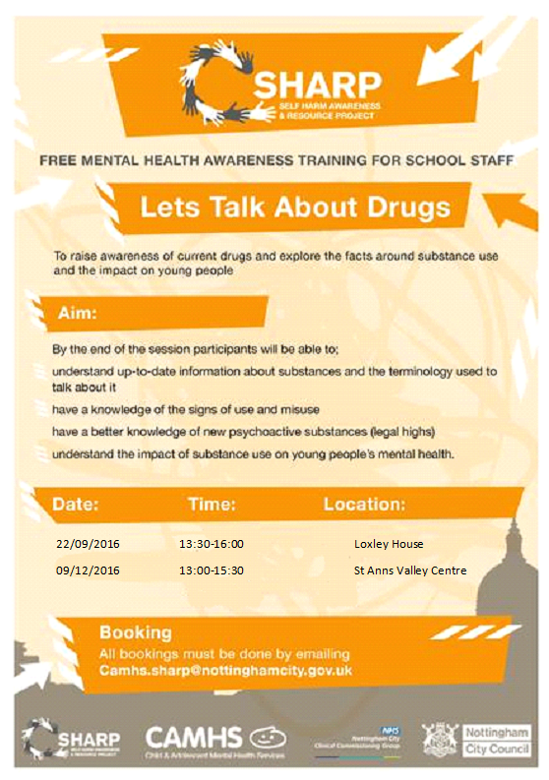
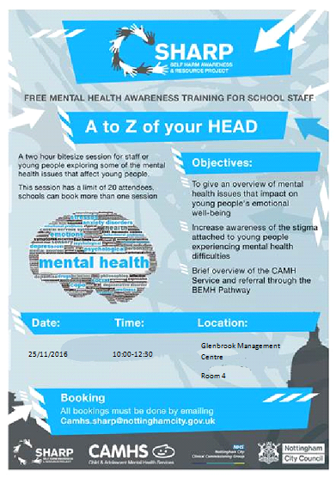
SHARP Training - Sessions
Self- Harm Awareness
Suicide – Everybody’s Business
Breaking the Silence
If Toys Could Talk
Understanding Girls who Self-harm
The Transgender Child
A to Z of Your Head
Let’s Talk About Drugs

Slide 9
School Self-harm Clinics
Between Oct 2016 – Sept 2017;
Key early intervention in supporting CYP presenting with self-harm / suicidal behaviours by completing a risk assessment with the young person, providing a brief intervention and make further recommendations for school and wider network to support
72 secondary school self-harm clinics
135 CYP were seen in clinic
87% of CYP seen received ongoing support from Universal Services
100% of CYP seen did not require medical treatment for their self-harm

Slide 10
Support for Schools
“reassuring that I’m on the right track”
“useful to have space to reflect on the issues”
SHARP have developed a school self-harm guidance which has been embedded in safeguarding policy
Bite-size refresher training is offered to all schools
All secondary schools have a SHARP Link Worker ensuring consistency and transparency
Consultation is available for all front-line professionals – between Oct 2016 – Sept 2017 368 professionals received consultation
CYP group work – ME:Source – Building resilience/DBT skills

Slide 11
Consultations
Between Oct 2017 – Sept 2018 370 front-line professionals received a consolation (CAMHS, Social Care, Education, Residential, DCT, Children’s Emergency Department, family Support, Spiral, Youth Workers, Attendance Officers) – 79% gave the highest feedback 5/5
Offer support, guidance and resources to any professional working with a CYP who presents with self-harm or suicidal behaviours
Weekly face to face and telephone consultations available for all professionals.
Facilitate reflective space to ensure CYP needs, strengths and risks are harnessed and appropriate support is offered – use Signs of Safety model
Average score of 9/10 on scale of helpfulness by professionals (0- not helpful, 10 - very helpful)
Notes:
SHARP works directly with children, families and the professional network around them, and can provide consultation to professionals in this context on a case-by-case basis.
The aim of this work is to support their understanding of self-harm and sucidality in children, and to develop relevant skills in order to support often very complex work with children and their families.
An independent evaluation of the service completed in 2015, concluded that ‘the SHARP project provides an effective intervention service for adolescents who self-harm both in a school and an NHS context. Findings from the interviews and the statistical analyses converged and corroborated one another. The survey of professionals working with children and adolescents who had undergone the SHARP training programme indicated that the programme had been useful and increased their knowledge of self-harm. Findings from the interviews with school and healthcare staff suggested that this increase in awareness had led to an increase in personal confidence and capability when dealing with cases of self-harm’.

Slide 12
SHARP 4 Parents/Carers
Monthly support group for parents/carers
Various themes including safety plans, building trusting relationships, managing crisis, understanding self-harm
Share information and guidance
Peer support space
Build confidence in managing self-harm

Slide 13
‘It’s Good to TALK but even Better to be HEARD’
Notes:
5 MINUTE WARNING AT 13H50
AND AT 14H50

Slide 14
Southend, Essex and Thurrock - Selfharm management Toolkit for educational settings Frederick van Heerden (Commissioning Delivery, ECC)
30th November 2017
Notes:
START AT 14H00
START AT 15H00

Slide 15
Background
Future in Mind: transformation of Children’s Mental Health
5 year Local Transformation Plan ‘Open Up, Reach Out’
New Emotional Wellbeing & Mental Health Service
Year 1: EWMHS engagement with schools to shape support programme
Year 1: review of suicide and self-harm prevention
Refresh existing suicide guidance for schools
Need for self-harm guidance with schools
Need for more emotional wellbeing information & advice
Year 2: putting learning into action

Slide 16
Process……….
3. Draft toolkit produced
4. Consultation:
We’ve looked at data, evidence and best practice
2. Partners identified who worked on the toolkit
Notes:
Partnership working group includes: Safeguarding, educational psychology, mental health/children’s commissioners, EWMH service (NELFT) etc
Data analysis and best practice
We’ve looked at the evidence – 4 key areas complete
Data analysis complete – what do we know about self harm in Essex?
Evidence review complete – what coping strategies does evidence suggest are helpful for young people in coping with self harm?
Best practice visit to a self harm service
Desktop review of self harm guidance best practice in other areas
2. Partners
Partners identified who worked on the toolkit:
We’ve established a partnership working group to work on the toolkit including representatives from safeguarding, EWMHS, educational psychology
4. . Consultation underway:
Interviews with 10 EWMHS service users who have experience of self harm
Schools safeguarding forums
Online consultation to be circulated to schools (infolink newsletter)
Wider partners via e-mail

Slide 17
Consultation and feedback:
Essex School Safeguarding forums (x6) – June/July
Schools and school nurses - Essex
Education SEND, ECC
Social care staff, ECC
Responses from Suicide prevention toolkit Focusgroups (2016)
Youth Service, ECC
Virgin Care, 0-19 Service, Essex
Directors of Nursing, NELFT
Clinical feedback across EWMHS
CCG’s – Basildon & Brentwood, Thurrock, Mid Essex
Named nurses – Southend, Thurrock CCG and BBCCG
Public Health – Thurrock
Voluntary sector
District Council - Harlow
Southend consultation feedback
Young people engagement feedback - NELFT

Slide 18
So what does the Toolkit look like………?

