Slide 1
The role of Educational Psychologists in Essex EWMHS hubs
Essex Educational Psychology Service
Improving lives: using psychology to create positive change

Slide 2

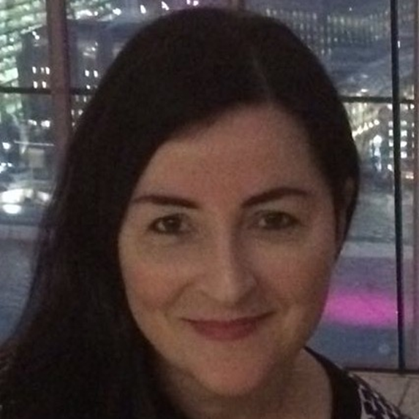

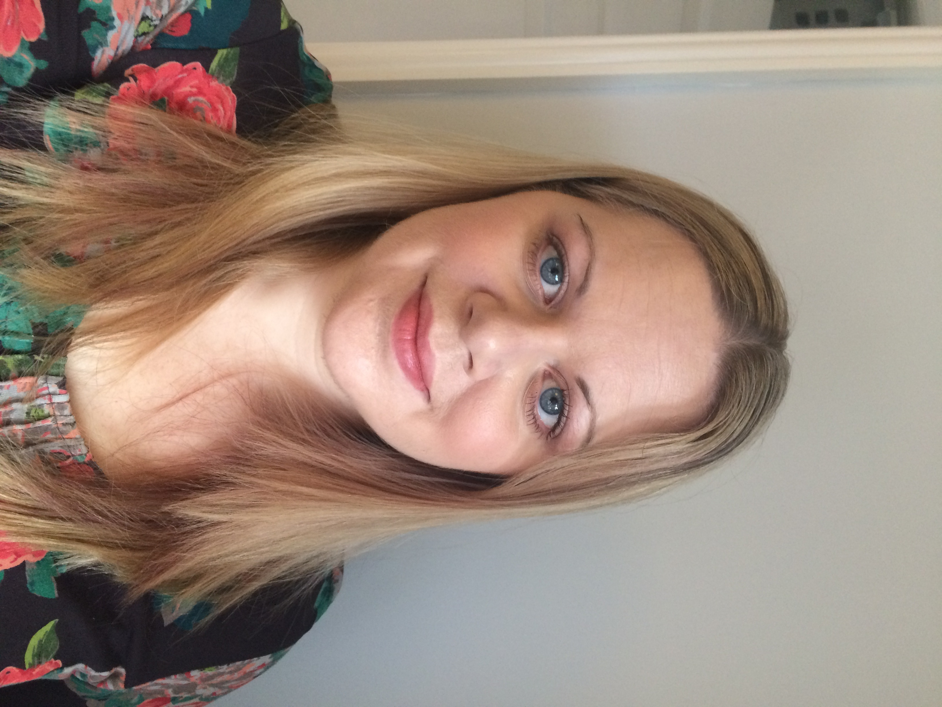
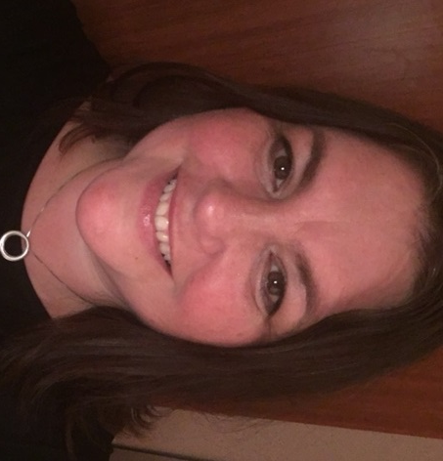
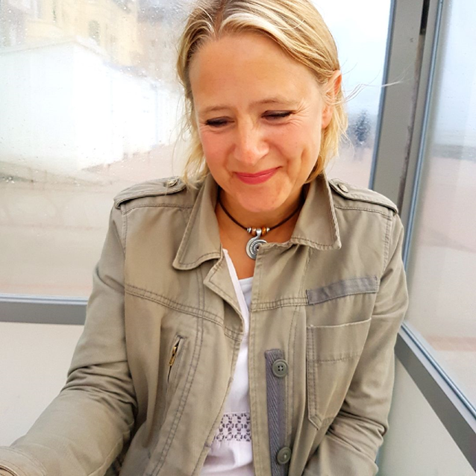
EPs working in Essex EWMHS
(since May 2019)
There are 5 Educational Psychologists across Essex who work one day per week for each EWMHS hub | Sophia Wareham (West) | Kate Barnett (Mid)
Laura Barton (CP&R, South) | Natasha Colley (B&B, South) | Jane Tyndale-Biscoe (North East)

Slide 3

EP work in Essex EWMHS
We try to have a core day dedicated to EWMHS work, but are also flexible with this and liaise with Hub Managers as needed.
The remainder of our working weeks are within quadrant EP teams. Some of us are part time: Jane, Sophia and Natasha 0.8; Kate 0.6
We work with EWMHS managers and EPS managers to plan strategic approaches to our work – specifically Samantha Morgan, (EWMHS) and Ros Somerville (Principle EP of EPS).
There is a clear strategy enabling consistency of service across all teams. EWMHS Managers can collectively contribute to the development of projects undertaken by the EPs.

Slide 4

EP work in Essex EWMHS
Our focus: Supporting EWMHS hubs to empower school staff and whole school systems via existing training work in schools and extending the training offer.
We liaise with EWMHS colleagues to plan and deliver the training programmes.
Our aim: To enable schools to further support the emotional wellbeing and mental health of children, young people and adults.
Key areas of work:
Support to schools in Essex, including
  Training (including follow up workshops to embed)
  Resources for staff to use within schools (e.g. access to materials online)
  Weekly telephone helpline for school staff re: wellbeing / mental health themes.
Support to Single Point of Access (SPA) team – weekly on a rota basis.
Support systemic work within EWMHS– linked to strategy for parity across hubs
Notes:
The role is NOT going to be focused on individual schools or C/YP cases – if there are issues arising re individual case, this can be discussed as a consultation with a view to informing what we would offer to schools / groups of schools eg themes coming up
We can consult with EWMHS hub staff about school systems and provisions as well as consulting with school staff around EWMHS work and helping schools to understand the windowscreen of need and referral systems / SPA etc

Slide 5
Schools training programme 2019 - 2020
Autumn term 2019 (currently underway)
Supporting CYP with Stress and Anxiety
ASD and emotional wellbeing
(Two part sessions: 1st session for information and 2nd session is a workshop to embed and plan support based on what they have learned from session 1)
Spring term 2020 (information to come soon)
Repeater sessions from Autumn term?
Needs analysis topics so far…
  School attendance difficulties
  Anger
  Low mood
Summer Term 2020
??

Slide 6

Schools helpline
Thursday afternoons between 12pm and 4.30pm (term time)
Six pre-bookable slots:
12.00pm, 12.45pm, 1.30pm, 2.15pm, 3.00pm & 3.45pm
For any member of school staff with concerns about the emotional well-being/mental health of children/young people they work with
Opportunity for consultation/problem-solving on any emotional wellbeing or mental health issue (not for discussing individual C/YP)
Not for referrals – please continue to use the EWMHS Single Point of Access (tel: 0300 300 1600)
Book consultations by emailing EWMHSschoolsadviceline@essex.gov.uk
State name / role in school / telephone number
You will be contacted by an EWMHS EP with the offer of the next available date and time slot

Slide 7

Further ideas for the future…
Please let us know (using the Post-it notes):
Ideas you have for emotional wellbeing or mental health topics which you feel would be particualry helpful to have training/support on.
Different ways in which school staff could access resources/training materials e.g. webinar (voice over PP) / podcast / video clips
What kinds of materials/activities do you think it would be helpful for school staff to have access to?
Ideas for how good practice could be shared across school communities and how info from training sessions can be embedded into school systems
Thank you!

