Slide 1
Primary Area Seminar
Tim Coulson
Regional School Commissioner
East of England and North East London

Slide 2
Outline
Update on performance across the region
High performing MATs
Features of high performing MATs
Schools that are not academies
- Discussion
Key Stage 2 – meeting the higher standards
- Discussion
‘Schools that work for everyone’ proposals
- Discussion

Slide 3
Miracle in the East
Shift the dialogue from structures to structures that deliver better standards
Expectations are rising in a context of shifting support for the system
Increasing social mobility
As has always been the case, the challenge is one of leadership

Slide 4
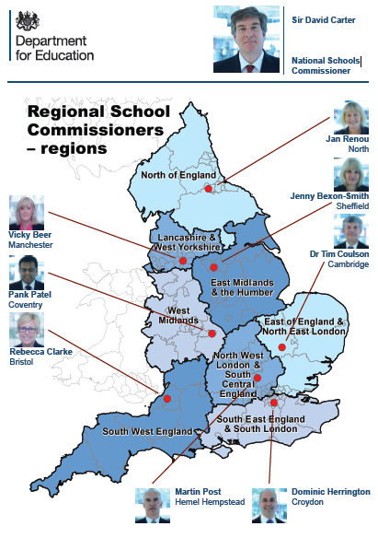
Why RSCs?
The eight Regional Schools Commissioners (RSCs) came into post in September 2014 and report to the National Schools Commissioner (Sir David Carter)
RSCs take decisions regarding academies on behalf of the Secretary of State. The Secretary of State remains responsible for the academy system and will hold RSCs to account for the performance of academies in their region.
RSCs provide expertise and local knowledge for the management of the academy system:
Develop school autonomy.
Give system leaders greater influence over the direction of the academies system.
Regional decisions, centrally supported – Supported by their Headteacher Boards, RSCs bring decision-making closer to schools by adding greater local/regional knowledge and context.
Create an evolving system – allowing flexibility for the system to continue to evolve as the number of academies and free schools grow.
Notes:
Very brief discussion of the RSC role (likely to be a number of LA maintained schools attending)
NB Christine Quinn replaces Pank Patel in the West Midlands from 3 October 2016

Slide 5
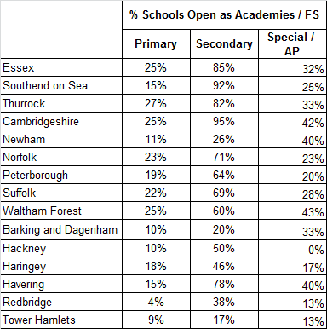
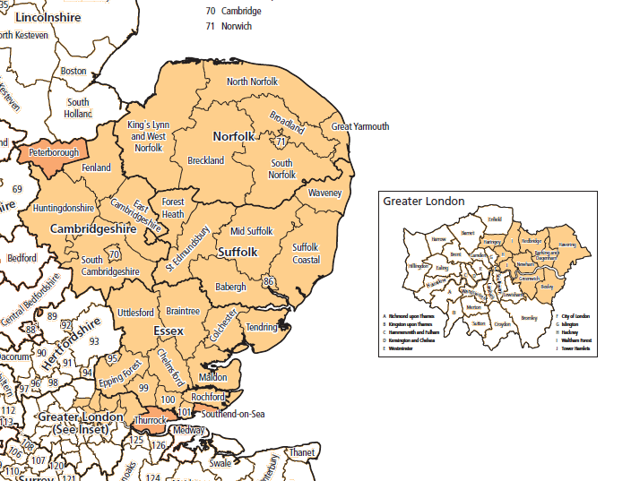
East of England and NE London

Slide 6
Headteacher Board
Provides advice and support to RSC decision making.
  Approve Academy Conversions
  Approve new sponsors
  Approve new MATS
  Challenge the RSC that interventions are effective & appropriate
  Add capacity to RSC office
Consists of eight members – 4 elected and 4 Co-opted / appointed. Members are headteachers, CEO’s of MAT’s and others with specific required skillsets.
Elected:
    Caroline Haynes (Tendring Technology College)
    Stephen Munday (CAM Trust)
    Debbie Rogan (HEARTS Academy Trust)
    Margaret Wilson (The King John School Academy Trust)
Appointed:
    Dame Rachel De Souza (Inspiration Trust)
    Sir Steve Lancashire (Reach2 Academy Trust)
Co-opted:
    Mark Jeffries (Mills and Reeve LLP)
Have extensive knowledge of the region and a breadth of educational experience.
Next elections for the HTB will take place in 2017 and planning is in place for this.

Slide 7
Changing role of the RSC
Devolution of functions and responsibilities from the ‘national core’ teams – greater local decision making

Slide 8
Overall objectives and structure of plan
Overall objectives and structure of plan for East of England and North East London
Our ambition is to drive up standards across the region so that every child attends a school or academy whose results are above the national minimum floor standard and is rated as good or outstanding by Ofsted.
We will do this by:
Building strong sponsors
Facilitating collaboration
Opening high quality new provision
Challenging underperformance
There are 141 approved academy sponsors in our region. We will meet all trusts of 3 or more schools during the autumn term.
We will use the meetings to identify those with potential to grow and those who need support to improve.
We will use our trust evaluation tool to identify areas for development and offer support, for example mentoring, CEO leadership training.
We will target Sponsor Capacity Funding to help develop trusts in priority areas of the region.
We will identify more sponsors and encourage outstanding schools and academies to support others.
We will use Academy Ambassadors to strengthen trust governance.
Collaboration lies at the heart of the school-led system. We will continue to work proactively with schools, academies, LAs, Teaching School Alliances and others to share best practice, support school improvement and the development of leadership and pedagogy.
We will continue to hold events to get system leaders to meet, share knowledge and best practice and form new networks.
With the Teaching School Council we will develop a website sharing best practice and making resources available for all to use.
We will work with Teaching School Alliances and the National College to ensure work focusses on school improvement and that school to school support goes to institutions most in need.
We will support the government ambition to open 500 new free schools during this parliament.
We will encourage existing high quality trusts to apply to open free schools.
We will identify the areas of areas of low social mobility and basic need in the region to ensure new provision is opened where it is most needed.
We will work with to encourage non-school based groups such as parents, charities and universities to open schools. We will also work with independent schools and faith based providers.
HTB members will play an active role in the interview process for free schools.
We will work closely with LAs who open new provision through the academy presumption process to ensure new provision is run by high quality providers.
We will balance support with challenge where academies are underperforming.
We will visit academies to understand obstacles to improvement before deciding how to intervene.
We will use local intelligence and relations with trusts to identify performance issues early.
We will use formal intervention in a small number of cases where academies have underperformed for a period of time or where we are not convinced by trusts improvement plans.
When required we will transfer academies to other trusts.
We will ensure that maintained schools judged inadequate by Ofsted become sponsored.
We will use our intervention powers where maintained schools are underperforming or defined as `coasting’.
We will monitor, support and challenge newly opened free schools to help ensure they are rated Good or Outstanding by Ofsted in their first inspection.
We will help to address common issues with UTCs and Studio Schools around pupil recruitment and funding.
N.B. Work strand 2b sets out our commitment to SESL staff and appropriate internal resourcing. We will not use for national reporting but will link with national indicators on expected capacity of staff.

Slide 9
Making sense of the accountability landscape
SATS and MATS are accountable for outcomes in their schools
OFSTED assesses how well schools perform against schools with same context
RSC challenge and support those schools not yet good enough
NCTL provides the pipeline of teachers and leaders and system capacity
Local authorities oversee SEN, admissions, safeguarding, transport and sufficiency of places

Slide 10
2016 Phonics outcomes
 | Percentage Meeting Expected Standard Year 1 | Percentage Meeting Expected Standard Year 2
Peterborough | 77 | 88
Cambridgeshire | 78 | 91
Norfolk | 78 | 91
Suffolk | 79 | 91
Southend on Sea | 80 | 91
Redbridge | 80 | 88
Essex | 81 | 92
Tower Hamlets | 81 | 92
Barking and Dagenham | 81 | 90
Haringey | 82 | 88
Thurrock | 83 | 92
Waltham Forest | 83 | 92
Hackney | 85 | 93
Havering | 85 | 94
Newham | 87 | 92
EENEL | 81 | 91
England | 81 | 91

Slide 11
2016 Key Stage 1 outcomes
 | Reading | Writing | Mathematics
Peterborough | 68 | 61 | 69
Suffolk | 72 | 64 | 71
Cambridgeshire | 73 | 63 | 71
Norfolk | 75 | 70 | 74
Barking and Dagenham | 75 | 68 | 75
Thurrock | 76 | 68 | 75
Tower Hamlets | 76 | 70 | 75
Essex | 77 | 68 | 74
Southend on Sea | 77 | 69 | 74
Havering | 77 | 70 | 77
Redbridge | 77 | 68 | 76
Haringey | 78 | 74 | 78
Newham | 79 | 75 | 79
Waltham Forest | 79 | 74 | 80
Hackney | 81 | 78 | 82
EENEL | 76 | 69 | 75
England | 74 | 65 | 73

Slide 12
Provisional 2016 Key Stage 2 outcomes
 | Percentage of pupils achieving the expected standard | Average of Reading progress score | Average of Writing progress score | Average of Maths progress score | KS2 below floor 2016
Norfolk | 49 | 0.02 | 0.76 | -1.18 | 18
Cambridgeshire | 49 | 0 | -0.8 | -0.72 | 16
Essex | 55 | 0.01 | 0.51 | 0.13 | 13
Suffolk | 48 | -0.43 | -0.96 | -1.26 | 13
Peterborough | 39 | -0.9 | 0.63 | -0.62 | 5
Hackney | 63 | 1.63 | 2.81 | 1.71 | 1
Barking and Dagenham | 57 | 0.2 | 1.59 | 1.7 | 1
Southend on Sea | 55 | -0.11 | 0.84 | 0.02 | 0
Thurrock | 51 | -0.93 | -0.12 | -0.4 | 0
Haringey | 49 | 0.91 | 2.97 | 1.47 | 0
Newham | 59 | 1.45 | 3 | 2.7 | 0
Tower Hamlets | 60 | 1.21 | 2.02 | 1.82 | 0
Havering | 62 | 0.8 | 1.11 | 0.82 | 0
Redbridge | 56 | 0 | 0.73 | 1.15 | 0
Waltham Forest | 53 | 1.07 | 2.76 | 2.29 | 0
EENEL | 53 | 0.15 | 0.64 | 0.00 | 67

Slide 13
2016 Key Stage 4 Outcomes
 | 5 A*-C GCSE inc En , Ma | Progress 8 average
Havering | 64% | -0.13
Essex | 65% | 0.01
Norfolk | 61% | 0.02
Suffolk | 61% | 0.02
Peterborough | 56% | 0.03
Thurrock | 64% | 0.05
Barking & Dagenham | 60% | 0.06
Southend-on-Sea | 70% | 0.06
Haringey | 64% | 0.12
Cambridgeshire | 69% | 0.14
Tower Hamlets | 65% | 0.14
Newham | 62% | 0.2
Waltham Forest | 64% | 0.28
Hackney | 71% | 0.29
Redbridge | 72% | 0.3

Slide 14
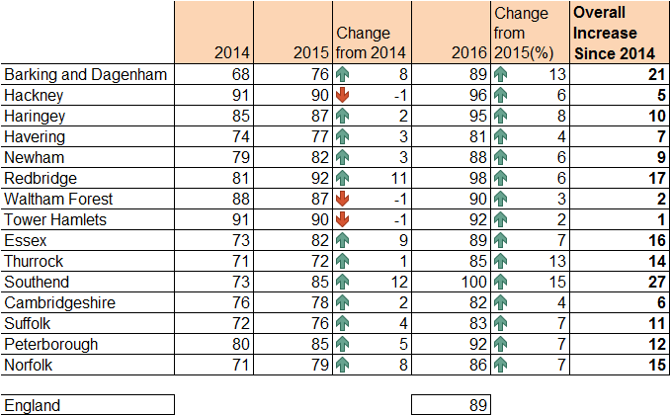
Ofsted Judgements – Primary

Slide 15

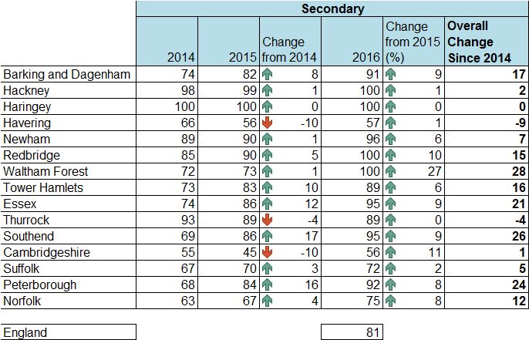
Ofsted Judgements – Secondary
East of England and North East London Region

Slide 16
Education and Adoption
Act 2016
Academy Orders
A duty on the SoS* to issue an Academy Order to all inadequate# maintained schools
A power for the SoS* to revoke an AO, for instance where a schools is found not to be viable
Duty to Facilitate
A duty on LAs and GBs to facilitate conversion where an AO is or has been issued to a school eligible for intervention. A power for SoS* to direct a LA/GB to take specified steps to facilitate conversion
Warning Notices
A power for the SoS* to issue Warning Notices to maintained schools (as exists now for LAs).
Inadequate Academies
Coasting
A power for the SoS* to terminate even the oldest academy funding agreements of inadequate academies quickly & easily
A power for the SoS* to intervene in coasting schools & academies (will apply once 2016 results are published & coasting provisions have been laid - Dec 16 Primary, Jan 17 secondary)
A Schools Causing Concern guidance published on the DfE website.

Slide 17
What is a ‘coasting school’?
A coasting school is where data shows that, over a three year period, the school is failing to ensure that pupils reach their potential. A school will only be coasting if performance data falls below the coasting bar in all three previous years.
Schools will identified for the first time in December 2016, based on revised 2016 performance data
The coasting definition is not linked to Ofsted judgments

Slide 18
Our role with coasting schools
Coasting schools are identified on data alone
All identified schools will have to submit information/a plan for how it will ensure improvement
We will have to decide whether the school:
  is supporting pupils well at this time OR;
  has a sufficient plan and capacity to improve OR;
  needs additional support/challenge OR;
  needs formal intervention in order to improve.
We then need to decide on what, if any, action is appropriate to bring about sufficient improvement

Slide 19
Coasting Process Overview
Immediately after final data publication
Notification letter sent to coasting schools advising that they have fallen within the coasting definition
School responds to notification letter
DfE school’s response and other evidence to decide upon course of action
RSC’s decision on next steps may fall within one of four broad headings:
No Action
School supporting pupils well at this time
No Action
Sufficient plan and capacity to improve at this time
Formal Intervention
Improvement only possible using formal powers
Informal Action
Support and Challenge arranged
Coasting school enters cycle of monitoring and review
Revise decision on action in response to developments where required
Arrange additional action as required
School improves and no longer falls within coasting definition

Slide 20
Free schools – the numbers
In England there are currently 429 open free schools and 236 pipeline (‘pre-opening’) projects. 77 of these projects were announced on 16 September 2016.
In the East of England and North East London region:
  67 open free schools including 7 University Technical Colleges and 2 studio schools. 20 open free schools are at primary phase.
  50 pipeline free school projects including 1 University Technical College. 24 pre-opening projects are at primary phase .
The latest application window closed on 28 September 2016. DfE does not publish the number or details of applications received until a later date.
Currently 86% judged good or better in the region

Slide 21
Free schools – how to apply
There are two main ways to establish a new school:
  Applicant group (of any type) applies centrally to DfE. Group puts forward case to apply wherever they choose. Application windows are open twice a year. Ministers decide final outcomes. Groups go through a ‘pre-opening’ phase before school opens.
  Local authority runs ‘presumption’ competition (at any time) in area of need for places. Only academy sponsors can apply. Local authority puts forward preferred sponsor. Regional School Commissioners (RSCs) agree or choose another sponsor. Groups go through a ‘pre-opening’ phase before school opens.
There is also a dedicated new route to set up special free schools. Local authority specifications will be published nationally at the same time. Any group will be able to apply. RSCs and local authorities will need to agree the successful bidder.

Slide 22
Free schools – future developments
DfE plans another central application window in or close to March 2017. Guidance and criteria for applicants will be published nearer the time. Applicants working on bids currently should use existing information published in July 2016.
Elements of the government’s current consultation – ‘schools that work for everyone’ – may impact the free schools programme. The government will consider carefully any comments about the proposals on selection, faith schools, independent schools and universities etc and what this might mean for the creation of new schools.

Slide 23
Questions
Daniel.Cooke@education.gov.uk about possible applications
James.Crane@education.gov.uk about current free schools that have opened
Useful links
www.gov.uk/government/news/more-choice-as-over-80000-new-free-schools-places-created
www.gov.uk/government/publications/free-schools-open-schools-and-successful-applications
https://www.gov.uk/government/publications/free-school-application-guide

Slide 24
Growing the system with care
Starter Trusts – first 5 or 6 schools up to around 1200-1500 children
Established Trusts - 5 to 15 schools or around 1200 to 5000 children
Regional Trusts-15-30 schools
System Trusts - 30 or more schools
5 Components in a Healthcheck
  Standards and Track Record
  People and Leadership
  Governance Capacity
  Risk Management
  Financial Sustainability

Slide 25
When multi-academy trusts work at their best……
Building a Community around moral purpose and high aspiration
The authority of the lead educationalist
Collective responsibility for the results of all children
  “If one fails we all fail”
Strategic governance allied to educational focus at LGB
Recruitment and retention
Career progression for staff
  retain the best staff in the trust if not in the same school
Efficient Management of Resources
  Trust appointments on behalf of the schools
Where possible the “all through” 0 to 19 MAT makes sense of the learning progression of children

Slide 26
Best collaborations to sustain improvement
Plan and strategy - Keep it simple
  Focus relentlessly on making teaching as good as it can be
  Personalised and bespoke development
  Ensure the best practice is aligned to and alongside the less strong practice
  Ensure consistency of what the leaders believe to be the best way to improve a core standard
  Scrutiny is high quality & improves practice-not just used to show what is already known
Delivery - Maintain the focus
  Use strongest teachers to support those not yet good
  Improving Practice and Next Practice
  Ask the question why the best practice leading to the best outcomes is not used by everyone
  Beyond Best Practice to transfer of ideas with impact
  “Weighing the pig” and “Fattening the Pig”

Slide 27
Qualities of successful system leaders
Diagnosis of what is needed
Can lead with credibility in the school improvement space
Can see the MAT as an educational hub for excellence
Ability to take action and execute the plan & evaluate it
Understands how to hold people to account and welcomes being held to account
Can tell the difference between context and an excuse
Has a mindset that puts children’s needs ahead of adults’ expectations

Slide 28
Support and guidance
‘Growing multi-academy trusts’ – suggestions for ambitious trusts - https://www.camb-ed.co.uk/Portals/0/Documents/CE%20Growing%20MATs%20-%20Suggestions%20for%20ambitious%20Trusts%20(final%20published).pdf
To be published shortly – commitment from ‘Educational Excellence Everywhere’ about MAT Design Principles
Trust self evaluation tool

Slide 29
2016-2019
What will this area look like in three years’ time, performance and structures?
What help does the area need to reach this new stage, performance and structures?

Slide 30
Key Stage 2 expectations
Expectations are higher
Expectations are higher than most schools realised they had been raised
Progress rates vary widely and not always in line with schools’ previous performance
How are schools changing their practice this year?

Slide 31
‘Schools that work for everyone’
Jonathan Lewis / Claire Mycock
Deputy Directors
East of England / North East London RSC Office

Slide 32

Promoting Social Mobility
We want to build a country that works for everyone – and that means providing a good school place for every child; one that caters to their individual talents, abilities and needs.
https://consult.education.gov.uk/school-frameworks/schools-that-work-for-everyone

Slide 33
Rationale for Change
The drive for change has been strong –
  1.4m children more children attend schools rated good or outstanding than in 2010
  Free schools and academies programme has enabled strong schools and school leaders to extend their success to open a greater diversity of provision.
  New curriculum and qualifications reform are driving school standards to match best international comparisons.
But…
  1.25m children are attending primary or secondary schools in England are rated either require improvement or inadequate
  Demographic pressure for places are increasing – 4% increase expected in Primary and 10% increase in Secondary in 2020.

Slide 34
Meeting these challenges
Radically expand the number of good school places available to all families, not just those who can afford to move into the catchment area, go private, pay for tuition to pass selective tests or belong to certain faiths.
Give all schools with a strong track record, experience and valuable expertise the right incentives to expand their offer to even more pupils, driving up standards and giving parents greater control.
Delivering a diverse school system that gives all children, whatever their background, the opportunity to help them achieve their potential.

Slide 35
Building upon ‘Educational Excellence Everywhere’
Consultation proposals complement our wider approach to school improvement and our drive to build capacity in the system through multi-academy trusts.
It remains the ambition that all schools ultimately benefit from the autonomy and freedom to innovate and to meet the needs of their community that academy status brings, and we will be supporting schools to make this transition.

Slide 36
‘Families who are just about managing’
We currently judge schools support families of modest means on Ever 6 free school meals - i.e. income benefits. Continue to support pupils on free school meals through the Pupil Premium.
Greater focus required on those children of people on modest incomes, who do not qualify for such benefits but who are nevertheless just about ‘managing’.
No way to differentiate outcomes for child from a family which is ‘managing’ to get by but not in receipt of benefits and that of a child from the wealthiest 10% of families nationally – creation of a cliff edge.
How do we identify these children / families to understand how policy affects their outcomes?

Slide 37
Key Consultation Areas
All proposals have checks and balances built into the proposals
Independent schools
Universities
Schools that work for Everyone
Selective schools
Faith schools
These are institutions which are not currently incentivised or actively prohibited by current regulations to create new school places or improve existing schools

Slide 38

We need to hear your views…..

Slide 39
‘Independent schools directly assisting the state-funded sector, through creating more good places, and giving more choice and control for parents.’
Currently independent schools educate an estimated 425,000 pupils aged 5-15 outside the state system, paid for privately.
Outcomes and progression rates into higher education are higher than state sector.
Schools with charitable status must demonstrate that they meet Charity Commission ‘public benefit’ rules – that is to say they benefit a reasonably wide section of the public rather than a narrow group of individuals. The most common way in which this is done is through the use of funds to give bursaries and fee discounts. This is currently discharged through –
  Partnership arrangements with state schools (1,112 of the 1,157 Independent Schools Council schools).
  Sponsoring or co-sponsoring an academy or setting up a free school - only 8 independent schools already sponsor 11 academies.
Expectation they assist the state-funded sector more directly, without necessarily spending more money, by building capacity in the sector through more good places and choice and control for parents.

Slide 40
Independent schools - Proposal
For independent schools with the capacity and capability should meet one of two expectations in recognition of the benefits of their charitable status:
  To sponsor academies or set up a new free school in the state sector – expectation any school would be good or outstanding within a certain number of years
  Increased proportion of places as fully funded bursaries to those who are insufficiently wealthy to pay fees.

Slide 41
Independent schools - Proposal
Smaller independent schools are unlikely to have the capacity and capability to take on full sponsorship.
We will ask these schools to fulfil one or more of the following:
  Provide direct school-to-school support with state schools.
  Support teaching in minority subjects;
  Senior leaders become directors of multi-academy trusts, to give strategic steer / leadership and staff to be governors;
  Provide greater expertise and access to facilities
  Provide sixth-form scholarships to a proportion of pupils in each year 11 at a local school; assisting with their teaching; or helping them with university applications.
Schools that do not meet these expectations will no longer qualify for charitable status.

Slide 42
‘Faith schools delivering more good school places, while meeting strengthened safeguards on inclusivity’
Faith schools make up a third of all schools in England. The large majority of faith schools are either Church of England schools (67%) or Catholic schools (29%). In all cases, faith schools are more likely to be good or outstanding as compared to non-faith schools (89% as compared to 86% at primary; 81% as compared to 75% at secondary).
Faith designated schools and academies are allowed to prioritise children of their faith when they are over-subscribed.
The government currently applies a 50% cap on the number of children admitted by faith for oversubscribed new free schools, in order to foster inclusivity. However, the evidence suggests that this rule does not achieve inclusivity and in fact prevents some high-performing faith schools from expanding or establishing new schools.
We want to deliver real inclusivity in schools, while increasing the number of good school places, including at new faith schools.

Slide 43
Faith schools –
Removal of 50% rule
In place of the 50% rule, it is proposed the following requirements for new faith schools:
Prove that there is demand for school places from parents of other faiths.
Establish twinning arrangements with other schools not of their faith.
Setting up mixed-faith multi-academy trusts, including becoming a sponsor for underperforming non-faith schools.
Placing an independent member or director who is of a different faith or no faith at all on the governing body of new faith free schools.
Strengthened intervention powers where schools do not meet our expectations, including in relation to uniform policy, food policy and curriculum.
Closer monitoring of these requirements would be through regular visits from DfE education advisers in the first two years of the school’s operation in the run up to their first Ofsted inspection. Existing funding arrangements and Ofsted requirements remain in place including
actively promote the fundamental British values of democracy
tolerance of those with different faiths and beliefs.
Schools that do not meet these requirements would lose the right to admit on the basis of faith and become a non-faith school.

Slide 44
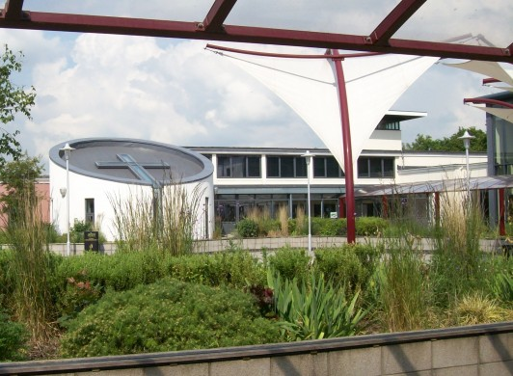
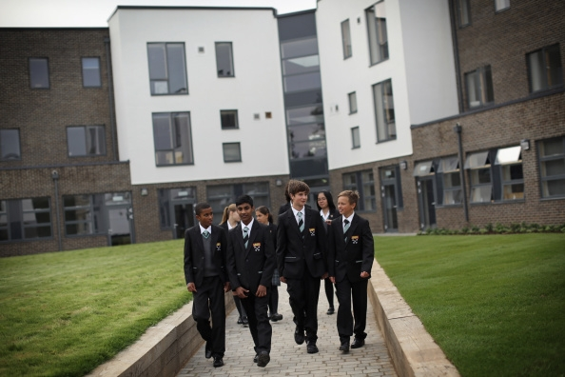
Independent and Faith Schools Proposals
Discussion and Feedback

Slide 45
‘Universities playing a direct role in improving school quality and pupil attainment’
Britain has some of the best higher education institutions in the world with four of the top ten in the world. They have considerable academic expertise, and teaching resource.
Universities are often criticised for charging higher tuition fees without widening access to lower income students, but they have little direct control over the main driver of better access: students’ school-level attainment.
It is strongly in universities’ interests to improve attainment at schools - prior attainment of pupils is the overriding factor in predicting access to university.

Slide 46
Universities - Proposals
It is proposed that higher education institutions will be required to meet the following requirements as a condition of charging higher fees:
  Establish a new school in the state system, of which the capital and revenue costs will be met by the government, or;
  Sponsor an academy in the state system.
In both cases, there would be an expectation this school would be good or outstanding within a certain number of years, and over time we would expect universities to extend this partnership with the schools sector, to charge the higher rate of fees
In addition to, but not instead of, the above requirements, universities could consider:
  supporting schools through being a member of the governing body or academy trust board;
  assisting with curriculum design, mentoring of school pupils, and other educational support; and
  provision of human resources, teaching capacity (for example in A-level STEM subjects), and finance support.

Slide 47
‘Selective schools providing more school places, and ensuring that they are open to children from all backgrounds’
163 existing grammar schools in England, educating around 166,000 students (around 5% of state secondary pupils). No new grammar schools have been allowed since the 1998.
99% of selective schools are good or outstanding.
Evidence suggests grammar schools deliver high-quality education to their pupils and that their pupils outperform their counterparts at non-selective schools, including when the effects of selection are taken into account.
The educational gain from attending a grammar school is around twice as high for pupils eligible for free schools meals, compared to the overall impact across all pupils. However in January 2016, only 2.5% of pupils were eligible for free school meals, compared to 13.2% for all state schools.
The government want more good schools, including selective schools, but we want selective schools to make sure they help children from all backgrounds.
This is not a proposal to return to the old grammar school and secondary modern system; grammar schools will be required to share their expertise and work closely with other local schools, to ensure that there is no negative impact on the educational outcomes of pupils in surrounding non-selective schools.
The consultation outlines the case for relaxing restrictions on selective education, in order to provide more good school places within the system in the interests of improving education standards and increasing choice for parents.

Slide 48
Selective schools - Proposal
We want to retain and increase the academic success of selective education, while at the same time improving the educational outcomes for those that do not attend selective schools. In practice this means -
  Support for existing grammar schools to expand.
  Permitting the establishment of new selective schools.
  Permitting existing non-selective schools to become selective.
To ensure an increase the number of good and outstanding places in non-selective schools, we intend to apply conditions on new or expanding selective schools.
  Take a proportion of pupils from lower income households
  Establish a new non-selective secondary school, with the capital and revenue costs paid by government;
  Establish a primary feeder in an area with higher density of lower income households to widen access
  Partner with an existing non-selective school within a multi-academy trust or sponsor a currently underperforming and non-selective academy.
  Ensure that there are opportunities to join the selective school at different ages, such as 14 and 16, as well as 11. This might be facilitated through the partnership or sponsor arrangements with other schools.

Slide 49
Selective schools –
Oversight and Sanctions
Require selective schools to provide information on their websites about their partnership with other schools and on their success in recruiting a fair proportion of below-average income pupils.
Where schools are not meeting expectations or selective schools do not deliver good or outstanding non-selective education alongside new selective places, we will consider a series of sanctions -
  Removing access to any additional funding streams.
  Removing the right to select by ability (either temporarily or permanently) for the offending school.
  Restricting access to future growth
Committed for fairer funding a National Funding Formula - rewards those schools that support schools with a higher proportion of lower attaining pupils and those from less wealthy households.

Slide 50
Selective schools supporting children at non-selective schools
Delivered through –
Encouraging multi-academy trusts to select within their trust - MAT and/or other good or outstanding academies can already establish a single centre in which to educate their "most able” pupils. This centre could be ‘virtual’ or have a physical location. As pupils are identified as ‘most able’ pupils after they had been admitted to their individual school through a non-selective admissions process this is permissible.
Require existing selective schools to engage in outreach activity including working closely in partnership with local primary schools to identify individual pupils who may benefit most from targeted activity.
Fair admissions and access - Selective schools need to ensure that the pupils they admit are representative of their local communities - require all selective schools to have in place strategies to ensure fair access. Legislation would require selective schools to prioritise the admission of, or set aside a number of specific places for, pupils of lower household income in their oversubscription criteria.

Slide 51
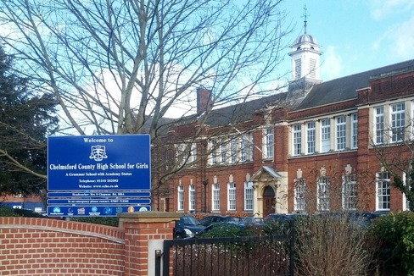
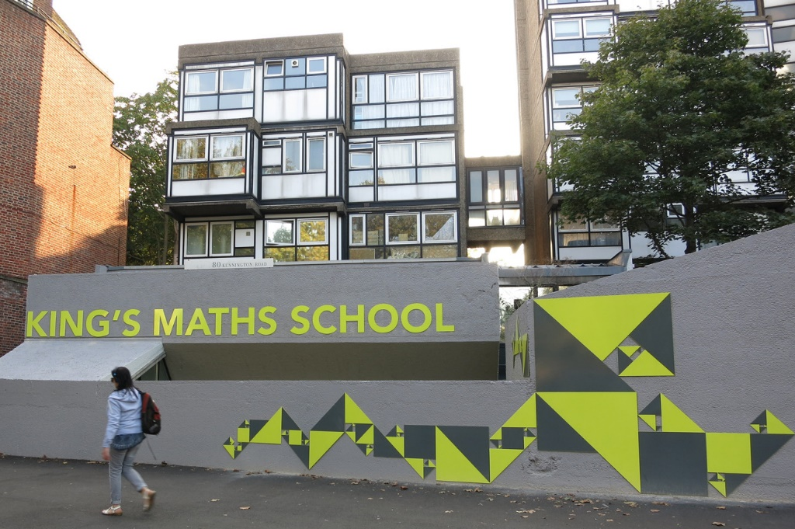
Selective Education and Universities Proposals
Discussion and Feedback

Slide 52
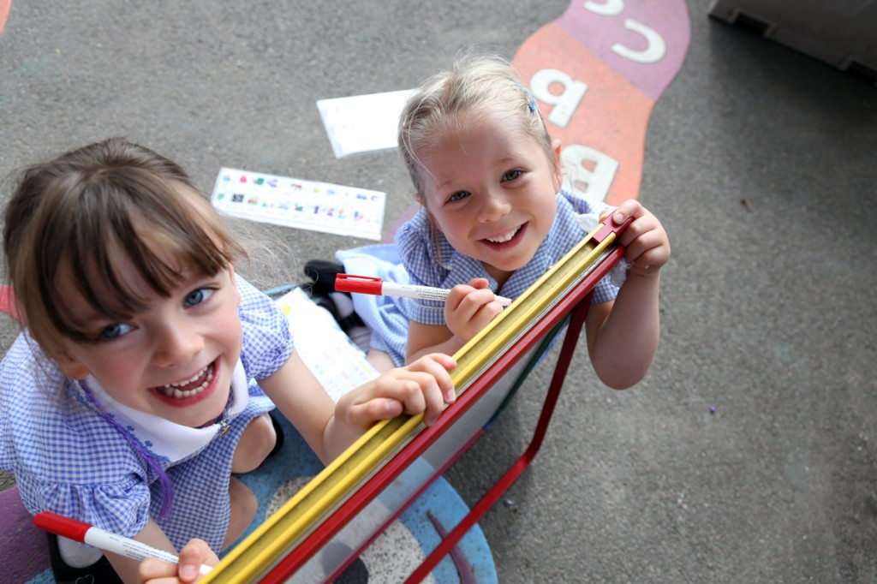
Responding to the consultation
Important your voice is heard
Consultation launched 12th September 2016
Consultation closes on the 12th December 2016.

