Slide 1
Refugees and Asylum Seekers in Essex Schools

Slide 2
When supporting adults 1. Show respect for clients and make sure clear information is given about meetings. 2. Always use professional interpreters. 3. Maintain good contacts with other services to avoid duplication of services. 4. Ensure professional boundaries are kept between you and the client, and make sure you have regular supervision to reflect on your work and avoid vicarious traumatisation. When supporting children, young people and unaccompanied minors 5. Children must never be asked to be an interpreter, especially when their parents are being examined or seen by a psychologist. 6. When assessing children, interview them separately, as they may not want to upset their parents. 7. For unaccompanied minors, be aware that turning 18 is a crucial age – both in terms of whether they have leave to remain, and the support they receive from social services if they stay. When supporting families 8. Assess families not just in terms of their needs, but also their strengths and abilities. 9. Signpost sources of support for securing appropriate, sound and reliable legal representation. 10. Be sensitive as to which is the appropriate community for these families, rather than what is assumed to be.
Guidelines for working with Refugees Summary of key guidance
Written by - Social, Emotional and Mental Health (SEMH) Strategy Team SEND Strategy and Innovation Essex County Council
Notes:
The next two slides describe guidelines but not necessarily only for schools, settings and colleges. These guidelines are for any agencies working with refugees.

Slide 3
When supporting nurseries, schools and colleges 11. Swift access to education and well-planned school-based assessments help these children integrate successfully. 12. Assess such children in their home language and correct dialect. 13. Don’t automatically place children in lower-attaining groups if English is not their first language; assess them on their previous schooling, ability and needs. 14. Engage the community and whole school so that these children and young people can be quickly integrated. Intersectionality 15. Refugees should not be seen as a homogenous group but offered specialist support if needed on terms of race, gender or sexuality. Reference Guidelines for Psychologists Working With Refugees and Asylum Seekers
Guidelines for working with Refugees Summary of key guidance
Written by - Social, Emotional and Mental Health (SEMH) Strategy Team SEND Strategy and Innovation Essex County Council

Slide 4
Best Practice for Supporting Refugee Families and Children* - What can schools and settings do?
Introduction
Good practice
Liaise with colleagues
‘Signpost’ to local advice and support
Create partnerships
Listen to parents
Find out about support in school and other local resources and services
Authors - Bill Bolloten & Tim Spafford NALDIC | Refugee and asylum seeker children | Supporting refugee families

Slide 5
Frequently asked questions
Is it a job for teachers to support families? Shouldn’t social workers and others be doing that?
School practitioners have always been a source of support and advice for parents, not just about issues relating to their children’s education. Providing support can help improve the wellbeing of the family, this will in turn have a positive effect on children’s educational progress. For many refugee families, their children’s school may be the only neighbourhood resource that they are confident to approach. Parents may be more at ease talking to school staff they know and trust than they do other agencies.
What do I do if I am concerned about a child?
When teachers are worried about a particular child and think that additional support may be advisable, it is can be helpful to discuss these concerns with the SENCO, or the local Child and Adolescent Mental Health Service. Schools should also discuss concerns with parents. Together a decision can then be made about whether a referral is necessary and which local service might be the most suitable place for the child to receive extra support.
Authors - Bill Bolloten & Tim Spafford - NALDIC | Refugee and asylum seeker children | Supporting refugee families

Slide 6
Frequently asked questions
Aren’t family issues a big thing to take on, on top of my teaching workload?
Schools as a whole have a collective role in responding to the wider needs of families and children. Ofsted inspections will also focus on how schools support the progress of children who are particularly disadvantaged and/or from vulnerable groups. In practice, schools will aim to work closely with a range of local services for children and families. A multi-agency approach means that schools and teachers can work in partnership with others to address the full range of needs that can affect children’s progress and achievement.
What kinds of advice should schools make available to families?
Teachers and student teachers should not give advice in those areas where they lack knowledge and expertise as this may do more harm than good. Schools can find out about local services and agencies that work with families and maintain up-to-date information on them. Some schools display leaflets and posters of agencies such as the Citizens Advice Bureaux.
Authors - Bill Bolloten & Tim Spafford - NALDIC | Refugee and asylum seeker children | Supporting refugee families

Slide 7
Best Practice for Supporting Refugee Families and Children* - Supporting Refugee Families
Introduction
Good practice
Avoid generalisations about children’s experiences and needs
Identify current factors that may be affecting wellbeing
Focus on resilience and positive coping behaviours
Help children make friendships
Listen to parents
Authors - Bill Bolloten & Tim Spafford NALDIC | Refugee and asylum seeker children | Supporting refugee families

Slide 8
Frequently asked questions
Are all refugee children ‘traumatised’ by their experiences?
It is important to remember that both past experiences and the present will influence how a child copes with their situation. When refugee children have had challenging experiences, it may be tempting to assume that all their difficulties are because they have been ‘traumatised’ by their past experiences. This can lead to ignoring other aspects of their lives such as poor housing, financial problems, tensions at home and lack of progress in learning English. After settling into school and having time to adjust, most refugee children make good progress.
Do refugee children need specialist help to enable them to cope?
The most important sources of support for refugee children are their teachers and their peers. Showing an interest in their lives and experiences, and providing consistent care and support is usually more important and necessary than referrals to outside help. A child who is making steady progress in learning, in understanding and speaking English and in mixing with other children and who does not show persistent behavioural or emotional difficulties that interfere with learning or relations with others, should not give rise to concern. However, some children may well need specialist support.
Authors - Bill Bolloten & Tim Spafford - NALDIC | Refugee and asylum seeker children | Supporting refugee families

Slide 9
Frequently asked questions
How can I tell if a child is not coping and may need help?
Difficult experiences from both the past and the present can lead to emotional or behavioural problems for some children. For example, some children may be nervous, jumpy and fearful. They may be afraid of loud sounds or dislike being alone. Some children may appear withdrawn and sad. They may cry easily and may not seem interested in playing with other children. Some children become very worried or anxious. Other children may become irritable and lose their temper quickly. They may have problems sleeping and suffer from nightmares. Some children may look tired and have trouble concentrating. If a child appears to fit any of the above descriptions, it is possible that the child may be experiencing emotional distress. However, it should be remembered that these behaviours might also be normal reactions to difficult experiences.
Authors - Bill Bolloten & Tim Spafford - NALDIC | Refugee and asylum seeker children | Supporting refugee families

Slide 10
The next few slides are linked with ECC TPP Values
Gathering Key Information about the CYP and Families from Afghanistan
Guide for Practitioners
The values of Trauma Perceptive Practice are going to be very important to hold in mind when engaging with and supporting Afghan children and families. It is everyone’s responsibility to ensure they experience:
Compassion & Kindness
Hope
Connection & Belonging

Slide 11
Gathering Key Information about the CYP and Families from Afghanistan
Guiding principles for offering support
Show respect and make sure clear information is given about meetings.
Use professional interpreters.
Maintain good contacts with other services to avoid duplication of services.
Ensure professional boundaries are kept between you and the family, and make sure you have regular supervision to reflect on your work and avoid vicarious traumatisation.
Notes:
Read the slide

Slide 12
The legal framework
In addition to all other legal frameworks, children are subject to the UN convention on the Rights of the Child (United Nations, 1987). These rights remain whether the children are displaced, seeking asylum or with or without other family members. Amongst the most relevant articles of this area:
Article 9 – the right not to be separate from their parents
Article 24 – the right to access health care
Article 28 – the right to education
Article 34 – the right to protection from sexual exploitation and sexual abuse
Article 35 – the right to protection from abduction, sale and trafficking
Article 38 – the rights to be protected from war and armed conflict, and for under 15’s, not to take part in war or join the armed forces.
Article 39 – States parties shall take all appropriate measures to promote physical and psychological recovery and social reintegration of a child victim of … armed conflict.
In summary, the legal framework makes clear that the duty of the state is to protect the children, keep them with their families as far as possible, and provide education and health care. In particular, the state should provide interventions to ameliorate the effects of traumatic experiences that the child or young person has been exposed to.
Gathering
Key
Information

Slide 13
Gathering
Key
Information

Slide 14
Gathering
Key
Information

Slide 15
Gathering
Key
Information

Slide 16
Gathering
Key
Information

Slide 17
Three Basic Mental Health Care Principles for Working with Refugee Children*
Three principles of mental health care are well documented in the research and clinical literature on the needs of refugee children and families: the necessity of comprehensive services, the importance of cultural competence in clinicians, and the need to integrate evidence-based practice with practice-based evidence.
1. Use Comprehensive, Community-Based Services
Comprehensive services are designed to address a broad range of needs in the population. Given the numerous stressors on individuals facing resettlement in a new country—including language, work, education, financial issues, and acculturation—it is important for clinicians working with refugee children and families to take a holistic approach by addressing daily life adaptation and problems, as opposed to focusing solely on mental health symptoms.
Since stressful environmental and social conditions can create and maintain psychological distress, interventions for refugee children must address and have an impact on these conditions. The use of a case manager or social worker, who focuses on the daily needs and concerns of a refugee family, may provide stability so that the family can later address its mental health needs with a trained clinician.

Slide 18
Three Basic Mental Health Care Principles for Working with Refugee Children*
2. Provide Culturally Competent Services
Clinical services for war-affected refugee populations must reflect cultural competence by offering services that effectively meet the needs of multicultural populations. Inherent in this notion of culturally competent care is the concept of identifying needs and creating clinical services consistent with a population’s values, beliefs, and practices. The development of culturally competent care with refugee populations entails more than a training module or collection of “facts” about an ethnic or racial group’s beliefs. An understanding of an individual’s or community’s views related to human development and social expectations allows a clinician to design interventions that integrate cultural beliefs and norms about well-being and health with Western approaches and techniques. A child’s acculturative level should be taken into consideration. Careful query regarding the cultural and faith-based beliefs, values, and rituals central to refugee families may provide openings for clinicians to integrate these beliefs and practices into treatment.

Slide 19
Three Basic Mental Health Care Principles for Working with Refugee Children*
Integrate Evidence-Based Practice With Practice-Based Evidence
Evidence-based practice in psychology integrates the best available research with clinical expertise in the context of patient characteristics, culture, and preferences. When working with children, an evidence-based orientation to practice consists of assessment, intervention, and ongoing monitoring. A clinician should conduct these three elements in a scientifically minded manner and informed by clinical expertise, as well as remain attentive to the developmental processes and contexts of care that are critical for children and adolescents.
When working with refugee children and their families, clinicians should use evidence-based treatments when possible. However, since few treatment effectiveness studies have been conducted with refugee children, it is necessary for psychology to examine and recognize the efforts of providers in the field working with this population. These caregivers can provide “practice-based evidence”—reports of clinical interventions and existing practices successful with refugee children and gleaned from real-world settings.
Clinicians must be flexible, utilizing evidence-based techniques and protocols when
possible, while incorporating other methods developed to meet the unique needs of
war-affected refugee children. This delicate balance requires creativity and rigor and, in some cases, collaboration with others who have tackled similar issues. Clinicians who rigidly adhere to protocols and treatment plans devised for populations with very different cultural backgrounds, beliefs, and values may lose opportunities to intervene effectively with refugee children or families.
American Psychological Association - refugees-health-professionals.pdf (apa.org)

Slide 20
Useful websites for working with refugees
Guidelines for Psychologists Working With Refugees and Asylum Seekers - Summary_0.pdf (bps.org.uk)
NALDIC | Refugee and asylum seeker children | Emotional Well Being
UNHCR - Teaching About Refugees - Guidance on working with refugee children struggling with stress and trauma
refugees-health-professionals.pdf (apa.org)
ECC Infolink EMTAS resources: Ethnic Minority and Traveller Achievement - EMTAS resources (essex.gov.uk)
NEU guidance: Layout 1 (neu.org.uk)

Slide 21
Useful websites for working with refugees cont’d
Investing in inclusion - Left Behind - Refugee education in crisis (unhcr.org)
Secondary schools guide: https://www.google.co.uk/url?sa=t&rct=j&q=&esrc=s&source=web&cd=&cad=rja&uact=8&ved=2ahUKEwjcnoetjd7yAhVMQUEAHYkuC2EQFnoECBkQAQ&url=https%3A%2F%2Fschools.essex.gov.uk%2Fpupils%2FEMTAS%2520Ethnic%2520Minority%2520and%2520Traveller%2520Achievement%2520Service%2FEAL%2FDocuments%2FWelcoming%2520Asylum%2520Seeker%2520and%2520Refugee%2520Pupils%2520into%2520Your%2520School.docx&usg=AOvVaw2qL_iI3YxiaOKJfHz2gw83
Tips for educators: Supporting Refugee Students (nasponline.org)
Article for headteachers from 2015: Supporting refugee children arriving in your school (headteacher-update.com)
Article from 2015: NALDIC | Refugee and asylum seeker children | Refugee and asylum seeker children in UK schools
Compiled by Social, Emotional and Mental Health (SEMH) Strategy Team SEND Strategy and Innovation ECC

Slide 22
Other helpful resources and advice:
DfE Guidance
Teaching Pack from the NEU
Unaccompanied Asylum Seeking Children Pack – Essex Virtual School 2019
The Bell Foundation
Oak National Academy
Flash Academy
Sanctuary Foundation
EAL HUB

Slide 23
DfE Guidance – Ukrainian Refugees
Resources to help support children and young people arriving from Ukraine - GOV.UK (www.gov.uk)

Slide 24
Here you will find resources which have been developed and shared by teachers to help schools support refugees. Find out more about their experiences and how they make new connections in their communities.
Welcoming refugee children to your school | NEU

Slide 25
New Arrivals - The Bell Foundation (bell-foundation.org.uk)

Slide 26
The Bell Foundation provides evidence-informed guidance to school staff about supporting provision for learners who use English as an Additional Language (EAL)
Welcoming-Refugee-and-Asylum-Seeking-Learners.pdf (bell-foundation.org.uk)

Slide 27
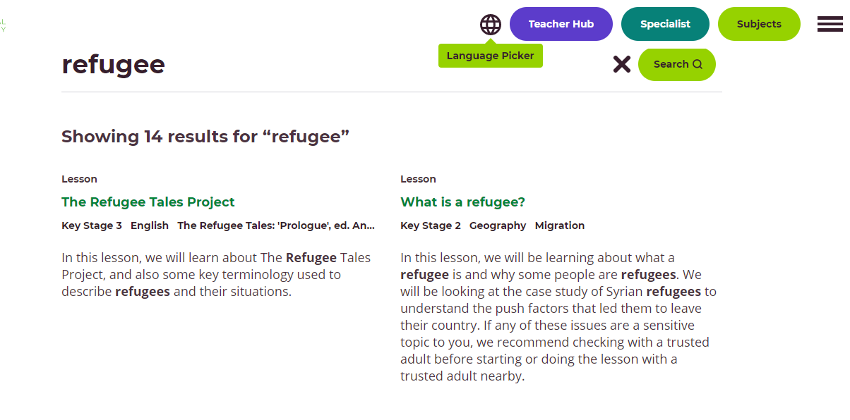
[Type Main Point #3 Here]
[Type evidence to support main point #3]
[Type evidence to support main point #3]
[Type evidence to support main point #3]
[Type evidence to support main point #3]
Oak National Academy Online Classroom (thenational.academy) – Search refugee

Slide 28
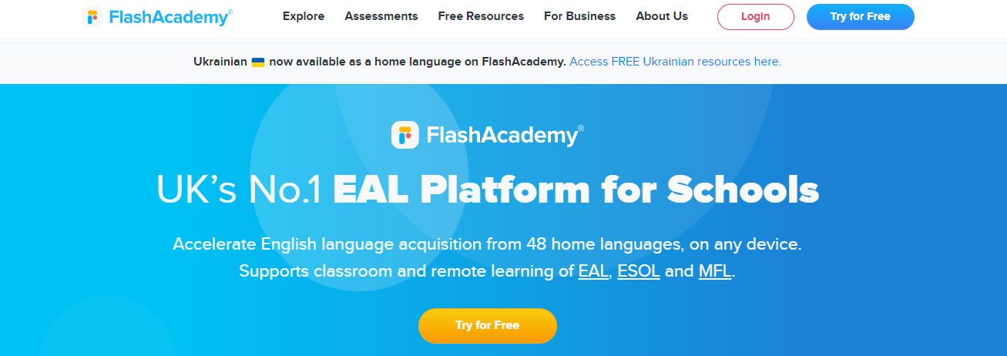
FlashAcademy® - Learning Platform for EAL, MFL & Literacy

Slide 29
Sanctuary Foundation | Promoting refugee welcome and welfare

Slide 30
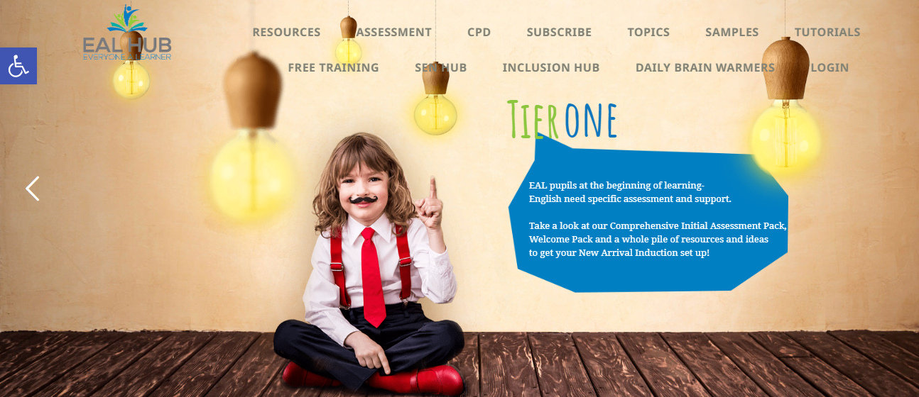
EAL HUB - High quality EAL resources, assessment and CPD

Slide 31
Welcoming refugee Children - 1 (pagetiger.com)

