Slide 1
Primary Improvement This session to include updates on: - Statutory assessment - Support for the review of safeguarding - Update on data tools (Analyse School Performance and FFTAspire) - Support for School Led Improvement Partnerships

Slide 2
Statutory Assessment

Slide 3
Update
KS1 data must be submitted to the LA by Thursday 29 June 2017
KS2 data must be submitted via NCA tools by Thursday 29 June 2017
All KS1 and KS2 submitted data will be analysed by the Standards and Excellence team to check that it matches external moderation decisions and to investigate any unexpected pattern of attainment
KS1 – schools will receive email notification that the data has been checked. If there are any queries schools will be asked to respond within 3 working days of receipt of the email
KS2 – if no queries are raised schools will receive email notification that the data has been checked. If there are any queries the school’s Standards and Excellence Commissioner will contact the school by phone on 28th June.

Slide 4
Support for the review of safeguarding

Slide 5
How does your governing body ensure and evidence compliance with all statutory responsibilities in regard to safeguarding all pupils?
What training has the link governor for safeguarding had to ensure they have the skills and knowledge to effectively carry out their role?
What training have members of the Governing Body had to ensure they have the skills and knowledge to effectively evaluate the safeguarding and child protection arrangements in the school?
What evaluation has taken place to establish the Governing Body’s capacity to carry out their safeguarding duties and responsibilities?

Slide 6
https://www.safeguardinginschools.co.uk/understandingsafeguardingandgovernance2/

Slide 7
In development…
* Governors’ Safeguarding Framework;
Audit tool for self or peer review with guidance prompts
Termly calendar for monitoring and evaluating
Route cards to use to rectify any areas of non-compliance
* Standards and Excellence Commissioners’ focussed visit to schools in summer term, schools due inspection are a priority. Raising awareness of safeguarding at any event with leaders and governors including SLIS
* Traded review of Safeguarding:
Half and full day options available September 17
Strongly recommend that schools buy in external audit
from Schools HR.

Slide 8
Update on data tools
- Analyse School Performance
- FFTAspire

Slide 9
Analyse School Performance (ASP)
Compares school performance at school and pupil group level against national averages
Ofsted and LA can see the same data, but anonymised
This is the first release which will be added to with features such as:
- Question Level Analysis
- Named Pupil Data
The last three Inspection Dashboards are available to download there are plans to release a 2017 version
Summary view of data, data tables and scatter plots are there now, downloadable and printable
ASP will allow users to filter on multiple characteristics
Easy to navigate, same view for teachers, governors, LAs, MATs, Ofsted and Diocesan Authorities

Slide 10
Current differences with ROL and ASP
ASP+ | ASP-
LA averages on headline data page in ASP | 2016 data only in ASP
ASP allows multiple filters | No contextual information in ASP - exclusions, absence, basic characteristics trend, basic characteristics by year group, ethnic groups and English as a first language trend, Main SEN type trend, KS1 PA
Some improvements in formatting | No ethnic group or term of birth performance data
Greater range of characteristics in scatterplots | No Year 1 phonic marks 2016 - cumulative distribution graph
Less repetition of data | No Year 2 resit phonic data
 | No KS1 attainment data compared to EYFS starting points
 | No transition matrices
 | No KS2 ranking
 | No significance shading / confidence intervals
 | No ability to create school’s own data
 | No detail given about National Comparison
 | No ability to change National Comparators
 | No National comparator for filtered groups

Slide 11
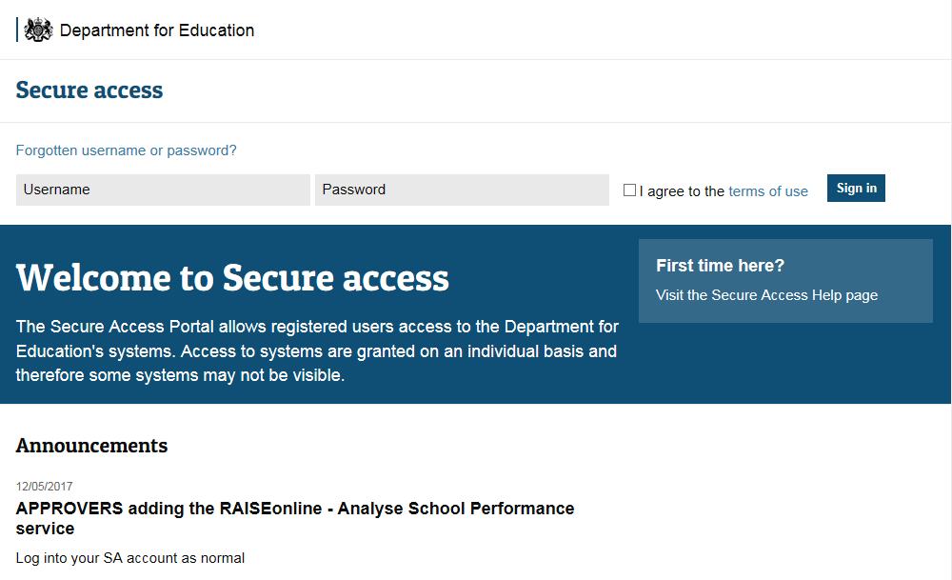
https://sa.education.gov.uk/idp/Authn/UserPassword

Slide 12
FFTAspire Update

Slide 13
New Aspire developments in 2017
- Full organisation refresh (including mergers; new schools; MATs and Chains)
- Final (2016 Self Evaluation and Y3 estimates)
Updated School Leaders/Governors dashboards
Pupil data management
- Removing pupils from a report
- Favourite report settings – access these quickly via ‘My reports page’
Pupil Premium reporting – 4 sections
Aspire static PDF dashboards: Extended Headteacher/SLT dashboard
Scaled score estimates:
- Pilot of Primary Pupil Tracking (Autumn 17)

Slide 15
Cohort termly tracking

Slide 16
School level reports - disadvantaged

Slide 17
FFT Training offer
Two days overview training for schools through LA includes:
Introduction to Aspire for new users
Using the RAISE replacement in combination with Aspire
Analysing your attainment and progress data in Aspire
A walk through the Aspire Dashboard for Governors.
Bespoke training options
‘Out of box’ and bespoke sessions can be run for LA staff, group.
fft.org.uk/roadshow-primary - London Friday 29 September or Cambridge Thursday 16 November
Outlining the key features of the new FFTAspire and ASP systems
A blended approach to self-evaluation –maximising the impact of Aspire and ASP

Slide 18
FFT Subscription 2017-18
The annual subscription to FFT for schools has increased for by 16%. This is the first pricing increase for several years. The LA need to consider its pricing strategy for schools to cover the increase in costs.
Pricing for 2018/19 will need to be considered in the Spring term 2018.
Price in 2016/17 £ | Price in 2017/18 £ | Increase £ | Number of subscribers expected based on 2016/17
£80 (under 80 pupils + for 2017 to include Infant schools) | 93 | 13 | 64
£125 (all primary schools and secondary with less than 650 pupils) | 145 | 20 | 305
£500 (Secondary) | 580 | 80 | 68

Slide 19
School Led Improvement Strategy (SLIS)

Slide 20
Development Visits
Main Successes
Increased commitment to the partnership and each other, and stronger collaborative working
Sharing of expertise and professional development opportunities, and supporting schools
How the partnership has organised itself, and working with the LA and TSAs
Capacity to lead and facilitate the partnership
Using funding for partnership projects
Activities to help schools understand each other’s strengths and areas for development
Engaging governors
Developing trust and relationships between schools, and commitment to the partnership
Projects to develop knowledge, expertise, and capacity

Slide 21
Development Visits
Main Challenges
Engaging schools in the partnership
How the partnership worked together
Developing relationships and trust between schools
Commitment of all schools to the partnership
Sustainability of funding
Sharing data between schools
Confidence to share needs, challenge to other schools, and feelings of accountability
Capacity to lead and facilitate the work of the partnership
Engagement between primary and secondary
Support for vulnerable schools

Slide 22
Development Visits
Next Steps
Engaging other schools and individuals
Increasing partnership capacity, and developing how the partnership operates
New and additional priorities for partnership work
Develop capacity in schools at all levels
Create links with and learn from others e.g. TSAs
Work with governors
Support data and intelligence sharing
Strengthen partnership tools and processes
Develop plans to support schools across the partnership
Evaluate impact
Plan for the future

Slide 23
The Partnership Evaluation and Development Tool
Roll out 13th June 2017
Why are we developing it?
To strengthen our vision of Essex as a self reviewing, self reporting, self supporting and self improving system
In line with the national trend and the Essex vision, to move the responsibility for review and improvement to school and partnership level
To know the priorities of partnerships and help link partnerships with common priorities for improvement
To know where all the talent and effective practice
in the system is and to use in the service of the
system as a whole

Slide 24
Focus of sessions from the Standards and Excellence Team to Partnerships 16/17
RAISEonline training | High Impact Governance
Moderation for KS1 & 2 | Process and outcomes validation- contribution to partnership development plan for 2017-18
Maths and English moderation / End of KS assessment | Planning meeting for SEC days
EYFS/Year 2 / Year 6 moderation | Middle Leadership Training Day
Running department Reviews - secondary | Action Planning Training
Reading and Writing subject leader training | Peer Review Quality Assurance
Safeguarding | Peer review training
Meeting with Independent Chair to discuss Partnership needs for the session | FFT training
Data analysis- group data | Middle leader training
Presentation of data analysis | Subject Leadership
Middle Leadership (6 x ½ day sessions): Data analysis Preparing for interviews with inspectors Monitoring foundation subjects Managing awkward conversations Action planning Moderation | Observations
Primary/secondary transition | Reading Moderation
Partnership meetings- attendance at/ view from LA item on the agenda. | Maths Moderation

