Slide 1
How to retain key staff to ensure outstanding provision for all
Andy Hodgkinson
Thursday 17th November 2016

Slide 2
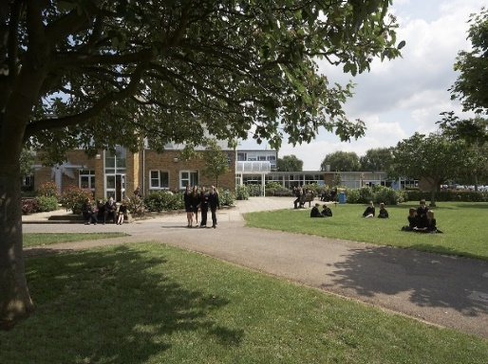
Context
Staff attendance at 98% for last 3 years
No agency staff used since 2006 for teaching or cover
No unfilled vacancies since 2007/only one “May 31st” resignation
Teaching staff turnover 3% for 2015/16
Resource Base for 24 Deaf Pupils
Investors in People Gold (2010, 2013, 2016)

Slide 3
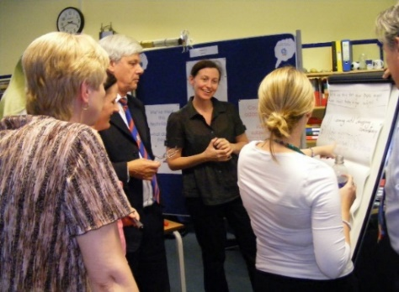
Philosophy
Recruit ➔ Retain ➔ Lead Staff
Reframed as:
Lead ➔ Retain ➔ Recruit staff
“Collective teacher efficacy” (Hattie, 2016)
(more than double effect size of feedback, more than treble that of pupils’ background and levels of motivation)

Slide 4
Collective Teacher Efficacy
Advanced teacher influence
(leadership roles; decision-making)
Goal consensus
(vision/shared priorities)
Responsiveness of leadership
(leaders’ responsibility to help/show concern/respect)

Slide 5
Leadership
Clear values/ethos/vision
Modelling – e.g. cover, discipline, duties, teaching, to reinforce sense of team cohesion
Keeping your word: “to consult, or not to consult?”
Principles are easy when times are good – e.g. time off
The “pay paradox”
Morale and the importance of communication

Slide 6
Communication
Tone – e.g. Staff briefing – share pedagogy/best practice/celebrate pupil success (moan in private!)
Bulletin with weekly headlines about the big picture/our school etc. plus “thank yous”

Slide 7
Thank yous!

Slide 8
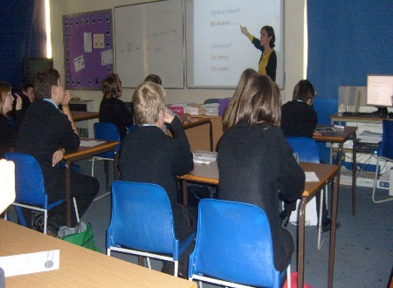
Retention
Excellent staff need to be freed up to teach/initiative overload
Difficult conversations need to take place early
Justice is seen to be done
Outstanding staff sometimes need to leave
Praise and recognition (portfolio notes/staff bulletin)

Slide 9
Praise Portfolio Form

Slide 10
CPD
Personalised
Performance Management analysis for identifying steers/signposting relevant personal training opportunities.
“Favourites” are problematic
School to school support opportunities
Opening a new Sixth Form!
“Acting leadership” opportunities
September payments (retention and succession planning!)

Slide 11
Recruitment
ITT offer to providers (as well as the students)
Recognition of the Early Careers Teacher/NQT programme
Recruitment practices and interviews (e.g. rejection)
Word of mouth within the community
All new staff do a TLA or enrol on a Masters course
Volunteers!
Resource Base staff – growing our own specialists

Slide 12
The End Result
Trust/staff commitment/honesty with you
Attendance at 98%
Covering for absence/maternity etc
Staff “overload” to avoid agency staff (none used since 2006)
All cover done by retired Sweyne Park teaching staff
When the school has an issue to overcome, e.g. critical incident, poor set of data, there is a collective will to overcome it.

Slide 13
Collective Teacher Efficacy
Advanced teacher influence
(leadership roles; decision-making)
Goal consensus
(vision/shared priorities)
Responsiveness of leadership
(leaders’ responsibility to help/show concern/respect)

Slide 14
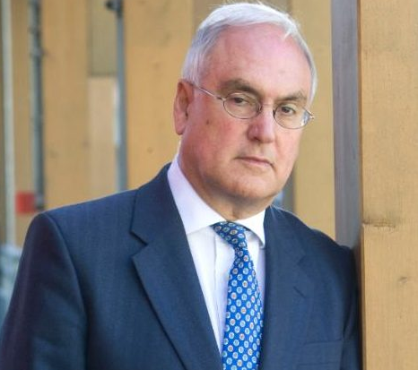
And finally…
Sir Michael walks into a bar and pays for his pint with a tenner…
- he expects change immediately!
Sir Michael walks into a bar…
- ironic, as he is the one who raised the bar in the first place!
Sir Michael walks into a bar “whiskey please!”
- “Teachers?”
- “Don’t you start!”
- “Famous Grouse?”
- “I’ve been called worse!”

