Slide 1
NCE Strategic Partnership
Possibilities through the Apprenticeship Levy…

Slide 2
State of Apprenticeship today…
2015 – Manifesto Commitment
2017 – Levy announced
2018 – NCE began programmes
2019 – Ofsted and ESFA inspections
2019 – A guide to apprenticeships for the school workforce, DfE, Nov 2019 paper
2020 – circa. 1500 learners on apprenticeship programmes
2021 – NCE portfolio development and building regional collaborations
2021 – Budget commitment to increase apprenticeships impact
2022 – NCE Regional Partnerships roll out
For further information on Apprenticeship and the Apprenticeship Levy, read our NCE Apprenticeship Whitepaper

Slide 3
The NCE Programme Portfolio

Slide 4
NCE Apprenticeship Portfolio
Our products

Slide 5
Level 7 Senior Leadership Programme
Level 7 Links
Webpage
Brochure
For whom
Current Senior Leaders in schools, Trusts or Local Authorities
Qualifications
MSc in Education Leadership and Management
L7 Senior Leader Apprenticeship
Eligibility
Currently in a leadership role in school
Serving Headteachers, Trust Central Team members*
Bachelors Degree (2:2 or above)
Price
£14,000 (funded by the apprenticeship levy)
GCSE (C or above) in English and Maths
Aspiring Senior Leaders
* For Executive and System Leaders there is also the NCE Level 7 MBA in Educational Management

Slide 6
Level 7 Senior Leadership Programme
Level 7 Links
Webpage
Brochure
Module Content
Foundation Module
Strategy
People Management and Development in Education
Innovation and Change
Finance, Governance and Risk in Education
Research Methods and Project
Format
24-month programme
First day of learning and five 2-day Professional Learning Days
Assessment through 4 Essays, 2 Reports, 2 online Assessments, Dissertation and Strategic Business Proposal, Professional Discussion and a portfolio of evidence
Support from dedicated Professional Learning Mentor
Monthly engagement and 12-weekly Reviews (with Line Manager)

Slide 8
Module | Start date | Assignment deadline | Live learning days | Workshops with Tutor | Indicative content
Strategy in Education | 30/08/2021 | 08/11/2021 | 2 Days | 2 x 1.5hrs | Vision, Culture and Values Stakeholder engagement Organisational structures Macro and micro-environmental factors New market strategies Horizon scanning Brand and reputation management
People Management and Development in Education | 15/11/2021 | 31/01/2022 | 2 Days | 2 x 1.5hrs | Equality, Diversity and Inclusion Legislation Developing and leading an inclusive culture Talent management Succession planning Coaching & Mentoring Matrix management
Finance, Governance and Risk in Education | 07/02/2022 | 25/04/2022 | 2 Days | 2 x 1.5hrs | Professional Ethics Corporate Social Responsibility Financial planning Supply chain management Governance Risk management
Innovation and Change in Education | 02/05/2022 | 11/07/2022 | 2 Days | 2 x 1.5hrs | Disruptive innovation Design thinking Project, programme and portfolio management Setting objectives and key results (OKRs) Influencing and negotiation strategies Executing and evaluating change
Research Methods and Project | 29/08/2022 | 30/01/2023 | 2 Days | 4 x 1.5hrs | Reviewing academic literature Refining a research focus Qualitative and quantitative research methods Research ethics Identifying trends - correlations, causal relationships Disseminating findings

Slide 9
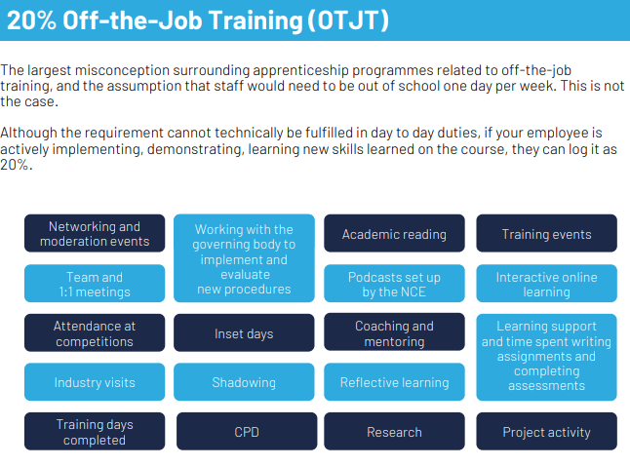

Slide 10
Level 5 Education Management Programme
Level 5 Links
Webpage
Brochure
For whom
Current middle leaders or aspirant senior leaders (2-5 years)
Qualifications
Level 5 Departmental and Operations Manager Apprenticeship
Eligibility
GCSE (C or above) in English and Maths
Price
£7000 (funded by the apprenticeship levy)
School Business Managers
For teaching and non-teaching leaders
Line Management Role

Slide 11
Level 5 Education Management Programme
Level 5 Links
Webpage
Brochure
Module Content
Leading People
Personal Effectiveness and Decision Making
Operational Management
Finance and Project Management
Managing People and Building Relationships
Format
22-month programme
First day of learning and 13 seminars (½ days)
Delivery from Andy Buck and ex-headteachers
Assessment through a School Leadership Project, a portfolio of evidence and assignments
Monthly engagement and 12-weekly Reviews (with Line Manager)

Slide 12
Level 4 Instructional Coaching Programme
Level 4 Links
Webpage
Brochure
For whom
Early Career Framework Mentors & NQT Mentors
Qualifications
Level 4 Coaching & Assessor Apprenticeship
Eligibility
GCSE in English, ICT and Maths
Price
£7000 (funded by the apprenticeship levy)
HLTA, Cover Supervisors, in-school coaches or Pastoral support staff
Subject Specialist or School Improvement Lead/Officer
Opportunities to coach others in school

Slide 13
Level 4 Instructional Coaching Programme
Level 4 Links
Webpage
Brochure
Module Content
Coaching Framework (including the BASIC model)
Professional Framework
Frameworks for delivery
Professional Practice 1
Professional Practice 2
Format
18-month programme
12 online professional learning sessions with Andy Buck (6) Tom Sherrington (5) & Sam Twiselton (1)
Assessment by observation and professional discussion around your online portfolio of evidence
Support from Peer Learning Partners and Professional Learning Mentor
Each school will receive access to Volume 1 of the Teaching Walkthrus online resource and will become a member of that growing community.
Monthly engagement and 12-weekly Reviews (with Line Manager)

Slide 14
Proposal: Employer-led customisation and input
Input*
Vision, Values & Mission
Trust Talent Strategy
Input
Strategic aims and implementation
Input
Alignment of Dissertation, Business Proposal or Project to Trust’s Strategic aims
Input
Impact evaluations
Next steps
Apprenticeship Working Group/s within programme cohorts addressing Trust’s priority areas
Educational Research Masters drawing on Apprenticeship Impact on Trust’s Talent Management/People Strategy
*For Sept 2021, these inputs will not form part of the official programme content – they will be an opportunity to complement NCE input and allow organisational context for on-programme learners.

Slide 15
The Process

Slide 16
Get in Touch
020 8221 9089
info@nationaleducation.college
https://www.nationaleducation.college

