Slide 1
Essex Primary Headteachers Meeting
ECC Education Directorate
9th November
Mid Quadrant

Slide 2
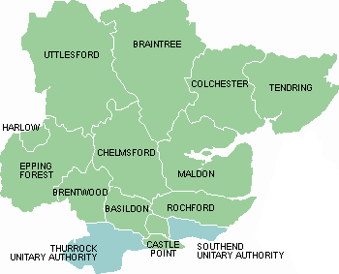

9:10am Welcome:
        2022-2023 Essex student outcomes
        Essex OfSTED overview
        Updates to OfSTED Framework September 2023
        Childcare reforms
        Inclusion Strategy update
9:40am SEND update
10:05am Autism Hubs update
10:30 Coffee

Slide 3

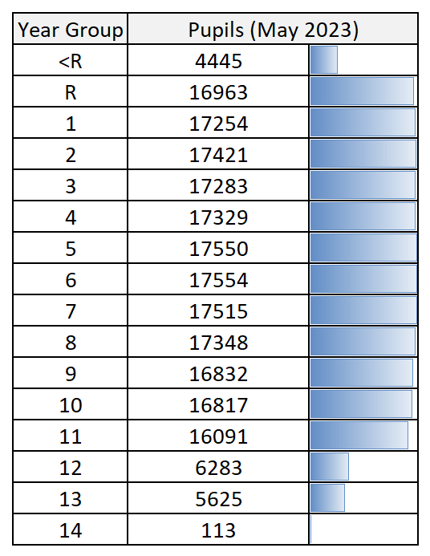



EDUCATION DATA OVERVIEW - 2023
Essex Pupils
222,423 pupils in Essex schools |  | 19.5% eligible for FSM
 |  | 10.1% English as additional language
 |  | 12.2% receive SEN Support
 |  | 4.0% have an EHC Plan
 |  | Source: May 2023 Census
Performance & Business Intelligence
Chief Executives Office
September 2022
Produced by Essex County Council Performance & Business Intelligence
| 3

Slide 4

DATA OVERVIEW – Essex v National 2023
 | National 2023 outcomes | Essex 2023 outcomes | Difference
Good Level of Development | 67.2% | 69% | +1.8%
Y1 Phonics | 78.9% | 79.2% | +0.3%
KS1 RWM | 56% | 57.9% | +1.9%
KS2 RWM | 59.4% | 60.7% | +1.3%
*This is subject to change until all data has been certified as final by DfE.

Slide 5

KS2 DATA OVERVIEW – Disadvantaged v Non-disadvantaged 2023
Year | Group | KS2 RWM
2019 | All | 65%
 | Disadvantaged | 50%
 | Non- Disadvantaged | 71%
 | Gap | 21%
2023* 17,531 cohort size | All | 60.7%
 | Disadvantaged | 42.5%
 | Non- Disadvantaged | 67%
 | Gap | 24.5%
*This is subject to change until all data has been certified as final by DfE.

Slide 6
Support for Disadvantaged Champions and School leaders 23/24
September – reflection tool submission to sign up for the academic year– supports with monitoring and evaluating your disadvantaged strategy, updating your PPG statement and reporting to governors.
Deadline Friday 29th Sept. Summary Reflection Tool
Online termly Disadvantaged champion training 3- 4.30pm:
  27th Nov – the overlap between SEND and disadvantage
  7th March
  6th June
In person workshop on completion of a PPG statement that reflects best practice:
  NE and Mid champions – 5th March 10 am to 3pm– venue to be confirmed
From November 23, partnership reflection tool overview

Slide 7

Attendance (Spring & Autumn terms 22/23)
Source: School Census files processed in NEXUS
Gender gap: -0.1% points Disad. gap: 5.5% points

Slide 8
Ofsted inspections
Source: data taken from Ofsted Monthly Management Information reports
 | ▪ OfSTED overall grade outcomes, of schools, across Essex districts as of July 2023
 | ▪ OfSTED overall grade outcomes, of Early Years settings, across Essex districts as of July 2023

Slide 9
School inspection Handbook - updates in September 2023
Terminology (Para. 18) especially regarding leaders/leadership. More reference to CEO in MATs. Reference to this throughout the handbook eg Para 122-124, 132-136, 338-351. Para. 97-99 as part of the Headteacher phone call – maintained schools/academies. Curriculum leadership – Para. 241-244.
Greater clarity over governance in maintained schools/academies – Para. 344-351.
Contextual information will include all those with responsibility for the school.
Areas of weakness will be referred to as the responsibility of ‘the school’ rather than individuals.
Preparation carried out by the lead inspector (Para 101).
Revised complaints procedure – increased transparency and easier for schools to raise concerns (Para 166-167) or see Inspecting Schools Guide.
Staff can be accompanied when speaking to inspectors (Para. 116)
Sharing of information/inspection outcome – Headteachers can decide which colleagues/others they share this information with, although outcomes remain provisional until the final report is published.
Timing of inspections – greater clarity about the year in which a school is likely to be inspected (Para.34-42).
School week of at least 32.5 hours, must be in place for 1 September 2023 (Para 223) – DfE have delayed until September 2024.
Evaluating behaviour – specific considerations eg attendance (Para. 292-295)

Slide 10

Essex School Partnership Strategy
Accelerators of School Improvement
Quadrant update
Autumn 2023

Slide 11
WEST Colin Raraty Head of Rodings | MID Dida Burrell, Head at Whitecourt | NORTH-EAST Kerry Malcolm, Head St Lawrence C of E Primary And Nicky Patrick, Head of Spring Meadow | SOUTH Katherine Parker, Head of St Peter’s catholic and Heidi Blakeley, Head of Abacus School
Dunmow Excellence in Education Partnership | Blackwater Partnership and Friends | Colchester Partnership | Basildon Excellence Partnership (BEP)
Epping Forest Partnership | Braintree and Villages Partnership | Colchester Priory Street | Billericay Partnership
Epping Forest Schools Partnership Trust | Chelmsford Learning Partnership | Constable Collaborative Partnership | Brentwood Collaborative Partnership
Harlow Education Trust (HET) | Chelmsford TSA | HEP (North Tendring - Harwich) | Canvey Schools
Saffron Walden Partnership | Colne Valley NE Braintree Partnership | Learning Connections | Castle Point Partnership
Uttlesford Partnership | Dengie Partnership | North Essex Schools Partnership | South Essex Teaching Institute (SETI)
REAch2 Academy Trust | Notley Family of Schools, Braintree District Partnership | CSMT (Colne, Stour, Mid Tendring) Partnership | Wickford Partnership
The Learning Partnership Trust | River Chelmer Partnership | South Tendring Primary Partnership | Academies Enterprise Trust (AET)
NET Academies Trust | Seven Spires Partnership | Tiptree and Stanway Primary Schools Consortium Partnership | South Essex Academy Trust
Burnt Mill Academy Trust | Tanglewood Partnership | Connected Learning | Hearts
 | The Witham Collaborative |  | Berlesduna Multi Academy Trust
 | Woodham Ferrers Partnership |  | The Like Minded Group
 | Connected Learning |  | Lee Chapel Academy Trust
 | All Saints MAT |  | The Epsilon Star Multi-Academy Trust
 | Canonium MAT |  | Brentwood Academies Trust
 | Life Education Trust |  | Lion Academy Trust
 | Eveleigh LINK Academy Trust

Slide 12
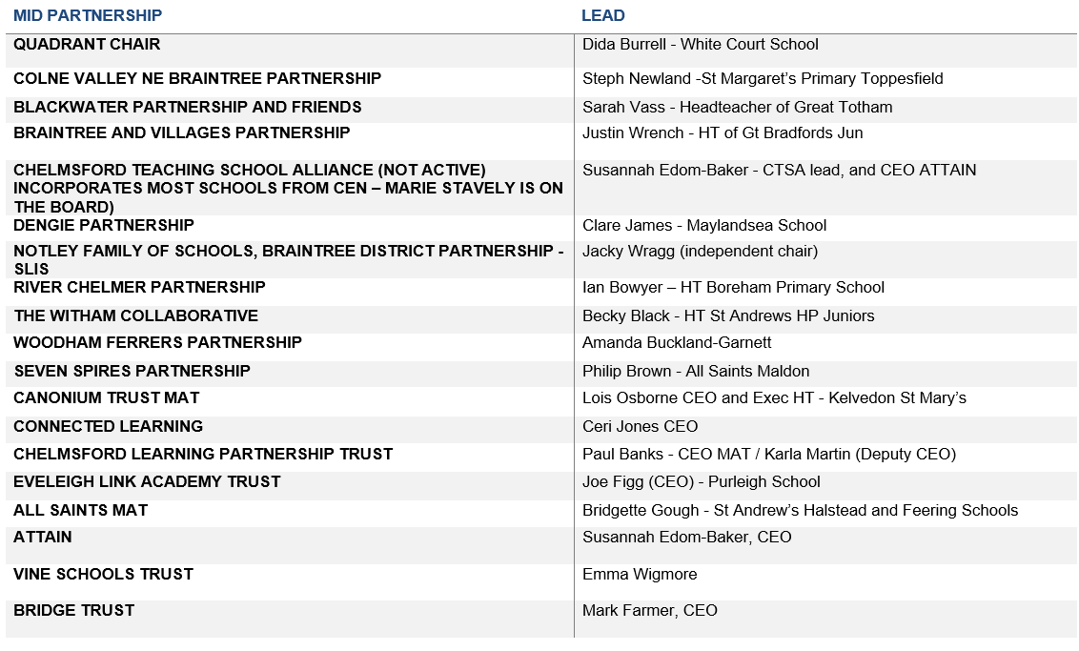
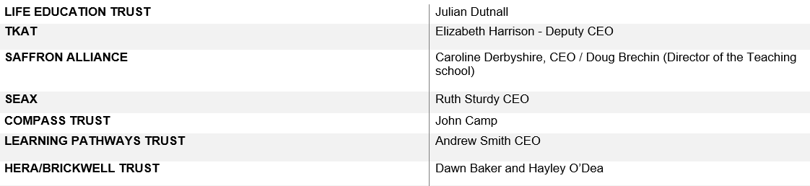

Slide 13
Core offer to all schools via the partnership model
School Partnerships refers to all types of partnerships, including local authority-maintained school partnerships and multi-academy trusts (MATs) and mixed partnerships of maintained and academy schools.
Up to 4 days LA SEP/ Head of Education support across the year which will include:
SEP will arrange a termly meeting with partnership Lead/MAT CEO or steering / management group - this will depend on size of partnership and the relationship and knowledge of the partnership. This meeting will include how collaborative working can improve curriculum equity and opportunity for all pupils with a focus on Disadvantage and SEND Support outcomes.
SEP support for collaborative working in and between partnerships so that Partnerships can be accelerators of school improvement.
Support for Peer review if requested:
  Facilitating/Quality assuring peer review
  Assessing the Impact of Peer review
  Capacity training for Peer Review
Support with Partnership Meeting agenda planning.
Support and training for Partnership Evaluation and Development Tool and outputs where requested.
County Partnership Leads meetings.
Support and attendance at Quadrant meetings.
Support with analysis and resulting actions of partnership data pack if purchased.
Support for Quadrant chairs in their role.
Support with identification of additional traded work to support the partnership agreed priorities.

Slide 14
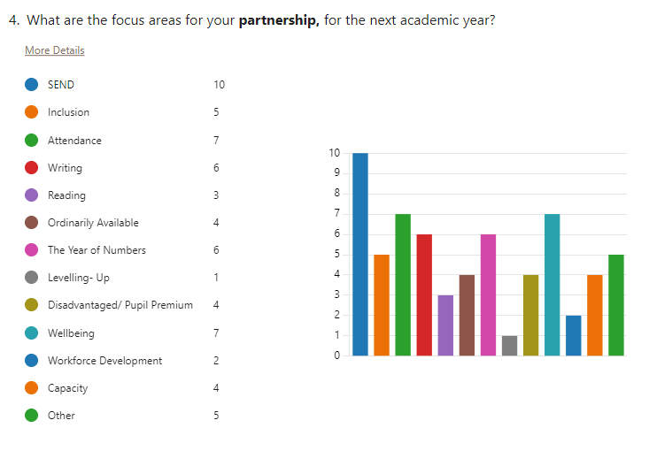
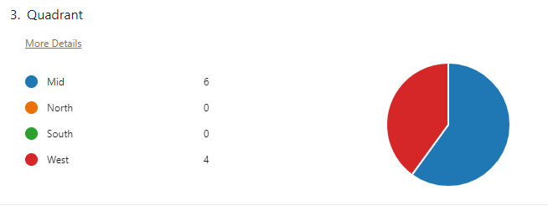
Partnership Survey
Please complete the very short form here: https://forms.office.com/e/avDvnjRE4S.
Notes:
We sent this survey out in July – however as only had ten responses - quadrant chairs sent this out again this term – please encourage partnership leads to complete – so the top priorities van be a focus of collaborative work
This is the email we asked quadrant chairs to share with partnership leads
Dear Partnership Leads,
Last term the central team supporting the school partnerships system (Quadrant Chairs and LA colleagues), created a form to capture the priority areas of focus for each partnership. We appreciate that some partnerships were still in the process of agreeing their priorities and so weren’t able to complete the form at the time.
The information captured will help us to align the support offer, connect partnerships with relevant focus groups and project activities, and it will also ensure we’re not duplicating any activity which is already in place across the partnerships.
Please complete the very short form here: https://forms.office.com/e/avDvnjRE4S.
Many thanks

Slide 15

National Wraparound Childcare Programme

Slide 16
Wraparound Childcare Programme Summary
The national Wraparound Childcare programme is part of the overall childcare reforms announced at the 2023 Spring Budget
The Government’s ambition is that: -
starting in September 2024 and by 2026, all parents and carers of primary school-aged children who need it will be able to access term time Ofsted registered wraparound childcare in their local area, from 8am-6pm to support working patterns
the wraparound care will be school-centred, with provision delivered by a variety of childcare models through: -
  provision on a school site either run by the school or a private childcare provider,
  the school supporting signposting parents to alternative local provision, for example PVIs and childminders.
This programme will only focus on: -
primary school-aged children from reception to year 6
creating places that are available Monday to Friday, term time 8am-6pm (unless data shows that local demand is for different hours)
The DfE are providing funding to Local Authorities to fund new and expanded wraparound provision to meet current demand and to start to create capacity to meet future demand.
Funding will only be available to create new places or expanded places and will not cover ongoing revenue costs to support running costs

Slide 17
Wraparound Childcare Programme Next steps
The Essex Early Years team are currently undertaking an audit on current wrap around childcare provision and will also be consulting with parents to understand the expected level of need
Once this is concluded, an analysis will be undertaken on the expected demand and identify areas around the County where wraparound childcare places will need to be created
The ECC Early Years team will be offering bespoke support to all schools, private voluntary and independent childcare providers and childminders interested in creating new wraparound childcare places. This support will consist of: -
Wraparound briefing sessions, that will start to be run in the coming weeks
Information packs, including the data on needed places and registering with Ofsted
Business support to create new wraparound places and to apply for available funding
Facilitation of creating local partnership wrapround childcare models between schools, PVI and / or childminders

Slide 18

Essex Inclusion Strategy
https://essexcc.pagetiger.com/dpxonua/1
Notes:
Dan

Slide 19

Supporting Inclusion
Inclusion Strategy
Inclusion Framework
Inclusion Reviews
Resources & Learning
Our vision and commitments, for equity and excellence in education for all children and young people.
Enabling early intervention and inclusion in mainstream schools through the principle of Lives without Labels.
Supporting schools to review and reflect on their culture, provision and practices.
Research visits, gathering and sharing intelligence and best practice, as well as professional learning programmes.
Notes:
Clare – hand to Dan

Slide 20




Commitments
Achieving and moving-on
Commitment 4
Cohorts, contexts and evidence informed practice
Commitment 1
Attending and participating
Commitment 3
Positive, mutually respectful relationships & wellbeing
Commitment 2
Inclusion strategy

Slide 21
Delivering our commitments
Inclusion Framework
Profiling of individuals and pupil cohorts, early intervention, and opportunities to seek financial support to develop systemic inclusive practices.
Inclusion Reviews
Supportive reviews offered to all schools and academies.
Inclusion Strategy
Ongoing delivery plans
Plans that specifically focus ECC resources on the delivery of our commitments.
Support for schools and academies
Training, resources and support for schools and academies to facilitate the further development of inclusive practices, including the Ordinarily Available.
Inclusion strategy
Notes:
Dan to Ralph

Slide 22


Inclusion Framework
Resources and Documents:
https://essexcc.pagetiger.com/dcneqoo/1
Guidance:
https://essexcc.pagetiger.com/dxdfsro/1
For support, please speak to your Inclusion Partner

Slide 23

Who is the Inclusion Framework for?
When can it be used?
The Inclusion Framework is for all pupils/ students who are experiencing a barrier to accessing a full, mainstream education. Use of the Inclusion Framework should therefore not be seen as a tool just for SENCOs.
The approach has been designed to support schools where they are struggling to include any pupil/s.
The process can be instigated at any time, for a single or group of children. We would encourage schools to use the profiling tool proactively, rather than wait for a barrier to present itself.
School-age children. We are continuing to pilot the IF for preschool age children to ensure the approach is as supportive and effective as possible.
Inclusion Framework

Slide 24
Test and Learn Feedback
Rating the objectives is a useful way of assessing progress and demonstrating this progress to families
It’s positive to have a common language around inclusion
The IF enabled relationship building, was easy to use, and examined a broad range of needs rather than just one over-arching matter
Accessing support was faster than existing processes
IF has been influential in expanding our thinking
Timing of sharing the OA and the IF has been very helpful – to be clear on what should be in place every day and what should be targeted and additional
Helpful ‘nudging’ from our IP!
With the new format it is easier to see how the columns themselves build on each other left to right, to cover the holistic journey of the child

Slide 25

Inclusion Reviews
Information for Primary:
https://essexcc.pagetiger.com/cpiulug/1
Information for Secondary:
https://essexcc.pagetiger.com/cpiulug/1
To express an interest in a review please share your details here:
https://forms.office.com/e/Fh6Y2mDie3

Slide 26
What do we review?
Values, vision and culture of inclusion across the school
Pillar 1
Positive, mutually respectful relationships, and wellbeing
Pillar 2
Attending and participating
Pillar 3
Achieving and moving-on
Inclusion reviews
Notes:
Catherine

Slide 27
What reviews lead to / the support offer
Schools receive a report following their review. This includes evidence-informed recommendations.
As our evidence base deepens, schools will also be linked to other schools who can share good practice in key areas.
The recommendations will form a part of the ongoing work with school leaders and their allocated IP/SEP.
Where appropriate, the report will also highlight links to additional ECC support (e.g. from the traded offer or our package of ‘support for schools’).
Inclusion reviews
Notes:
catherine

Slide 28






Ready to Regulate – a TPP professional learning programme
Endorsement and Pre- engagement
Applied Practice
Commitment from leadership and alignment with school ethos and development priorities
Commitment to attend, engage and apply TPP attitudes
Accessing pre-session materials
Using the learning in own work
Sharing learning with small groups
Continuing to connect with the learning content outside of training days
Evidence & Research
Reflection and Supervision
Neuroscience and learning from trauma-informed research studies
Evidence based models such as Panksepp and RRR
Practical approaches and relationship based regulation techniques
Regular protected time for reflection on own practise
Facilitation and Interaction
End of Programme Assessment
Practical activities – experiential learning
Considering the application of models to own environments
Sign-posting to additional resources
Developing own materials
Presentation of learning and impact throughout the programme and intentions for the future

Slide 29

Best practice visits
Identify examples of best practice – focus on inclusive practice.
Underpin the inclusion reviews and overall inclusion strategy being adopted in Essex.

Slide 30
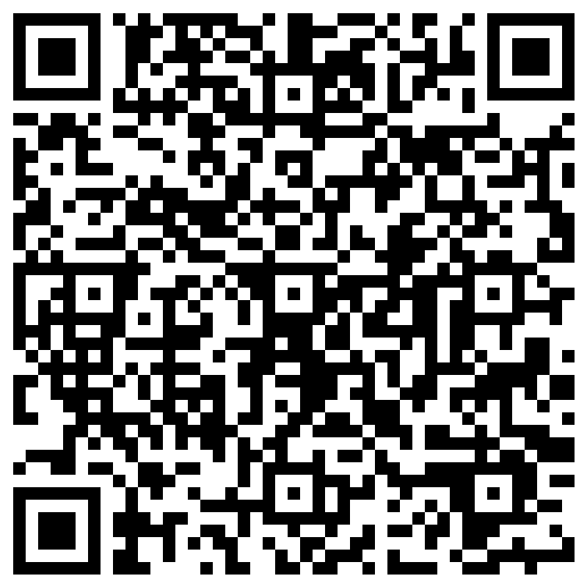
Opportunities to become involved
Nominate a Senior Leader to join a relevant research visit
Nominate a Senior Leader to shadow an Inclusion Review
Express interest in an Inclusion Review for your school
Contribute to development of the ‘facilitated workshops’
Express an interest in piloting the Ready to Regulate programme
https://forms.office.com/e/Fh6Y2mDie3

Slide 31
SEND Sufficiency
Ralph Holloway, SEND Strategy and Innovation

Slide 32
Change and growth in volume and complexity
As evidenced by
EHCP data
Special School Population
Independent special schools
EHCNA data

Slide 33
Number of EHCPs maintained by Essex
Jul-16 | 7550 | EHCPs and Statements
Jul-17 | 8057 | EHCPs and Statements
Jul-18 | 8536 | EHCPs and Statements
Jul-19 | 9183
Jul-20 | 9768
Jul-21 | 10,824
Jul-22 | 11,275
Jul-23 | 12,193
A 33% increase in number of EHCPs over the last 5 years

Slide 34
Number of EHCPs per quadrant
Quadrant | Jul-19 | Jul-21 | Jul-23 | Total increase
Mid | 2584 | 2965 | 3221 | 637 (25%)
North East | 2019 | 2455 | 2867 | 848 (42%)
South | 2789 | 3386 | 3812 | 1023 (37%)
West | 1791 | 2018 | 2293 | 502 (28%)
Total | 9,183 | 10,824 | 12,193 | 3010 (33%)
Notes:
NE highest % increase
South highest number increase

Slide 35
Plans by category of need
 | Cognition and Learning |  | Communication and Interaction |  | Sensory/Physical/ Medical |  | Social Emotional Mental Health |  | Unspecified
2019 | 2227 | 24% | 4485 | 49% | 963 | 10% | 1504 | 16% | 4 | 0%
2020 | 2203 | 23% | 4928 | 50% | 986 | 10% | 1644 | 17% | 7 | 0%
2021 | 2294 | 21% | 5517 | 51% | 1089 | 10% | 1916 | 18% | 8 | 0%
2022 | 2200 | 20% | 5851 | 52% | 1101 | 9% | 2073 | 18% | 50 | 1%
2023 | 2229 | 18% | 6256 | 51% | 1119 | 9% | 2350 | 19% | 239 | 2%
% have stayed relatively consistent
Most significant change in communication and interaction, where 1771 additional plans have been issued since 2019.

Slide 36
Number of pupils in Essex special schools
Sep-17 | 2720
Sep-18 | 2951
Sep-19 | 3154
Sep-20 | 3184
Sep-21 | 3387
Sep-22 | 3532
Sep-23 | 3671
35% increase since 2017
16% increase 5 years

Slide 37
Essex pupils funded in Other LA special schools
Sep-17 | 220
Sep-18 | 237
Sep-19 | 244
Sep-20 | 234
Sep-21 | 259
Sep-22 | 282
Sep-23 | 266
Sep23 may not yet include all pupils so is likely to increase
Notes:
Numbers for Other LA special schools have kept fairly consistent over the last few years

Slide 38
No. of pupils placed in Independent Special Schools (38 week day)
Between Sept-19 and Sept-23, the number of known placements has grown by 178.
This is a 102% increase.
Between Sept-19 and Sept-23, the average cost of a placement has increased by £11,909.
This is a 24% increase.
Notes:
20% increase in number of children placed over the last 5 years across all specialist provision in Essex, OLA and Independent

Slide 39
Requests for EHCNA over time – academic years
Notes:
142% increase since 15/16
67% higher than 18/19
20/21 – 22/23 = 42% increase in requests.
20/21 – 21/22 = 15% increase
21/22 – 22/23 = 23% increase.

Slide 40
Requests for EHCNA 22/23 - countywide
TOTAL countywide academic year = 3611
Notes:
TOTAL Countywide academic year = 3611
Average a month countywide = 328
Average a month for highest quadrant = 94
Requests always reduce in school holidays as majority of requests are from schools and settings

Slide 41
Response to date
New and additional special schools
  £115m capital investment in SEND, including the approval of four new free school special schools
Increased / over-capacity in Essex special schools
Additional PRU capacity
Development of GROW provision and new Enhanced Provision
£1m+ investment in early intervention for 22/23, additional for 23/24
Collaborative working with individual schools to develop new onsite provision – primarily in primary

Slide 42
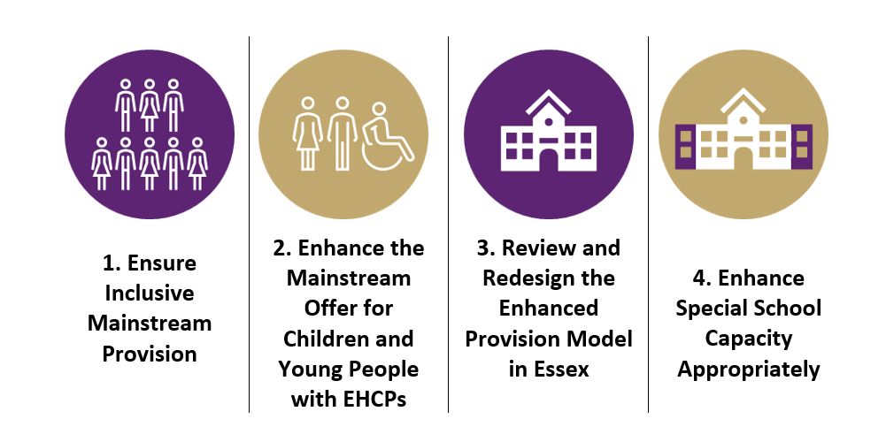
Future Plans

Slide 43
To deliver those intentions
  Access new and different funding streams i.e. developer contributions, to invest in schools differently
  Develop new and reclassify existing Enhanced Provisions appropriate to the needs of Essex children and young people,
  Develop effectively supported outreach/ inreach models
  Support for mainstream schools with children for whom special school has been deemed appropriate
  Delivering the wider inclusion support offer
  Best practice visits bringing research and evidence into Essex
  Rollout of the Ordinarily Available with associated support offer
Capacity analysis, review and potential reclassification of existing specialist provision
Development of satellite provisions

Slide 44

What opportunities for growth in provision are available, that we have missed?
Discuss in your groups and share your thoughts?

Slide 45
Autism update
Ondrea Bloom, SEND Strategy Lead- Autism

Slide 46
Training- Professionals
Autism Education Trust Training (AET)
New format for Good Autism Practice (GAP)
2 x 2hr sessions with implementation/development task
Initial discussion with IP/EP -
Advanced Autism Course (10 week course)
In process of being rewritten and will be launched for Summer Term
AutismStrategy@essex.gov.uk
Procured training
Autism, anxiety and transition package
Notes:
Procured training- attention autism was well attended. PECS has been pushed to Spring due to not enough numbers- available through training booking as normal
Autism, anxiety and transition package- have applied for some funding to work with secondary schools and their feeder primary schools to support a detailed and clear transition. Will be looking for pilot schools to trial and new package

Slide 47

Autism Portal
https://schools.essex.gov.uk/pupils/Autism_Portal/Pages/default.aspx
Bitesize Training/ Videos
Notes:
Autism portal - Available now on Essex Infolink – information to support OA
Bitesize Training- Have secured funding to create 15 bitesize videos for ND young people. It will support the targeted layer of OA

Slide 48
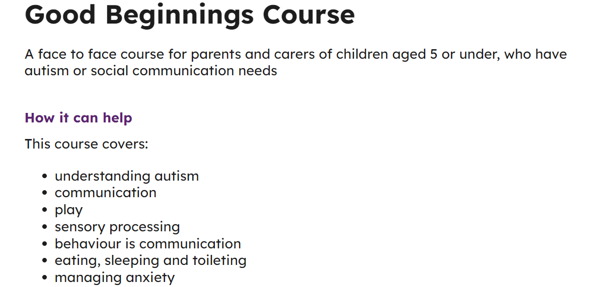
Training/ Events - Parent/ Carers
Good beginnings- for parent/ carers of children in Early Years ( inc Reception)
https://send.essex.gov.uk/search-support-groups-and-activities/good-beginnings-course

Slide 49
Training/ Events - Parent/Carers
Peer to Peer regional support hub
peersupporthub@essex.gov.uk
3 part offer- see slides
Please promote with parents/ carers in your school

Slide 50

Programme Governance
National Autistic Society (host)​
Autism Education Trust ​
Great Minds Together​
Contact​
Autism Alliance​
British Institute of Learning Disabilities​ (BILD)
Autistica​
Ambitious about Autism ​
National Network of Parent Carer Forums
Autism Central is a 3-year programme commissioned by Health Education England and will be delivered by a consortium of nine not-for-profit organisations:

Slide 51

A Three-Part Offer
A free service for parents/carers of autistic people, with or without a diagnosis.
Peer Educators are all parents/carers with lived experience of autism. They are trained in sharing their knowledge and experience and offering support.
East of England Hub
Essex, Suffolk, Norfolk, Cambridgeshire, Hertfordshire, Bedfordshire

Slide 52






Part One - The website
Autism Central for Parents and Carers | Autism Central
A growing source of information and guidance for parents and carers

Slide 53
Part Two - Group Online Session – accessed via the Autism Central Website
Access the Autism Central Website
Select Find Help
Select East of England Hub
Select chosen event and book a place

Slide 54

Group Online Session – accessed via the Autism Central Website

Slide 55


Part 3 - 1:1 Support
To change image:
Delete existing image and insert new by clicking on icon
or
Right-click, change picture
If new picture causes placeholder to resize or rotate
Click on ‘Reset’
under ‘Slides’ tab
on Ribbon
To resize or reposition image within placeholder:
Picture Format> Crop
Resize using white circles at corners
Move by click+hold on grey area of image then drag to position
  Parents, carers and Personal Assistants can request 1:1 support via a telephone call.
  For some, this is a brief conversation involving some fact sharing and signposting. For others, it is a longer conversation enabling parents/carers to share and unpick their experiences with someone with lived experience.
  Parents/carers can scan the QR code to register for a telephone call. The average wait time is less than one week.

Slide 56

How else we can support you
To change image:
Delete existing image and insert new by clicking on icon
or
Right-click, change picture
If new picture causes placeholder to resize or rotate
Click on ‘Reset’
under ‘Slides’ tab
on Ribbon
To resize or reposition image within placeholder:
Picture Format> Crop
Resize using white circles at corners
Move by click+hold on grey area of image then drag to position
  Schools and other groups can request Peer Educators to attend family/carer events.
  Many schools are already arranging visits to coffee mornings and support groups.
  If you would like a visit, please email:
  peersupporthub@essex.gov.uk

