Slide 1
EPHA Quadrant Termly meetings – Headteacher Briefing pack

Slide 2
Contents
1
8 - 13
SEND Funding Briefing
Briefing: National Framework for Penalty Notices
2
14- 24
SPM Review
Inclusion Strategy
3 - 6
Prioritisation Criteria
25-31
Childcare Reforms Update
7
32-26
Traded Offer – New Booking System
Review of the Relations, Sex and Health Education statutory guidance

Slide 3



How SEND Funding works for schools
If the Head, Bursar or SENCO were not able to attend the SEND Funding Briefing, we have included a recording to ensure all are able to access this training.
LINK TO RECORDING COMING SOON!

Slide 4

SPM Review
We are currently reviewing the implementation and impact of the SEND Strategic Planning Meetings. Alongside the roundtable discussion that will be held at the EPHA events we would like Headteachers, Bursars and SENCOs to independently complete the following, in order to aid our review of these meetings for 2024/2025.
https://forms.office.com/e/HsAN5jqEVt

Slide 5
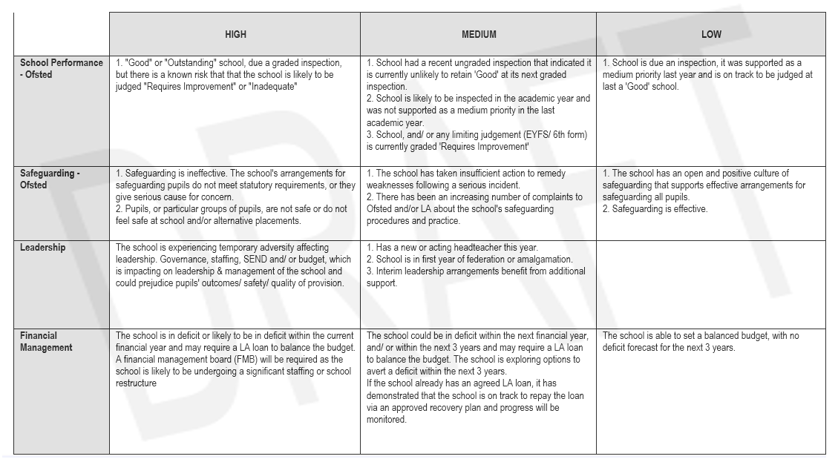

Prioritisation Criteria
3

Slide 6
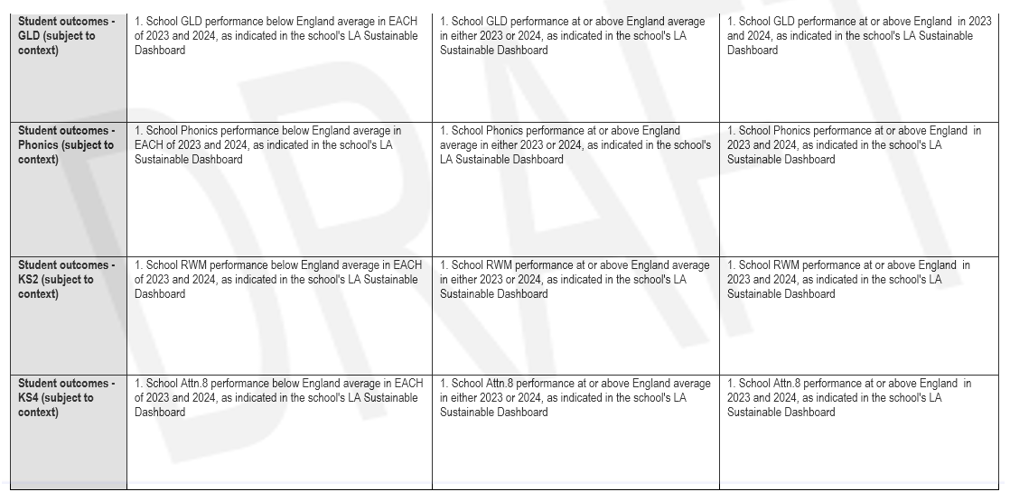
Prioritisation Criteria
4

Slide 7
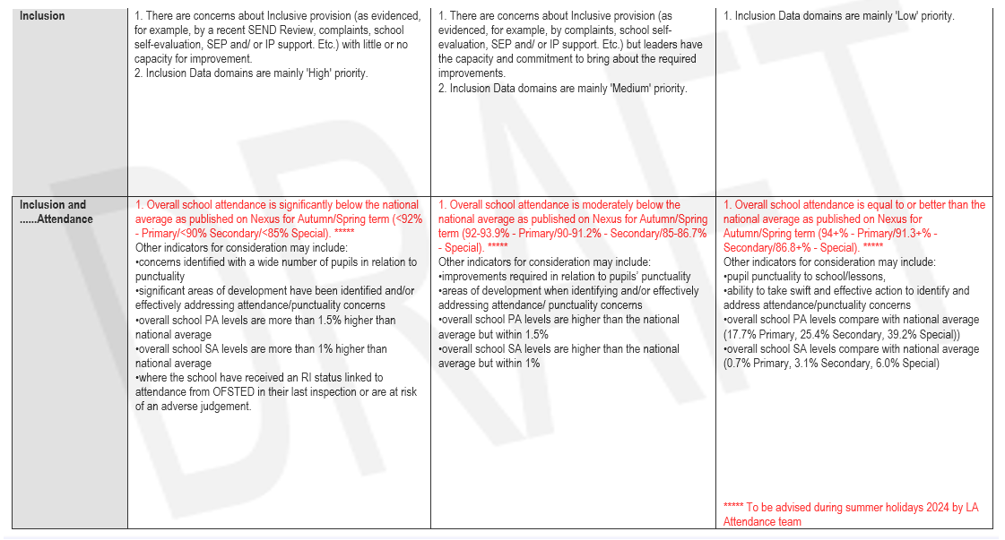
Prioritisation Criteria
5

Slide 8
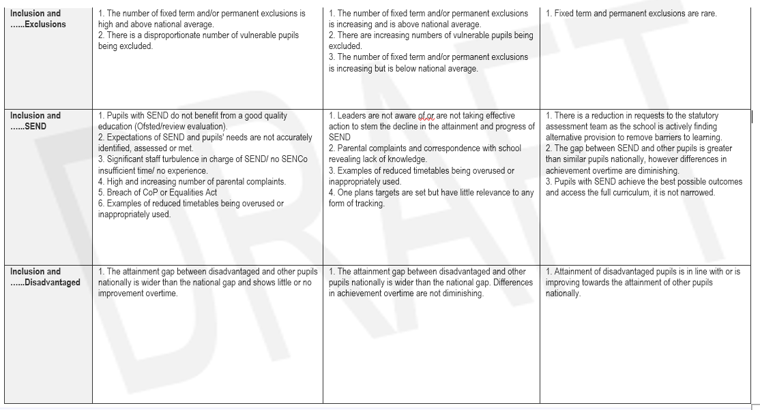
Prioritisation Criteria
6

Slide 9
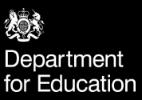

7
Review of the Relations, Sex and Health Education statutory guidance
Overview
The DfE are seeking views on changes to the relationships, sex and health education statutory guidance.
The DfE want to hear your views on proposed changes to the statutory guidance on teaching:
relationships education
relationships and sex education
health education
These subjects are collectively known as RSHE. Your views are important to help ensure that this guidance supports schools to provide high-quality RSHE which meets the needs of children and young people.
Closes 11 Jul 2024
Opened 16 May 2024
Review of the RSHE statutory guidance - Department for Education - Citizen Space

Slide 10
Briefing: National Framework for Penalty Notices
8
By Anita Patel-Lingham – Statutory Education Compliance Manager

Slide 11
New guidance in place
9
Working together to improve school attendance guidance is due to be placed onto a statutory footing as from 19 August 2024.
Previous version (published May 2022), has been updated and a new National Framework for Penalty Notices will also come into force from the start of the new academic year.

Slide 12
New national threshold
10
The national threshold for penalty notices under the new national framework will be:
10 sessions of unauthorized absence (any combination of G, O and/or U code) within a rolling 10 school week period. The 10 school week period may span across different terms/academic years and a school week is considered to be any week in which the school has a session on which their pupils are expected to attend school.
N.B. The current 3 day/6 session provision, which is within our local code of conduct (for the first two calendar weeks of September), will not apply as from September 2024.

Slide 13
Changes to fines
11
The national threshold for penalty notices under the new national framework will be 10 sessions of unauthorised absence (any combination of G, O and/or U code) within a rolling 10 school week period.
The 10 school week period may span across different terms/academic years and a school week is considered to be any week in which the school has a session on which their pupils are expected to attend school.
N.B. The current 3 day/6 session provision, which is within our local code of conduct (for the first two calendar weeks of September), will not apply as from September 2024.

Slide 14

Changes to fines
12
Fine levels are increasing under the new national framework, in line with inflation - £80/£160.
Under the new national framework, LAs will be limited to issuing a maximum of two penalty notices, per parent, per child within a rolling three year period. This is a significant departure from the provisions within our current, locally agreed code of conduct (which allows for two penalty notices per parent, per child within any 12 month period).
The first fine issued to a parent under the new national framework will be issued at the £80 rate, doubling to £160 if the fine remains unpaid after 21 days. Any second fine which is to be issued to the same parent, in respect of the same child will be issued at an escalated rate of £160, payable within 28 days, with no option to pay at the reduced rate of £80. Should a parent trigger the national threshold for penalty notices for a third time within a rolling three year period, the school/LA will need to consider alternative responses which may include consideration of prosecution under section 444 1/1A Education Act 1996.
N.B. The three year period will begin from the date on which the first penalty notice is issued. Any penalty notices issued in respect of suspended/excluded pupils (seen within a public place during the first five days of their suspension or exclusion), do not count towards the two penalty notice limit within the three year period.

Slide 15
Changes to fines
13
There are provisions within the national framework for penalty notices for headteachers to issue a Notice to Improve to provide parents with one final opportunity to improve school attendance patterns, before a penalty notice is requested. A template of this Notice will be shared with schools as soon as possible.
A Steering Group meeting took place on 30 April 2024 to discuss the implications of the National Framework for Penalty Notices – representatives from EPHA, ASHE, ESSET, Essex Legal Services, Essex School Governance Association, Essex Police, companies accredited to issue penalty notices within Essex via the Community Safety Accreditation Scheme and Essex County Council were present.
The current, locally agreed, Essex Code of Conduct for Penalty Notices remains in place to cover all unauthorised absences which are recorded by Essex schools until the end of this academic year. Where penalty notices are requested in September 2024, for absences which took place at the end of this current academic year, penalty notices will be issued in line with the current Code of Conduct NOT under the new national framework.
N.B. Essentially, timelines reset as from 19 August 2024. Any penalty notices which have been issued before this date (or issued after this date in respect of absences which were recorded during the 2023/24 academic year) will not count under the new national framework provisions. Only fines issued after 19 August 2024, for absences recorded after 19 August 2024, will fall under the provisions of the new national framework for penalty notices – for the purposes of the new fine levels, escalation requirements and maximum fine limits per parent, per child.

Slide 16
Inclusion Strategy
14
By Catherine Hutley – Assistant Director of Education – Mid Quadrant

Slide 17
Inclusion Strategy
15
The Inclusion Strategy was introduced in September 2024 against the backdrop of increased pressures faced by schools and the LA. For example, rising suspensions, P/Ex, demand for EHCPs, and levels of persistent absence. Inclusive schools were struggling to respond to these pressures, while examples of poor inclusion-related practice were becoming more common.
We developed a vision for inclusion that responded directly to the current context and that was grounded in ECC’s ongoing strategic work. It links closely to the DfE Trust Descriptions for high-quality inclusive education and the descriptors underpinning judgements in the EIF.

Slide 18
Our vision
16
Positive, mutually respectful relationships underpin and support the inclusion of all pupils and their families, and promote equality and diversity
The wellbeing of all members of school communities is well-supported and safeguarded
All pupils enjoy school and have high levels of attendance
All pupils are empowered and eager to participate in all aspects of school life
An equitable, high-quality curriculum supports all pupils to achieve well, from their different starting points
All pupils are well-supported to move on to appropriate next steps
Although our vision applies to all Essex children and young people, it has a spotlight on SEND and disadvantage.

Slide 19

Our commitments
17
Essex County Council will support schools to plan, implement, and review inclusion strategies that are evidence-informed and tailored to their cohorts and contexts.
In addition, we will review and support:
... the extent to which positive relationships and children's wellbeing is prioritised
... children’s attendance and participation
...children’s achievement and the extent to which they move-on to appropriate destinations

Slide 20

Delivering our commitments
18
Our approaches to delivering our commitments range from the short term (for example, the alignment and QA of our current offer with our vision for inclusion) to the long term (for example, how our workforce is organised to deliver our commitments into the future).

Slide 21

September 2024 Launch
19
We wanted to support the launch of the strategy by offering something different and immediately accessible to schools. Therefore, we launched the Inclusion Framework and Inclusion Reviews.
The Inclusion Framework is a tool that supports schools to profile the barriers to learning of cohorts of pupils, and target early-intervention at the point of need. The Framework is directly linked to the six elements of our vision. As part of the rollout of the programme, schools have been able to bid for funding for projects that will bring about systemic change to support inclusion.

Slide 22
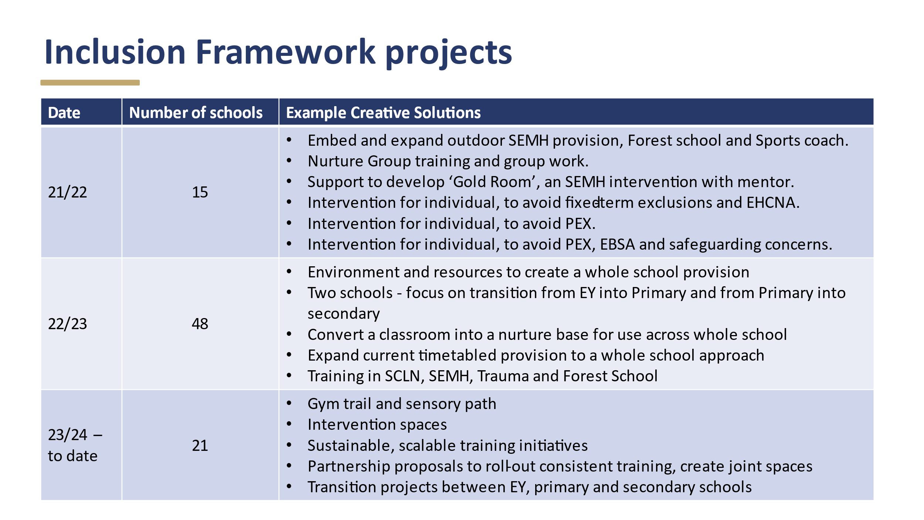
Projects supported by the framework
20
Inclusion Reviews are a truly collaborative, no-stakes review process that aim to support leaders by getting under the surface of some of the key challenges that they face. Again, they are explicitly linked to the six elements of our vision. Reviews are offered without charge to academies and maintained schools.
We have launched versions for small and average primaries, and one for large primaries, secondaries, and all-through schools. In addition, we have rolled-out a MAT version with three trusts, and we are beginning to include serving Headteachers as part of review teams.

Slide 23
Headline themes
21
2023/2024 reviews undertaken
Transition, specifically challenge of moving between schools with different values
Uncertainty about ‘Inclusion’ internal provisions
Quality first teaching versus out of class interventions
Relationships underpinning the best approaches
Common understanding of inclusion essential
Importance of teams around children approaches versus teams working in silos
The extent that TPP values are filtering down
Inclusion strategy versus inclusive approaches
Recommendations to utilise the OA and IF to support
Primary – 28
Secondary – 14
All-through – 1
MAT pilots - 3

Slide 24
2024/2025 plans
22
Bookings will open later this term- information will be sent to all schools
We will be looking for interest from another sample of MATs and we would also like to get a group of small schools interested so we can undertake individual reviews but also take a broader look at the inclusion landscape in that context (NB there has been an initial discussion about this with Jinnie Nichols)

Slide 25
Ready to Regulate
23
A new professional learning programme, aligned to our Trauma Perceptive Practice programme, which is evidence informed and shares practical approaches that use relationships to support regulation.
40 schools across primary and secondary are taking part in the pilot.

Slide 26
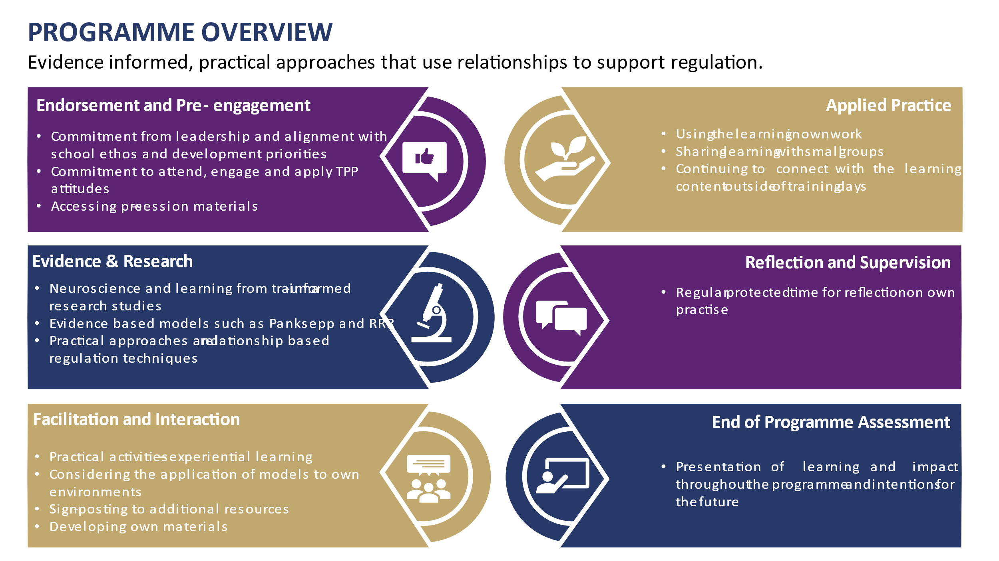
24

Slide 27
Childcare Reforms
25
By Carolyn Terry – EYCC Sufficiency and Sustainability Manager

Slide 28

Capital Funding Available
26
Early Years - capital budget allocated £2.8M.
This capital is for the creation of 795 new early years funded places for children aged from 9-month-olds to 23-month-olds at up to a maximum of £3,500 per new place created.
Wraparound – budget allocated £7M between now and 31st March 2026
The funding will include split between revenue and capital streams, including SEN funding.
This FY allocation £4.7M

Slide 29
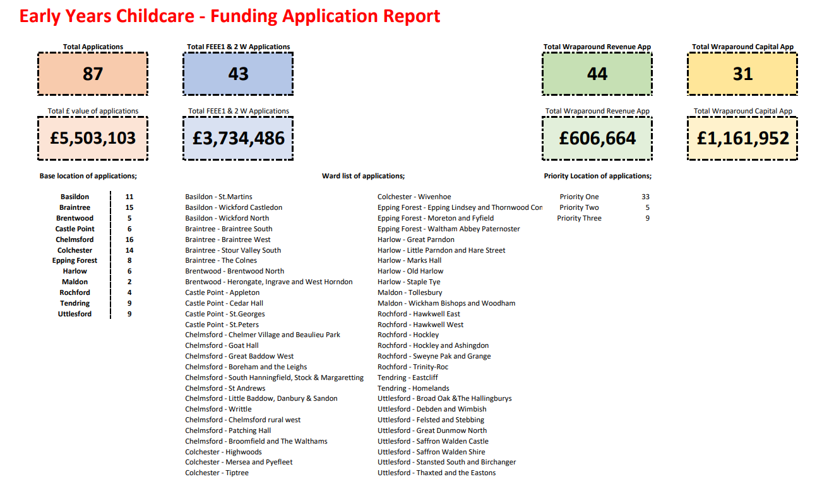
27

Slide 30
Phase 1 Next steps
28
Applications being evaluated and reviewed at Quadrant Panels over 4 weeks - starting 23 May 2024
Outcome of process will be: -
Applications agreed or
Further clarifications sought on information provided or
Applications declined
Outcomes to be communicated as soon as possible – with an aim this is completed by end of June
Phase 2 application process for Wraparound funding expected to be launched mid June 2024

Slide 31
Phase 2 Next steps for Wraparound Childcare
29
Proposed starting date 17 June 2024
5pm on the 2nd Monday of the month (8th July, 12th August, 9th September, 14th October,11th November) | Applications due in (will be on a rolling basis until all of the funding has been awarded)
By the 4th Friday of the month | Last date for Business Management Consultant Support
Feedback | From the closing date, applications will be processed within a 12-week window.

Slide 32
Traded Offer – new booking system
30
By Katy McBride – Workforce Development and Performance Manager

Slide 33

Traded offer – new booking system
31
The School Effectiveness and Workforce Development teams in Education are excited to announce a new system set to launch to Schools for the new academic year. The new system is required to replace the current Education Essex Online Booking System closing in July. This comes following a service review and consultation with schools, as the current system no longer meets our needs and restricts what we offer and how we collaborate. We know schools want a quick and easy system, with all services in one central place. The new system aims to centralise the booking process for training and school improvement traded services.

Slide 34
Benefits of the new system
32
The new system will streamline our continuous professional development offer and traded services by providing:
One front door: training and school improvement traded services on a single platform
A unified experience: schools will be able to browse, book, and pay for services online
Account migration: schools using our current system in the last two years will have an account automatically set up on the new system, unless they opt out
Minimised disruption: we aim to minimise any disruption to schools, courses on our current booking system will remain open for bookings until 5 July 2024

Slide 35
Support for schools will include:
33
Regular communications throughout the summer term about the new system
Instructions for schools registered on our current system, with details of what they need to do before the system closes in July 2024
User guides and videos to help schools use the new system
Our Workforce Development inbox and telephone helpline, open weekdays 9am-4pm

Slide 36
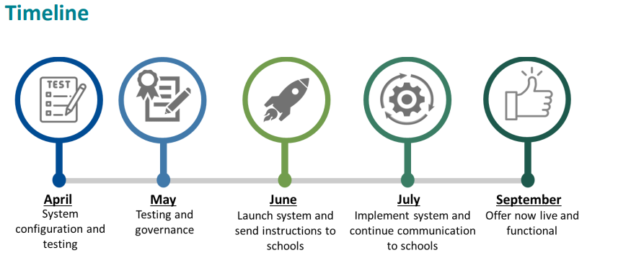
34

Slide 37
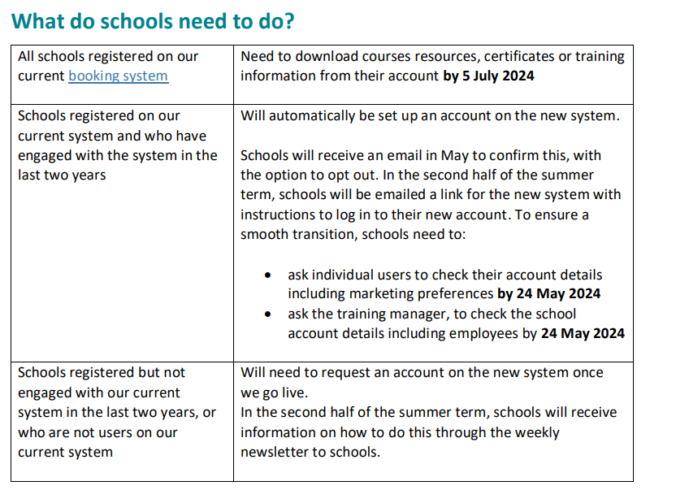
35

Slide 38

Help and Support
36
Email: workforcedevelopment@essex.gov.uk
Call: 0333 013 9891 (Available Mon to Fri 9am to 4pm)

