Slide 1
EPHA / ECC Summer Term Meeting 2019
12th June 2019 North East
13th June 2019 South
19th June 2019 West
20th June 2019 Mid

Slide 2
Agenda
SEND Organisational Design
Safeguarding – lessons learnt from recent Ofsted inspections
Excellence in Essex – Review linked to School Improvement System
School Effectiveness Support for School Partnerships
Education Traded Data Package
Elective Home Education/Flexi- Schooling Guidance
Headteacher well-being and support
Sale of EES
Natalie Banthorpe from Priory Street TSA: SSIF Phonics Programme

Slide 3
SEND Re-organisation update
The SEND redesign is not being undertaken in isolation, the wider SEND transformation includes:
The embedding and strengthening of the school led SEND system including sign up to an inclusion statement, development of the minimum offer, the construction of an outcomes framework and the introduction of SEND peer review
Co-production of a new SEND strategy and the creation of a SEND specific preparing for adulthood strategy
The completion of the strategic review of Essex’s High Needs Block
The launch of an Appreciative Inquiry into the Annual Review process
A SEND pupil place planning mechanism leading to the first Ten Year Plan for SEND;
Essex’s capital programme for SEND with the development of the first special school expansions
The early feedback from the public consultation has told us that
96% of parents understood the strategic vision we have shared;
93% of parents agreed or strongly agreed with the vision.

Slide 4
Quadrant
Quadrant Manager
SEND Operations Lead
SEND Inclusion and Psychology Lead
Senior Inclusion Partner
SEND Operations Partner
Inclusion Partner
Senior Educational Psychologist
Educational Psychologist
SEND Operations Co-Ordinator
SEND Engagement Facilitator
Assistant Educational Psychologist
SEND Operations Assistant

Slide 5
County Wide teams
HI, VE, PNI, MSI Sensory Teams remain as is but centralised
New strategic posts for Autism, SEMH and Language and Communication plus 2 EWMHS co-ordinator roles created.
New targeted employment team created
Business as usual during the autumn term
Small local workshops will be held for schools (governors, heads and SENDCos) to explain new structure and changes in ways of working in the Autumn term
Go–live January 2020.

Slide 6
Safeguarding lessons from recent Ofsted inspections
Oversight of governors – appropriate support and challenge:
What is reported to governors?
What questions do governors ask – where are the checks to the system?
What do governors look for when they visit?
How is this recorded and reviewed?
Is there an action plan to ensure safeguarding is effective?
Who monitors and reviews this?
How do governors know all staff are able to recognise and report concerns appropriately?
How do governors know all staff are appropriately inducted and trained?

Slide 7
Safeguarding lessons from recent Ofsted inspections
Child Protection records
Where is the voice of the child? How is this evidenced?
Do not rely on the knowledge of the Designated Lead – all information should be on the CP files
The files should ‘tell the story’ – a clear audit trail of all incidents, responses, actions (record all conversations / interventions).
Where there are multiple children in a family (in the same school), ensure checks are undertaken on all children where there is a concern for one child
How does the school respond to a concern raised? What advice was sought – what action was taken and recorded?

Slide 8
Excellence in Essex – Review linked to School Improvement System for 2019/20
Review to include:
Greater involvement of schools in local partnership when a school becomes vulnerable and requires a level of intervention
RAG to include criteria which reflect inclusion: SEND and Disadvantaged outcomes
School Effectiveness Partners support for partnerships to include allocation for new headteachers, schools due inspection, schools with enhanced provision

Slide 9
School Effectiveness Partner Support for Partnerships 2019/2020
Term | Focus
Autumn Term - 1 day (2 half days) | Analysing data, identifying strengths and weaknesses across the partnership and how they will support each other Support review of MOU/ToR
Spring Term - 1 day (2 half days) | Work on agreed focus coming out of the above
Summer Term - 1 day (2 half days) | Review of impact of Partnership – could be through the use of the Partnership Evaluation and Development Tool
In addition to the above: SEP will attend Partnership/steering group meetings Partnerships with schools that are due Ofsted (3 years from their last Ofsted or had Ofsted letter to say returning to undertake a section 5) will have additional half day allocated to each school Additional half day will be allocated to each new headteacher in the partnership (even if been a head in another school)
SEP will support partnerships to develop their strength, maturity and sustainability
- support partnerships to support vulnerable schools
-support schools with issues of multi-belonging
-support leads with schools’ engagement in partnerships
SEPs will support partnerships with the Quality Assuring of Peer Review to ensure it is having a positive impact across school
SEP time will also be allocated to individual schools identified as needing additional support through the RAGs of schools
Heads of Education will continue to support quadrant meetings

Slide 10
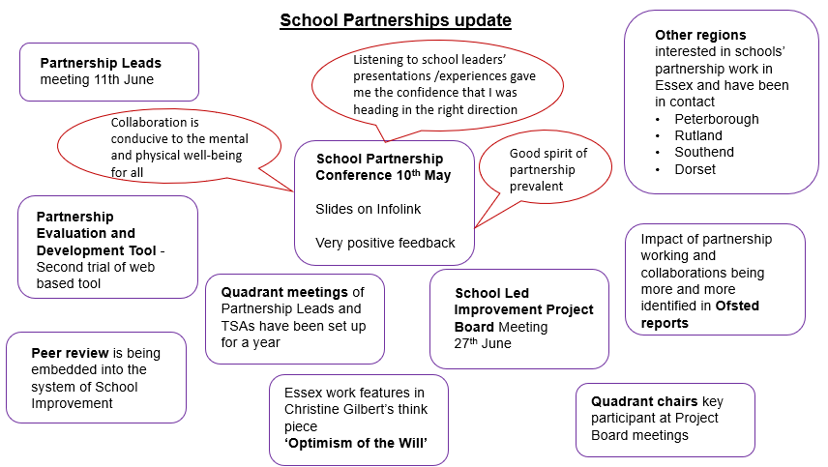

Slide 11
School Partnerships update
We need from you – up to date Partnership Lists – your link SEP will be in touch re updating these lists for 2019/2020
If your Partnership Lead is changing please let Nicola Woolf know at Nicola.woolf@Essex.gov.uk
Information on School Partnerships can now be found from the home page on Essex Infolink

Slide 12
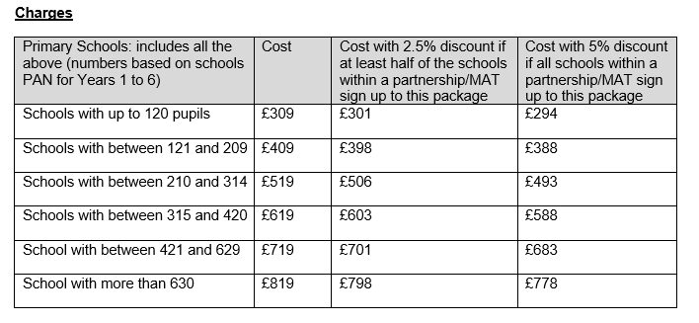
Educational Data Traded Services
This package includes all data that Infant, Junior and Primary schools have historically received from the Local Authority
Included in this package:
Subscription to Fischer Family Trust (FFT) Aspire
Essex Primary School Data Booklet
NOVA Reports
Data Training
Partnership Data reports
If there is full sign up from all schools within the partnership, a full and comprehensive pack will be provided at no extra cost.
NOVA
This was opened up to all schools in May to access and see the benefits of this package . It is open again through to 24 June 2019

Slide 13
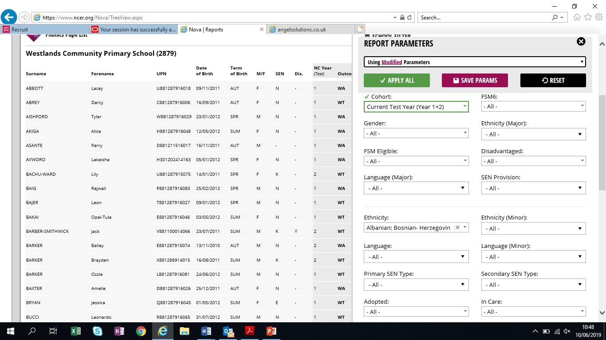
Access to NOVA via Perspective Lite can support leaders:
Enhanced interactive access, a suite of 80 attainment and progress reports, allowing you to draw comparisons drill down to characteristics, child, group, cohort for any previous year through to 2012 (see example)
Early analysis of 2019 data and realtime data comparison with Essex and National as early as July 2019.

Slide 14
EYFS reports looking back since 2012

Slide 15
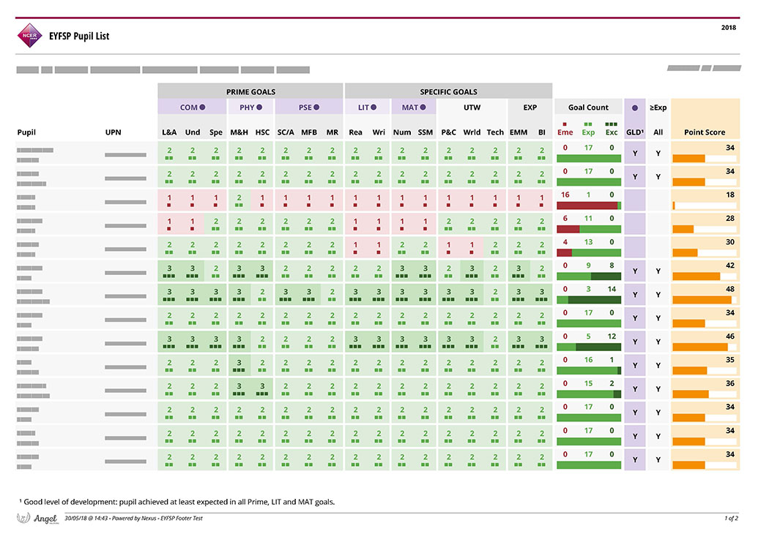
Helpful to identify ‘ just missed’

Slide 16
Use of NOVA has supported a school to show the impact of PPG targeted support to improve Phonics for Y1 and Y2 in 2018

Slide 17
KS1 useful reports include:

Slide 18
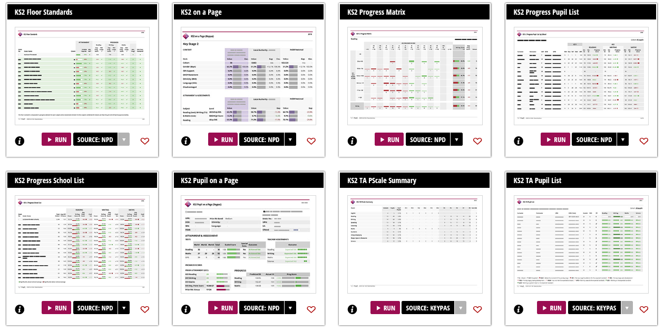
KS2 helpful reports include:

Slide 19
KS2 Pupil on a page and progress reports, time saving for the SENCo

Slide 20
Elective Home Education – DfE Guidance April 2019: Implications for schools
From September 2016 the Local Authority must now be informed of all deletions from the admission register when this takes place at a non-standard transition time.
Currently schools are asked to advise the LA when removal from |roll is due to EHE on the following link
https://essex-self.achieveservice.com/service/Notification_of_Parental_Decision_to_Electively_Home_Educate?accept=yes
Schools should not exert pressure of families to home educate
Ofsted has a focus around “off rolling” and is likely to ask local authorities about withdrawal rates at schools and whether action has been taken to identify patterns and a suitable strategic response.

Slide 21
LAs’ responsibilities for children who are, or appear to be, educated at home…. Should provide parents with a named contact ehe@essex.gov.uk Ordinarily makes contact with home educated parents on at least an annual basis Have a named senior officer with responsibility for elective home education policy and procedures – Anita Patel-Lingam Organise training on the law and the diversity of home education methods for all officers Ensure LA staff who may be the first point of contact for a potential home-educating parent understand the right of the parent to choose home education.

Slide 22
Section 7 Education Act 1996
The parent of every child of compulsory school age shall cause him to receive efficient full-time education suitable—
(a)to his age, ability and aptitude, and
(b)to any special educational needs he may have,
either by regular attendance at school or otherwise.
Reduced timetables guidance is on Infolink and will be updated over the summer https://schools.essex.gov.uk/pupils/Education_Access/Pages/Provision.aspx
The key points are:
Children are entitled to a full time education so a decision to place on reduced hours must be an exception.
Parents / carers must agree to the reduced timetable. If they don’t it can’t be put in place.
The school should complete a risk assessment covering the hours the child is not in school (there is an exemplar risk assessment in the guidance document);
There must be a clear action plan to ensure the pupil is moved towards a full timetable as quickly as possible.
Regular reviews must take place
The school should let Education Access know at provision@essex.gov.uk
There is a dedicated officer, Megan Crombie, who will liaise with the school around reduced provision and, if necessary, will ask other colleagues / teams to support the school as necessary.
The time the child is not in school should be coded as an authorised absence

Slide 23
Flexi-schooling: Guidance to Essex Schools
A document has been produced by the Education Access Team at Essex County Council to provide additional advice and guidance to schools who may need to consider requests from parents who are considering flexi-schooling as an option for their child (uploaded onto ESI).
The decision on whether to approve a request for flexi-schooling must be made by the Headteacher of the school who has received the request.
The document clarifies what is meant by the term flexi-schooling and aims to support conversations between parents and schools about this approach to education.
Arrangements for flexi-schooling can only be made at the request of the parent/carer. This is not an arrangement that can be initiated by the school. However, while there is a legal right to a school placement and to elective home education, there is no legal right to flexi-schools. Headteachers can refuse to agree to such requests and there is no right of appeal against the decision of the headteacher not to agree a flexi-schooling request.
Schools may find it helpful to read the April 2019 departmental guidance for local authorities on elective home education which references flexi-schooling
https://assets.publishing.service.gov.uk/government/uploads/system/uploads/attachment_data/file/791527/Elective_home_education_gudiance_for_LAv2.0.pdf

Slide 24
Other updates: - Headteacher well-being and support - Sale of EES

Slide 25
Natalie Banthorpe from Priory Street TSA: SSIF Phonics Programme

