Slide 1
Compassionate
Leadership
Professor Dame Alison Peacock

Slide 2

Allowing Children to surprise us

Slide 3



Slide 4
shifting the culture
Learning without Limits
Fixed thinking:
Everything is stuck – nothing changes.
or
Transformability:
The art of the possible.

Slide 5
Post-Pandemic Leadership
More than ever – build a listening school
Calm appreciation of all that is good and offers hope
Foster a sense of belonging and shared identity for both students and staff

Slide 6
Making a difference
Our core purposes and values matter more than ever as we support refugees and youngsters hearing of war atrocities
Less focus on ‘catch-up’ and more on re-inspiring connections and collective appreciation of learning
How can we keep trying to ‘find a way through’ to every child?

Slide 7
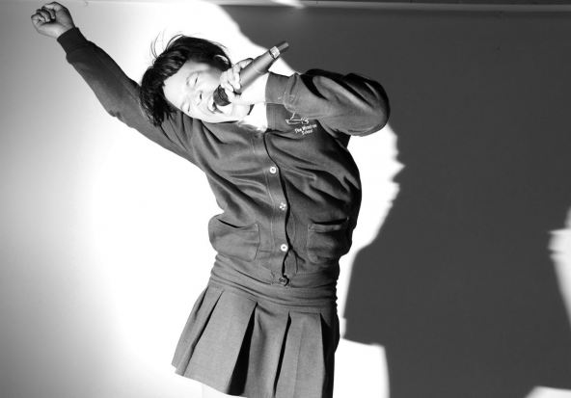
Affective domain
Persistence Stability

Slide 8
Wellbeing
Self care and awareness of how YOU and your staff team are feeling
Awareness of your role in ‘holding’ anxiety of others, especially the headteacher
Impact of loss and change for our young people
Acknowledging the impact of world events on our community

Slide 9
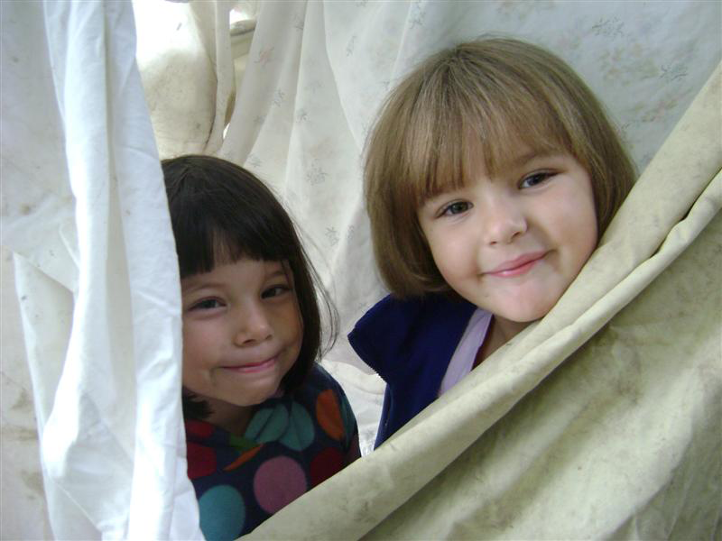
Social domain
Generosity Empathy

Slide 10
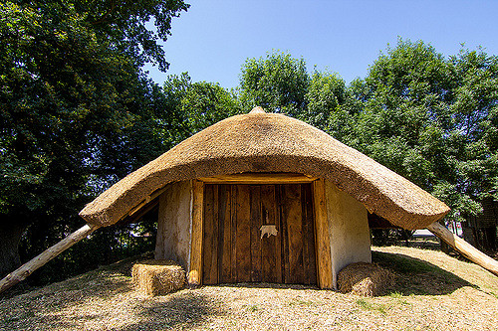
Curriculum
What are the key areas of learning within each subject?
Are there new opportunities afforded to us via flipped or blended learning models?

Slide 11
A collective response
Appreciating diversity as strength
Curriculum response
Valuing heritage languages
Cultural capital

Slide 12
Collective endeavour
Curriculum leadership via Faculties
Teams of experienced and novice teachers
Teaching assistants and nursery nurses
Governors
Pupil feedback via Circle Groups

Slide 13
Faculty Teams
Humanities – history, geography, languages, design & technology, maths
Creative – play, music, dance, drama, English, computing, art
Health and wellbeing – forest school, extended school, lunchtime play, religious education, RSHE, science, physical education and games, global education

Slide 14
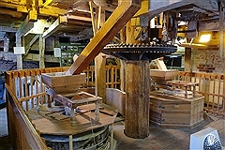
Intellectual domain
Openness Questioning Inventiveness

Slide 15
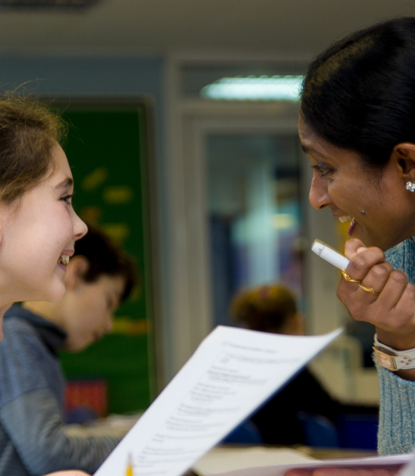
Quality of teaching
Clear explanation
Scaffolding
Feedback

Slide 16
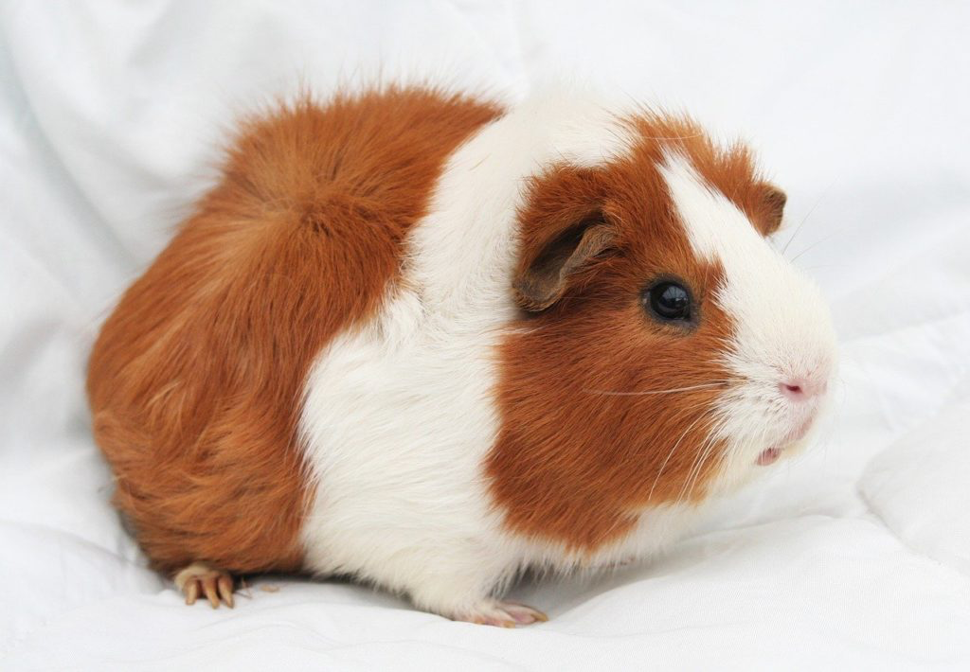
Equity & Empathy

Slide 17
Assessment
Low stakes methodology
Choice and challenge
Personal best
No ranking or sharing of grades / predicted grades
Learning Review Days
Report writing in partnership

Slide 18
Becoming CEO
A start-up professional body
New peer-reviewed journal
National conferences
Liaison with the Secretary of State
Launching membership
Making friends with adversaries
Building a new team

Slide 19
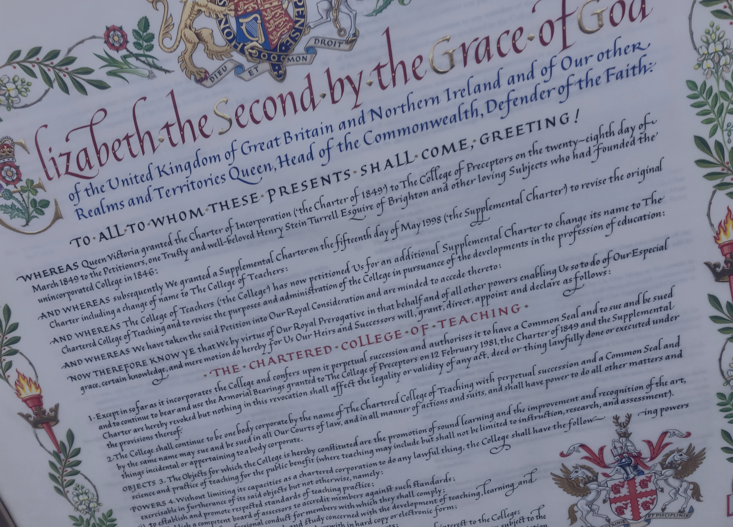
Royal Charter

Slide 20
Our vision
As the Professional Body for all teachers, our vision is that the Chartered College of Teaching will help teachers to work in a research-informed way, providing the best possible education for all children and young people.

Slide 21

Professional learning
Further reading COVID-19 chartered.college

Slide 22
Passionate advocacy
Speaking truth to power
Mutant algorithm
Hungry children and young people
Accountability without nuance
Exhausted teachers
Unfair media portrayal

Slide 23
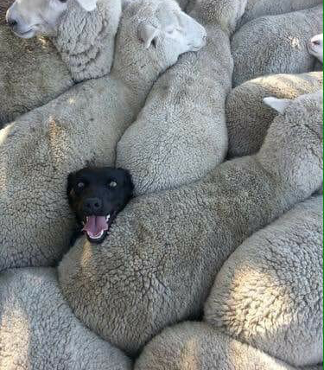
INTELLIGENT Accountability

Slide 24
Career pathways
Recruitment into our global profession
Support during Early Careers
Promotion prospects across the full range of posts
Being the change we want to see

Slide 25
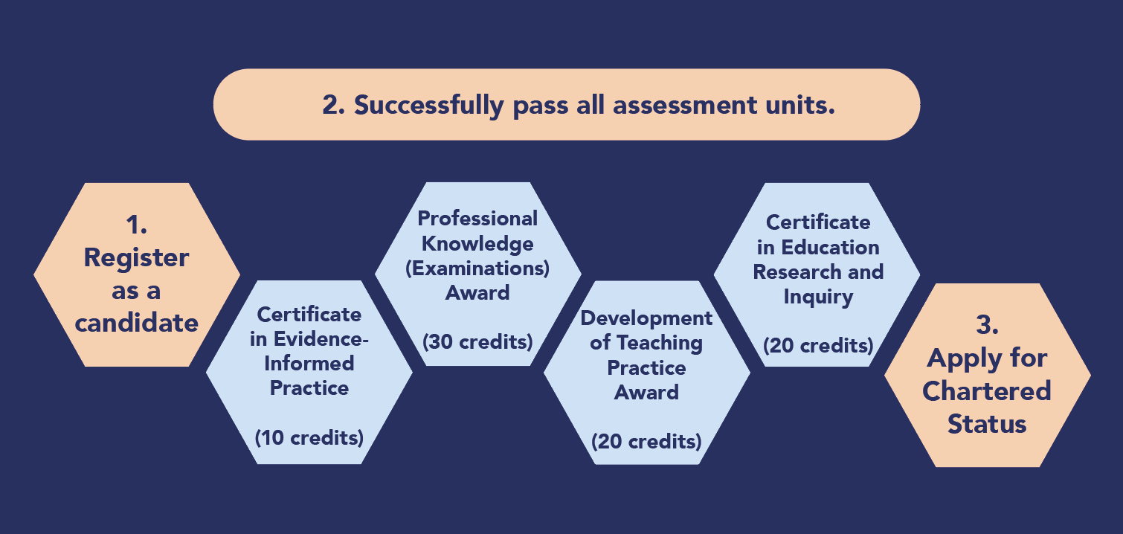
Chartered Status: from Jan 2022
Notes:
Once a teacher registers as a candidate for Chartered Status, they will have three years to complete the four assessment units:
- Certificate in Evidence-Informed Practice
- Certificate in Advanced Professional Practice
- Certificate in Educational Research and Inquiry
- Professional Knowledge (Examinations) Award
Each assessment unit is formally certified by the Chartered College of Teaching.
Upon completion of all assessment units, candidates are invited to submit a formal application for the award of Chartered Status. Upon successful application, teachers will be awarded Chartered Teacher Status and conferred with the postnominals ‘CTeach’.

Slide 26
5 years on …..
Building professional status
Chartered Status rigorous accreditation designed tested and available online – already accessed by 1,600 + teachers
Over 1,000 peer-reviewed articles in Journals
4 million + visits to Chartered College resources
Over 45,000 members and growing
Financial independence from government

Slide 27
Future opportunities?
Greater appreciation of our profession
Global connection
Discussion about future accountability
Assessment options
A more beautiful world

Slide 28
Membership
From £1.88 a month
Join now @chartered.college/join

Slide 30

We make the weather

