Slide 1
EPHA Summer 2017
Education

Slide 2
Looking Forward
Outcomes from the Statutory Assessment Service (SAS) and Specialist Teacher Team (SST) review
Growth Funding
Update on penalty notices
Proposed new school improvement model
Statutory assessment
Safeguarding
Analyse School Performance, FFTAspire
School-led Improvement Partnerships

Slide 3
SAS - Positive keywords in schools’ responses

Slide 4
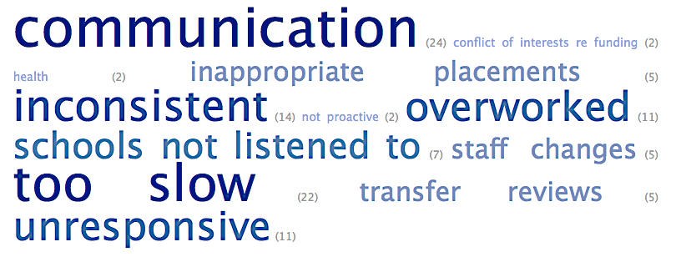
SAS - Negative keywords in schools’ responses

Slide 5
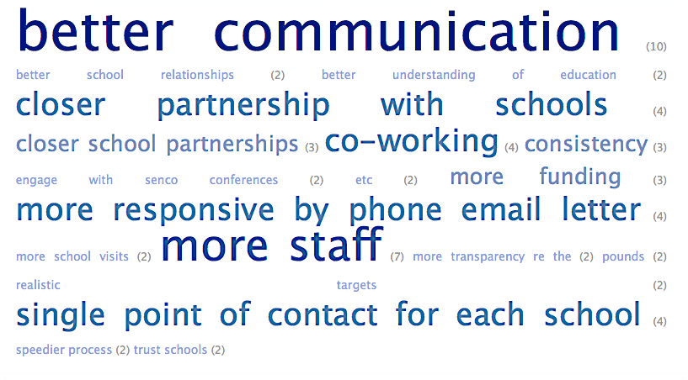
SAS - Keywords when schools asked for suggestions to improve

Slide 6
SAS - Recommendations
Recommendations were given to the LA addressing:
Procedures and systems
Communication
Developing new models of ‘co-working’ with schools
Review and evaluation of impact and effectiveness

Slide 7
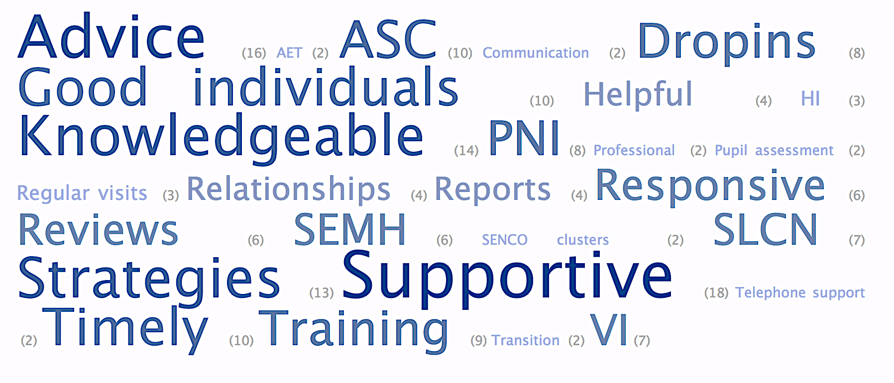
STT - Positive keywords in schools’ responses

Slide 8
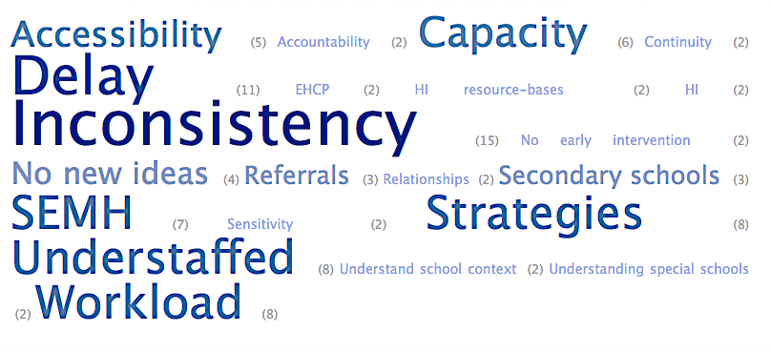
STT - Negative keywords in schools’ responses

Slide 9
Recommendations
Recommendations were given to the LA addressing:
Service delivery/quality
Leadership, management and organisation
Development of the service and link to strategic priorities
Effectiveness, outcomes and value for money
Working with schools to develop specialist teaching support in a school-led system

Slide 10
Table Discussions
What are 3 elements you would like from a newly designed Specialist Teacher Service?

Slide 11
Attendance
Isle of Wight ‘v’ Platt - Supreme Court ruling
Unanimously upheld Council’s appeal, ‘regular’ attendance means ‘in accordance with the rules prescribed by the school’
Replaces meaning of ‘sufficiently frequently’ assumed in earlier cases
School attendance is compulsory
Absence is a disruption on the education of the individual and other pupils
Addresses the criminality argument – penalty notices
Referred Mr Platt to the magistrates court

Slide 12
Proposed New School Improvement Service
Why change?
The school system is continuing to change rapidly. The way that the school improvement team works needs to evolve in order to:
Maintain the current excellent performance of Essex schools, effectively fulfilling our role of monitoring, challenge and support
Tailor services to schools based on performance within the context of the national education agenda, providing high quality educational opportunities for all young people in Essex
Maintain our knowledge of every school - but through partnerships of schools for the majority and individual visits for those who need them most, furthering the development of the school-led improvement system
Maintain support for schools in critical aspects of their work, such as safeguarding
Respond to the reduction in funding available.

Slide 13
Proposed New School Improvement Service

Slide 14
Working with School Partnerships Proposal
School-led improvement partnerships - considerable allocation of days. Topics may include:
Data analysis of schools within the partnership in partnership with headteachers
Evaluation of schools’ ‘Ofsted readiness’, which are likely to be inspected within the academic year
Support for newly appointed headteachers
Monitoring and support for schools where outcomes for vulnerable pupils are of a particular cause for concern
The use of the majority of allocated days will be agreed in consultation with partnership headteachers. A minority of primary schools are not in recognised partnerships. It is proposed that these schools have a half day visit per academic year.

Slide 15
Traded offer
The proposed traded daily rate for maintained schools and academies is £450. Traded activities will be finalised in due course but are expected to include:
Headteacher performance management
Deputy headteacher/leadership recruitment
Reviews of governance
Collaborative tailored reviews including ‘Ofsted ready’
Support for engagement with parents
Support to governing bodies
SEN/pupil premium reviews
Safeguarding audits and reviews
Quality assurance of self-evaluation/school action plans
Planning of conferences/events.

Slide 16
Core work…no changes
Schools Causing Concern, where schools are vulnerable, an additional allocation of days for individualised support is included within the proposed way of working, in addition to their allocation as part of a school partnership.
Investigating safeguarding complaints
Attending Ofsted inspection
School communications (Education Essex, school closures, critical incidences, business continuity Schools’ Infolink etc.)
Data and intelligence (School Summary Report, district and partnership analysis, Nexus etc.)
Media support (reactive press statements, advice etc.)
Informal support for headteachers/school leaders – email/telephone/drop-in visits
One day - advice and support for the governing body in Headteacher recruitment (additional support provided as a traded activity)
Support for structural solutions – federations, amalgamations and support to the development of Multi Academy Trusts.

Slide 17
Decision Making for Ethical leaders - Four quick tests to see if we are possibly stepping over the line:
1.The Sleeping Test. If I do this can I sleep at night? 2. The Newspaper Test. Would I still do this if it was published in a newspaper? 3. The Mirror Test. If I do this can I feel comfortable looking at myself in the mirror? 4. The Teenager Test. Would I mind my children knowing about this?
Marc Le Menestral

