Slide 1
Sensory Integration
A WHOLE CHILD APPROACH TO
An Introduction
Nerys Hughes

Slide 2
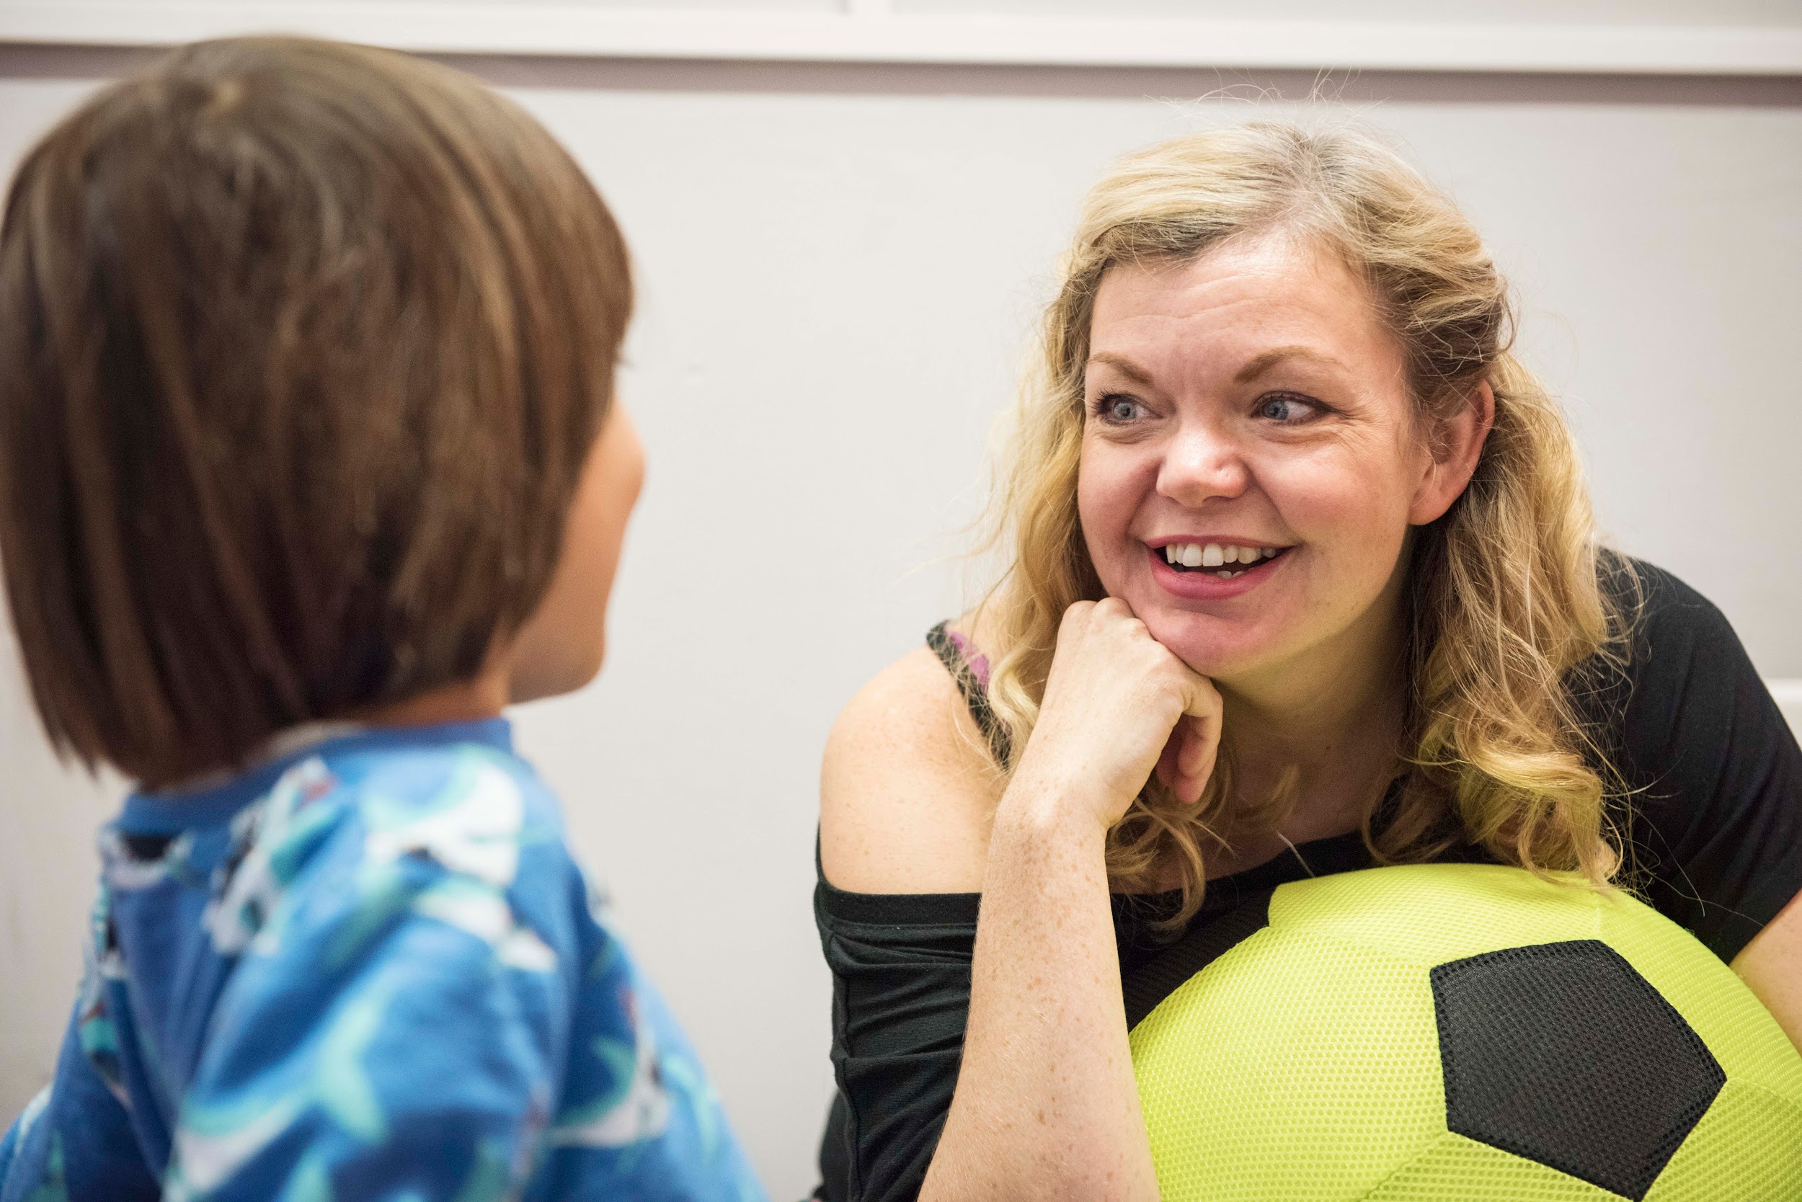
Nerys Hughes
Children’s Occupational Therapist
Clinical Director
Social enterprise
Interdisciplinary therapy centre
Schools, families, charities

Slide 3
Where am I now?
Regulatory State
Engaged and attentive but not over stimulated.
Learning and attention increasing
Bored–
Low arousal level makes learning difficult. Appears sleepy and disengaged.
Over stimulated– Learning difficult as too loud, too bright and too fast. Appears manic.
Stimulus and arousal increasing
HUGHES
Notes:
Before we start can you please rate how you are feeling, where you fall on this bell curve?

Slide 4
Developmental Movement
Lift head using shoulders and forearms- core stability
Stabilise
Find midline
Move head
Vestibular system
Look around
Attune to sound
Move with purpose to a location
Visual integration
Auditory integration
Know self in space
Notes:
A child will go from tummy laying to pushing the head up, to crawling, through this process a child will gain core stability and head control. They will also calibrate their eyes and ears to the vestibular system which allows them to learn about themselves in space, to integrate the visual system and to have both eyes working as one unit.

Slide 5
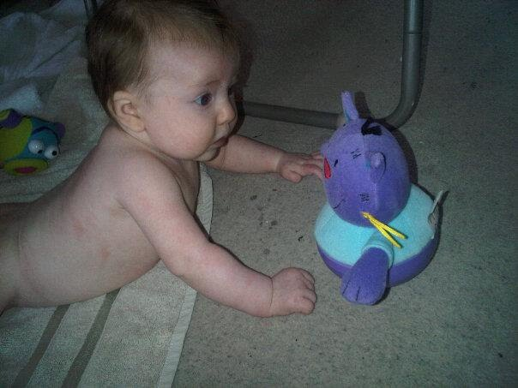
STNR to Functional Movement
3-4 months

Slide 6
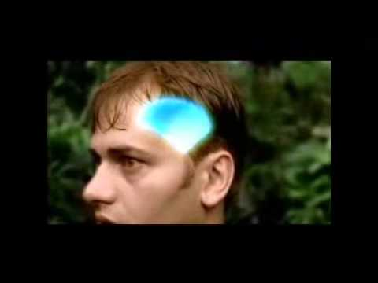
Fight or Flight
https://www.youtube.com/watch?v=jdJpLvSTZMU&feature=emb_logo
Notes:
Source: https://www.youtube.com/watch?v=jdJpLvSTZMU&feature=emb_logo (1’46”)

Slide 7
ABC of Attachment
Attunement
parents use their own internal state to help regulate the infant
Balance
a child’s achievement of balance between its body, emotions and state of mind
Coherence
sense of internal integration and interpersonal connectedness to others acquired by the child through its relationship with its parents
SIEGEL, 2004
Notes:
Again if we look at attachment through the lens of developing systems and sensory processing we can see how quickly the attachment and social relations are impacted on by a disruption of sensory processing

Slide 8
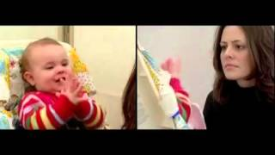
Emotional Disconnect
Notes:
Source: https://www.youtube.com/watch?v=apzXGEbZht0&feature=emb_logo (2’48”)

Slide 9
Emotional Development is Interrupted
Criticised
Defensive
Feeling under attack
Notes:
When our children respond differently to the input they receive, often they are under constant critic: ‘be quiet’, ‘don’t run’, ‘why won’t you sit still’, ‘why don’t you just eat like everyone else’. For a child with SPD their experiences are real. Their system interprets that sound as aggression or the need to move as a physical need and not a behaviour.

Slide 10
Rejection Sensitive Dysphoria
Builds up over time
Rejection does not have to be real only perceived
Repeated failures
Not belonging or fitting in
Missing simple social cues
Not being able to self regulate well
https://neuroclastic.com/living-with-rejection-sensitive-dysphoria/
Microaggressions cause trauma

Slide 11
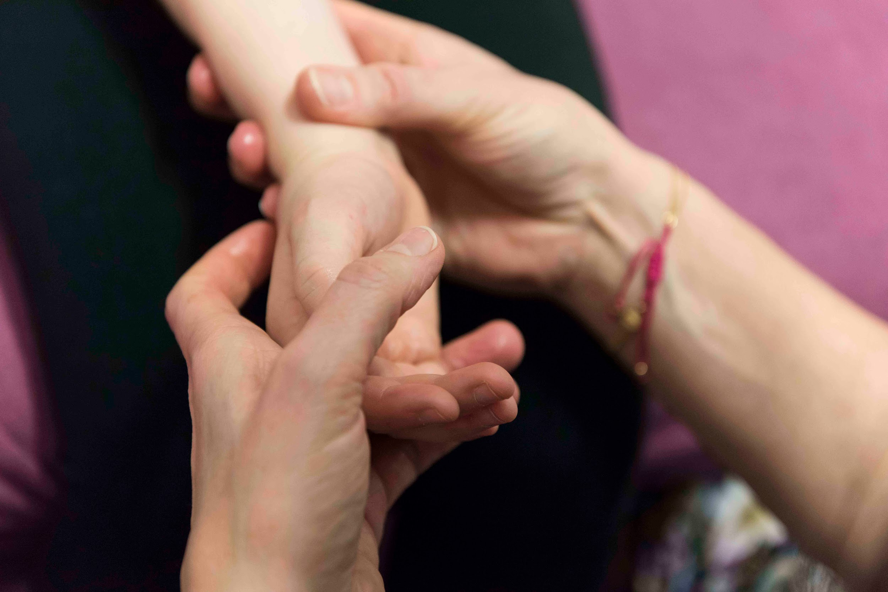
Being aware of ourselves
Reducing words
Problem-solve
Understand
Breathe
Muscle tone relax
Reduce challenge(s) leave an open door

Slide 12
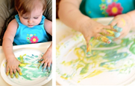
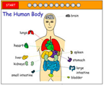
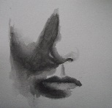
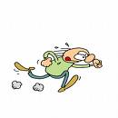
Touch- tactile, feeling through our skin, including our lips and tongue
Introspection
Internal organs
Taste and smell, olfactory, Gustatory
The 8 Senses
Movement sense- vestibular, the inner ear
Sound-auditory
Body sense-proprioception
Sight- vision, including ocular motor function (behavioral optometry)
Notes:
Most of these systems we all know, but proprioception and vestibular tend to be terms that most of us do not use.
During this presentation we will look in more depth at all of the senses with focus on the vestibular system and proprioceptive system

Slide 13
Optimum Learning
Where are you now?
Regulatory State
Engaged and attentive but not over stimulated.
Learning and attention increasing
Bored–
Low arousal level makes learning difficult. Appears sleepy and disengaged.
Over stimulated– Learning difficult as too loud, too bright and too fast. Appears manic.
Stimulus and arousal increasing
HUGHES
Notes:
Rate how you are feeling now, has this changed since the beginning?

Slide 14
Proprioception
Proprioceptive information relates to feedback about the position and movement of the body
Information is received from receptors in our joints and muscles
It allows us to know where our body is in space, this is vital for developing adequate body and spatial awareness
Helps our system regulate, and often has a calming and orienting impact on a child who experiences Sensory Integration Dysfunction
Helps us plan and organise our movements such as how much fource to use or how to balance
Notes:
When we lift a cup our proprioceptors tell us how heavy the cup is and how much force to use. Have a go lift up a pen and now a cup, see how your body tells you how much force you need.
True proprioceptive movement is created through volitional (willful) movements; when the communication channel from the body to the brain and the brain to the body is open and undisrupted.
When you think of children with neurological impairment, restricted or controlled movement, or impaired tone, you can see how they are missing out on vital information about their body and their relationship with the environment.

Slide 15
Have a go!
Chair push up
Push your brain in
Palm press
Notes:
Now take your hands and press them together firmly like this (prayer position) turn to the person next to you squeeze their elbow then swap over. Do you see how you have a greater knowledge of your arm, this can also be calming so have a go when your feeling overwhelmed… as well as improving one’s focus and attention.
In the classroom we often use proprioception to help a child find their optimum arousal level as it can positively impact on attention and focus. Let’s all engage our proprioceptive system… palm push push the person next to you.

Slide 16
Optimum Learning
Where are you now?
Regulatory State
Engaged and attentive but not over stimulated.
Learning and attention increasing
Bored–
Low arousal level makes learning difficult. Appears sleepy and disengaged.
Over stimulated– Learning difficult as too loud, too bright and too fast. Appears manic.
Stimulus and arousal increasing
HUGHES
Notes:
Rate how you are feeling now, has this changed?

Slide 17
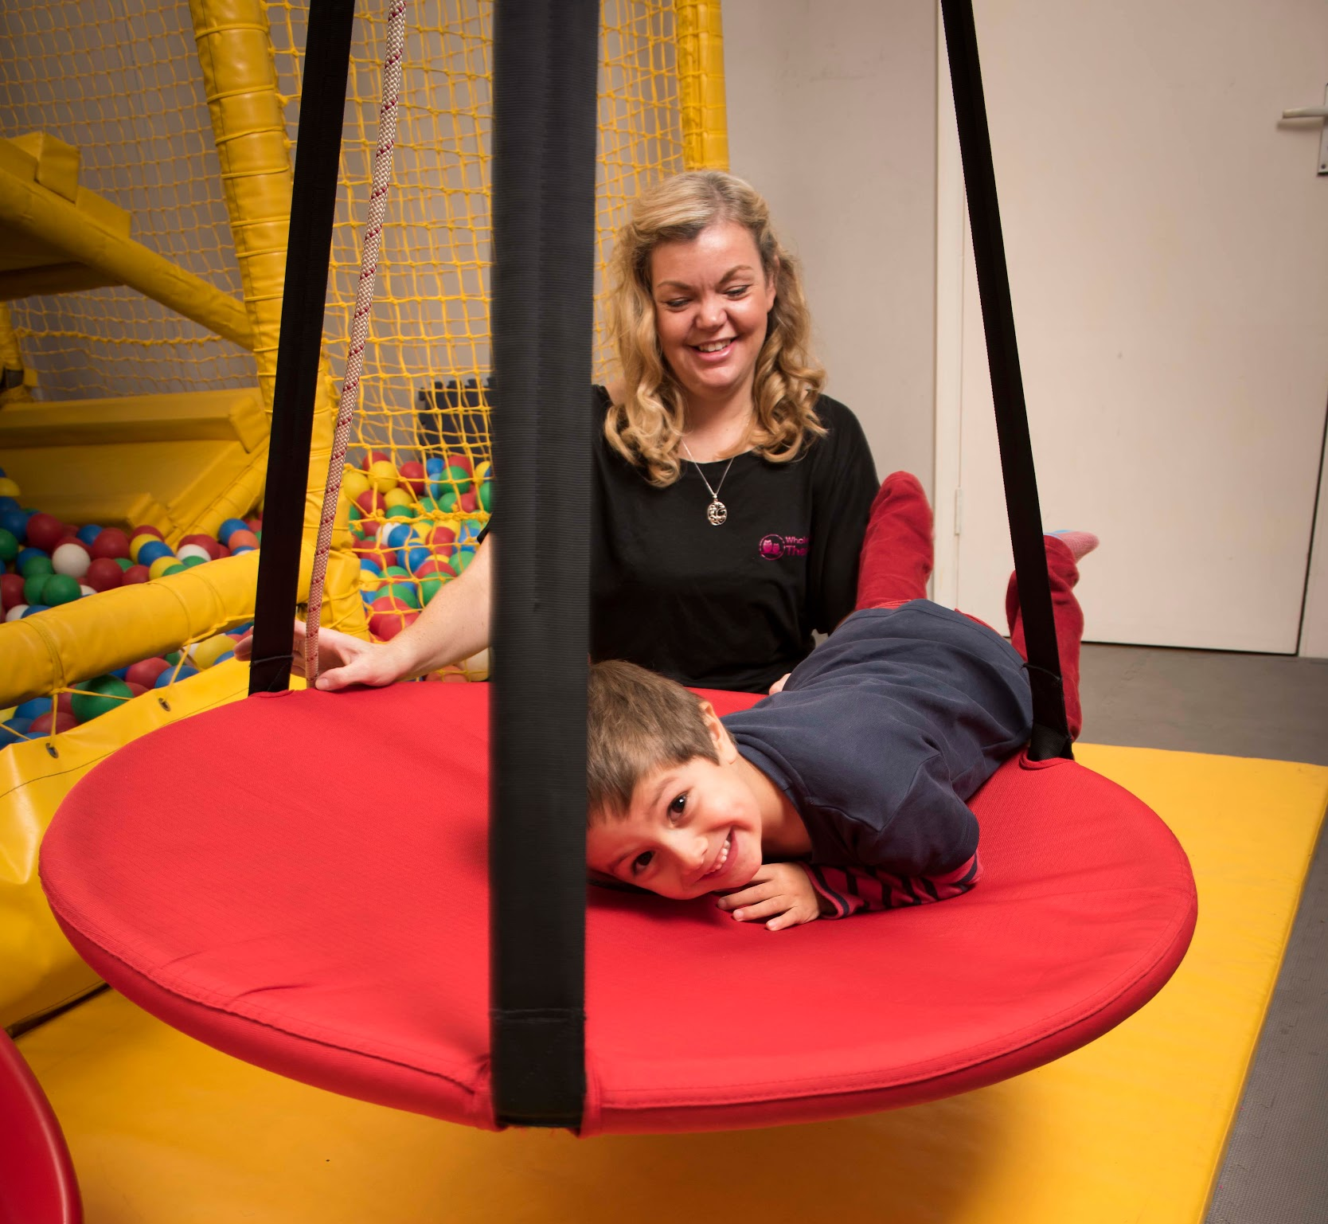
Vestibular System
Vestibular system refers to receptors located in our inner ears that tell us about the direction and speed we are moving in
This helps us modulate our own equilibrium
This is the spirit level on the CNS

Slide 18
Optimum Learning
Where are you now?
Regulatory State
Engaged and attentive but not over stimulated.
Learning and attention increasing
Bored–
Low arousal level makes learning difficult. Appears sleepy and disengaged.
Over stimulated– Learning difficult as too loud, too bright and too fast. Appears manic.
Stimulus and arousal increasing
HUGHES
Notes:
Rate how you are feeling now, has this changed?

Slide 19
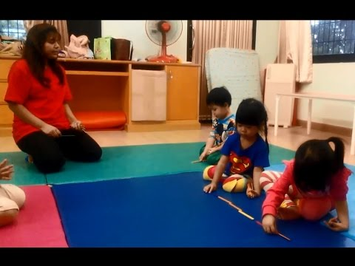
https://www.youtube.com/watch?v=Kyi2EO7LPIk&feature=emb_logo

Slide 20
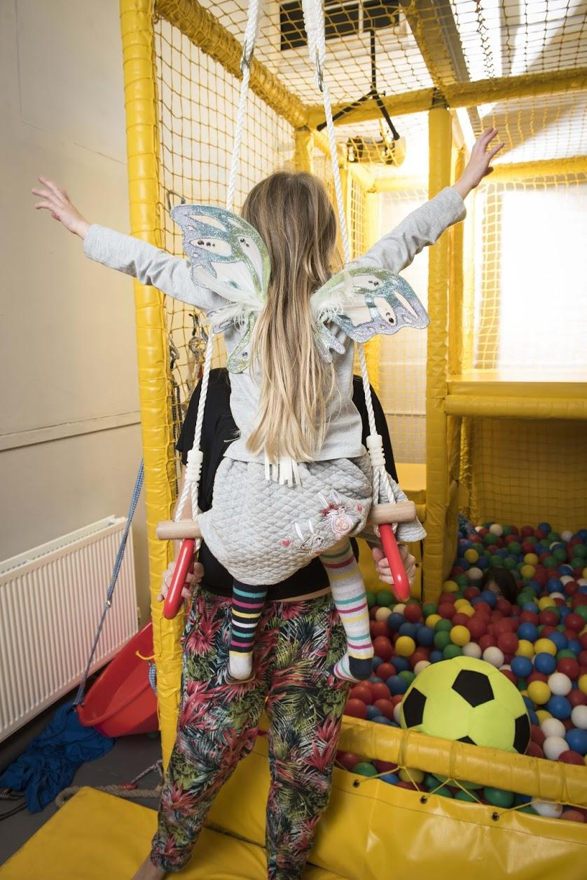
Sensory-Motor Disorders
Somatodyspraxia
Motor planning
Dyspraxia/ DCD
Postural Disorder
Miller (2015)
Notes:
Lucy Miller (2015) Mentorship Programme attended by Nerys Hughes

Slide 21
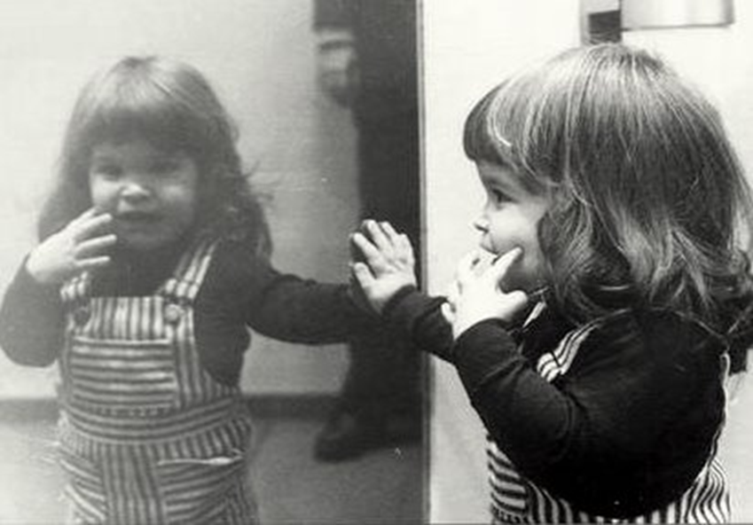
Developing a map
A sense of self in space
Notes:
So a child has developed a sense of themselves, their space their time, their responses to the world, and here we come with our new glasses, eye patch, physical space, and change that perception, disrupt that image what do we do. We disrupt them….

Slide 22
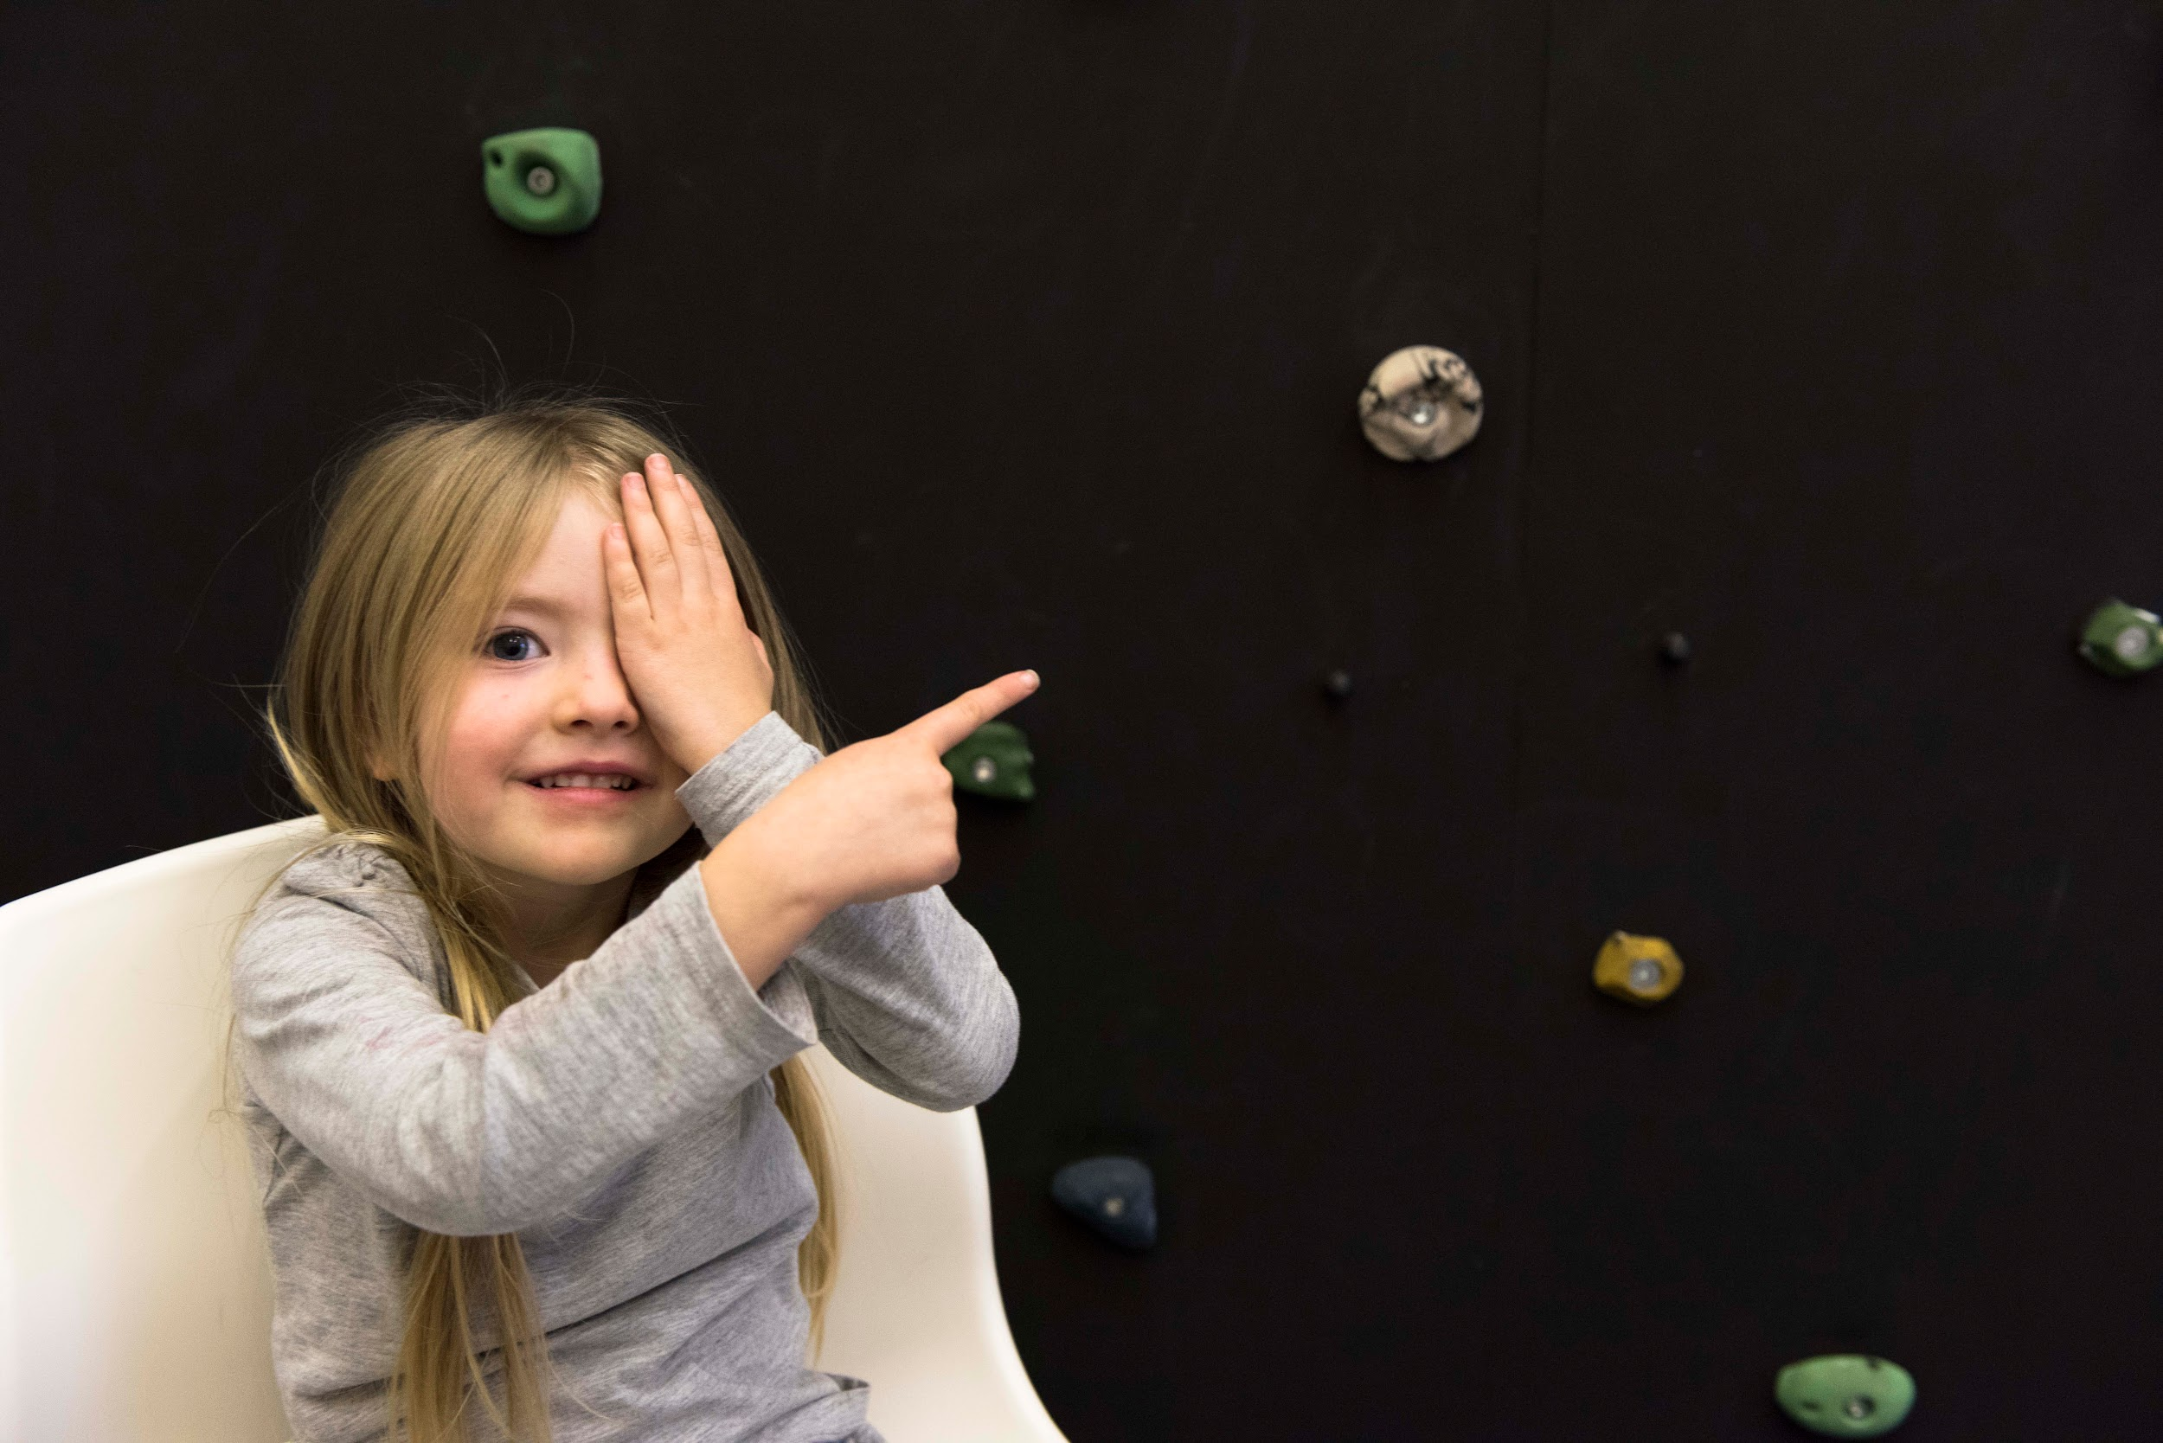
Visual
Sight, vision, including ocular motor function (behavioural optometry)

Slide 23
Ocular Function
Locating- eye spy, where is wally, distance- develop force and timing
Tracking - bubble pop, throwing and catching
Convergence- stack the spoon (in mouth), blow football
Rapid location- throwing loop (3 way throwing and catching), target and catch, light games

Slide 24
6 types of eye movement
VOR (Vestibulo-ocular reflex)- eyes move in opposition to head
Gaze holding- ability of eye to remain still whilst looking at an object
Saccades -are quick, simultaneous movements of both eyes in the same direction.
Vergence- eyes move towards each other as objects get closer
Smooth pursuit- smoothly follow objects
OKR (Optokinetic reflex)- the eyes ability to follow a moving object while the head remains still
Notes:
I put this slide in to show you how clever I am… no the aim here is not to trip me up with words I cant say but to demonstrate the inherent link between vision and vestibular function. Thee American association of opthalamists recommends parents encourage crawling, and make sure children do not omit this stage as it will impact on ocular motor function. As OT’s we look at reading writing, motor planning, head control, orientation all things stem from this internal spirit level.

Slide 25
Visual / Vestibular Experiment
Let’s do this!

Slide 26
Olfactory and Gustatory
Memory
Emotional response- amygdala
Can heighten flight or fight
Used as orientation tool in young children

Slide 27
Managing the Olfactory System
Learn triggers
likes / dislikes
Olfactory cueing
scents for times and spaces
Safe scent
carrying a safe scent
Alerting- citrus, rosemary, rosewood, ylang lang Calming- lavender, neroli, geranium Organising- sandalwood, basil, palmarosa

Slide 28
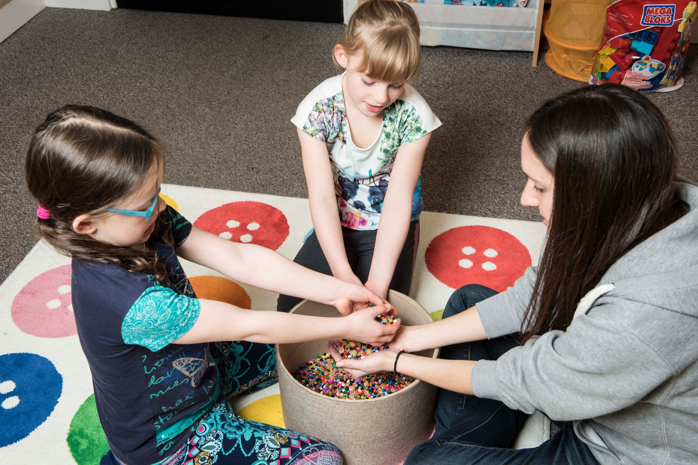
Tactile
Touch, feeling through our skin,
including our lips and tongue

Slide 29
Tactile Experiment
Let’s do this!

Slide 30
Auditory
Sound

Slide 31
Auditory Processing
Filtering, Dampening
Orienting, Localising
Processing to language
Responding appropriately-
Fight/Flight
Notes:
Knowing the direction of sound, knowing how to filter sound?
Dampening responses, if a loud bang or clatter happened today outside and we were all able to work out using our auditory filtering that there was a builder outside we would eventually filter out that sound; the first time we may jump but quickly we would know to tune it out. Also think how much we use sound to tell us our location or the location of others, think about how echo tells us the depth of a space. Now again the vestibular system is the baseline for us knowing where am I how big is the space around me how far are you from me.

Slide 32
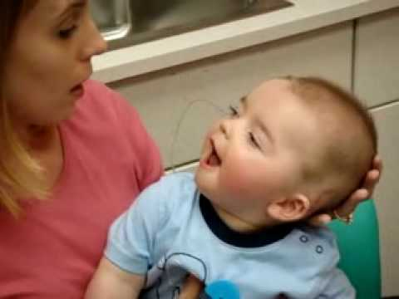
Auditory
https://www.youtube.com/watch?v=HTzTt1VnHRM&feature=emb_logo
Notes:
Source: https://www.youtube.com/watch?v=HTzTt1VnHRM&feature=emb_logo (0’49”)

Slide 33
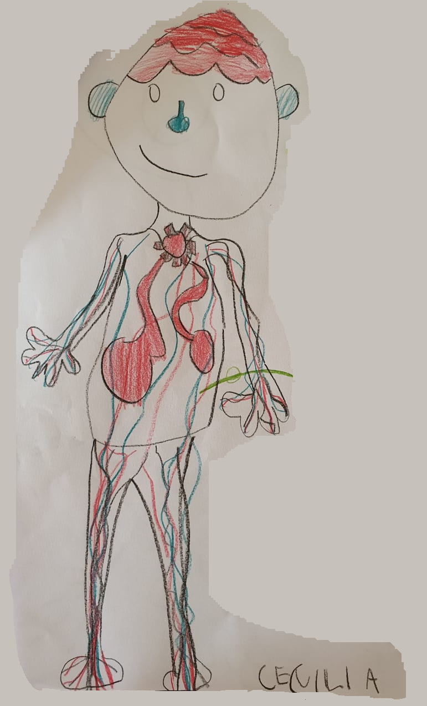
Interoception
Internal Organs

Slide 34
Interoception
Interoceptive Accuracy: This refers to our ability to objectively perceive bodily sensations e.g. helping the child to identify thoughts and feelings i.e. You are crying so I think you may be scared or sad.
Interoceptive Awareness: This refers to our ability to accurately perceive and interpret bodily sensations e.g. my tummy is rumbling so therefore I must be hungry!
Interoceptive Sensibility: This refers to our ability to subjectively perceive bodily sensations e.g. I feel pain on my knee where I fell over
Interoceptive Emotional Evaluation: This refers to our ability to make sense of the sensations and determine emotional meaning e.g. I feel butterflies in my tummy which I know to mean that I feel anxious
Notes:
This refers to our perception and interpretation of the signal from the organs and tissues within our bodies. This is when our brains and bodies communicate with one another to let us know we are tired, hungry, thirsty, have pain and that we need to go to the toilet. It is also the connection that helps us to identify whether we are angry, sad, excited, frustrated, feel love and trust ourselves and others. There are four main areas of interoception:

Slide 35
Internal and external motivating factors
Makes me happy
Makes me laugh
Curiosity I want to try it and see what it’s like/does/feels like
I enjoy it
It makes me excited
You look at me/touch me/talk to me/engage with me /you connect to me
A token
A reward
A threat
An expectation
A punishment

Slide 36
Time - Space - Self-orientation - Organise
TIME
Task
Transition
SPACE
Where am I?
Space relationships
ORIENTATION
Organise
Plan
Notes:
Did we consider- time space and orientation, how do we support the child in achieving these?

Slide 37
A WHOLE CHILD APPROACH TO
Sensory Integration
To book more training with Nerys Hughes
please contact
ellie@speakingofbooks.co.uk
To discuss internvtion and School Delivery
admin@wholechildtherapy.com

