Slide 1
National Centre for Computing Education (NCCE) Computing Hub - London & Essex Science Learning Partnership (SLP) - Southend, Essex and Thurrock
David Struthers
Director of South Essex Teaching School Alliance
Westcliff High School for Girls

Slide 2
Introduction
Westcliff High School for Girls
Located in Southend-on-Sea
Teaching School status since 2012
South Essex Teaching School Alliance (SETSA)
Science Learning Partnership (SLP) since 2014
Computing Hub since September 2019
Notes:
WHSG were recently awarded Computing Science Hub (London & Essex Area) status as part of the National Centre for Computing Education’s (NCCE) programme, funded by the DfE, to support and improve the provision of computing education in England.
The NCCE is delivered by the consortium of STEM Learning, BSC (The Chartered Institute of IT) and the Raspberry Pi Foundation. (STEM Learning taking the primary lead)
The London & Essex Area Hub will be administered by South Essex Teaching School Alliance (SETSA), based at WHSG. SETSA comprises a group of schools and organisations based primarily in Southend and South Essex who work together to train and attract the best teachers to Southend Schools, support areas of concern, share areas of success, and make a sustained commitment to each other.

Slide 3
Computing Hub

Slide 4
Rationale
UK needs 1.2 million new technical and digitally skilled people by 2022 (UK Digital Strategy)
£63 billion of GDP per year is lost to the UK economy due to digital skills shortages. Lack of digital skills inhibits growth and opportunities for employment. (UK Digital Strategy)
75% of existing GCSE CS teachers do not have an academic background in Computer Science
To meet demand we will need:
240,000 young people taking Computer Science GCSE every year
(In summer 2019: 77,400 took it of which only 21% were girls )
8,000 teachers of Computer Science GCSE

Slide 5
Aims

Slide 6
Primary Programme

Slide 7
Face-to-face courses
2-day courses:
Teaching & leading Key Stage 1 Computing
Algorithms and programming
Digital literacy, creative computing & presenting information.
Teaching & leading Key Stage 2 Computing
Computer systems & networks
Data fundamentals (e.g. binary)
How computers handle data to carry out useful tasks
1-day courses:
Primary programming
& algorithms
Engaging and effective ways to help children use computational thinking
Develop pupils’ knowledge of how technology works & the skills to make computers follow instructions in simple programs
Introduction to primary computing *NEW*
Knowledge to get started on the journey to outstanding computing in your school
For subject coordinators or other interested teachers

Slide 8
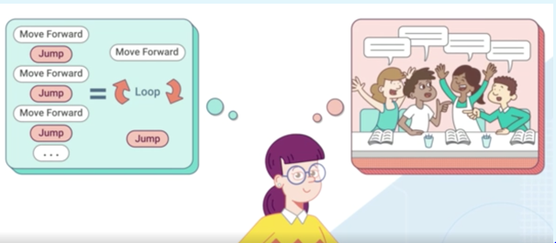
Online courses
Teaching Programming in Primary Schools
Understand key programming concepts and apply them using Scratch
Creating an Inclusive Classroom: Approaches to Supporting Learners with SEND in Computing
Explore ways to make your computing lessons more inclusive for learners with special educational needs and disabilities.
https://teachcomputing.org/primary-teachers

Slide 9
Primary Computing Certificate
Awarded by BCS, The Chartered Institute for IT
For those already teaching or planning to teach computing
Support teachers from all backgrounds who want to improve their knowledge of computing
Cover new areas while reinforcing existing skills
Obtain recognition for subject knowledge
Chose from face-to-face & online modules
Save time on lesson planning
Meet other teachers to share ideas
https://teachcomputing.org/primary-certificate
Notes:
Primary Computing Certificate info:
They have to do:
1 face to face course
1 online course
Contribute to online discussion
Complete 1 of: Host or attend a Barefoot workshop / Attend a CAS meeting / review a resource on CAS
Complete 1 of: Lead a session at a regional or national conference / run an after-school code club / lead a CAS Community of practice

Slide 10
Fees & bursaries
Free online courses
Schools receive a bursary to fund one face-to-face course place per academic year
No upfront cost; the course fee is deducted from the funding your school will receive on completion of the course:
Course fee £35 per day
Bursary £220 per day
The school receives £185 per day
*Subsequent teachers from the same school will pay £35 a day
Independent schools: Fee = £220/day (no bursary)
https://teachcomputing.org/bursary
Notes:
David I’m awaiting confirmation which of these courses are free for teachers who have successfully completed the CS Accelerator programme (originally, the 4 day course was free)

Slide 11
The CS Accelerator Programme

Slide 12
The CS Accelerator Programme
Certificate awarded by BCS, The Chartered Institute for IT
Accessible to ALL teachers
FREE Face-to-face & online courses
Generous bursaries (currently £220 per day for face-to-face courses)
Benefits for teachers:
update skills & be recognised for subject knowledge
increased confidence to teach this high demand subject across the curriculum
choice of face-to-face & online modules to suit learning needs
save time on lesson planning & gain inspirational teaching ideas
support from a team of champions throughout the programme

Slide 13
The CS Accelerator Programme
Face-to-face courses
Algorithms in GCSE computer science
Data and computer systems in GCSE computer science
Networks and cyber-security in GCSE computer science
Python programming essentials in GCSE Computer science
Introduction to GCSE Computer Science *NEW*
https://teachcomputing.org/cs-accelerator

Slide 14
Extending the NCCE’s reach
Computing Hubs will raise awareness of, and supporting other NCCE programmes such as:
Gender Balance in Computing programme
Government-funded project trialling a number of new initiatives aimed at improving girls’ participation in computing
Over 15,000 students and 550 schools across England will be involved in the trials (from 2019–2022) in key stages 1–4
https://blog.teachcomputing.org/new-gender-balance-in-computing-project-announced/

Slide 15
Computing at Schools (local Communities of Practice)
Computing Hubs will:
draw on local knowledge to ensure a range of CPD opportunities for all teachers to build local expertise and capacity for school-to-school support
Promote and support Computing at School (CAS) local communities of practice, extending the NCCE reach to all schools and colleges while supporting the NCCE to develop a sustainable model of CPD. Local hubs:
Colchester
Chelmsford
Wickford & Basildon
Southend

Slide 16
Subject Matter Experts (SMEs)
NCCE SMEs will work closely with Computing Hubs to support schools and colleges across England to develop their computing curriculum.
They are:
Computing and Educational experts
Supporting primary and secondary schools in category 5 & 6 priority areas
Providers of bespoke CPD/consultancy
They will:
Provide ½ day of SME support to Priority Schools and agree 3 year action plan
Support the schools to achieve their action plans

Slide 17
Useful links
https://www.setsa.info/1546/courses List of all our Computing and Science courses
https://teachcomputing.org/ NCCE’s Teach Computing website
https://www.computingatschool.org.uk/ Computing at Schools website
https://www.stem.org.uk/cpd STEM Learning’s searchable database of Computing & Science CPD

Slide 18
Contact – Computing Hub
For more information please contact:
Project Lead: David Struthers
d.struthers@setsa.info
01702 476026
Admin: Caroline Anderson c.anderson@setsa.info
01702 476026
www.setsa.info
follow us on twitter @cs_essex

Slide 19
Science Learning Partnership
Our Science Learning Partnership (SLP) combines local expertise in teaching and learning in science, facilitating CPD, & providing school-to-school support.
Part of STEM Learning www.stem.org.uk

Slide 20
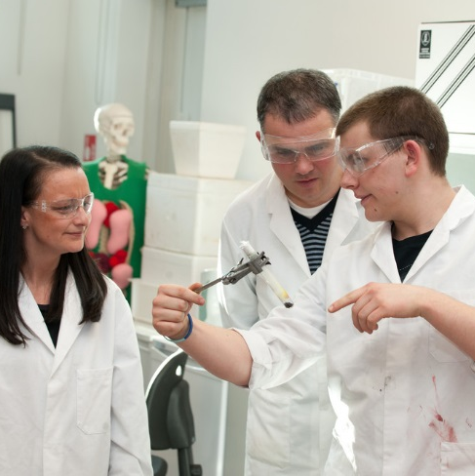
Our aims
High quality CPD for science teachers and technicians
To provide science-specific support, mentoring and advice
Outstanding science teaching for all pupils
All pupils knowledgeable about STEM pathways and careers

Slide 21
ENTHUSE partnerships for schools & colleges
ENTHUSE Partnerships inspire young people into STEM subjects and careers. We fulfil this by enabling groups of primary schools, secondary schools and colleges to improve young people's achievement and engagement in STEM.
We work with groups of 6-8 schools and colleges to develop a bespoke two-year action plan. Partnerships will also receive up to £20,000 worth of support, which includes access to CPD, free resources, immersion in industry or university through teacher placements, STEM Ambassadors and enrichment activities.
If you would like to register your interest, please get in touch.

Slide 22
Upcoming CPD for new primary teachers and NQTs – Outdoor learning
Learn new skills in the garden! 20 March 2020, 4-6pm
This popular twilight session at RHS Garden Hyde Hall is delivered by the RHS Campaign for School Gardening and is suitable for newly qualified or trainee teachers working within a primary or SEND setting, with or without a science specialism and with little or no previous experience of growing and horticulture.
“Really fun activities to encourage new teachers”
“Great delivery of the session. Really got across the importance of being outside”
£20 per person
If you would like to book places on this twilight session, please visit:
https://www.stem.org.uk/cpd/460312/learn-new-skills-garden
Note: This session starts formally at 4pm, however RHS staff have offered an optional garden tour for any students who can get to the Hyde Hall by 3.30pm.

Slide 23
What else can we offer primary schools?
Bespoke CPD for schools, MATs, Clusters
Network groups
Annual primary conference
Professional development as Facilitator for STEM Learning or leading a network group.
Mentoring & support

Slide 24
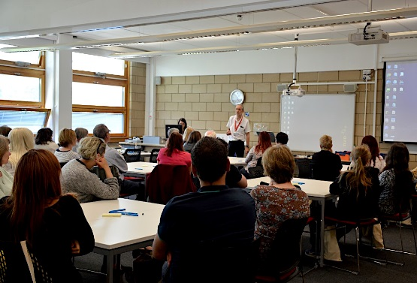
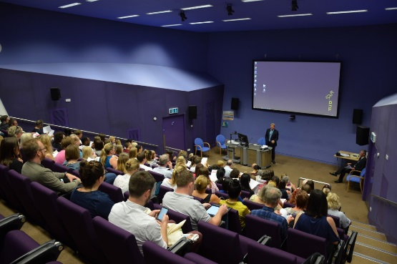
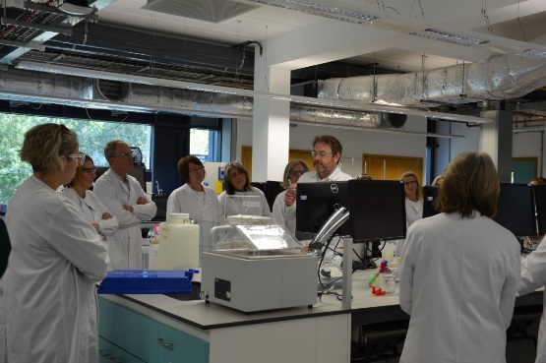
Opportunities
Annual Secondary Science Festival on June 19th at Anglia Ruskin University
Triple Science Support Programmes (41 schools since 2016)
Enthuse Partnerships (6-8 schools, £20k support)
Bespoke CPD for schools, MATs, Clusters
Professional development as Facilitator for STEM Learning or leading a network group.

Slide 25
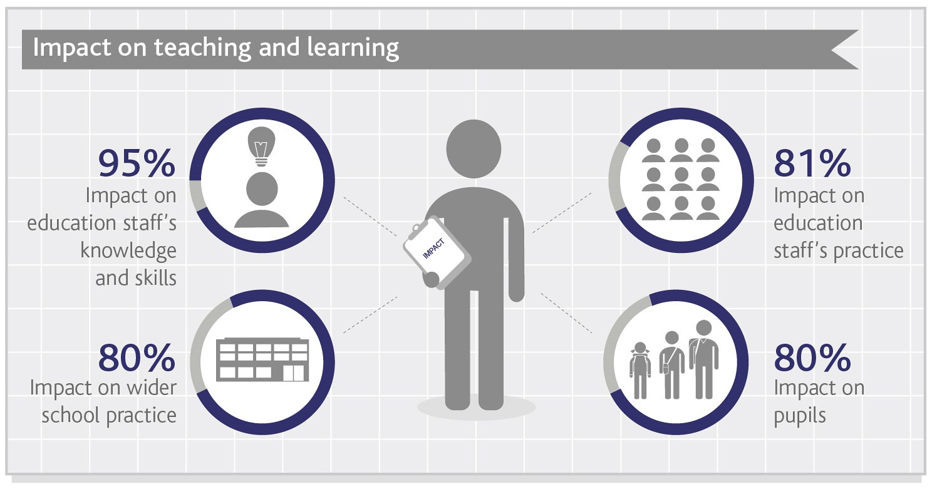
Impact of CPD
“One in 12 teachers who did not participate in STEM Learning CPD left teaching within two years. This drops to 1 in 30 for those who did.” Wellcome Trust, 2017

Slide 26
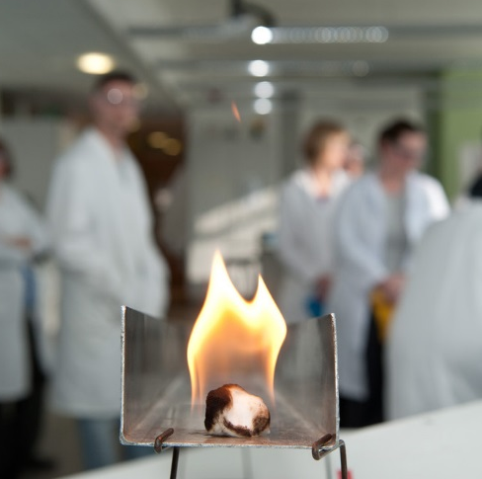
Contact the SLP
For more information, please contact:
Project Lead: David Struthers
d.struthers@setsa.info
Project Officer: Emma Emmerton e.emmerton@setsa.info
01702 476026 ext. 255
www.setsa.info
@SET_Science

