Slide 2
Exploring potential…

Slide 3
Schools
Workshops
Workshops linking into topics.
School Drama Clubs
After school drama clubs
Backstage Tours
Drama workshops

Slide 4
BESPOKE PROJECTS…
A consortium of schools commissioning Chelmsford Theatres to produce a Theatre in Education performance or workshop to tackle an issue pertinent to your pupils. Eg. Mental Health, Developing Growth Mind Set, Boys Literacy…
A ‘reviewing theatre’ project which combines writing for a purpose with a trip to the theatre.

Slide 5
FUNDING?

Slide 6
“Theatre feeds the heart and nourishes the soul and enlarges the spirit. When we are adults, and if we’re lucky enough to have developed the habit, we can find our own way to plays and operas, but children can’t do it on their own. They need to be helped into the experience by people who’ve been there before and who can excite their curiosity.”
Philip Pullman – Theatre, The True Key Stage 30/03/04 – The Guardian https://www.theguardian.com/books/2004/mar/30/booksforchildrenandteenagers.schools

Slide 7
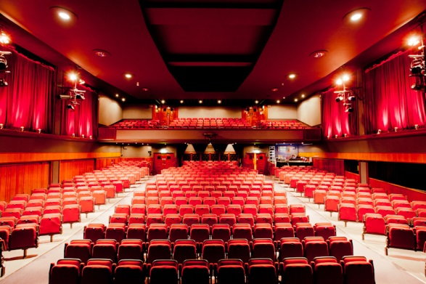
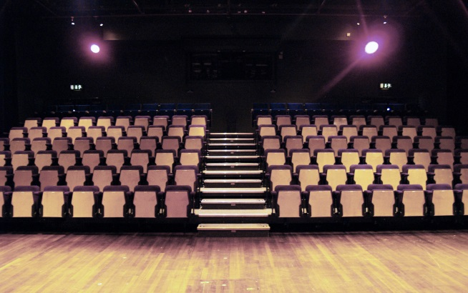
Get in touch…

Slide 8
Thank you

