Slide 1
C2C Recruitment
8am, 28th September 2017
NE Essex ASHE

Slide 2
Notes:
NE Essex has changed and we will need more teachers for more children in the coming years. We know there aren’t lots of qualified candidates ready to go.

Slide 3
Notes:
A word on our journey…

Slide 4
The proposal
Transforming teacher recruitment through system leadership
A new teacher recruitment service for qualified and unqualified teachers to serve the needs of North East Essex.
Source short and long term solutions for the primary, secondary and special sectors in the NE Essex region.
Provide staff that meet the requirements of our schools
Bespoke solutions
Build on our links with the University of Essex
Notes:
Idea commissioned by Essex CC a year ago.

Slide 5
Notes:
Essex CC have funded the start-up phase and continue to support the project.

Slide 6
Notes:
SHA – CV: background in corporate communication, PR, education – 10 years at the Colne, 4 years Head of English, last 2 years on SLT. Seconded to the project for this year.

Slide 7
Notes:
Rachel CV: background in HR, recruitment, administration.

Slide 8
What’s different?
Not for profit
At least 20% cheaper
No contract surprises/punitive charges
Try before you buy
New channels for recruitment
Bespoke solutions
Teacher-led
Values deeply rooted in education
Low overheads
We care!
Notes:
We offer an at cost service.

Slide 9
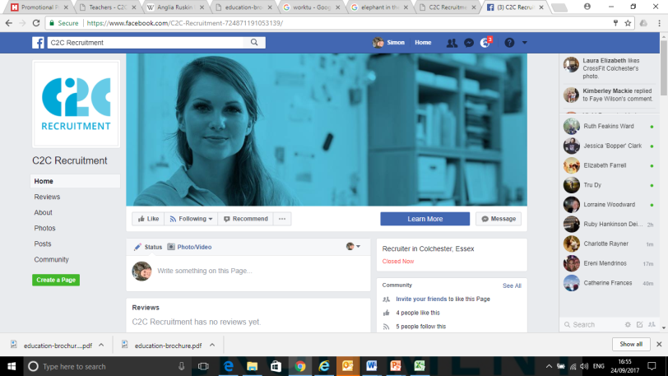
Recruiting Candidates
Notes:
Like recruitment agencies we’re using multiple channels to recruit. Plus schools. And EPHA we hope.

Slide 10
Candidates
Estimated savings for schools September = £3670
October deployment target = 80 days (4 per day)
October deployment - actual = 89 days
Estimated savings for schools = £5400
Saving based on average supply @ £200
43 days x qualified teacher @ £160. Saving of £1720
46 days x unqualified teacher @ £120. Saving of £3680
Notes:
Our margin is £40 for day to day cover (and £20 for Tas), compared to about £80 for most recruitment agencies. Any profits we do make will be re-invested in training and passed onto schools – the idea is we will be able to pass that on to schools by reducing our costs for day-to-day supply and we should also be able to offer things like taster days for nothing at that point.

Slide 11
Who we have recruited so far: A Sample of Candidate Profiles
Laura – undergraduate - £70 TA/£120 Cover
Viviana – post-graduate(d) - £120
Molly – returner - £160
Paul – returner - £160
Rachel – part-timer (PE) - £160
Steph – part-timer (KS1) - £160
Kika – overseas trained - £160
Andrew – part-time - £190
We aim to offer you a menu of options.
We want to be transparent and honest.

Slide 12
What’s in it for you?
At least 20% cheaper
No contract surprises/punitive charges
Try before you buy
New channels for recruitment
Bespoke solutions
Teacher-led
Values deeply rooted in education
Low overheads
We care!
Notes:
At cost

Slide 13
What’s next: unqualified
Recruiting more unqualified or part-qualified candidates for training
Interviews this week and next at University of Essex
Interviews with PGCE students from Colchester Institute
Extending the training
Now Associate teacher training (3-5)
Jan-Feb Associate teacher training (20-25)
April-May Associate teacher training (25)
June-July Associate teacher training (50)
Raising our profile
Anglia Ruskin University – 20,000 students
Suffolk University
Colchester Institute
University jobs boards
Website jobs boards
Social media advertising
Notes:
We aim to have a replenishable team of at least 60 unqualified staff on our books at any time by the end of this academic year, most of whom will be available on a part-time basis as they are still studying . We’ll have trained them thoroughly and we’ll continue to offer them CPD; they will be capable of working as TAs but also as associate teachers for day-to-day cover requirements.

Slide 14
What’s next: qualified
Finding more qualified/experienced candidates for your schools
CV libraries
Social media campaigns
Jobs on our websites
Poster campaigns
Schools help
Use of existing networks e.g. Essex CC returners training
Word of mouth
Training for qualified teachers
Regular workshops on behaviour management and teaching ideas. Tuesdays 3pm – 5pm.

Slide 15
The competition
Notes:
You can negotiate your terms – don’t be intimidated. We’d be happy to offer advice on what’s reasonable if that helps.

Slide 16
What impact can we have?
Notes:
Force costs down for others.
Find same candidates you’re being offered through agencies but offer them to you on a non-profit basis.
Help you to renegotiate contracts

Slide 17
Maybe you can help?

Slide 18
Maybe you can help? Please…
… encourage ‘Flippers’ to register with C2C Recruitment – it could save you money compared to having them on your payroll.
…try C2C Recruitment as your first port of call for your day to day supply/cover teacher.
…share our contact details with the bookers of supply or the HR leads in your schools
…get involved in the training/placements
… please try booking an unqualified associate teacher for a taster day – we don’t think they’ll disappoint you.

Slide 19
Notes:
We’re committed to finding and developing the next generation of teachers for your schools.

Slide 20
If you have any questions or you’d just like a chat about any of this, please give me a call or drop me an email: Tel: 01206 309906 Mob: 07710 764866 Email: simon@c2crs.org.uk Website: C2CRS.ORG.UK

Slide 21
C2C costs compared to typical recruitment agencies
School decides to try a qualified teacher before they recruit them permanently
For 8 weeks (40 days) they pay agency rate of £160
Our candidate pay = £120
Our agency margin = £40 per day
Overall payment to agency = £6,400
Overall profit for agency = £1,600
Agency will QA candidate for nothing,
Bespoke training can be organised (sometimes at additional cost)
Administrative fee for permanent placement = £200
Total cost for school = £6,600
School decides to try a qualified teacher before they recruit them permanently
For 4 weeks (20 days) they pay agency rate of £200
Their candidate pay = £120
Their agency margin = £80 per day
Overall payment to agency = £4,000
Overall profit for agency = £1600
Agency doesn’t have expertise to QA candidates
Agency doesn’t have access to bespoke training
Agency additional fees for permanent placement = £4,500
Total cost for school = £8,500

Slide 22
A worse case scenario
School decides to try a qualified teacher before they recruit them permanently
For 8 weeks (40 days) they pay agency rate of £160
Our candidate pay = £120
Our agency margin = £40 per day
Overall payment to agency = £6,400
Overall profit for agency = £1,600
Agency will QA candidate for nothing
Bespoke training can be organised (sometimes at additional cost)
Administrative fees for permanent placement = £200
Total cost for school = £6,600
School decides to try a qualified teacher before they recruit them permanently
For 9 weeks (45 days) they pay agency rate of £200
Their candidate pay = £120
Their agency margin = £80 per day
Overall payment to agency = £9,000
Overall profit for agency = £3,600
Agency doesn’t have expertise to QA candidates
Agency doesn’t have access to bespoke training
Agency additional fees for permanent placement = £4,500
Total cost for school = £13,500

