Slide 1
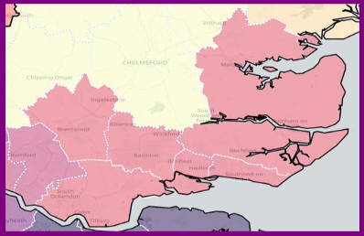
Teaching School Hub Test and Learn
Summary and Review
From Strategy to Implementation
Lead School: Harris Academy Chafford Hundred
Designation: East of England and North East London
Director: Mark Beyer-Woodgate
Essex
RM16 6SA
February 2021
https://www.harrischaffordhundred.org.uk/1147/welcome-to-the-teaching-school-hub
EENEL 6

Slide 2
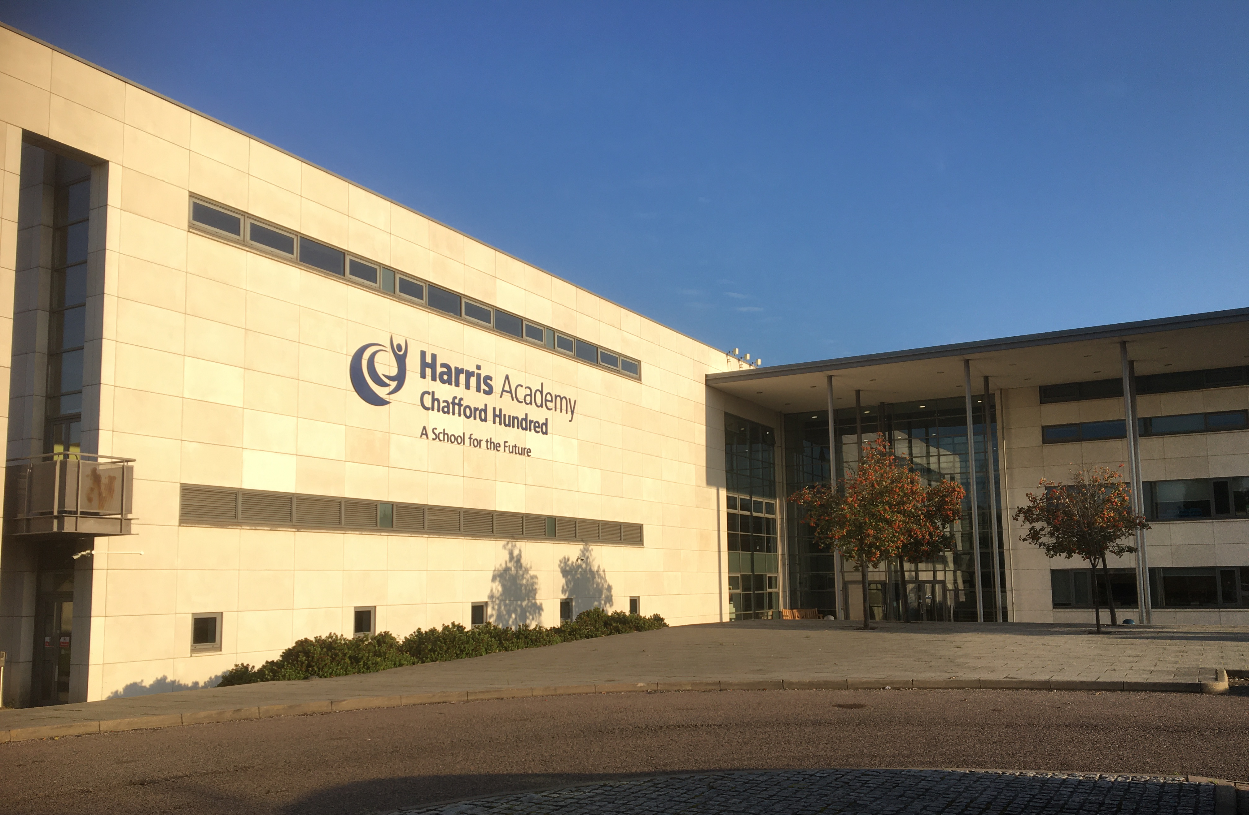
Vision Statement 2020-21
As a leading school in the Harris Federation we believe in excellence, every day, for every child. To achieve this aim, the Chafford Hundred Teaching School Hub will work closely with the Department for Education to deliver on the golden thread of professional development for all the schools in our designated area of Southend, South Essex And Thurrock.
Evidence informed practice* tells us that that the quality of teaching is the single biggest variable in student achievement, outside the students themselves, and it is also the variable most susceptible to the impact of good or poor leadership. We will use our influence and resources to build and sustain a growth environment for the region, that provides the very best in initial teacher training, newly qualified teacher induction, early career support and CPD pathways to retain and develop expertise for the entire workforce including national professional qualifications for school leaders, headteachers and executive leaders in multi-academy trusts.
Our vision is to strengthen school improvement through effective partnerships across every school in our region. We believe in system-led change, led by schools for schools. Our strategy is to simplify access to high-quality ITT, AB, ECF and NPQ providers and increase school engagement with Curriculum Hubs, Research Schools and the EEF. Our position as a hub, will enable us to deliver new opportunities at scale for the whole region, whilst sustaining a local focus on our local needs. It is our ambition for all teachers and leaders to be able to receive centralized support from the Teaching School Hub at any point in their career.
Our success will be measured by our schools and pupils that succeed. By investing in our people and making informed choices, we hope that they will learn and live well.
*Hattie (2003), Hanushek (2011), Cordingley et al (2015) Weston (2016), Burgess (2019), Fletcher-Wood (2020)

Slide 3
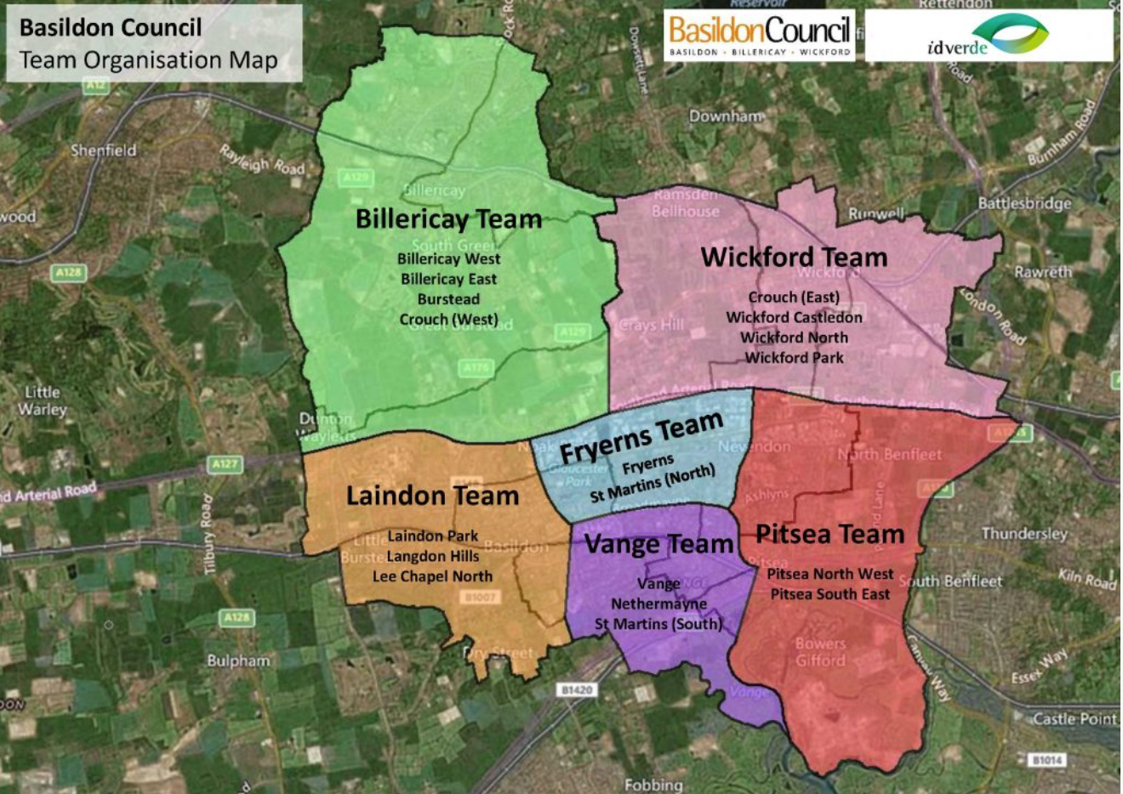
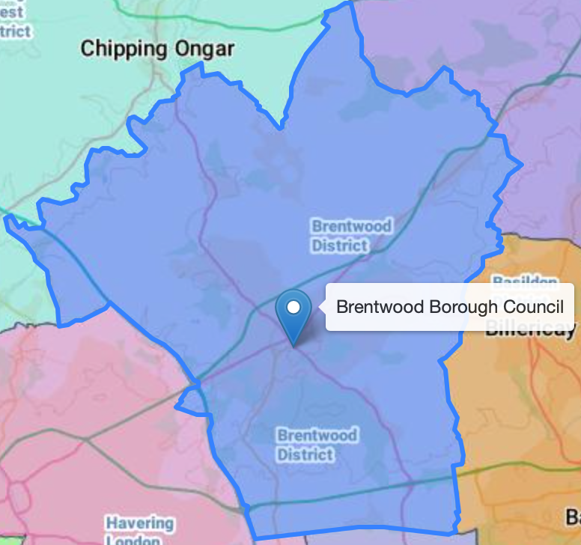
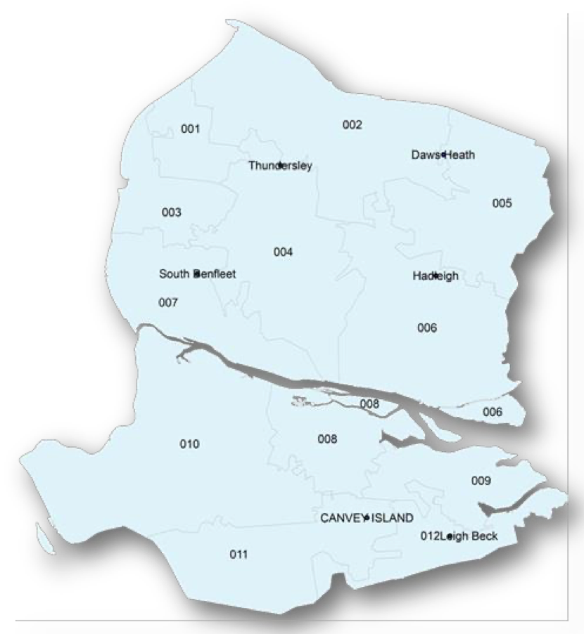
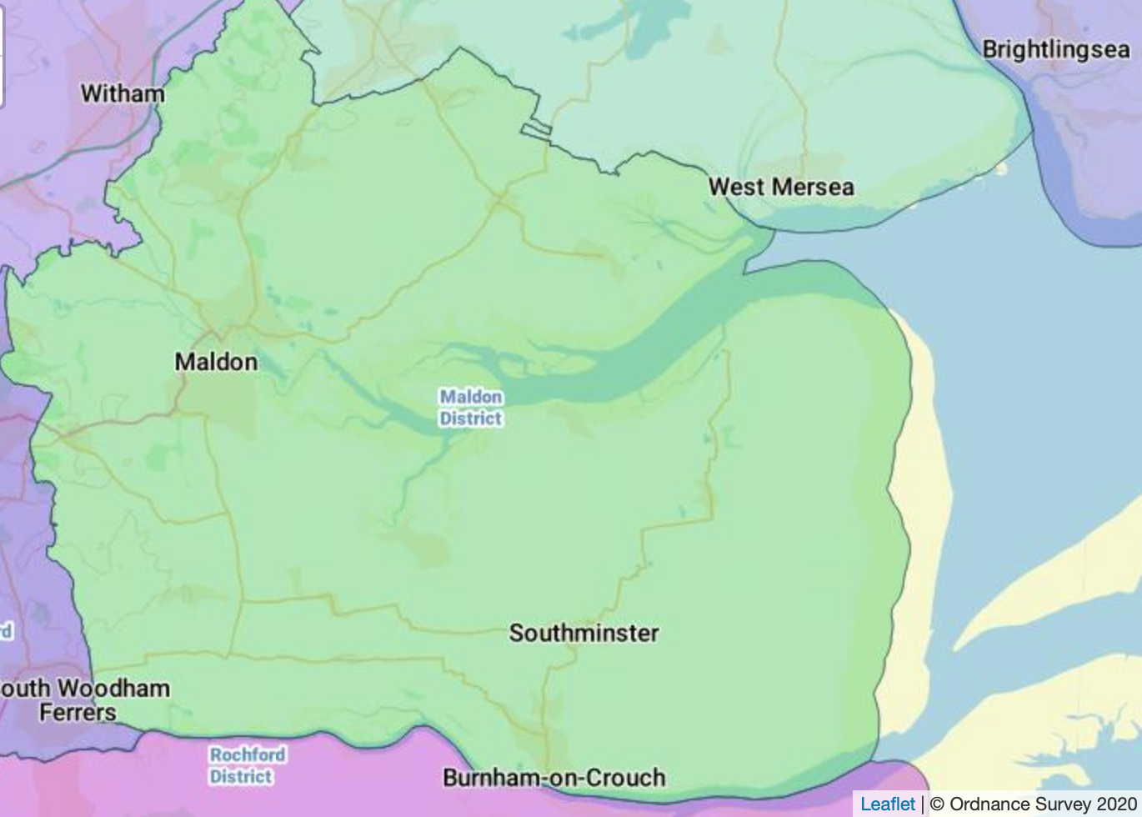
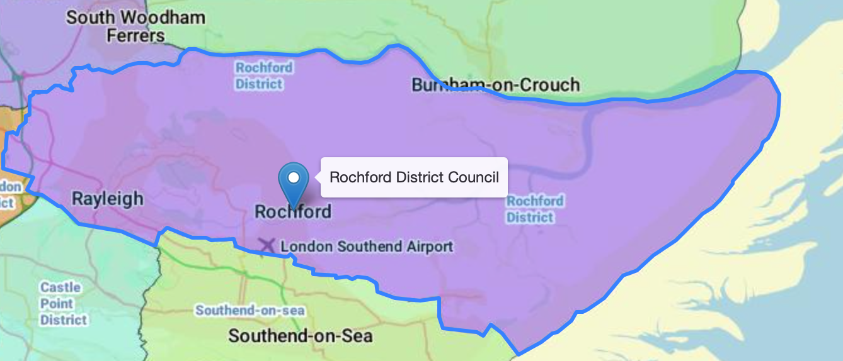
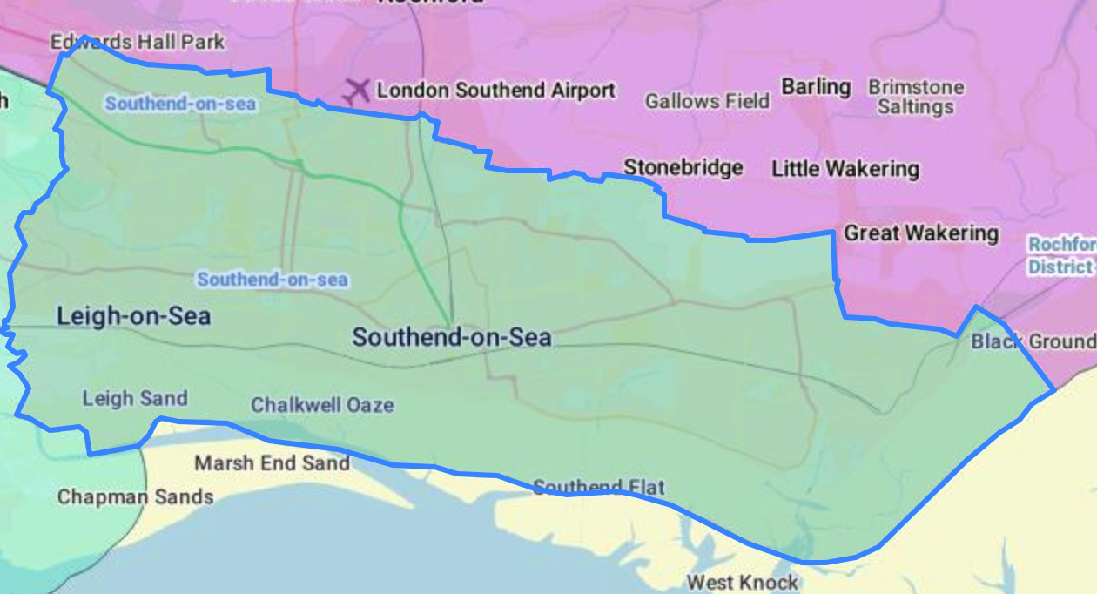
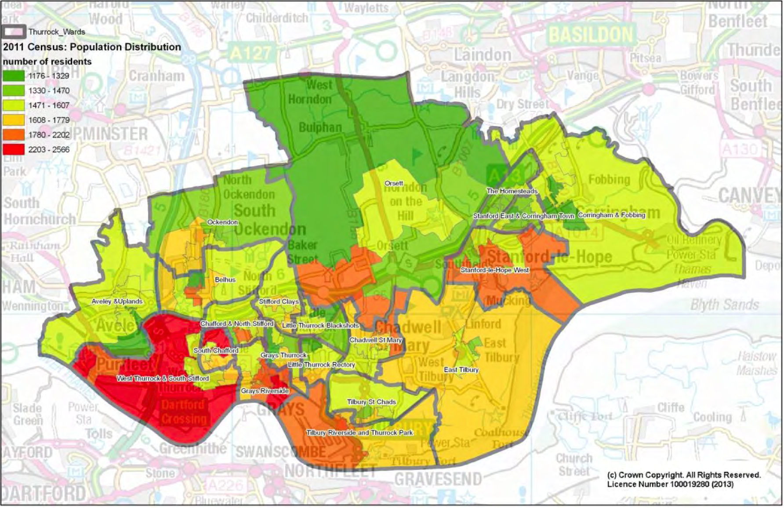
Detail and Context
LAD | Geography – km² | Population | Borough
Basildon | 110 km² | 107, 123 | Urban/Rural
Brentwood | 153.1 km² | 54, 885 | Rural Districts
Castle Point | 45.08 km² | 86, 608 | Canvey Island
Maldon | 358.8 km² | 64, 425 | Blackwater Estuary
Rochford | 169.5 km² | 86, 981 | Coastal
Southend | 41.76 km² | 183, 125 | Coastal
Thurrock | 170 km² | 174, 341 | Thames Gateway
Total | 1,048.24 km² | 757,578

Slide 4
Scale and Reach
Total Number of Schools – 275 (Aug 2020)
LAD | PRU | All Through | Primary |  | Secondary |  | Special | EY Nursery | Total
 |  |  | No. | % LA | No. | % LA
Basildon | 1 | 0 | 47 | 45% | 9 | 22% | 2 | 21 | 80
Brentwood | 0 | 0 | 24 | 79% | 6 | 0% | 2 | 0 | 32
Castle Point | 0 | 0 | 21 | 10% | 5 | 0% | 2 | 11 | 39
Maldon | 1 | 0 | 21 | 52% | 5 | 0% | 0 | 0 | 27
Rochford | 1 | 0 | 22 | 27% | 4 | 0% | 0 | 5 | 32
Southend | 2 | 1 | 33 | 36% | 12 | 0% | 5 | 17 | 69
Thurrock | 1 | 0 | 39 | 1% | 10 | 1% | 2 | 27 | 79
Total | 6 | (1) | 207 |  | 51 |  | 13 | (81) | 275
Notes:
275 Schools Listed S/S (277) +79 Schools outside of trusts
EYS THURROCK
Childminders 163
Full daycare/pre schools 56
School Nurseries 28
Total 247
(349 PRUs England (2019/20))
PRUs in Hub
1Basildon – Children’s Support Services (5-16yrs/129 pupils)
2Maldon – Heybridge Co-operative Academy (11-16yrs/54 pupils)
3Rochford – Poplar Adolescent Unit (11-16yrs/12 pupils)
4Southend – Victory Park Academy AP Primary/Secondary (5-16yrs FT/PT 85 pupils) https://www.victorypark.org.uk
5Southend - YMCA
6Thurrock – Olive AP Academy https://apthurrock.oliveacademies.org.uk
https://lginform.local.gov.uk/reports/lgastandard?mod-metric=2200&mod-area=E07000066&mod-group=AllDistrictInRegion_East&mod-type=namedComparisonGroup
All through Special Schools - https://schools.essex.gov.uk/info/schools-list/Pages/default.aspx
1Basildon – Castledon School (3-16yrs/224 pupils)
2Basildon – Pioneer School (3-18yrs/149 pupils)
3Brentwood – Endeavour Cooperative Academy (5-16yrs/113pupils)
4Brentwood – Grove House School (7-18yrs/104 pupils)
5Castle Point – Cedar Hall School (5-16/160 pupils)
6Castle Point - Glenwood School (3-18/225 pupils)
7-11Southend -
12Thurrock – Beacon Hill Academy (2-19yrs)
13Thurrock – Treetops School (5-19yrs/295 pupils)
All Through (Independent – Thorpe Hall School)

Slide 5
Strategic Partners
February 2021
National (17) | Regional (16) | Local (23)
Department for Education | Essex Local Authority ITT + AB | Thurrock Local Authority + Appropriate Body
Teaching School Council | Saffron Teaching School Hub (18) | Southend Local Authority
Chartered College of Teaching | Harris Federation HITE+AB+NPQs | Billericay Teaching School Alliance/SCITT+AB+SLE
Regional School Commissioner East of England + NE London | The Opportunity Group Apprenticeships, CMI | Science Learning Partnership + Computing Hub South Essex TSA + Appropriate Body
Education Endowment Foundation | Thames and London Maths Hub | Lee Chapel Teaching School Alliance/SCITT
Teach First ITT + ECF | Venn Essex Maths Hub | Wickford TSA – Hearts Academies
TES Global ITT + AB | New Vision English Hub | Benfleet Teaching School Alliance
NASBTT | Essex Primary SCITT | Plume School Trust
SSAT | Mid Essex SCITT | Ormiston Rivers Academy Trust
Research Ed | Essex and Thames SCITT | South Essex Teaching Institute, Rayleigh Primary
NASEN, Whole School SEND | ITTAG Network | Barons Court Primary TSA
Target Careers, Careers Dev. Institute | NQT Manager | Thurrock TSA PP Hub + AB
Sheffield Hallam University, UCL, UEA | NTLEC – Norfolk - TSST | Thurrock Primary TSA/Teach Thurrock
National Leaders of Governance Hub | Royal Opera House Bridge | EPHA/ASHE/ESSET Association Pri./Sec./Sp. Heads

Slide 6
Timeline January to December 2020
January – March
Recruiting for TSH Strategic Management and Administrative roles,
Restructuring Cluster Lead Delivery Model
PPR Training for NLEs inline with original School Improvement KPIs
Capacity Building of Facilitators for DfE Approved Programmes (i.e. Olevi)
April – August
DfE Data returns on ITT, AB, ECF, CPD, NPQ, Curriculum Hubs, DfE programmes, EEF
School Recovery Offer, Remote Teaching
Recruiting schools for the expansion of the early roll-out of the ECF
Revised KPIs led to funding redirected to training ECF facilitators,
EENEL 6 restructure loss Chelmsford, addition of Brentwood
September – December
Teaching School Hub Launch, New TSH Director, Strategic Lead, TSH School Bulletin
Teaching School Hub Governance, Collaboration with Teaching School Council and RSC
Joint ITT Network and Events Saffron Teaching School Hub, Membership of Regional ITTAG
Appropriate Body Status, Collaboration with Local Authorities: Essex, Southend, Thurrock
Delivery and Quality Assurance of Early Career Framework Programme,
Partnership consultation on SLAs with expertise from legacy TSAs
Capacity Building with Curriculum Hub Specialists and Research Schools Evidence Leads
TSH PRIORITIES
2020-21
1) Raise awareness of the TSH, through regular and effective communication with all stakeholders, uniting regional schools, through the golden thread of teacher and leader development.
2) To build and sustain a growth environment where schools can retain and develop expertise in quality-first teaching and evidence-informed practice.
3) To strengthen and simplify system leadership by providing access to and delivery of high-quality CPD that meets local needs.

Slide 7
From Strategy to Implementation
PRIORITY 1
Raise awareness of the TSH, through regular and effective communication with all stakeholders, uniting regional schools, through the golden thread of teacher and leader development.
Established processes and actions (to date) to ensure clarity around TSH remit to all Chafford Hundred TSH partners.
Teaching School Hub Live Online Launch Event available to all schools in our designated 7 LADs;
Outlining DfE Reforms, detailing teacher career pathways and showcasing key strategic partners from TSAs, ITT Providers, Curriculum Hubs, Research Schools, 11 speakers united the region.
TSH Bulletin published bi-monthly (Oct, Dec, Feb) provides all 275 school leaders with knowledge and opportunities to engage with evidence-based CPD into improving quality of teaching and the outcomes for pupils.
TSH Test and Learn Network Meetings led by Roger Pope, (TSC) with strategic direction from the DfE policy teams for TSH, ITT, ECF, AB. RDD
TSH Membership of Regional TSC Meeting; monitoring impact of de-designation of TSA, issues arising around AB relationships, ECF recruitment, deployment of SLEs, professional subject groups
TSH Governance Board discuss role and QA of Cluster Leads and Service Level Agreements across each LAD and consultation begins with 5 TSAs Leads. Regular reporting on KPIs.
TSH representation on the Curriculum Hubs governing bodies; for New Vision English Hub and Venn Essex Maths Hubs. Joint Curriculum Hub meeting with Saffron Teaching School Hub.
TSH membership of the regional ITTAG meeting developing working partnerships with 38 ITT members and Curriculum Hubs. Joint TSH ITT Network Meeting for training and supporting ITT leads, key speakers from Chartered College of Teaching, Cambridge University, Sheffield Hallam University and IoE. Joint Event for Get Into Teaching and upcoming Mentor Conference. Responsive to surveys and evaluations.
LA, MAT and Headteacher meetings to reach key staff for future partnership work, including onboarding of new Teaching School Hubs.

Slide 8
From Strategy to Implementation
PRIORITY 2
To build and sustain a growth environment where schools can retain and develop expertise in quality-first teaching and evidence-informed practice.
Established processes and actions (to date) to ensure clarity around TSH remit to all Chafford Hundred TSH partners
DfE induction programme with the EEF commenced in Dec 2020; providing the arguments and case studies for evidence-informed practice, implementation and evaluation in schools.
Promoting the Evidence Lead in Education (ELE) training and designation available through the Research Schools Network
Jointly identifying priority schools to work with whose pupils will benefit from long-term collaboration with ELEs and funding from the EEF.
Working with ITT providers to share best practice and peer review their CCF, and transition into the ECF, whilst increasing provision for subject specificity.
Deep Dives into regional Appropriate Body provision. Variable support provided.
Delivering the ECF for Teach First, since Sept 2020, training facilitators, quality assuring content for 63 ECTs and 52 Mentors and monitoring participant engagement. Negotiating workload for schools whilst protecting ECTs professional development entitlement. Collaborating with Kingsbridge TSH (TSSW) on evaluating the Teach First programme.
Recruiting Primary Literacy Specialists in local schools with New Vision English Curriculum Hub
Leading Secondary Maths Working Groups for the regional Venn Essex Maths Curriculum Hub.
Hosting events for the London and Essex Computing Hub.
Delivering TSST in Maths, MFL and Physics.

Slide 9
From Strategy to Implementation
Established processes and actions (to date) to ensure clarity around TSH remit to all Chafford Hundred TSH partners.
TSH engaging with strategic partners to lead and deliver ITT, AB, ECF, NPQ from September 2021, Harris Leadership College to review curriculum materials and recruit participants in Spring 2021
Increasing number of contributors (over 30) and subscribers (over 300) to the TSH Bulletin, with additions from SEND Careers Development Institute and Arts Council
Recruiting an ECF National Manager to coordinate a bespoke programme for our partners
Developing a bespoke digital platform with NQT manager for TSH to onboard trainees at scale, track progress and produce data analysis reports through a cluster and school level approach
Active social media presence with increasing presence online. New website in development for disseminating guidance reports, mapping provision and providing an interface between the range of DfE endorsed programmes and their providers in our region and the schools seeking to engage
Unity Research School delivering An Introduction to Evidence session to local School Leaders utilising the Great Teaching Toolkit and Engaging with Evidence from the Institute for Effective Education
Spring consultation with schools on collaborative EEF proposal for 2-3yr research projects
TSH delivers Lead Practitioner Training and Accreditation for staff leading on teaching and learning across a school and the Apprenticeship Diploma in Team Leadership for staff new to leading teams across middle and senior leadership
Tracking data to inform CPD Impact Reports for all our programmes with a focus on evaluating type of schools, disadvantage profiles, OFSTED ratings, participant attendance and completion
PRIORITY 3
To strengthen and simplify system leadership by providing access to and delivery of high-quality CPD that meets local needs.

Slide 10
REVIEW – WHAT WORKS WELL
Get Into Teaching Essex Event
Case Study 14.12.2020
“100% agreed that the event met the needs of the delegates, to make informed choices”
“100% agreed that the online format was effective”
“100% agreed that the ITT providers in the Hub regions were showcased fairly”
“100% agreed that the brochure was useful”
“Successful, collaborative event”
“Organisation and timings were very precise”
Event Speakers
Clearly defined vision, values and priorities, led by a supportive and expert leadership structure
Strong administrative capacity and infrastructure, with the potential to develop this further
Excellent communication channels across the region through network meetings and “impressive” TSH bulletin that provides a centralized CPD offer for teachers and leaders at every level: https://www.harrischaffordhundred.org.uk/2488/chafford-hundred-teaching-school-hub-bulletins
Positive engagement with the Regional Teaching School Council, on navigating the changing landscape, local intelligence on school partnerships and maintaining regular dialogue with the DfE
Effective collaboration with local TSHs allows for greater impact of regional events. Sharing resources for marketing services like Target Careers extends our ITT recruitment reach to the top 50 universities, and their alumni networks nationwide. 128 delegates registered to attend with the majority being graduates then career changers, with an even split between primary and secondary routes. ITT Providers in the region have significant cohorts, exceeding national averages, 500+
Hosting Exceptional Regional Conferences to schools at no cost, including the upcoming mentor conference with over 100 delegates registered, with keynote speakers from DfE Expert Advisory Groups for ITT, Behaviour Management, OFSTED Curriculum Research, Recruitment, Specialist NPQs and the Chartered College of Teaching
The Early Career Framework expansion programme provides a research-led, rigorous approach to induction that both supports and challenges early career teachers as part of the Recruitment and Retention Strategy. ECF Mentors are trained in instructional coaching to develop others well
The Curriculum Hub landscape is rich and innovative, providing geographical and financial access to subject specific training. There is a wide range of CPD that has all been adapted for online use.

Slide 11
REVIEW - TESTED EVEN BETTER IF
The Early Career Framework with Teach First
Case Study - January 2020
“All of our mentors are experienced mentors and most have significant responsibilities in school. Enforcing them to complete the extra training sessions is unrealistic on top of their already hectic workload. Especially at this time when they are ensuring live lessons are delivered all day by their departments and delivering lessons themselves. They also have a massive role supporting the wellbeing of our young staff, as do all our mentors, as many live alone.
Our accrediting appropriate body have high expectations of our NQTs and mentors which takes up a significant amount of time already. The extra sessions dictated by the ECF again are placing unrealistic time pressures on both mentors and NQTS. Asking young staff to deliver live lessons all day, which is the school’s requirement at this time, and then join a session till 5pm is just not realistic.”
Deputy Headteacher
Clear communication from DfE on the system changes is needed to ensure all school leaders are ready to engage with the Teaching School Hub initiative ahead of September 2021. There are mixed views from the profession at present, where perceptions have been skewed by COVID and school leaders have had to react to remote teaching, with a reduced focus on locating new Appropriate Bodies, preparing for the new ECF statutory requirements, or recognising the coherent rationale behind the new CCF that progressively builds into the new suite of NPQs
The TSH is maintaining a supportive stance on teacher wellbeing and promoting the DfE’s School Workload Reduction Toolkit to mitigate against some of these pressures during this transition. TSHs to work closer with the DfE to contribute to market reviews, national policy
Struggling schools who have been receiving support from the current Teaching School Alliances will require more intensive support during the NRO of the TSHs. Even Outstanding lead schools who will now be de-designated are seeking assurances from the TSHs through formal SLAs to maintain capacity where it is most needed. The TSH network and the DfE could collaborate better on standards for SLAs to ensure both accountability and growth
Engagement with the Research Schools Network in our region is slow to develop with 5 schools currently engaging in one off sessions: introducing evidence and evaluation, metacognition and self regulation. TSH to coordinate proposals for long-term, fully funded research projects
ECF Onboarding from Teach First: added in September with no notice, requires thorough induction for school leads, addressing technical issues around accessing the online platform. TSH to provide schools and national providers with a clear timeline for recruitment activity, induction, training and quality assurance and improved technical support
An agreed understanding with strategic partners on TSHs QA role is vital for TSHs to lead in these processes. TSH working with RSC and DfE on mandate to review ITT, AB, ECF, CPD, NPQs

Slide 12
REVIEW – NEXT STEPS
The Early Career Framework
Teach First Programme
Case Study January 2020
“I have found the courses on Zoom really interesting and helpful so far and thank you for your efforts organising and running them. It has really helped my transition from being a trainee to teaching so many hours, having the support and happy environment created by the team.”
Early Career Teacher
IN PLACE
Increasing the uptake of research programmes by designating ELEs in every LAD
Building on capacity for training facilitators for ECF and assessors for the AB
Collaborating with the LA to deliver the ECF for their NQTs
DEVELOPING PROGRESS
Integrating the new two-year AB induction monitoring and assessment alongside the ECF professional development training, whilst meeting the needs of the 650+ NQTs in this region
Providing further CPD options for staff unable to to access Equality and Diversity Grants
The future of SLE deployment is uncertain, previously coordinated by teaching schools. The TSH is collating a register of individual expertise and seeking to target support through interventions identified through ITT and AB monitoring and QA
Data Collection can be improved by drawing on DfE analysts to cut the data collected by ITT/AB providers centrally and by filtering by LAD codes. Closer analysis of EYS and AP. TSH in discussion with DfE on measuring KPIs against contextual metrics and not relying on quantitative methods that cannot show progress (i.e. % ITT numbers or NPQEL participants)
LEARNING MORE ABOUT
Promoting further DfE endorsed programmes such as EdTech Demonstrator network
Supporting the NRO of Teaching School Hubs and the Institute of Teaching
Working closer with the RSC, on supporting all schools in our region

Slide 13
REMINDERS FOR EPHA
Data Return - This half-term we will be working with the RSC to collect data from all schools in the Hub area to hear directly from you how you want to get involved with the TSH and improve efficient communications. Individual relationships matter.
Evidence Leads in Education – This half-term we will be identifying staff with you across our region to be designated as ELEs to lead on evidence-informed professional development, improve practice and raise attainment for all pupil groups. Research matters.
Alongside Essex LA we will be your only other local Appropriate Body – If you are getting services from Essex, we will be working with the LA to integrate this with our ECF offer. If you are currently accessing an AB through another TSA , we are pleased to report that we will be commissioning partners to continue this legacy under our new combined AB+ECF offer. Partnerships matter.
As a governor for the Venn Essex Maths Curriculum Hub, I am also championing their excellent work in the region and we would like to see more engagement from schools in our region, especially those that are currently under-represented. https://vennessexmathshub.co.uk Natalie Banthorpe: mrsbanthorpe@stthomasmores.co.uk
Cultural Capital is a core function of all school curriculums and now is the right time to be connecting with Royal Opera House Bridge and Arts Council England to lead this area in your school. We are looking to appoint Cultural Champions in all schools in our Hub region, along with Leaders in Cultural Learning and Cultural Governors. Roxie Curry: roxie.curry@roh.org.uk
https://www.roh.org.uk/learning/learning-in-thurrock/thurrock-trailblazer/cultural-champions

