Slide 1
Getting the most from FundEd
Richard Manville / MD
Community Inspired

Slide 2
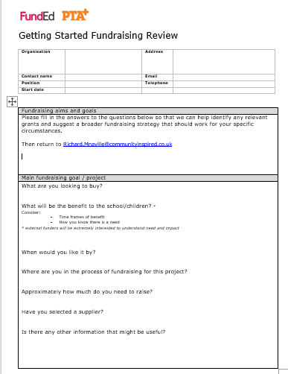
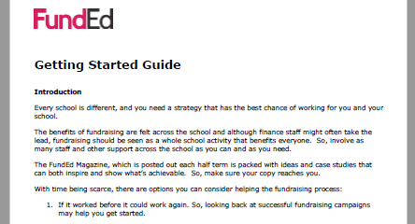
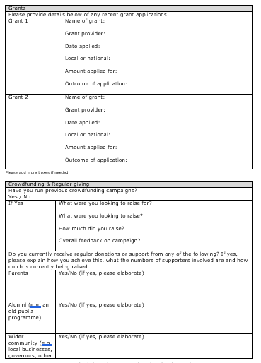
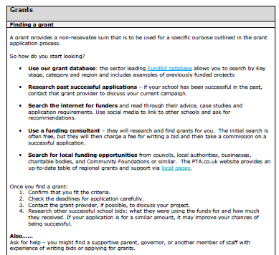
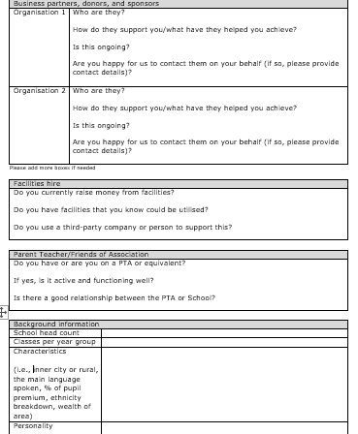
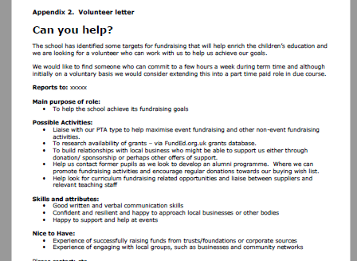
Getting Started Support
Fundraising Guides
Fundraising Review

Slide 3
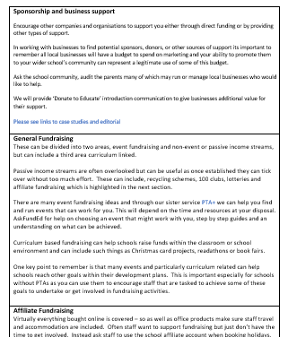
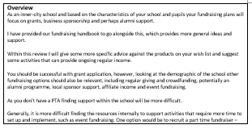
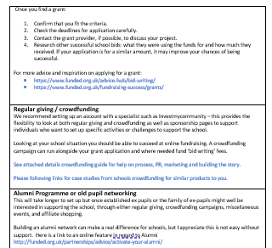
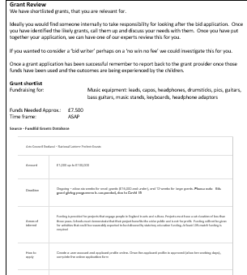
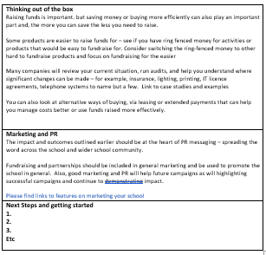
Review Example

Slide 4
Getting Started on your fundraising campaign
Outcomes are everything
Fundraising, as opposed to funding in general, is used to buy products and services that provide an enriched education.
The nature of these products and services will help you build a compelling story and highlight the positive outcomes that your fundraising will achieve for the pupils at your school.

Slide 5
What are you fundraising for?
The following questions will help you develop a plan
What will be the benefit to the school/children?
When would you like it by?
Where are you in the process of fundraising for this product?
Approximately how much do you need to raise?
Have you selected a supplier?
Notes:
Creating a ‘wish list’ is a good place to start. Useful both for planning your activity and gaining an understanding of how much you need to raise. Wish lists can be shared with potential donors and the wider school community.
Fundraising is usually thought of as an activity to raise money for enriching or extra-curricular activities or products. However, if you do need to raise funds for general classroom resources, we suggest you try to bundle these up into ‘classroom packs’ and add these to your wish list.
Liaise with your PTA if you have one, so that you are working together on developing your plan. A PTA will control their own funds, so if they are working to an agreed wish list these funds will then go towards those agreed targets.

Slide 6
Options to consider
If it worked before it could work again.
Select activities that fit with time/skills available
Paying a third party.
Utilise other staff or ask for help.
PTAs or volunteers
Link up with a larger school or group of schools
Use FundEd for inspiration
Notes:
Every school is different, and you need a strategy that has the best chance of working for you and your school.
The benefits of fundraising are felt across the school and although finance staff might often take the lead, fundraising should be seen as a whole school activity that benefits everyone. So, involve as many staff and other support across the school as you can and as you need.
With time being scarce, there are options you can consider helping the fundraising process:

Slide 7
Getting the most from funded
Notes:
The website and magazines are full of inspiration and support – back copies available on line.
The case studies can help a school understand what can be achieved via real life examples they can relate to.

Slide 8
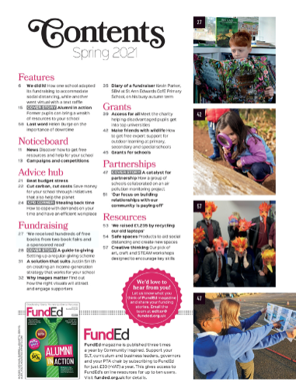

Slide 9
Developing your strategy
Your fundraising strategy will be determined by the type, location, and demographic makeup of your school, as well as the time and resources at your disposal.
A strategy using a mix of activities will maintain momentum and provide alternatives if one approach falls short.
These could include:
Grants
Crowdfunding
Regular Giving
Sponsorship
Facilities Hire
Event Fundraising
Non-event Fundraising

Slide 10
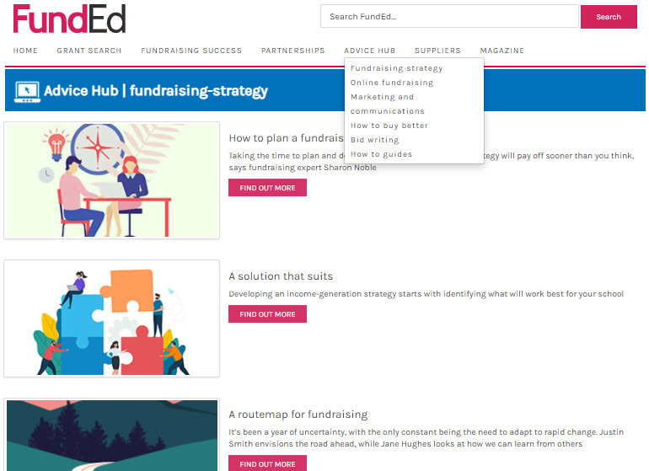

Slide 11
Finding a grant
A grant provides a non-repayable sum that is to be used for a specific purpose outlined in the grant application process.
Use the FundEd Grants database:
Research past successful applications
Search the internet for funders
Use a funding consultant
Once you find a grant:
Confirm that you fit the criteria.
Check the deadlines for application carefully.
Contact the grant provider, if possible, to discuss your project.
Research other successful school bids
Also……
Ask for help – you might find a supportive parent, governor, or another member of staff with experience of writing bids or applying for grants.
Notes:
So how do you start looking?
Use our grant database: the sector leading FundEd database allows you to search by Key stage, category and region and includes examples of previously funded projects
Research past successful applications – if your school has been successful in the past, contact that grant provider to discuss your current campaign.
Search the internet for funders and read through their advice, case studies and application requirements. Use social media to link to other schools and ask for recommendations.
Use a funding consultant – they will research and find grants for you. The initial search is often free, but they will then charge a fee for writing a bid and then take a commission on a successful application.
Search for local funding opportunities from councils, local authorities, businesses, charitable bodies, and Community Foundations or similar. The PTA.co.uk website provides an up-to-date table of regional grants and support via local pages.

Slide 12
Notes:
In addition you can sign up for newsletters
Funding Alerts via the group – though we can add you to this listing if you email us with permission
Social media
Twitter @fundEd4schools
Facebook Group @FundEd

Slide 13
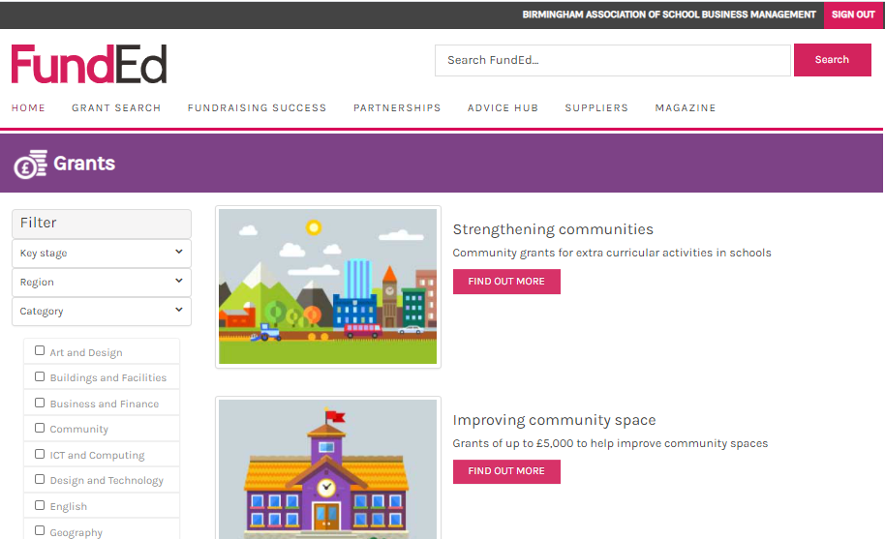
Notes:
Grant search
Login detils
Email: LBWF@Funded.org.uk
PW: LBWF1947

Slide 15
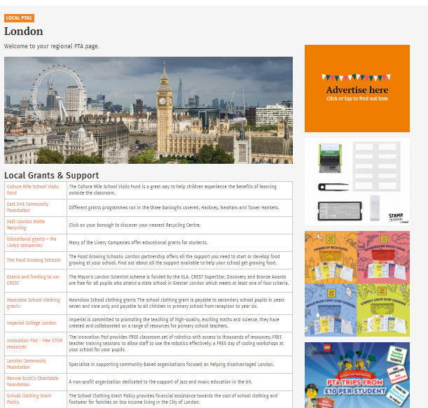

Slide 16
Notes:
Also.
A grant provider might require a school to find a proportion of the grant value themselves or ‘match fund’ the amount awarded. Additional fundraising activities can support this and cover fees of third-party funding consultants or bid writers.
Some grants require you to have charitable status. If required a PTA may be able to apply on the school’s behalf.
If you receive a grant, make sure you keep in touch with the provider, giving details on how the grant was spent and the subsequent benefits to the school. This will help if you wish to reapply to this funder in the future.
Demonstrating impact is important and will help with future fundraising campaigns.

Slide 17
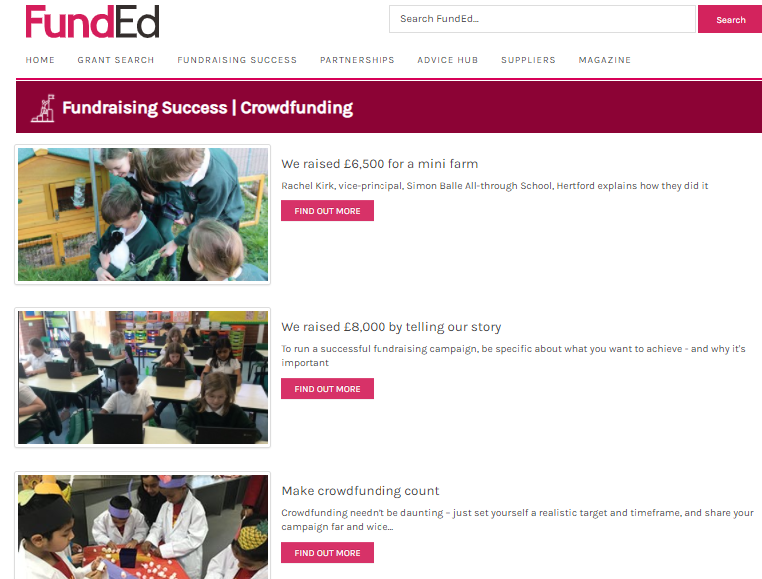
Notes:
Crowdfunding uses an online platform to attract lots of smaller donations, that when added together help achieve a larger fundraising target. Importantly, although you set a goal, you do not need to reach a specific amount to access the funds raised. The aim is to achieve or exceed the goal, but all funds donated during a campaign can be used.
Most schools are aware of sponsored activity fundraising.
These events are often organised by a PTA or pupils themselves and have the added benefit of your participants also being your main marketeers and cheerleaders for the event.
If combined with a crowdfunding campaign this help create more publicity for the fundraising goal and ultimately boost support.

Slide 18
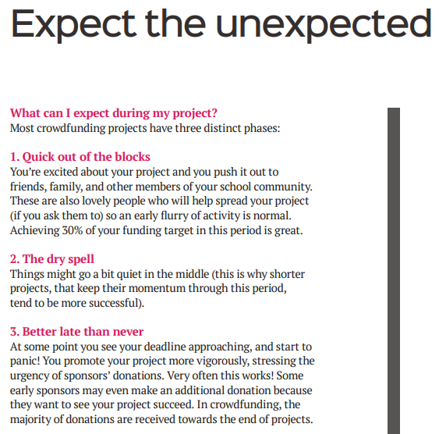
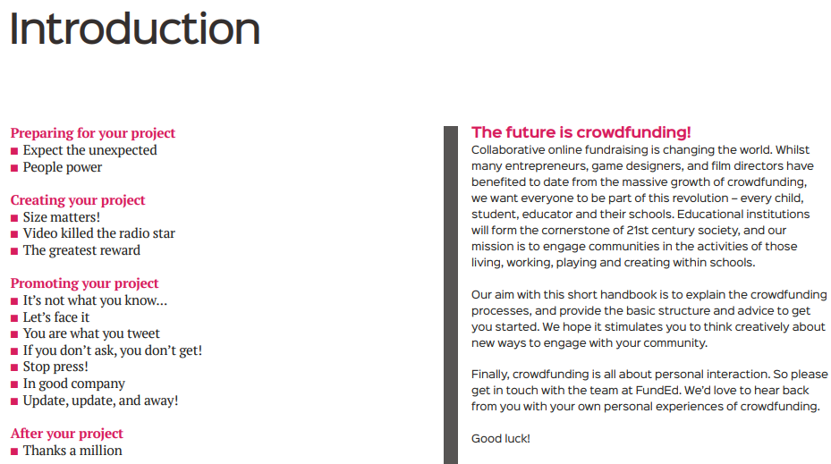
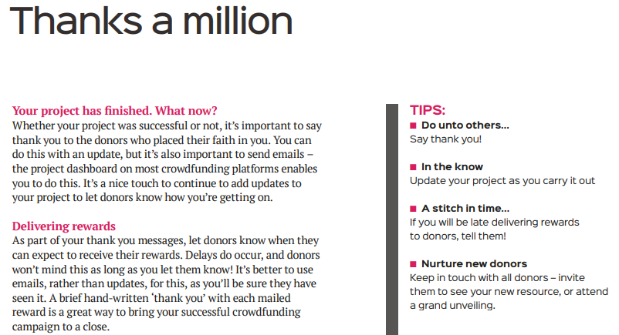

Slide 19
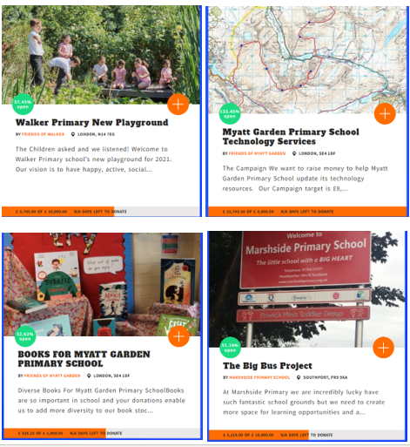

Slide 20
Regular Giving
Easy to set up, time efficient & delivers ongoing revenue
Allows you to promote a broader ‘wish list’ of projects
Donations can be made by the immediate school community & can help to develop an alumni support base
Provides a route to gain support from local companies and & in return promote them to the school community
Provides great ongoing opportunities to raise the profile of the school, both internally and externally
No Standing Orders or Direct Debits to set up
Gift aid where applicable is collected automatically
Notes:
Whereas a crowdfunding campaign can be time consuming once a Regular Giving account has been set up it is easy to maintain and grow interest and can provide valuable additional regular income.
Campaigns with eye-catching photography and exciting campaign graphics - can promote school successes and raise the profile of a school in its local community. Indirectly, this kind of activity can help to attract more pupils to the school, as well as creating opportunities to develop new relationships with community organisations and businesses.

Slide 22
Working with a PTA
If you are lucky to have one, it is important not to take a Parent Teacher Association for granted - instead, appreciate it as an invaluable asset. In additional to raising their own funds, PTAs can:
Support and help run school led campaigns and events.
Work with the school to develop wish lists.
Develop community partnerships.
Help engage ‘hard to reach’ parents.
Audit parents for useful skill sets.
Contact and liaise with potential suppliers.
Take the lead on social or eco campaigns.
Help create memorable, high profile events.
Notes:
Working with a PTA
If you are lucky to have one, it is important not to take a Parent Teacher Association for granted - instead, appreciate it as an invaluable asset. In additional to raising their own funds, PTAs can:
Support and help run school led campaigns and events.
Work with the school to develop wish lists.
Develop community partnerships.
Help engage ‘hard to reach’ parents.
Audit parents for useful skill sets.
Contact and liaise with potential suppliers.
Take the lead on social or eco campaigns.
Help create memorable, high profile events.
It is important to remember that most PTA’s operate as a separate legal identity, with their own bank account and constitution. Obviously, they are raising funds for the school, but they are not controlled by the school, but are run and managed by their own committee.

Slide 23
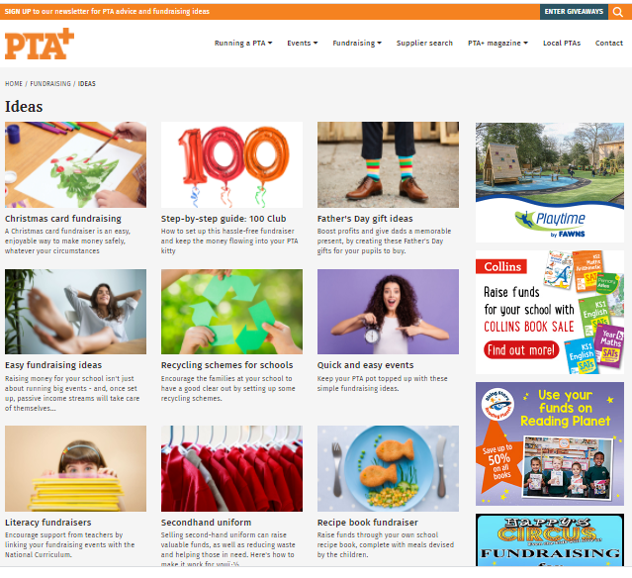
Notes:
PTA.co.uk

Slide 24
Examples of event fundraising
Music festival
Colour run
Zorbing at a summer fair
Open air theatre
Notes:
Events can create good PR and help promote the school to the wider community and help create interest from potential new intake.
High profile events can also include the who schools community and help staff and parents to interact in fun less formal environment.

Slide 25
Other general fundraising activities to consider:
Printed products - Popular examples include: Tea towels, Cook Books, Leavers Gifts, Mugs, Calendars & Christmas Cards.
Toys and Merchandise – these can be sold at events and used as raffle or competition prizes.
Recycling
Setting up a lottery is easy to manage and can generate repeating income.
Shopping affiliate or reward schemes

Slide 26
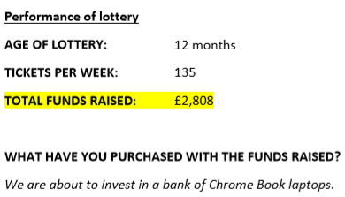
Case Study
Chase Terrace Community College
Notes:
They liked it as easy to join and easy to run – they used weekly news letters, facebook page, flyers at events, twitter and word of mouth,

Slide 28
Harnessing support from local businesses
To begin with, consider current partnerships:
How do they support you now?
What have they helped you achieve?
Is this support ongoing?
Have you talked to them about working with them more?
Then target ‘low hanging fruit’:
Local suppliers / businesses near the school.
Parents who work in or run local businesses.
Corporations having an impact in your area, construction companies, amenity tips, transport providers.
Local companies offering to ‘match fund’ employee fundraising.
BE BOLD!
Contact a decision maker and outline your campaigns.
Personal contact can be vital in securing support.
Show that you offer good value for money.
Give them options and choices.
Demonstrate impact!
Notes:
Consider affiliate opportunities – if you can encourage parents and staff to support a local business in return for them supporting your campaign, then everyone benefits.
Local suppliers / business near the school.
Parents who work in or run local businesses.
Corporations having an impact in your area, construction companies, amenity tips, transport providers.
Standing Out From the Crowd
Marketing and income generation should go hand in hand. Strategic marketing can help define and articulate key benefits to potential supporters and position your school so that it is attractive to sponsors.
Your fundraising plans should allow you to segment your target audience(s) and potential supporters and then tailor your approaches accordingly.

Slide 29
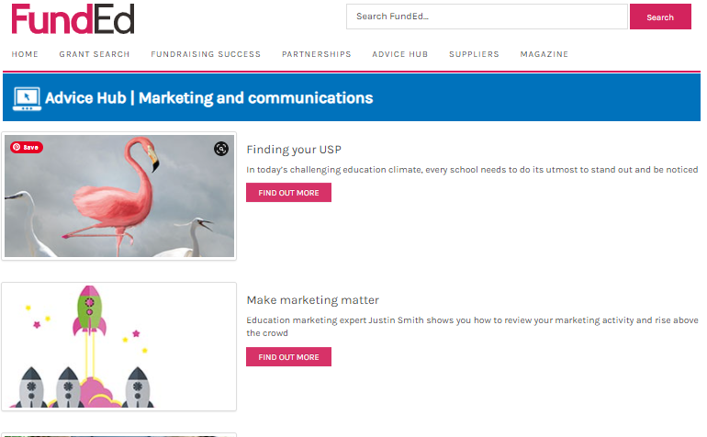
Standing Out From the Crowd
Marketing and income generation should go hand in hand
Notes:
Standing Out From the Crowd
Marketing and income generation should go hand in hand. Strategic marketing can help define and articulate key benefits to potential supporters and position your school so that it is attractive to sponsors.
Your fundraising plans should allow you to segment your target audience(s) and potential supporters and then tailor your approaches accordingly.

Slide 30
Fundraising Support Staff
The benefits of employing a school Fundraising Support Staff
What does the role of fundraiser entail
How to find a fundraiser
Options – volunteer, part time, full time
Notes:
Fundraising Support Staff
Many schools now employ someone to help with fundraising, either part time or full time depending on the needs and size of the school. Even a few hours a week can offer much need support to a business or finance manager.
However, it can be hard to justify the cost of employing this additional person, especially if a new role to the school. An alternative is to look for a volunteer to come in and help one day a week, perhaps with the understanding that this could develop into a part time paid role.
A fulltime fundraiser will take the lead on income generation while a volunteer or part time person will liaise with and be led by the Business Manager or equivalent. In both roles they will liaise with a PTA if there is one and help maintain continuity as PTA committee personnel change every few years.
How to find a fundraiser
Some larger schools may wish to advertise the role locally but for most schools this is not necessary.
Search across the wider school community, for an enthusiastic capable person. It may well be that someone from a PTA comes forward, but any parent with transferable skills (such as planning, networking and public speaking) could be attracted to a role that might eventually allow them to work part time.

Slide 31
We are always here to help.

