Slide 1

Key stages 1 & 2
Statutory Relationships Education, Health Education and the
new Ofsted framework – Essex Healthy Schools 2021

Slide 2

Fitting it all together
Health education and RE are part of PSHE education
Learning is enriched through the wider curriculum
Learning is reinforced through the ‘day to day’ micro and macro experiences of pupils in a ‘Healthy School’ setting.
Protocols, procedures and referrals provide coherent support to re-engage vulnerable pupils with learning
All ‘wrapped up’ in a coherent, accessible policy framework.
(Always think, curriculum first, ethos second, procedures third)
Key stages 1 & 2

Slide 3
What are the KS 1 & 2 statutory requirements?
The Health Education and Relationships Education aspects of PSHE (personal, social, health and economic) education became compulsory in all primary schools from September 2020.
Health Education is not a ‘new’ requirement in independent schools, where PSHE education is already compulsory. However, it is expected that independent schools will draw on the new statutory guidance for Health Education when planning their PSHE education.
Key stages 1 & 2

Slide 4
What does the statutory guidance cover?
The Department for Education published statutory guidance for Health Education, Relationships Education and RSE in June 2019.
This covers broad areas of particular relevance and concern to children and young people today. It ensures that every child is guaranteed a PSHE education that covers mental health and wellbeing, physical health (including healthy lifestyles and first aid) and learning about safe, healthy relationships, including understanding consent and negotiating life online.
See ‘Education for a Connected World 2020’ – Gov.UK website
Key stages 1 & 2

Slide 5
How can schools meet statutory requirements effectively?
Many schools are well on the way to delivering these commitments and should build on, rather than unpick, what they’re already doing well. 85% of schools already teach PSHE that covers health and relationships. The new requirements are about raising and ‘levelling up’ of PSHE standards across all schools in a way that does not cause undue burden on workload and resources.
PSHE education needs regular curriculum time like any other subject. ‘Drop down’ or ‘off timetable’ days can enhance a timetabled programme of regular, planned lessons but are not an appropriate or effective alternative to one. 91% of school leaders surveyed by NAHT agree on the need for regular, timetabled PSHE lessons. (See our guidance on models of PSHE delivery.)
Schools should tailor their programme to the needs of pupils and communities in order to be effective. There is no ‘one-size-fits-all solution’: there are many useful programmes and resources that schools can use to support their PSHE provision, but PSHE programmes should always be tailored to the needs of a school’s own pupils and community. (See our PSHE planning toolkits for KS 1 & 2.)
Key stages 1 & 2

Slide 6
Should schools only cover what’s included in this guidance?
Schools should not just ‘teach to the guidance’, but see it as the basic requirement which forms part of broader PSHE education.
There is a huge problem with ‘Pupils should know….’
The statutory guidance outlines what schools must cover – though not everything that schools should cover – in PSHE from 2020. The Department for Education (DfE) says: ‘All elements of PSHE are important and the government continues to recommend PSHE be taught in schools’.
The PSHE Education Programme of Study KS 1 - 5, covers all of the statutory content as well as vital non-statutory content related to economic wellbeing and careers education.
Key stages 1 & 2

Slide 7
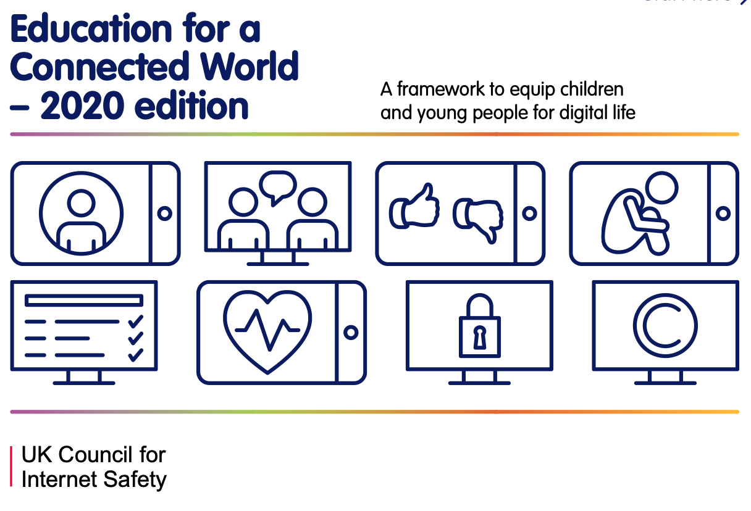
Online safety education (Compliments the Association’s POS)
Key stages 1 & 2

Slide 8
So schools should still teach economic wellbeing & careers through PSHE?
Yes, otherwise the ‘personal’ aspects of economic wellbeing will be lost. PSHE complements the financial education covered through Citizenship and Maths, but covers the personal aspects of economic wellbeing. It also lays the foundations of effective careers education, digital and media literacy (it is vital that the foundations of this learning are laid during the primary phase).
Health, relationships, economic wellbeing and successful careers are all linked. PSHE is the glue that binds them together. PSHE gathers all of these aspects of preparing for modern life together into a coherent curriculum subject.
PSHE education is the vehicle through which schools can best ensure they meet many of the Gatsby benchmarks. DfE data shows that the most common approach to careers education is delivery through PSHE lessons (87%), including the crucial early learning in primary years that raises aspirations and broadens understanding of the world of work. Therefore, schools should not undo what they are doing well in this area.
Key stages 1 & 2

Slide 9
Why is this all so important?
PSHE education has proven impact on life chances and academic success when delivered well, but has suffered from reduced curriculum time and patchy provision.
This strengthening of PSHE education’s status can have a major impact on the quality of PSHE in all schools for all pupils.
These developments mean that all pupils can benefit from an education that keeps them safe, healthy and prepared for the realities of modern life.
“The evidence shows that personal, social, health and economic (PSHE) education can improve the physical and psychosocial well-being of pupils. A virtuous cycle can be achieved, whereby pupils with better health and well-being can achieve better academically, which in turn leads to greater success.”
Department for Education review of PSHE education impact and effective practice
An extensive 2017 literature review by leading economists found ‘Very strong evidence’ that PSHE (personal, social, health and economic) learning has a positive impact on health, well being and academic attainment.
Key stages 1 & 2

Slide 10
What about sex education?
These new statutory requirements do not extend to sex education at KS 1 and 2 (beyond the biological/reproductive aspects schools are already required to cover in science)
However, the Department for Education ‘continues to recommend that all primary schools should have a sex education programme tailored to the age and the physical and emotional maturity of the pupils’
Where schools provide sex education at key stages 1 and 2, parents will have the right to withdraw their child from sex education but not from statutory Relationships Education or Health Education
Key stages 1 & 2

Slide 11
How can I get the right Relationships Education/RSE policy in place?
All primary schools will need to have a Relationships Education policy in place (or where sex education is also taught, an RSE policy). This must be freely available for parents to access, and include:
an outline of what will be taught to children within the Relationships Education/RSE curriculum
a rationale for this learning (for example in relation to safeguarding)
a clear procedure for withdrawal from sex education
reasons why the school believes children should not be withdrawn from these lessons
Download PSHE Association guidance on how to write a comprehensive policy.
Key stages 1 & 2
Statutory Relationships Education and Health Education

Slide 12
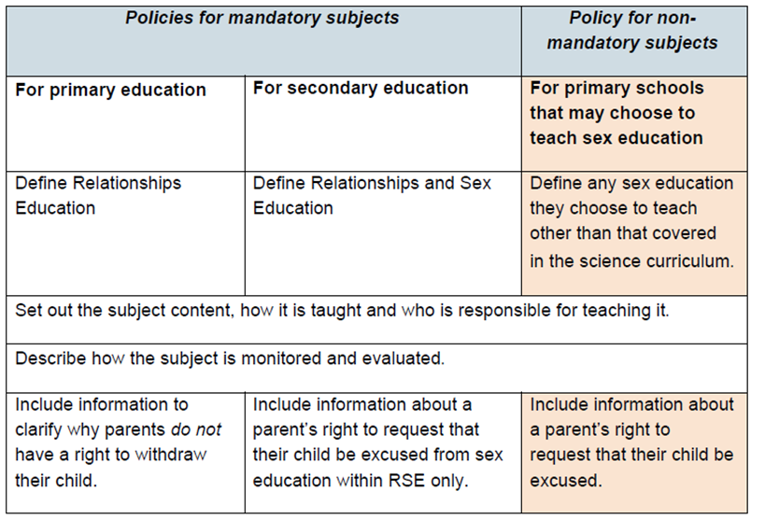
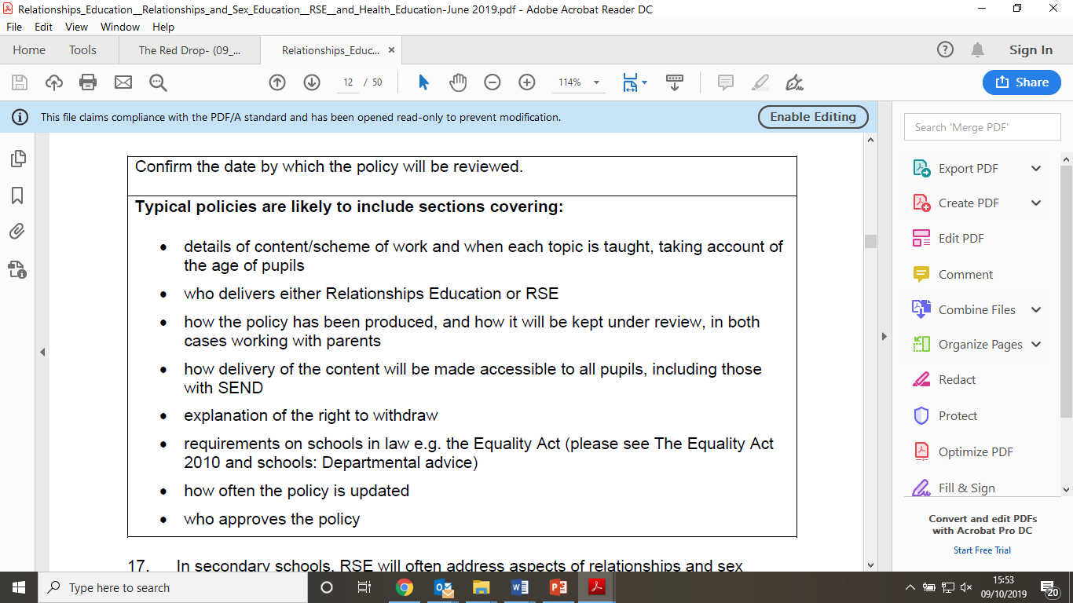
How can I get the right Relationships Education/RSE policy in place?
The new statutory
guidance outlines requirements
regarding policies:
Key stages 1 & 2
Statutory Relationships Education and Health Education

Slide 13
How can I get the right Relationships Education/RSE policy in place?
The new statutory
guidance outlines requirements
regarding policies:
Key stages 1 & 2
Statutory Relationships Education and Health Education

Slide 14
What about a policy for Health Education/PSHE education?
Schools do not have to have a policy for Health Education, or for broader PSHE education, but we would recommend having a PSHE policy that includes (or links to) your RSE policy and includes specific information on Health Education.
See our guidance on creating a PSHE education policy for your school
Key stages 1 & 2
Statutory Relationships Education and Health Education

Slide 15
Does the new Ofsted framework put greater emphasis on PSHE?
Yes, there is more scope for PSHE education to be a focus of inspections under the new framework (including through ‘deep dives’) in providing evidence for key judgements, particularly ‘personal development’. The new Ofsted inspection handbook (para 241)also refers specifically to the inclusion of the new statutory content in the curriculum, and that ‘if a school is failing to meet its obligations, inspectors will consider this when reaching the personal development judgement’.
n I get the right Relationships
Chief Inspector Amanda Spielman said that “In the new inspection model, we are particularly interested in how schools contribute to the personal development of children. This area is now a judgement in its own right. This makes more space in inspection for discussing things like the PSHE lessons in which wider life issues can be explored.
PSHE education also makes a unique contribution to safeguarding, and will support schools to fulfil their statutory duty to teach pupils to keep themselves safe. See the statutory ‘Keeping children safe in education guidance for schools and colleges on safeguarding children – (see para 303 – 310)
Read our blog post ‘What does the new Ofsted framework mean for PSHE education?’
Key stages 1 & 2

Slide 16
What about engaging with parents?
Open dialogue: It is important to create and maintain an open dialogue between parents and teachers as early as possible. As the DfE statutory guidance states: ‘Parents should be given every opportunity to understand the purpose and content of Relationships Education and RSE. Good communication and opportunities for parents to understand and ask questions about the school’s approach help increase confidence in the curriculum.’
It’s not all about sex!: Schools should engage with parents about the whole of the PSHE education curriculum from the beginning of their child’s school career. This will foster a greater understanding of (and support for) a subject that encompasses diverse topics from first aid and road safety to healthy eating and staying safe online, rather than allowing parents to see this as a subject that’s just about sex.
Mechanisms for engagement: Most schools have existing mechanisms in place to engage parents. They should continue to use these as their means of engaging parents with all aspects of PSHE including Relationships and Health Education – there is no requirement that this should involve new or additional mechanisms.
Key stages 1 & 2

Slide 17
What about engaging with parents? (continued)
PSHE Association guide to parental engagement: The PSHE Association has published a guide with practical advice for primary schools on engaging with parents about PSHE education – including a template letter and parent workshop plan – on how to positively communicate with parents about statutory Relationships Education in particular, as well as an overview of statutory requirements regarding withdrawal of pupils from sex education.
DfE ‘Parental Engagement on Relationships Education’ guidance: The DfE also published parental engagement guidance for schools in October 2019. It includes relevant information, advice, tips and case studies on effective parental engagement.
Key stages 1 & 2

Slide 18
What about engaging with parents? (continued)
DfE guidance for parents: The Department for Education has published a useful list of FAQs for parents on the new RSE/Relationships Education requirements, and new guides for parents on Relationships Education, RSE and Health Education.
Key DfE requirements: The DfE is clear that schools should publish relevant policies online, and ensure parents are consulted and examples of resources shared.
What the DfE says about parents and curriculum content:
  ‘What is taught, and how, is ultimately a decision for the school and consultation does not provide a parental veto on curriculum content’.
Key stages 1 & 2

Slide 19
What are schools’ commitments to equality and diversity?
There have been challenges from a vocal minority of parents to schools’ commitment to equality and diversity, including LGBT+ inclusion.
The National Association of Head Teachers (NAHT) has produced a useful policy update on schools’ commitments under the Equality Act.
Key stages 1 & 2

Slide 20
Useful resources & support
Programme of Study for PSHE Education (Key stages 1-5) 2020 edition: The national programme of study for the subject, regularly signposted to by the Department for Education for schools to use and updated in January 2020 to support schools to integrate the new statutory content into their broader PSHE programmes.
Programme Builders for PSHE education (Key stages 1-4): Designed to help schools develop their PSHE education schemes of work, the suite of Programme Builders provide examples of possible curriculum frameworks, setting out what pupils could be taught in each year group, in each half term / term across the year, in order to cover the whole Programme of Study and the new statutory content.
PSHE Association mental health lesson plans and teacher guidance: a suite of lesson plans available in slideshow and pdf. document format.
‘Preparing for statutory RSE and relationships education’ packs; and the ‘Roadmap to statutory RSE’ (jointly produced by the PSHE Association and the Sex Education Forum).
Our suite of CPD training days on preparing for statutory relationships education, preparing for statutory health education, getting your PSHE education ‘Ofsted ready’ for the new framework, and more.
A range of resources that have gained the PSHE Association Quality Mark.
Guide to parental engagement: practical advice for primary schools on engaging with parents about PSHE education.
Key stages 1 & 2

Slide 21
About the PSHE Association
The PSHE Association is the national body for personal, social, health and economic (PSHE) education — the school curriculum subject that supports pupils to be healthy, safe and prepared for modern life. PSHE education incorporates health education, relationships education/RSE and economic wellbeing and careers.
A charity and membership organisation, the PSHE Association works to improve PSHE education standards by supporting a national community of over 40,000 teachers and schools with resources, training and advice. Find out more at www.pshe-association.org.uk.
Key stages 1 & 2

