Slide 1
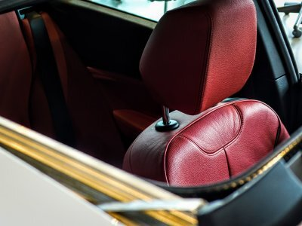
H E A D R E S T
(n): A safety device designed to support the head
@Headrest_UK

Slide 2
WHO WE ARE
Andrew Morrish
Ros McMullen
Kenny Frederick
Pete Crockett
All experienced headteachers and CEOs from primary, secondary and special schools. Working Pro Bono.
NLE and coaching experience
H E A D R E S T
(n): A safety device designed to support the head
@Headrest_UK

Slide 3
WHY NOW?
H E A D R E S T
Headteacher wellbeing a priority
Increase in workload/anxiety levels
Operational and not strategic
Lack of support for headteachers
Sodden sponges
The need for rapid response
We’ve sat in your chair
Safe, non-judgmental, anonymous
(n): A safety device designed to support the head
@Headrest_UK

Slide 4
@Headrest_UK

Slide 5
KEY ISSUES
Bubbles/safety
Ill health (self and family)
Feeling overwhelmed/stress
Parental demands
Facebook/Social Media
Lack of governance support
Lack of LA/MAT support inc HR
Suspension, disciplinary etc.
Ofsted, monitoring etc.
H E A D R E S T
(n): A safety device designed to support the head
@Headrest_UK

Slide 6
WHAT WE DO
Listen
Reassure
Signpost
H E A D R E S T
(n): A safety device designed to support the head
Headwell: A headteacher wellbeing blog
#newHTvoices
@Headrest_UK

Slide 7
@Headrest_UK

Slide 8
HOW IT WORKS
DM us on Twitter @Headrest_UK
Phone us for free on 0800 862 0110
Website: www.HeadrestUK.co.uk
Email us at Hello@HeadrestUK.co.uk
We will always get back to you.
H E A D R E S T
(n): A safety device designed to support the head
@Headrest_UK

Slide 9
H E A D R E S T
A big thank you to all our supporters:
NAHT
Chartered College of Teaching
Navigate NDC
Education Support
SSAT
Satis Education
Ambition Institute
Innovate My School
Schools Advisory Service
Headteachers’ Roundtable
Schools of Tomorrow
Guest headteacher bloggers
@Headrest_UK

