Slide 1
North East Primary Head Teachers' Spring term meeting – 2019 Lizzy Kingsford Quadrant Manager North East
Essex Child and Family Wellbeing Service

Slide 2
Content
Overview of our delivery model within schools and local provision
3 Year Strategic Plan for School Age Children 2018 – Universal and Targeted provision
Medical Conditions
Case Study
Healthy Schools
Community and Healthy Family Drop in’s
Online Guidance
Daily Mile

Slide 3
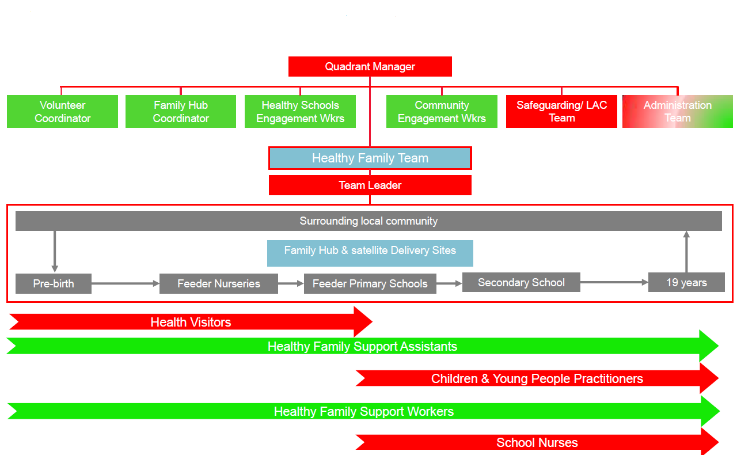
Overview of our delivery model

Slide 4
Overview of our delivery model within schools
Development and Quality Assurance of Public Health Education resources; Personal Social Health and Economic education (PSHEe) curriculum and targeted Behaviour change interventions
Oversight of Targeted Healthy Schools Action Plans
Training, Advice and Guidance on Public Health agendas, including leadership of calendar of Health Promotion campaigns
Healthy Schools & Public Health Specialist Team
Public Health Specialists
Healthy Schools Engagement Workers
School Population level needs assessment and development of Enhanced Action Plans
Support to Schools to self assess against and achieve foundation Healthy Schools status
PSHEe curriculum advice
Recruitment and Training of Peer Educators within Schools

Slide 5
Local school provision
Targeted support for Parents and Children in Early Years Foundation Stage (EYFS) and Key Stage 1
Health Assessments for all children and young people in the safeguarding arena
Targeted support for Children & Young People in Key Stages 2,3, 4 & 5
Medical Conditions awareness training for School Staff
One to one sessions in every secondary school and CHAT Health (Virtual drop-in)
Liaison with SENCO, Pastoral Support and Senior Leadership team
Healthy Family
Team
Targeted support for young people and parents as delegated by School Nurse
Support to Peer Educators in delivering PSHE and Health promotion campaigns
Lead projects to improve Health and Wellbeing with young people i.e. care leavers
Targeted support for Children KS1 and 2 and parents as delegated by School Nurse
Facilitate community drop ins
NCMP
Universal Intervention delivered through Family Hubs and Delivery sites
Resource support for schools in line with Health Promotion calendar
Notes:
Handout – District Level Handouts of Teams and names professionals. Photos if possible.

Slide 6
Universal Provision: EYFS, KS1 & KS2
UNIVERSAL PROVISION - In supporting the development of children and young people throughout primary school, the Essex Child and Family Wellbeing Service will provide:
A linked Specialist Community Public Health Nurse (Health Visitor or School Nurse)
We are going to commence termly contact from link practitioner to each school’s senior leadership and pastoral support team to discuss needs and priorities
Bulletin to share public health messages to support PSHE curriculum development
School Entry Health Assessment: Vision screening, NCMP and hearing (All school children who require a hearing test will be invited to their nearest drop in)
Year 6 National Child Measuring Programme
Year 6 Transition Talk session bespoke to year group needs identified through Risk Avert questionnaire - schools to contact our service for session support if required.
Information, Advice and Guidance to Parents via social media, telephone and face to face
Accessible community drop-ins within Family Hubs and Family Hub Delivery Sites
Family activities at Family Hubs and Family Hub Delivery Sites, both during school holidays and after school
Notes:
Handout of the Team Structure and points of contact
Take Risk Advert Primary Resources
Talk about Family Hubs and Healthy Family Drop In’s

Slide 7
Targeted Provision for school – age children
In supporting the development of children and young people identified as being at risk of poor outcomes, the Essex Child and Family Wellbeing Service will provide:
PSHE training and resources in response to identified children and young peoples needs in your school – Once support is requested the School Nurse will contact the referrer and organise an assessment meeting to devise the best solution in partnership. From this we may offer a Practitioner to deliver a bespoke plan in school or family home. Alternatively we may suggest other agencies i.e. NSPCC or CAV’s who have specialist subject knowledge to help provide support. This assessment approach will help us make the best response possible to resolve the issue quickly and effectively.
Holistic Health Needs Assessments of young people and school community
One to one work with young people to build self efficacy, emotional wellbeing
Behaviour change interventions with young people to
support in reducing unhealthy lifestyle behaviours
Sub Contract to CAVS to provide 8yr+ mentoring support
CAVS – Group work for emotional wellbeing (8yr+)
Community projects to address local need e.g.
period Poverty, Holiday Hunger, addressing Child Exploitation
Notes:
Identified by School Nursing, Healthy Schools Offer.
Copy of the referral forms to give out or refer via a school nurse
List of Healthy Family Drop In’s – Which ones have hearing tests?
Generic Email Address Business Cards

Slide 8
Medical Conditions
Medical conditions such as Anaphylaxis, Asthma and Epilepsy can have a significant impact on a child or young persons general health and wellbeing and their success in school. School Nurses will provide Anaphylaxis awareness Training (includes basic asthma awareness) for School Staff:
•Corporate; termly training delivered in central locations
•Number of places based on number of children attending each School
•Minimum of 2 spaces up to a maximum of 8 per school
To increase attendee numbers we are encouraging the requesting schools to
offer to their local consortium, then we can flexibly fit around the chosen date
venue and time. This has been a good solution and is working better
for the schools and for us.
North Specific :- Epilepsy training is provided by
ESNEFT, however your school nurse will liaise with
them to organise this for you if they haven’t approached
you directly, when a child with Epilepsy is diagnosed or
transfers into the school
Notes:
Print off training dates for each quadrant and booking details

Slide 9
Case Study
Young Person (YP) on a child protection plan-
This YP when first met lacked confidence, was worried and anxious
Identified Need
YP in Year 6 was grieving following sudden death of a family member and required support
YP required support with understanding mother’s substance misuse
YP reported by school to having episodes of feeling dizzy
YP’s carer requested support on personal hygiene
Who did we work with – Designated Safeguarding Lead of
School; Social care; Counsellors

Slide 10
Case Study Continued
What we did:-
1:1 regular health checks with the School Nurse where needs were identified over a period of time.
The School Nurse carried out a health check with YP where physical, social and emotional health was assessed.
Explored whether the grief the YP was feeling required further intensive support. Following assessment a referral was made for children’s bereavement counselling at St Helena Hospice as the YP felt that some counselling would be beneficial.
During health checks the YP would discuss parental substance misuse with the School Nurse and in turn was referred to The Children’s Society for counselling for support on this.
Following reports of dizziness from the carer and school the YP was further assessed by the School Nurse. Puberty and hormonal changes in the body was discussed with healthy eating to allow for healthy growth and development with the YP where she interacted and was allowed to answer questions. The carer was also given the advice on healthy eating and the monitoring of her intake to ensure that enough food was being consumed. On further discussion with the YP it was reported that she was having headaches and blurred vision. It was recommended that the carer take the YP to optician and the YP was prescribed glasses.
Following the carer having concerns on the YP’s poor personal hygiene the School Nurse arranged a 1:1 session which covered body changes, puberty in more detail and the importance of personal hygiene

Slide 11
Case Study Continued
What was the impact :–
Since supporting this YP there has been improvement in her confidence and wellbeing where she presents as a happy child.
Following a couple of sessions from the bereavement counsellor the YP felt supported enough to feel that the grief that she was feeling was part of the normal grieving process. The YP’s emotional wellbeing had improved which would improve behaviour and concentration in class.
The YP continues with emotional support from The Children’s Society and finds the weekly session helpful in supporting her emotional feelings around the parental substance misuse. This not only will make a difference to this YP now but will make a difference for challenges in the future.
By giving the YP and carer advice on hormonal changes and healthy eating the YP dizziness did improve. The YP now has glasses so can see clearly which will improve her health and learning in school.
By giving the YP a 1:1 session on puberty and the importance of personal hygiene it has improved her presentation. This will build confidence on how the YP looks after herself and for her be prepared for the future stages of puberty.
Although the YP had 1:1 sessions should there be a targeted need for a group or class these sessions could be delivered as a group session.

Slide 12
Healthy Schools
Currently 74 out of 80 Colchester schools have Foundation status and 8 have Enhanced status and 42 out 47 Tendring schools have Foundation status and there are 5 Enhanced Healthy Schools.
Healthy Schools will be celebrating your achievements on 19th and 20th March at the Awards Ceremonies which will be held at Chelmsford Race Course. All schools that successfully revalidated or achieved Enhanced Healthy School status have been invited.
The main focus for this term and next year will be to support schools in the transition to statutory Relationship and Health Education. There will be a series of workshops in each quadrant for PSHE coordinators and Healthy School coordinators to attend.
Schools will continue to be encouraged to become Enhanced Healthy Schools recognising and celebrating the excellent work schools doing to support children’s physical activity and good health as well as their EHWB and mental health.

Slide 13
Community Drop In’s
Tuesday 15.00 - 17.00 (from the 02/04/19)
Sydney House Family HUB. 61a Langham Drive, Clacton-on-Sea CO16 7AG
Thursday 15.00 - 17.00
Berechurch Family HUB
School Rd, Colchester CO2 8NN
Greenstead Delivery Site
Greenstead Community Centre, Hawthorn Avenue, Colchester, CO4 3QE
Dovercourt & Harwich Community HUB
276 High Street, Dovercourt, CO12 3PD
Additionally see our website www.essexfamilywellbeing.co.uk for
all other Healthy Family Drop In’s which are available in every HUB,
Delivery site and community settings each week
All families with children aged 0-19 are welcome to attend
Notes:
Print off training dates for each quadrant and booking details

Slide 14
Momo & other malicious viral scare stories
There is no confirmed evidence that the phenomenon ‘Momo’ is actually posing a threat to children and the NSPCC have said they have received more phone calls about Momo from members of the media than concerned parents. The story has spread due to legitimate concerns about online child safety, however the sharing of unverified material on local Facebook groups which are based on little hard evidence have now caused fears that they have exacerbated the situation by scaring children and spreading the images and the association with self-harm https://www.theguardian.com/technology/2019/feb/28/viral-momo-challenge-is-a-malicious-hoax-say-charities
Kidscape - Simple advice for parents
Set age-appropriate boundaries
Children of any age should be very cautious about adding anyone they don't know to their networks
https://www.saferinternet.org.uk/advice-centre/parents-and-carers/parental-controls-offered-your-home-internet-provider
Have open conversations about online safety, and let your child know they can come to you if they see anything that upsets or worries them
Report any malicious content to the platform (e.g. YouTube, Instagram)
Teach your child what it means to be assertive and explore saying no to doing things they don't want to do - whether face to face or online
Overall, be calm and reassuring. Memes like the Momo challenge draw their power from fear, so make sure your children see that you’re not scared of the issue and that it’s a problem you can solve together

Slide 15
Daily Mile and the Essex Child and Family Wellbeing Service
During 2019 we will be launching our Feel the Difference project for ECFWS practitioners and the local community. We will be working alongside the ‘Daily Mile’ and sport England to improve the North of Essex's physical and emotional wellbeing.
We will be:-
Contacting every school with our plan for the year ahead
Termly Awards for the most miles walked per full term per school. One for
Colchester and One for Tendring each term
Overall awards for the most miles walked with a prize
to be given out annually at the Healthy School Awards
Walking Together - Practitioners will participate in the daily
mile with each school during the academic year across North
East Essex to promote the mile - Aim once a month
Promote families to join the ‘Daily Mile’ in schools on the days
when practitioners visit
Wrist bands ‘We smashed the daily mile’
Once established we will offer a variety of activities from
short 10 minute fun health topics, family walks etc.
https://thedailymile.co.uk/

Slide 16
Any Questions?

