Slide 1
Leading for Staff Wellbeing

Slide 2
Teachers in England have lowest job satisfaction of all English-speaking countries, study finds.
“It is not surprising that so many teachers are leaving the profession when morale is this low”
Full chaos of funding cuts in England's schools revealed.
Guardian
Teachers endure greater job-related stress than other professionals.
National Foundation for Educational Research (NFER)
31% of teachers experienced a mental health issue in the last academic year.
Education Support Partnership

Slide 3
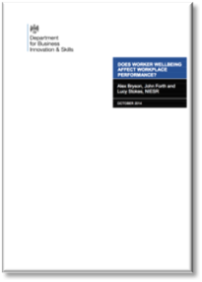
Why Improve Staff Wellbeing?
Moral Purpose
Legally
Outcomes
Financially
Retention, recruitment & absence

Slide 4
Ofsted Leadership and Management
Leaders engage with their staff and are aware and take account of the main pressures on them. They are realistic and constructive in the way that they manage staff, including their workload.
Leaders protect their staff from bullying and harassment.

Slide 5
14
Notes:
What do we mean by wellbeing?

Slide 6
Working hours largely unchanged over last 25 years
"These findings suggest that workload may have been given undue emphasis in the debate on teacher retention.
"Policymakers might therefore be better off focusing on other, better evidenced approaches to improving retention, such as increasing teacher pay, improving school leadership and improving working conditions."
University College London Institute of Education

Slide 7
What schools wanted
Know where to start
What to focus on
Simple and easy to use
Stress
Satisfaction

Slide 8
What has the biggest impact on wellbeing at work?

Slide 9
6 Causes – Management Standards
Demands (workload, working hours, deadlines, pupil behaviour, etc.).
Control (the say staff have over what and how they work).
Support (from school, resources, line managers, senior leaders and colleagues).
Relationships (how they get on with colleagues and how this is managed).
Role (staff know of what is expected of them and how this fits with their department objectives and aims of the school)
Change (and how it is managed).

Slide 10
“The thing that is causing people to get ill at work and adversely affect their quality of working life is line managers who are not socially and interpersonally skilled. They don’t have the soft skills that are needed.”
Professor Sir Cary Cooper

Slide 11
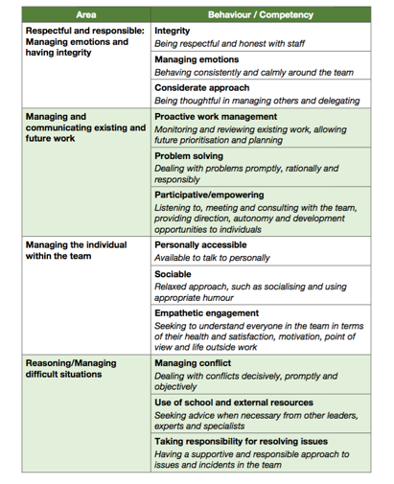
Leadership Behaviours
Goldsmiths, University of London
On behalf of the HSE, Investors in People & CIPD

Slide 12
How do you improve staff wellbeing?

Slide 13
© wellbeing accelerator for schools
Your Culture
Notes:
Intros – what do you do to deal with the issues highlighted. What do you want from the day?

Slide 14
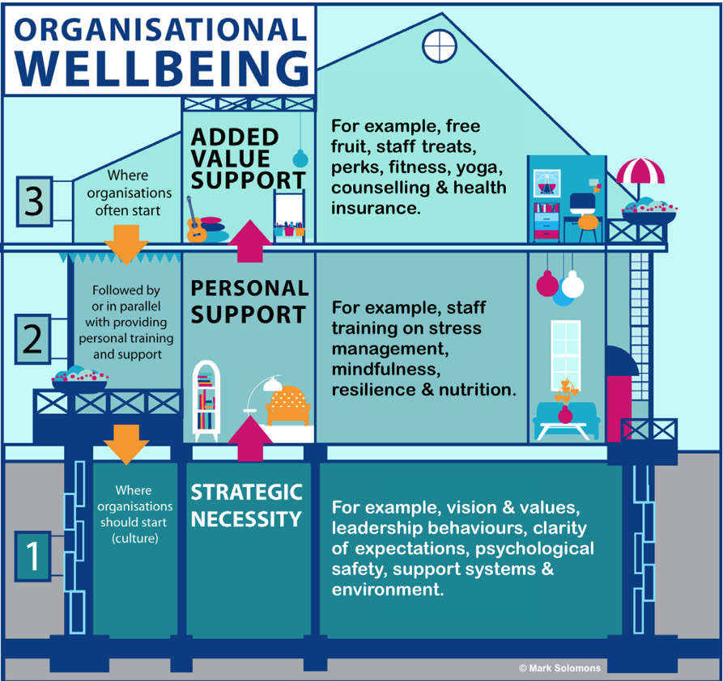

Slide 15
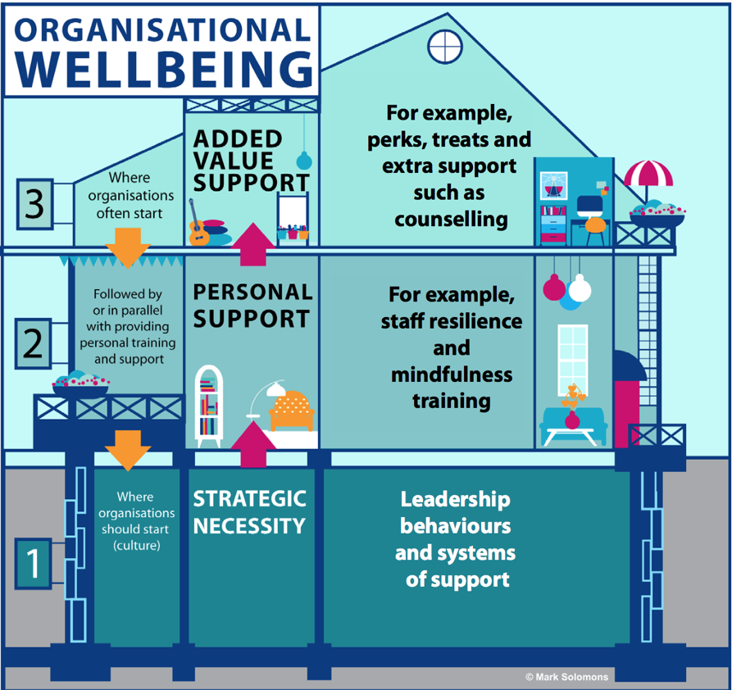

Slide 18
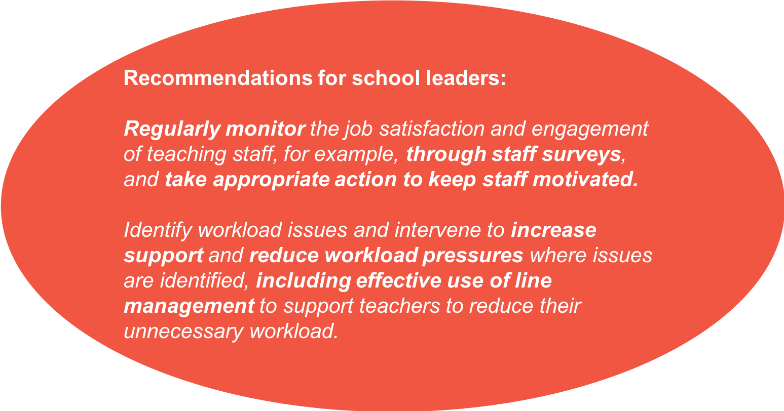
Where should you start?
National Foundation for Educational Research?

Slide 19
Why Measure?
To establish the gap between current performance and where you want to be
To engage staff
To focus on specific outcomes
To create actions as part of your school plan
To measure impact and agree future action

Slide 20
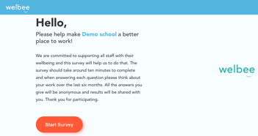
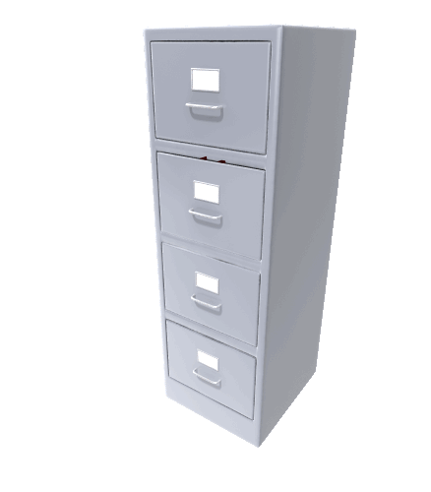
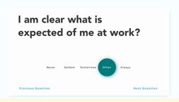
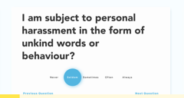
How can you effectively measure?

Slide 21
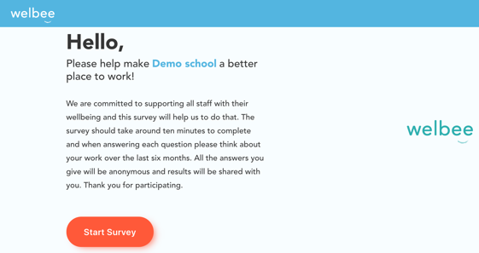
Evidence built
Independent evaluation
Benchmarks
Filters

Slide 22
HSE Indicator Tool
Demands
Control
Support
Relationships
Role
Change

Slide 23
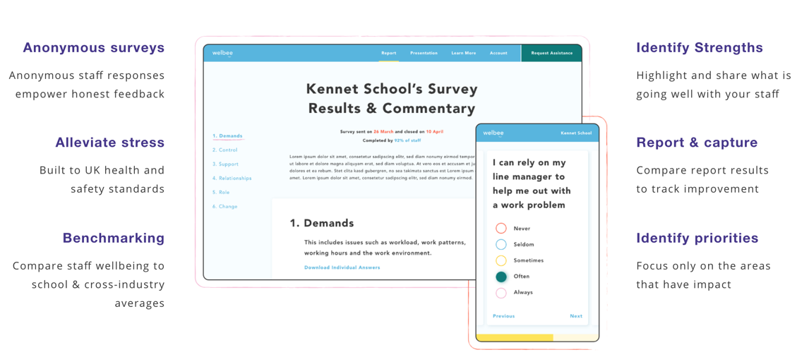
Outputs
We deliver a tool to understand your staff’s wellbeing experience, from their point of view

Slide 24
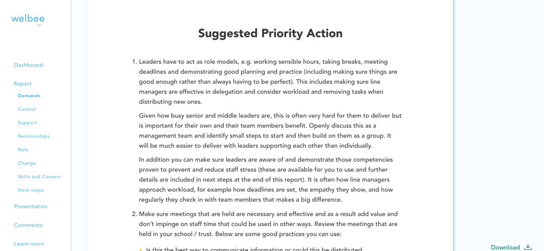
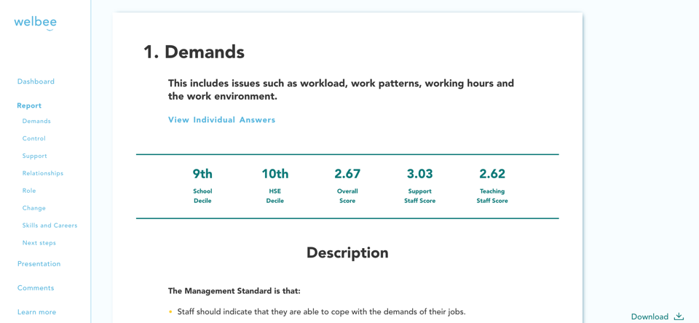
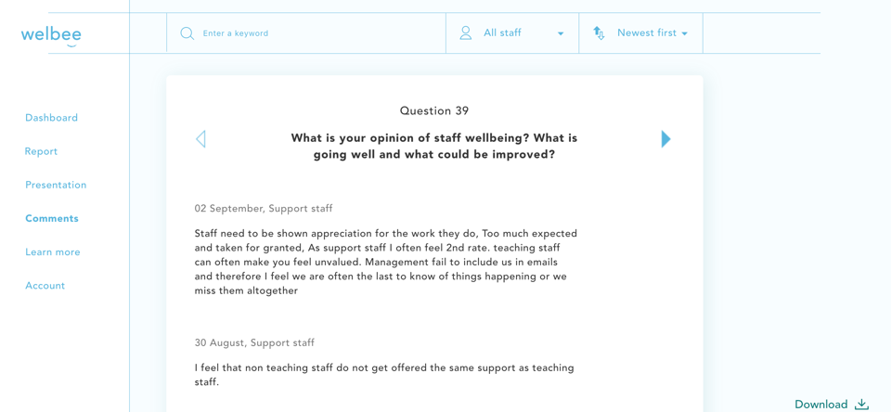
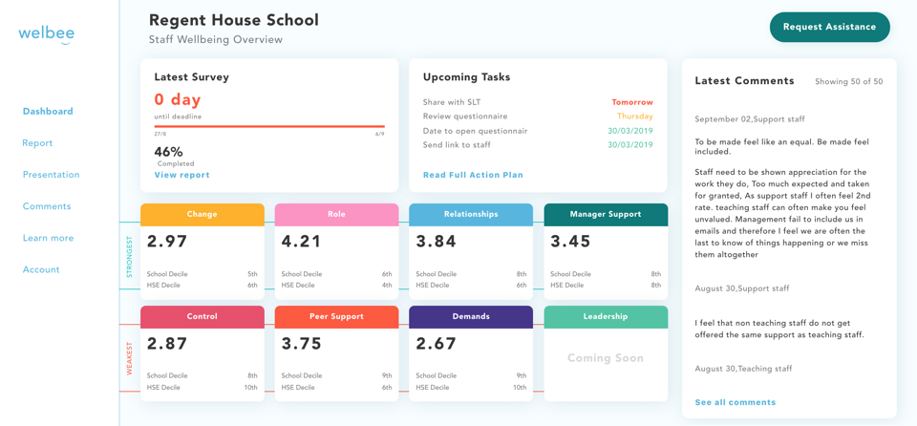
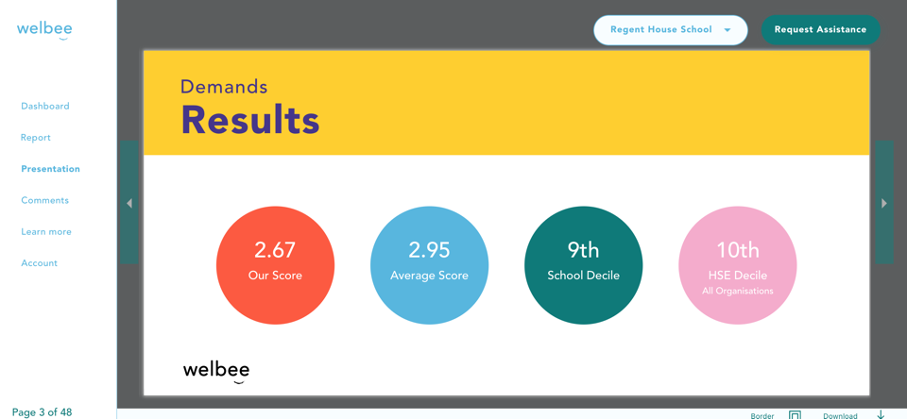
Automated Results
Stress
Satisfaction

Slide 26
Get Involved

Slide 27
What’s Included
Administration and running your survey
Advise on staff participation
You just need to give your staff members a link
Full reporting of results, available online through your dashboard
Filters and benchmarks
Your strengths and areas for focus
Priority actions
A presentation of results that you can use to feedback to staff
A call to review results and help with setting your plans

Slide 28
More than pay for itself
One staff member not leaving – lower turnover & recruitment costs
Reduced staff absences and lower cover costs
Improved pupil outcomes

Slide 29
Guarantee
No Risk

Slide 30
Get in touch
E: marksolomons@wellbeingaccelerator.co.uk
W: https://welbee.co.uk/epha-members

