Slide 1
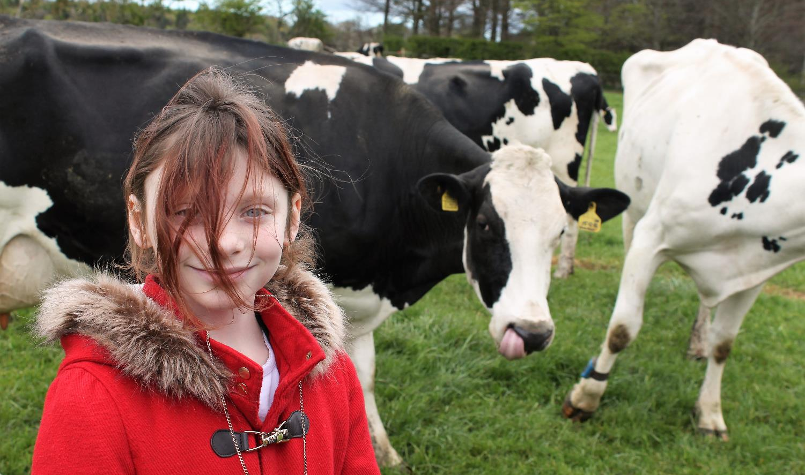
The Country Trust Where children learn and grow

Slide 2
Who are we?
National Education Charity
To bring food, farming and the countryside alive for the children least able to access it

Slide 3
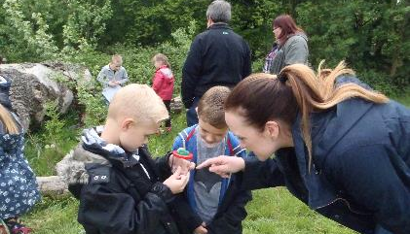
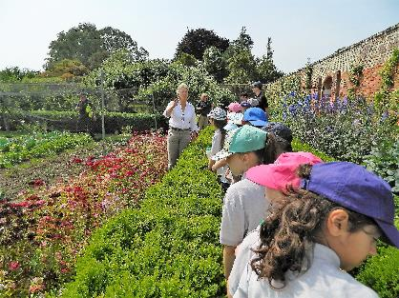
How do we find the children who are most in need?
We focus on primary schools with a greater than average percentage of children from low income families and therefore eligible for Free School Meals – the national average is 24.3% using the Ever6 measure.

Slide 4
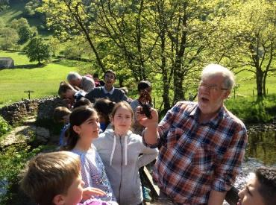
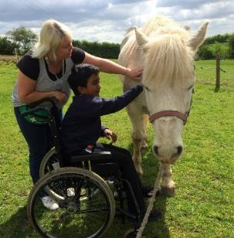
Farm Discovery – One day visits
Food Discovery – Year working with a school
Countryside Discovery – Residentials

Slide 5
Essex wide funding Farm Discovery
Farm visit to host farmers in the area
19,528 children visited farms last year
10am-2pm
Visit free
School organises and pays for transport
Work with the farmer & school to develop risk assessments
Links to curriculum

Slide 6
Just some of the activities we do on the farm
Butter-making
Watch lambs being born
Apple picking, pressing and drinking
Porridge tasting
Festive decoration making
Milling wheat and making apple scones
Pond-dipping
Mini beast hunting
Nest building
Tree hugging
Having a run or roll in the field
See cows being milked

Slide 7
And there's more
Exploring machinery – old and new
Map work
Poos and Clues
Worm Dancing
Roman broth making
Environmental art
Listening to the sounds of nature
Talking to the birds
Meeting cattle
Feeding sheep
Holding chickens
Cheese tasting

Slide 8
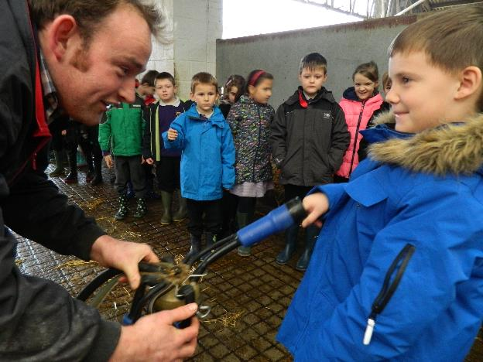
Our outcomes- the difference we aim to make
Children, their parent helpers and teachers are more knowledgeable and more aware of food, farming and the countryside.
More farmers are able to share their love and passion for what they do
Children are more engaged with
formal education as a result of increased ‘real world’ and
interactive learning experiences
Children are better able to make informed decisions about the food that they eat.

Slide 9
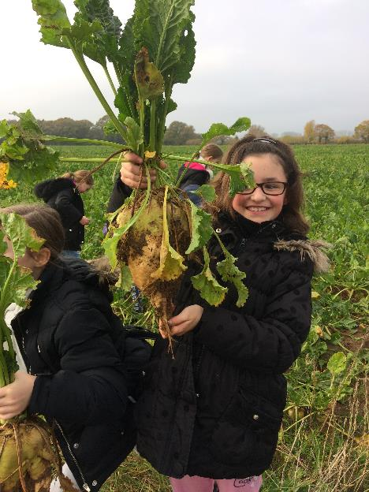
More teachers see the potential of countryside as a learning resource and feel more confident to use it to enhance their teaching
Children feel more responsible for their own and the wider environment.
Children have more opportunities to develop and display non-cognitive skills, to experience patience, wonder and success.
Children feel more at home in the countryside and greenspace.

Slide 10
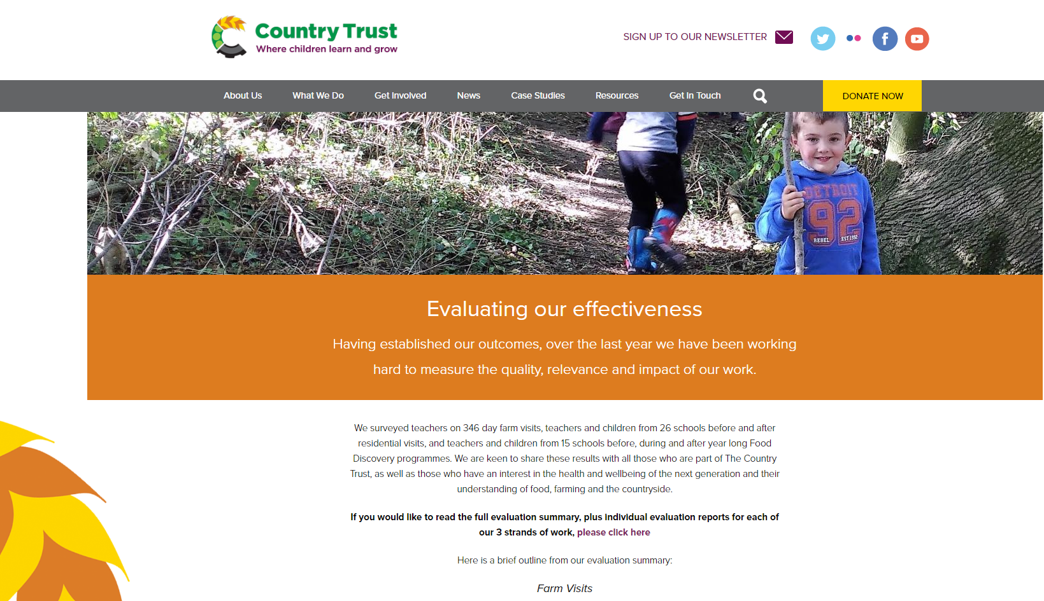
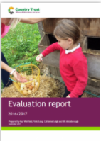

Slide 11
Farm Discovery (92% return rate for feedback forms)
Quality:
Over 99% of teachers agree that their pupils have a better understanding of how and where their food is produced as a result of the visit.
Over 99.7% of teachers agree that being on a farm is not an experience their pupils would normally have. Qual: Nearly a quarter of the teachers chose to highlight the visit as a rare experience in the children’s lives.
96% were given the opportunity to tailor their visit to their chosen area of the curriculum
Over 99.5% of teachers agree that their pupils gained confidence in being outdoors and in the countryside during their visit.
After their visit, 99.7% of teachers felt more confident in using the countryside as a learning resource to enhance their teaching.
99.6% of teachers and leaders rated the visit as ‘very good or ‘excellent’ for organisation and delivery and 98.5% rated the same in terms of health & safety

Slide 12
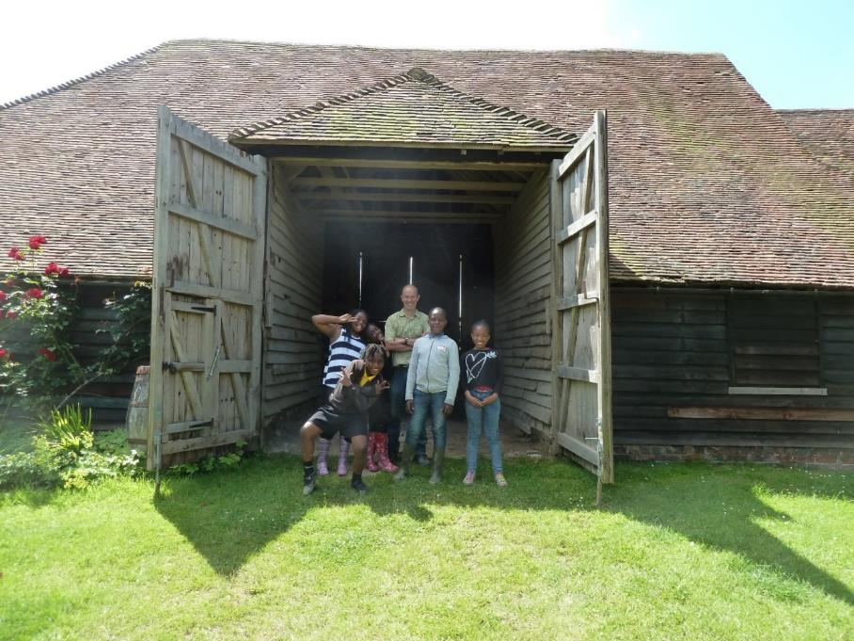
Thank you for listening – please come and see me during your coffee and lunch break

Slide 13
For free Country Trust Essex farm visits please contact:
Sharon Roberts - Essex Farm Discovery coordinator:
sroberts@countrytrust.org.uk
Visit us on:
www.countrytrust.org.uk
Office address:
The Country Trust, Moulsham Mill, Parkway, Chelmsford, Essex CM27PX
Tel: 01245 608363

