Slide 1
Teaching and Learning in the 2020s
Jonathan Bond
Jonathan.bond@yahoo.co.uk

Slide 2
The drivers of teaching and learning in the 2020s
Ofsted
The DfE
Research
A movement away from data to curriculum and practice

Slide 3
Being a driver
Become a school that researches
Project management
The clarity of aims
The importance of monitoring
The importance of sharply assessing effects on learning
Bravery to change, discard and adapt

Slide 4
Agenda
Embedding mastery
Understanding the knowledge drive and cultural capital
Understanding effective curriculum design and assessment
Developing effective subject leadership
Understanding and using memory theory
Using Rosenshine’s principles
Tackling Covid recovery
Understanding adaption
Developing early reading
Developing self-regulation in learners

Slide 5
1. Embedding mastery

Slide 6
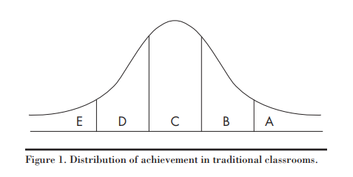
A problem to be solved
Notes:
Think of the letters as how well you learn something – E poorly, A completely

Slide 7
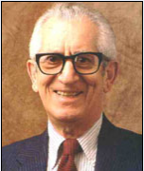
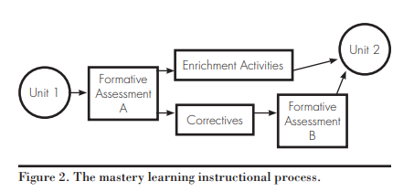
Benjamin Bloom’s solution

Slide 8
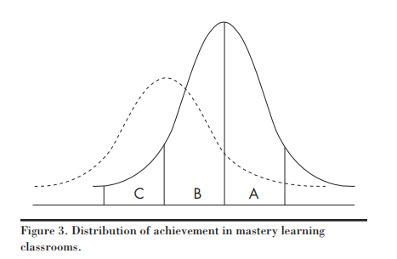
This should be the result

Slide 9
Do not venture into depth until mastery has been achieved

Slide 10
4 ways of looking at mastery
A mastery approach – Principles and beliefs
A mastery curriculum – One set of knowledge, concepts and skills for all
Teaching for mastery – A set of pedagogic practices that keep the class working together on the same topic whilst at the same time addressing different needs
Achieving mastery – Having a full understanding of knowledge, concepts and skills so you can apply it in new and unfamiliar situations

Slide 11
Where mastery can go wrong
Covid has derailed it
The school’s curriculum isn’t clear enough. Mastery can only work if each teacher knows clearly what children MUST learn in a year
The teachers lack a common understanding of what achieving mastery looks like (the mastery point)
The school’s assessment system isn’t robust enough. Either:
It isn’t linked tightly enough to the curriculum
The statements are too vague
Teachers aren’t using it properly
The thresholds are wrong thereby enabling pupils to be labelled as secure in their year group even when they haven’t achieved mastery in key objectives
Management isn’t holding teachers to account for the lack of achievement in key objectives

Slide 12
Problems mentioned so far mean that children still commonly have gaps in their learning (like they would in the previous system). This means that in each unit it’s hugely difficult to start everyone at the same place.
Teachers are over-differentiating. This can cause an artificial ceiling meaning that children fail to master the learning fully.
Over-use of ‘choose your own challenge’
Moving on too quickly
Teachers are not understanding that teaching for mastery and teaching for depth are different
Teachers don’t really believe in it so pay it lip-service
It only exists in certain subjects

Slide 13
2. Understanding the knowledge drive and cultural capital

Slide 14
What we teach
Attitudes
Knowledge
Skills
Concepts

Slide 15
Examples
Knowledge – Name and locate the world’s seven continents and five oceans
Skills – Set up simple practical enquiries and fair tests
Concepts – Understanding why countries invade other countries
Attitudes – To persevere with a difficult problem

Slide 16
Nick Gibb and E. D. Hirsch
“People who have lots of subject-specific knowledge find that new knowledge ‘sticks’ to it. Helping them to commit the new information to long-term memory”
“...because they know more, they learn more, and the gap between them and their less-advantaged peers grows even wider.”

Slide 17
“The notion of ‘generic skills’ (e.g. How to be creative, to work in teams, to be problem-solvers) is one of the most damaging myths in education today”
Every lesson which requires thinking like an expert e.g. a historian or a scientist “is a lesson wasted”
“A curriculum based on relevance to pupils is to deny them an introduction to ‘the best that has been thought or said’”

Slide 18
“The more shared knowledge we have as a society, the more integrated and inclusive that society. And the vehicle for delivering that shared knowledge is own school system, but only if schools teach a knowledge-based rather than a competence-based curriculum.”
“Ensuring young people are equipped with knowledge is ever more important with the rise of social media”

Slide 19
Cultural capital
‘familiarity with the legitimate culture within a society’ Pierre Bourdieu
Bourdieu points out that cultural capital is a major source of social inequality. Certain forms of cultural capital are valued over others, and can help or hinder one’s social mobility just as much as income or wealth.

Slide 20
Cultural capital and the DfE
“Users of the term, including the schools minister Nick Gibb and the former education secretary Michael Gove, suggest it is about ensuring that disadvantaged children are exposed to cultural experiences and background knowledge that those from better-off homes take for granted”
The Guardian

Slide 21
For the many not the few
“When we shared Grieg’s ‘In the Hall of the Mountain King’ with our inner-city, disadvantaged eight-year-olds, the class spontaneously cheered at the end.”
Claire Sealy, headteacher
Use cultural capital not to give access to a different level of society but to take ownership of the best that our culture has produced

Slide 22
3. Understanding effective curriculum design and assessment

Slide 23
A subject intent
Purpose of study / vision / rationale
Aims
Organisation
Curriculum

Slide 24
Deciding on areas of study
Areas of study are largely dictated by the National Curriculum in maintained schools
Academies have more freedom here
Areas of study need to be decided upon using a clear subject knowledge rationale
They should give balance to the subject. For instance in geography there should be a balance between place studies, human geography units and physical geography units.

Slide 25
Areas of study – Geography Key stage 1example
Places
Local geography
A contrasting UK locality
A contrasting overseas locality
Human and physical geography
Towns and cities
Countyside
Seaside
Weather
Hot and cold areas of the world

Slide 26
Areas of study – Geography Key stage 2 example
Places
A UK region
A contrasting European region
A region in the Americas
Human geography
Settlements and land use
Trade
Energy
Food and farming
Mining
Physical geography
Rivers
Mountains
Volcanoes and earthquakes
Climate
Human and physical geography
Water

Slide 27
Deciding on learning
After each area of study, what must children have learned?
Consider how much time you have
Keep objectives limited, clear and assessable
If you are unsure, do some research on the key aspects of the area
There must be clear educational reasons behind your choices
If possible, order the objectives

Slide 28
Monitoring the intent
Is the curriculum being taught as envisaged?
Are subject leaders checking?
Are senior leaders monitoring the subject leaders? (consider timetabled subject meetings with senior management)
Is anything still being taught that isn’t in the curriculum?
Are any parts of the curriculum underdeveloped?

Slide 29
Assessment

Slide 30
Types of assessment
Retrieval assessment – Assessment based on retrieval and demonstration of knowledge e.g. much of geography
Ongoing assessment – Ongoing assessment usually against skills which cannot easily be assessed at the end of a unit/topic e.g. much of PE
Outcome assessment – Assessment against a final product, performance, presentation. Piece e.g. dance

Slide 31
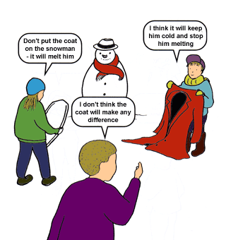
Strategies for assessing mastery
Observing pupils working
Questioning and dialogue
Representing in different ways
Quizzing/ testing
All class response
Assessment tasks

Slide 32
4. Developing effective subject leadership

Slide 33
The importance of subject leadership in the 2020s
A secondary model
Strong knowledge of the subject - Content knowledge and pedagogical content knowledge
Ownership of the intent
A full awareness of the subject in the school
Driving development
Measuring impact
The SLT monitoring subject leadership

Slide 34
What a subject leader needs to know
Laying the foundations
The subject leader role
Considering vision
Developing aims
Taking stock through auditing
Making a Plan
Maintenance and development
Understanding the school development plan
Choosing focuses
Prioritising actions
Action Planning

Slide 35
Making things happen
The three types of subject knowledge
Pedagogical content knowledge in your subject – making your subject unique
Bringing the subject alive
How to implement change
Supporting and extending
Inspiring colleagues
Supporting, coaching and mentoring
Dealing with tricky situations
Beyond the curriculum – finding extra-curricular opportunities

Slide 36
Checking progress
Monitoring the teaching of your subject (maintenance and development)
Triangulation
Assessment
Evaluating impact
Measuring, recording and reporting impact
The role of your subject in the big picture
Working with governors
Thinking ahead

Slide 37
5. Understanding and using memory theory

Slide 38
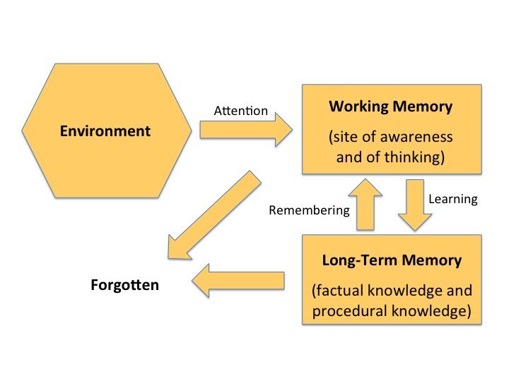
Willingham’s model

Slide 39
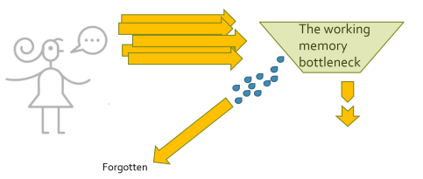
The limits of cognitive load

Slide 40
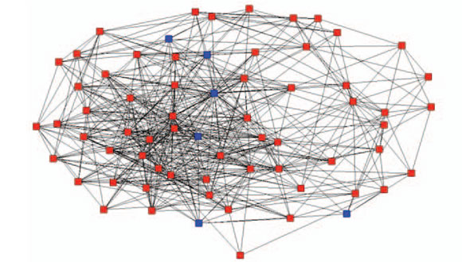
Using long term memory - Schemas
A schema organises elements of information according to how they will be used
They provide a system for storage
They become increasingly complex and there is no limit to how complex they can become

Slide 41
Automation
This is when information can be processed automatically with minimal conscious effort
It occurs after extensive practise
What can you do automatically? How did this happen?

Slide 42
An example - Reading
Squiggles on a page have meaning
The phonic code
Reading words
Reading phrases and sentences
Reading a text
Fluency
Reading a text and deducing the meaning

Slide 43
Bypassing the limits of working memory
A schema constitutes only a single element in working memory
The automation of schemas therefore reduces the burden on working memory
Notes:
The lower attaining reader

Slide 44
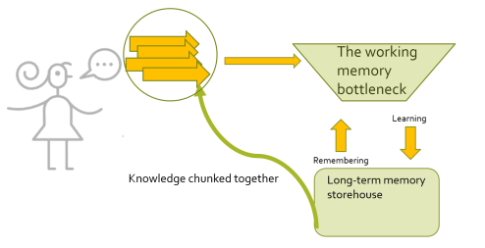

Slide 45
Things that help cognitive load
Building automated procedural memory with all children
Linking new learning to previous learning
Positioning new learning
Explicit teaching
Clarity
Stepping the learning
Worked examples

Slide 46
Reducing the redundancy effect
Reduce unnecessary or redundant information
Reduce repetition of the same information in different forms
The problem of ‘extra support’
“Most people assume that providing learners with additional information is at its worst harmless and might be beneficial. Redundancy is anything but harmless. Providing unnecessary support can be a major reason for instructional failure.” Sweller 2016

Slide 47
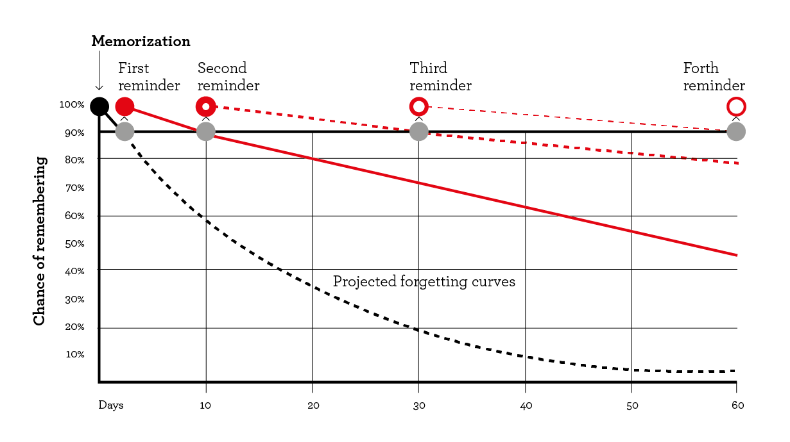
Using retrieval practice

Slide 48
Retrieving from the long term memory
The retrieval effect – the more you search for a memory, the easier it becomes to find it
So, the less you access a piece of information the harder it becomes to find it
Therefore we need to allow time for practice and application
And we need them to ‘tussle’ with the remembering to make the memory stronger
We need to avoid re-teaching too quickly, letting the ‘tussle’ happen first

Slide 49
The retrieval effect is stronger if we allow a bit of forgetting to happen before getting children to retrieve
Because our memories get stronger once retrieved if we have had time to forget them

Slide 50
Ideas for retrieval practice
Spaced practice (practise and repeat)
‘Do now’ tasks
Entry tickets
Start of lesson plenaries
Quiz quiz trade
Brain dumps
Flashback Friday
Learning logs

Slide 51
6. Using Rosenshine’s principles

Slide 52
Rosenshine’s instructional procedures
Begin a lesson with a short review of previous learning.
Present new material in small steps with student practice after each step.
Limit the amount of material students receive at one time.
Give clear and detailed instructions and explanations.
Ask a large number of questions to check for understanding.
Provide a high level of active practice for all students.
Guide students as they begin to practice.
Think aloud and model steps.
Provide models of worked-out problems.

Slide 53
Ask students to explain what they had learned.
Check the responses of all students.
Provide systematic feedback and corrections.
Use more time to provide explanations.
Provide many examples.
Re-teach material when necessary.
Prepare students for independent practice.
Monitor students when they begin independent practice

Slide 54
7. Tackling Covid recovery

Slide 55
Covid recovery
The situation is different in every school
Affected children and affected year groups vary
We need to protect mastery by making use of key objectives
Make use of school-led tutoring of ‘disadvantaged’ pupils (www.gov.uk/government/publications/school-led-tutoring-grant)
Online training available for this from November at https://nationaltutoring.org.uk/

Slide 56
Using Rosenshine’s principles for effective tutoring - steps
List what you want the child to master over the tutoring period
Tie this to the amount of time you have
Logically order the objectives
Create a tutoring plan
Share the journey with the child

Slide 57
Review
Begin each session with a review of what was learned before
Reactivate this knowledge – don’t re-teach it

Slide 58
Teach
Teach through models
By modelling
By sharing an exemplar
By comparing an exemplar and a non-exemplar
Explain clearly / talk through the thought process
Don’t over-question or attempt to extract the learning from the child

Slide 59
Check the understanding
Use questioning to check for understanding
Ask them to explain what they have learned
Do this at a variety of points during the tutoring session
Use these questions to find the misconceptions

Slide 60
Guide them in some practice
Work together at first building confidence and ensuring the child is not making too many errors.
Keep checking the understanding
And dealing with any misconceptions
Ask the child to explain their thinking

Slide 61
Towards independence
Scaffold if the task is complex
This can only be a step to independence though, so there must be a point when it is removed
Now step back and let the child work independently (stop talking!)

Slide 62
Ensuring mastery
You are likely to be working on key objectives so it is important that these are fully mastered.
A success rate of 80% signals mastery
Children need to keep practising until they reach this point

Slide 63
Review
This is to head-off the natural process of forgetting
And to create more extensive schemata by show how the objectives link together
As well as starting a session with a review build in spaced regular review sessions/ tasks
Keep revisiting ‘the journey’

Slide 64
8. Understanding Adaption

Slide 65
Ofsted research
Pupils are likely to make progress at different rates. As a consequence, they may require different levels and types of support from teachers to succeed (Hattie, 2009; Kriegbaum et al., 2018)
In-class differentiation, through providing differentiated teaching, activities or resources, has generally not been shown to have much impact on pupils’ attainment. In Scheerens and Bosker’s (1997) meta-analysis of school effectiveness research, for example, this factor showed no or a very weak relationship with pupils’ outcomes. Hattie (2009) likewise found the effect of differentiation to be among the weakest in his influential work on ‘Visible Learning’.

Slide 66
Adapting not differentiating
On the other hand, adapting teaching in a responsive way, for example by providing focused support to pupils who are not making progress, is likely to improve outcomes (Deunk et al., 2018; Education Endowment Foundation, 2018e)
However, this type of adaptive teaching should be clearly distinguished from forms of differentiation that cause teachers to artificially create distinct tasks for different groups of pupils or to set lower expectations for particular pupils.

Slide 67
You can change two things
The programme – what is taught (the classroom curriculum), goals, specific learning outcomes etc.
The supports – what is provided to assist the child to access and achieve educational outcomes, including materials, people, specific teaching strategies, changes in the classroom and environment etc.
Giangreco, Cloninger, and Iverson (2011)

Slide 68
What are you changing?
Differentiations: changes to the classroom programme – the content of the school and class curriculum and expected responses to it (the "what")
Adaptations: changes to the supports – the school environment, the classroom, teaching strategies, and teaching and learning materials (the "how").
Adapting other language

Slide 69
The big change
This child is a low ability child. How can I differentiate for them.
This child is struggling to master this piece of learning. Why? What do they need?

Slide 70
Teaching style
New learning
Deductive style
Direct Teaching
Activities tightly structured
Explanation more important than questioning
Deeper learning
Inductive style
Facilitating
Coaching
Conferencing
More pupil choice
Questioning more important than explanation

Slide 71
What slower learners might need
More time
A different explanation
Simpler teaching
More examples
A misconception to be dealt with
Less cognitive distraction/overload
More practice
An unidentified gap in previous learning to be filled
Encouragement
The C or P in CPA

Slide 72
Challenging faster learners
Increase complexity
Problem solving
Co-ordinating different pieces of information
Using different processes together
Investigating
Explaining or evaluating
Convincing
Exploring non-examples
Not being given the whole picture
Creating something new
Finding more than one answer
Dealing with restrictions
Playing
Open-endedness
Working independently
Broadening content

Slide 73
9. Developing early reading

Slide 74
Areas to develop
https://www.gov.uk/government/publications/the-reading-framework-teaching-the-foundations-of-literacy
Making your phonics robust
Telling stories, class novels, reading children poetry across the school
Early vocabulary acquisition e.g. Nuffield Early Language Intervention
Handwriting linking to early phonics (no continuous cursive)
Decodable books
Use of group reading for early readers
An emphasis on consistency and routines
Book banding to gradually build challenge and to ensure pupils and books ‘match’
Targeted support for lower attainers

Slide 75
Phonics
DfE has launched a new process to validate complete systematic synthetic phonics teaching programmes. This process is for both previously assessed programmes and new applicants.
Programmes that feature on the current list will need to apply by 28 February 2022. If they do not apply, they will no longer feature on the list.

Slide 76
Validated so far
Bug Club Phonics
Essential Letters and Sounds
Letterland
Little Wandle Letters and Sounds Revised
No Nonsense Phonics
Phonics International
Read Write Inc.
Reading Planet Rocket Phonics
Success for All Phonics

Slide 77
Ofsted and Letters and Sounds
https://educationhub.blog.gov.uk/2021/05/17/the-removal-of-letters-and-sounds-2007-from-the-departments-list-of-validated-phonics-programmes-teachers-questions-answered/
“No. You don’t have to stop using Letters and Sounds 2007 now, or at all. Ofsted do not have a preferred programme or approach. What’s important is that schools take an approach that is rigorous, systematic, used with fidelity, and achieves strong results for all pupils, including the most disadvantaged.”

Slide 78
Your own approach
“If your school uses its own approach based around Letters and Sounds 2007 which includes appropriate resources, has decodable books matched to pupils’ phonic knowledge, high-quality staff training and achieves strong results, there is no need to change approach. Schools should check that the approach taken is sustainable and works for all children, including the most disadvantaged.”

Slide 79
10. Developing self-regulation in learners

Slide 80
What is Self-regulation?
“Self-regulation is about the extent to which learners are aware of their strengths and weaknesses and the strategies they use
to learn. It describes how they can motivate themselves to engage in learning and develop strategies to enhance their learning and to improve.”
EEF

Slide 81
Components
Cognition is the mental process involved
in knowing, understanding, and learning
Metacognition is about the ways learners monitor and purposefully direct their learning
Motivation is our willingness to engage
our metacognitive and cognitive skills and apply them to learning

Slide 82
What metacognition looks like
We approach learning with
Knowledge of ourselves as a learner (abilities and attitudes)
Knowledge of which strategies are effective and available
Knowledge of the particular task
When undertaking a learning task, we start with this knowledge, then apply and adapt it
This is metacognitive regulation
This involves planning how to undertake a task, working on it while monitoring the strategy to check progress, then evaluating the overall success
The task has to be at an appropriately high level of challenge

Slide 83
7 key strategies
Build self-regulation of behaviour
Build the skills of focusing and attending
Develop metacognition
Model metacognition and cognition e.g in modelling a maths problem or reading a poem
Build opportunities for independence
Support independence (with goals, strategies and structures)
Develop accuracy of judgements e.g. success criteria

Slide 84
Next steps, thoughts and questions

