Slide 1
Welcome to the LA / EPHA Summer Term Meeting
West
20th June 2018

Slide 2
AGENDA – Session 1
The New Structure
Update on the School Led Improvement System
The future of the School Meals Service
Inclusion - The draft Essex Statement and Exclusion discussion
Schools Broadband

Slide 3
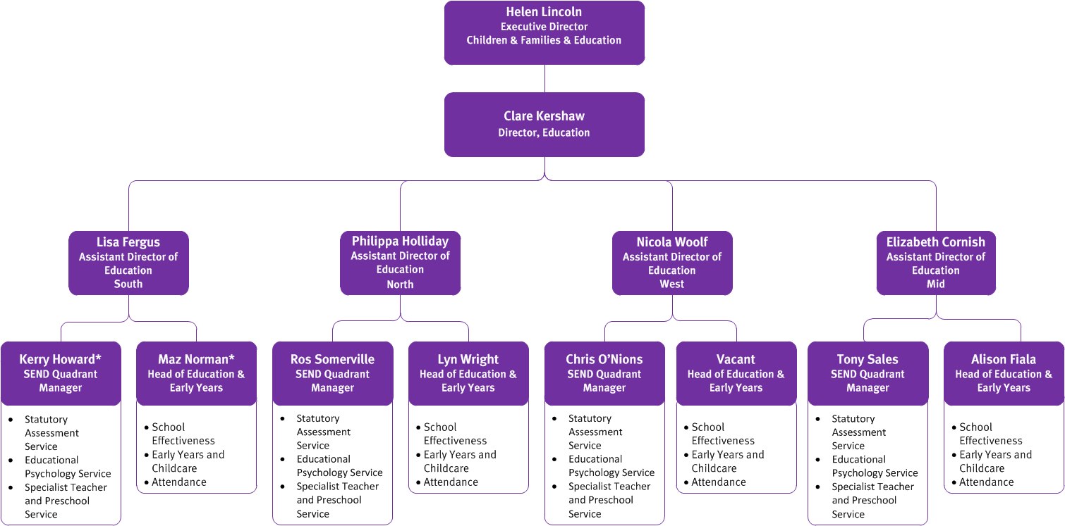

Slide 4
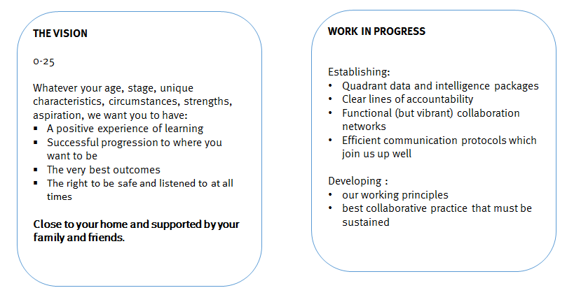
Vision and Ambition

Slide 5
West Key Characteristics
West Ofsted Outcomes as at 31/3/18 (relates to schools with current inspection only)
13% outstanding
86% Good
89% Good/Outstanding
10% Requires Improvement
2% Inadequate
West Districts
Epping
Harlow
Saffron Walden
143 PVI settings
115 Good or outstanding
3 Requires Improvement
1 Inadequate
25 not yet inspected
228 Childminders
West Schools 3 special schools,101 primary, 17 secondary, 1 PRU
41352 pupils in 122 schools and settings
SEN Support 9.9% 4089 Pupils
EHCP 2.7% 1132 Pupils
FSM6 19.8%, Looked After 0.4%, Adopted 0.5%,
Disadvantaged 20.3%
There are two academy chains
ATT Mark Hall
TKAT Debden and King Harold.
MATS - Secondary
BMAT who have Forest Hall Mill and ESJ.
Bridge Trust (based in Mid) have Ongar
SWCH sponsor secondaries in Mid
The rest are stand alone converters.
All secondaries are academies apart from Roding Valley who are due to go into a MAT July 2018.
MATS in West | SLIS Partnerships | TSAs
Reach 2 (3 schools) | Elsenham (4 schools) | WETSA
Learning Partnership Trust (3 schools) | DEEP (10 schools) | Saffron Walden
BMAT (7 schools) | Saffron Walden (8 schools) | Only 2 schools in west not in a recognised partnership – although they do work with other schools
NETAT (5 schools) | Epping Forest (12 schools)
Epping Forest Schools Partnership Trust (7 schools – 8 schools 1/7/18) | Epping Schools (14 schools)
 | Uttlesford (13 schools)
 | HET (27 schools)
Enhanced Provisions:
1 HI - primary
1 Speech and Language- primary
1 Dyslexia – secondary,
1 SLD – primary and 1 ASC Hub (1 primary, 1 secondary and 1 special school)
Most prevalent primary needs type for SEND (after MLD) SEMH, ASC and SLCN
Secondary schools all in ASHE Partnerships

Slide 6
West Key Characteristics- West achievement outcomes 2017
74% GLD (England 71%, Essex 73%)
83% Phonics (England 81%, Essex 82%)
Key Stage 1 Reading 78%, Writing 71%, Maths 78%
(Reading England 76%, Essex 78%, Writing England 68%, Essex 70%, Maths England 75%, Essex 76%)
Key Stage 2 RWM 65%
(England 61%, Essex 63%)
Key Stage 2 Progress Reading 0.2, Writing 0.2, Maths 0.1
(England 0, Essex Reading -0.2, Writing +0.2, Maths -0.2)
Key Stage 4 Standard Passes (9-4) in English and Maths
West Essex 65.5% England 64.2% Essex 65.3
Key Stage 4 Standard Passes (9-5) in English and Maths
West Essex 41.9% England 42.9% Essex 42.8%
Key Stage 4 Ebacc achieved (9-4 EM)
West Essex 24.1% England 23.9% Essex 21.8%
Key Stage 4 Ebacc achieved (9-5 EM)
West Essex 21.0% England 21.4% Essex 19.6%
Key Stage 4 Attainment 8: West Essex 46.9% England 46.4% Essex 46.7%
Key Stage 4 Progress 8:West Essex 0.02 England -0.03 Essex -0.04
NEET 2.30% (142 young people) England 2.80%

Slide 7
Attendance Service

Slide 8
SLIS Survey
Thank you to those of you that returned this. The Project Board and Leads of Partnerships are using the outcome to plan next steps in terms of ensuring the sustainability and developing maturity of the partnerships
School-led Improvement System Update – summer 2018
Project Board
Terms of reference , minutes and priorities all on info link
Delighted to say that for the summer term meeting the 4 new SLIS quadrant chairs will be on the board
SLIS Quadrant Meeting Chairs
Chair of West Quadrant meeting
Colin Raraty, Head of Rodings School
Chair of South Quadrant meeting
Sue Jackson, Headteacher of Lee Chapel
Peter Malcolm, Headteacher of Rayleigh Primary offered to be the Vice-Chair
Chair of North-East Quadrant meeting
Nicola Sirett. Headteacher Mersea Island School
Chair of Mid meeting
Lisa Feldman. Headteacher Finchingfield Primary School
Peer Review Case Studies
We have 12 just in the process of being finalised. These will be then be shared through the partnerships and on info link. Great practice and examples that partnerships will be able to draw on
LA SEP time for Partnerships 18/19 (proposal)
8 Core days per partnership –Universal offer
May be able to submit an expression of interest for extra days
Quotes from Ofsted Inspections
Notes:
Partnership Leads meeting 7th June
All of these will be discussed in more detail
SLIS Survey – on info link
SLIS quadrant meetings:
Eg of agenda items for next meeting - all before summer except mid
School Improvement Priorities from partnerships
Sharing Good Practice and Projects
How SEP days have been used
Partnership strengths, challenges, sharing effective practice that is having a positive impact in more than one school
Autumn Term: Sharing Partnership priorities action plans linked to data
TSAs - What is on Offer now and in the future, How it can be accessed
TSA Activities eg SSIF bids and Centres of Excellence work
SEND input from Ruth re partnership working and SEND
System leadership within the partnerships/quadrants
Governor Involvement in Partnership working
Recruitment and Retention strategies
West 19th June
North-East 21st June
South 22nd June
Mid 16th October
Chairs will be able to feed into Project Board following these meetings
Idea – Partnerships will meet, then quadrant meetings then the Project Board so that there is an effective communication channel
Proposal
Each partnership to have a set number of core days 8 per partnership to be used for the universal offer
Data
Partnership Evaluation Development Tool /Self Evaluation of the partnership
Support for new heads
Transition including early years
Support for partnership Governance
Progress of pupils with SEND and Disadvantaged
Schools due Ofsted
Work with Governors across the Partnership
Notional number of days for ‘green’ school visits should intelligence confirm there are some concerns
Termly meeting with SEP to discuss ‘Health’ of Partnership/schools
Partnerships may be able to submit an expression of interest for extra days
Peer Review Case Studies – Partnerships received £2000 to write them – been QAd and Partnerships have all agreed that they will disseminate these and talk about their work in this area as well as putting them in info link
12 from
Colchester Partnership
Epping Schools
Notley
Chelmsford Education Network
Colchester Priory Street
Saffron Walden
South Essex Teaching Institute (SETI)
CHEC
Dunmow
Harwich Education partnership
Chelmsford – Tanglewood Partnership
12. Tiptree and Stanway
Quotes – from Ofsted reports on table
8

Slide 9
Peer Review Case Studies
Colchester Partnership | Richard Potter, Home Farm Primary School
Epping Schools Partnership - SLIS | Veronica Wallace, Staples Road Primary School
Notley Family of Schools, Braintree District Partnership | Jacky Wragg (independent chair)
Chelmsford Education Network Partnership | Marie Staley, Moulsham Junior School
Colchester Priory Street | Bridget Harris, St Thomas More's Catholic Primary School
Saffron Walden Partnership | Mary-Jo Hall, St Thomas More Catholic Primary School Academy
South Essex Teaching Institute (SETI) | Melissa Heatherson, Hockley Primary School
CHEC | Sarah Donnelly, Richard de Clare Community Primary School
Dunmow Excellence in Education Partnership - SLIS | Colin Raraty, Rodings Primary School
Harwich Education Partnership | Julie O’Mara, Chase Lane Primary School
Chelmsford District Tanglewood Partnership | Helen Hutchings, Highwood Primary School
Tiptree and Stanway Primary Schools Consortium Partnership | Nicola Sirett Mersea Island School
Notes:
9

Slide 10
LA SEP (School Effectiveness Partner) allocation of days to Partnerships 2018/2019
Proposal
Each partnership to have a set number of core days 8 per partnership to be used for the universal offer
Data
Partnership Evaluation Development Tool /Self Evaluation of the partnership
Support for new heads
Transition including early years
Support for partnership Governance
Progress of pupils with SEND and Disadvantaged
Schools due Ofsted
Work with Governors across the Partnership
Notional number of days for ‘green’ school visits should intelligence confirm there are some concerns
Termly meeting with SEP to discuss ‘Health’ of Partnership/schools
Partnerships may be able to submit an expression of interest for extra days
Notes:
10

Slide 11
School Meals Support Service Review and Offer Geraldine Smith Senior School Meals Support Manager

Slide 12
The Service
The School Meals Support Service is a non-statutory ,chargeable, ECC service providing compliance support to 67% of Essex Schools.
The budget for the service is currently top sliced from the Essex LA maintained schools, via the Schools Forum or provided to academies as a traded offer
Schools Forum decided in November 2017 to:
De-delegate the funding for the service from April 2018 – July 2018
To move the service into fully traded service from September 2018.
For a number of reasons we are not ready to launch a fully traded service from September 2018 and therefore have agreed with EPHA to continue to run the service between September 2018 – March 2019. This will be part funded by ECC but we are seeking a contribution of £200 per school towards the costs.
We have continued to work on the development of a fully traded service in consultation with schools

Slide 13
Consultation: You said…
What schools valued:
Compliance: Support was critical
Training: The highest add-on preference
Relationships: You valued the professional support
What schools preferred:
Pick and mix
To chose the number of visits
To design their own package of services
What was holding schools back:
Cost for smaller schools
Detail of add-ons
Financial start dates

Slide 14
What does compliance mean for you…?
All schools have a legal duty to ensure the food they prepare and serve, meets the necessary standards to protect consumers.
Schools are legally bound to provide meals to all Key stage 1 children (UIFSM) and other Free Meals Pupils (based upon pupil premium data).
Legislation in place that schools must work to is:
The Food Hygiene (England) Regulations, 2006.
EU Regulation No. 852/2004 on the Hygiene of Foodstuffs
The Food Safety Act 1990
The School Food Plan (School Food Standards 2015)
Health and Safety at Work Act 1974

Slide 15
Without support, schools must manage…
Effective and efficient service delivery
Compliance (audit, record and review)
Training by a competent trained person
Changes to legislation
Menu planning and food presentation
Continuous service development and innovation
Catering team development and performance
Developing and driving meal uptake
Business planning and financial efficiencies
Supplier price negotiation and sourcing
Kitchen design and development

Slide 16
March 2019 - Our proposed offer …
Pupils on roll | Under 100 on roll | 101-210 on roll | 211-315 on roll | 316-420 on roll | 421-525 on roll | 526+ on roll | Secondary School | Servery
Charge per annum | £400 | £700 | £1000 | £1450 | £1750 | £2000 | £1600 | £300
What is included: Coordinated site visits per year Support manager with industry experience and knowledge Annual compliance audit Annual service health check Annual Statutory Training Controlled copy procedures manual (HACCP) Twice yearly Nutritionally Compliant Menu Pack Discounted pricing framework for food purchasing Financial controls system/audit Access to Statutory Training Courses Benchmarking data for best practice modelling Annual report to Governors FAQ’s for self service Industry updates with required responses Healthy Schools lead and advice Governor Training Invitation to Manager Inspiration and Networking Events Also available: Hands on training Recruitment advice and support PMR support and objectives Business plan School Food Policy and development | 3 visits ● ● ● ● ● ● ● ● ● ● ● ● ● ● ● ● ● | 4 visits ● ● ● ● ● ● ● ● ● ● ● ● ● ● ● ● ● | 4 visits ● ● ● ● ● ● ● ● ● ● ● ● ● ● ● ● ● | 5 visits ● ● ● ● ● ● ● ● ● ● ● ● ● ● ● ● ● | 5 visits ● ● ● ● ● ● ● ● ● ● ● ● ● ● ● ● ● | 5 visits ● ● ● ● ● ● ● ● ● ● ● ● ● ● ● ● ● | 5 visits ● ● ● ● ● - ● ● - ­● - ● ● ● ● ● ● | 2 visits ● ● ● ● ● ­- - - ● ● ● ● ● ● ● ● ●

Slide 17
What we need from you is…
Your feedback
An indication of your intention.
Your commitment to support this service post March 2019

Slide 18
Schools Broadband Sean Russo Commercial and Traded Development Team

Slide 19
Inclusion Ruth Sturdy SEND School Effectiveness Leader

Slide 20
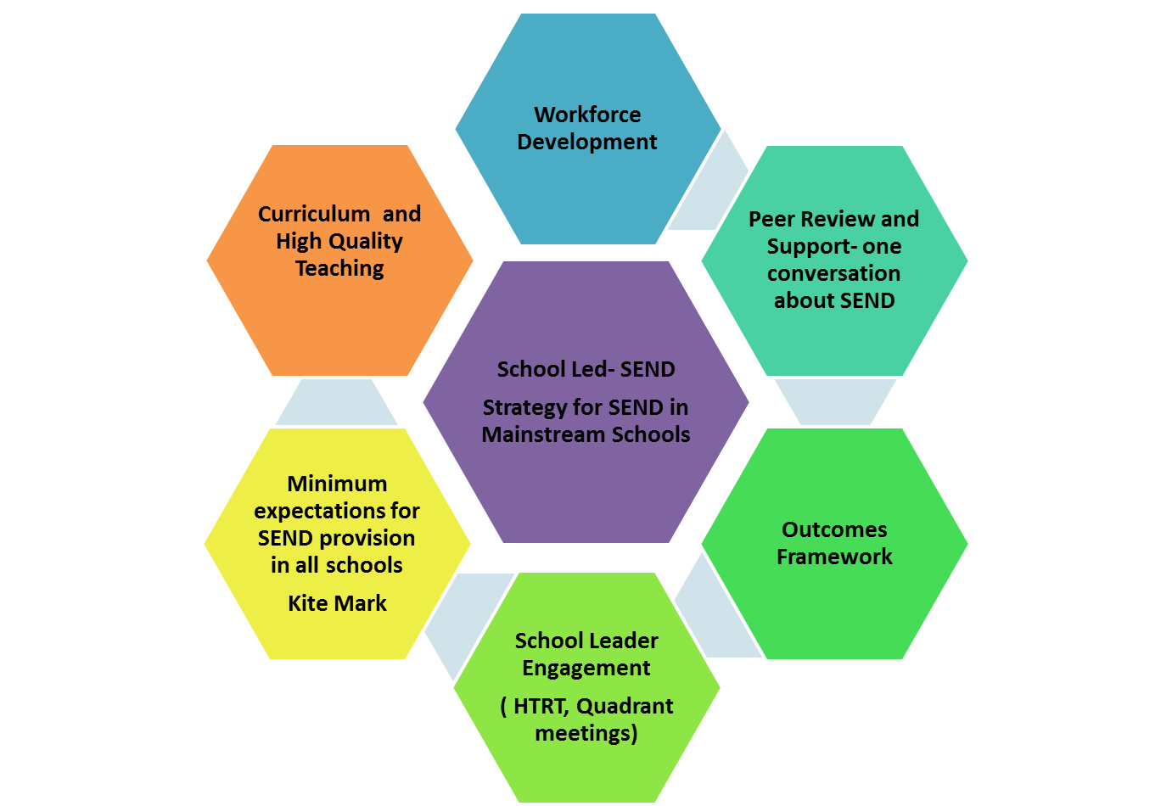

Slide 21
Key elements
Developing a shared language and understanding
Developing communities of professional practice
Capturing the expertise
Ensuring the best outcomes
Local projects

Slide 22
Progress …
Inclusion Position Statement now complete
Universal provision expectations ( minimum expectations) work beginning- linked to SEND strategy and using the current SEND provision guidance as a starting point
Outcomes Framework initial version complete and training programme being developed ready for roll out in September
Partnership SENCOs identified- space for more
SEND Peer Review – the one conversation about SEND- first training completed led by David Bartram OBE, pilot reviews taking place by the end of term. Next training September
Discussion about exclusions with ASHE and the start of a conversation with EPHA at EPHA exec.

Slide 23
The Exclusion discussion so far…
Proposals are
Develop a managed move protocol across the County including when they are appropriate, when they can be terminated, when pupils transfer to their new schools
Protocol for when elective home educated children return to school
Seek a commitment from schools to admit a pupil returning from a PRU, managed move or PR1’s every time they use permanent exclusion
Ensure county- wide data is made available at each EPHA meeting from the LA.
There is a need to address social factors which are leading to exclusions – gangs, county lines, drugs, knives
Develop an expanded offer from PRUs – outreach and short-turn around provision
We need to review the arrangements for anxious school refusers and pupils with mental health needs
We need transition plans for primary pupils in PRUs, GROW or those at risk of disengagement in Yr 7
Look at other models to learn from them and adapt them to our needs

Slide 24
Steve Whitfield Admissions to GROW Emma Prince EVOLVE Intervetion

Slide 25
Coffee

