Slide 1
Children & Families - links and information update
Children & Families (Children’s Social Care)
Liz Martlew – Lead for Partnership Delivery, South Essex
Liz.martlew@essex.gov.uk

Slide 2
Introduce myself
Context within which I work
Sources of Information in particular Directory of services
My colleagues Lauraine Portwood will introduce Effective Support Website and on line Request for Support

Slide 3
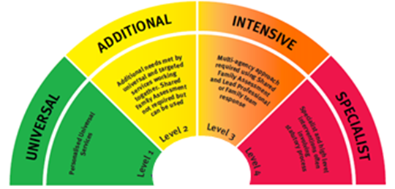
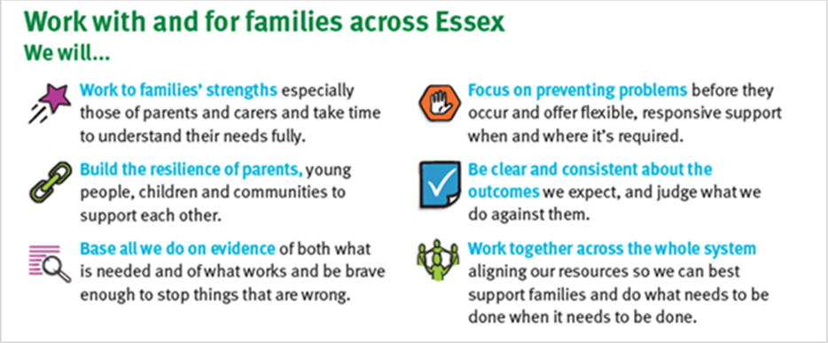
The Children’s System in Essex
Early help
Needs led
Right support
Right time
Right place
Focus on Strengths
Build resilience
Evidence based
Clear outcomes

Slide 4
A system view;
How it’s developed
Family Innovation Fund (VCS)
Family Solutions complex families
Social Care
Communities
Schools GPs, Pharmacist, Opticians
Education services (incl. youth) additional
School & college support
Emotional Health and Well Being Service
Child and Family Well Being Service
Strengthening communities

Slide 5
Finding out about services – resources
ECC Early Years Provider Portal - http://dnn.essex.gov.uk/eycp/Home.aspx
ESCB Website - www.escb.co.uk
Essex Local Offer Website- http://www.essexlocaloffer.org.uk/
Living Well Website - https://www.livingwellessex.org/
NSPCC - useful information regarding learning from Serious Case Reviews (SCR) www.nspcc.org.uk
CAPI (Children Affected by Parental Imprisonment) www.i-hop.org.uk
Social Prescribing - http://www.essexconnects.org.uk/social-prescribing/
Essex Active - https://activities.essex.gov.uk/
South Quadrant – CSC Assessment & Intervention team have named links for Schools. Family Solutions also have nominated education leads
Specifically here to talk about :
Children & Families Effective Support Directory of Services
Request for Support Portal

Slide 6
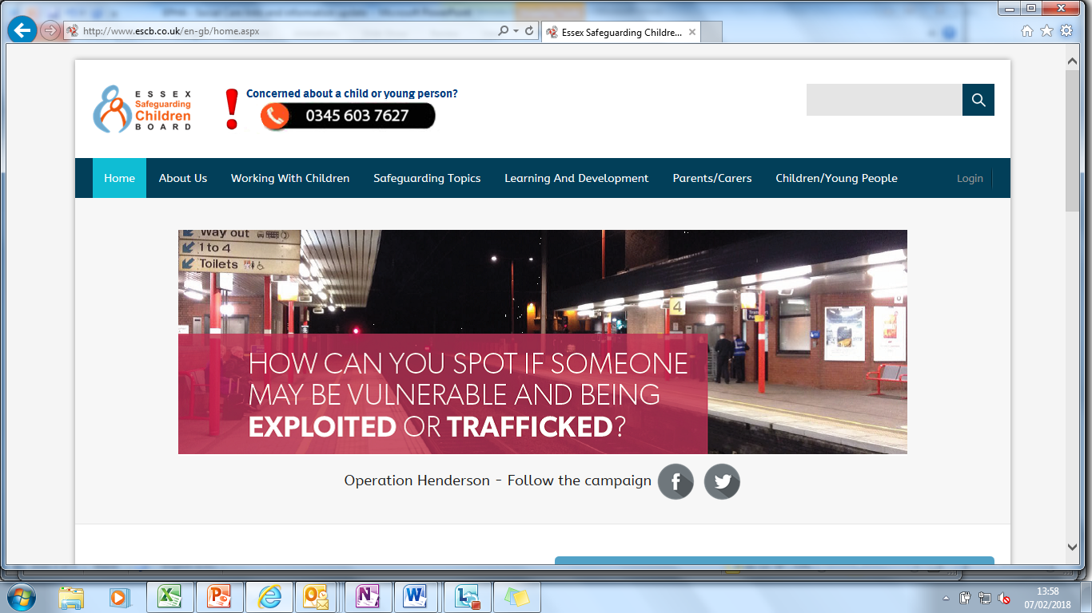
The Effective Support Directory of Services
The Children & Families Hub uses the Effective Support Directory to signpost to services when the level of need in a request for support does not meet Children Social Care or Family Solutions.
The Directory of Services is publicly accessible, via the ESCB website:
http://www.escb.co.uk/

Slide 7
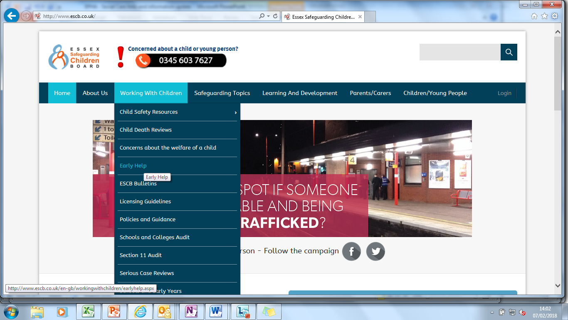
How to find it Under ‘Working with Children’, click on ‘Early Help’ in the drop down menu

Slide 8
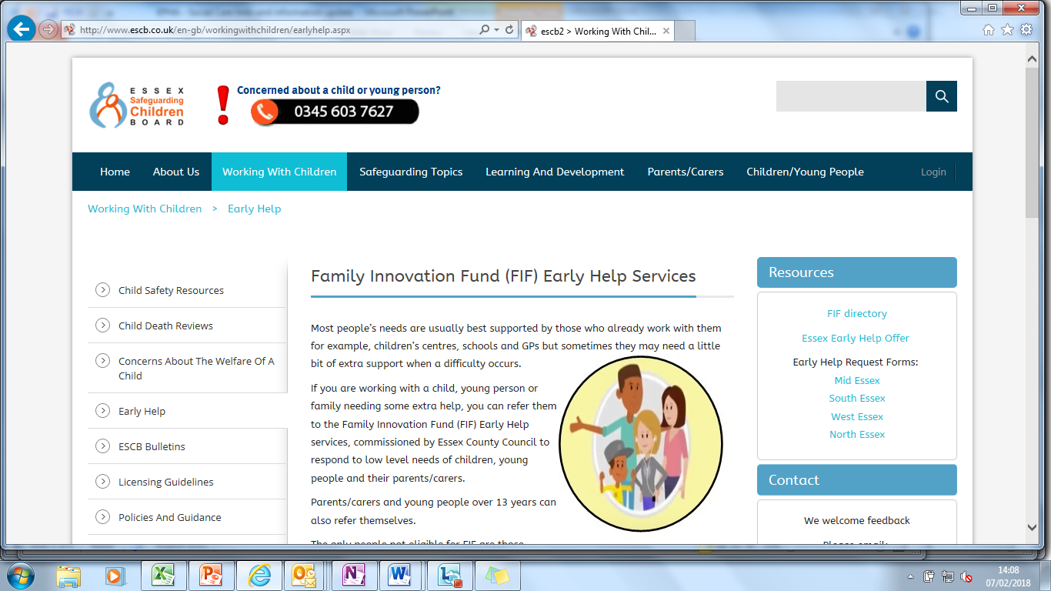
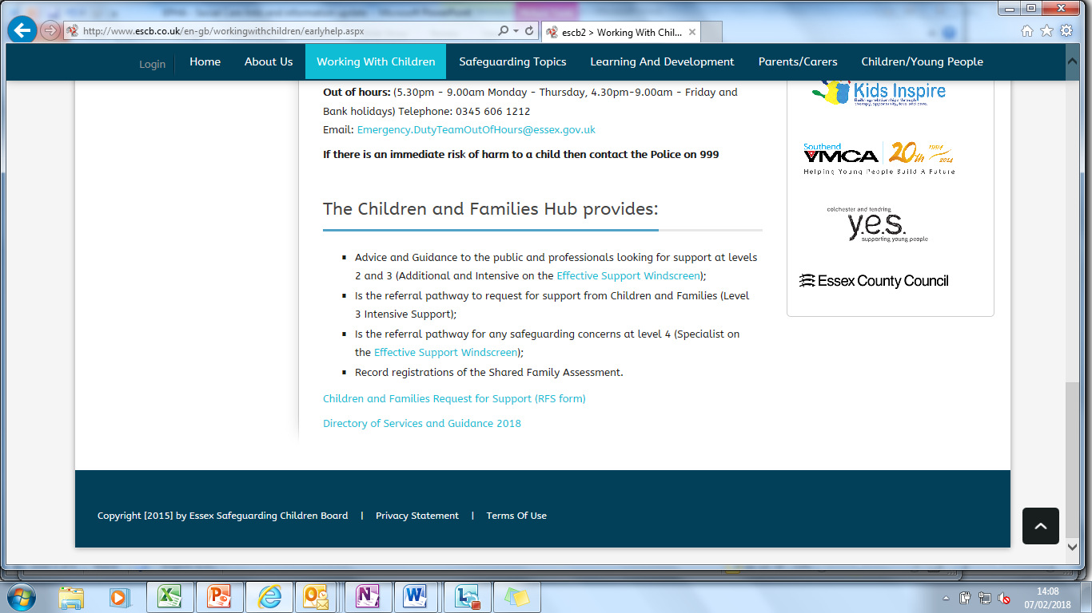
How to find it Scroll down to the bottom of the ‘Early Help’ page and click on ‘Directory of Services and Guidance 2018’

Slide 9
Directory of Services – Front Page

Slide 10
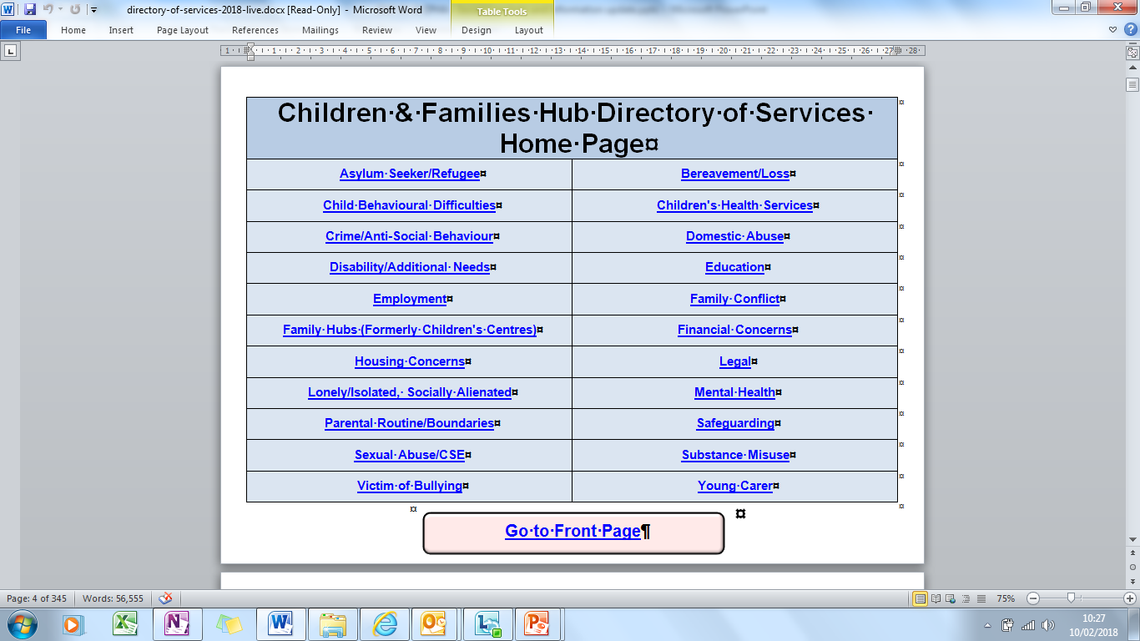
Directory of Services – Home Page

Slide 11
Directory of Services – Topic Front Page

Slide 12
Directory of Services – Topic Local Page

Slide 13
Directory of Services – Topic Local Provision Information

Slide 14
Directory of Services – Topic Front Page

Slide 15
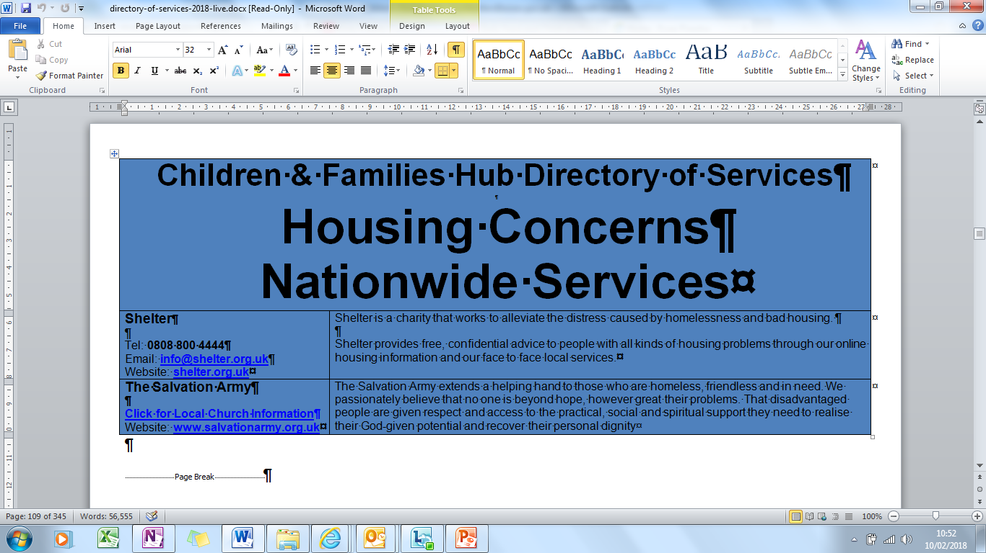
Directory of Services – Topic National Provision Information

Slide 16
Effective Support Website & Online Request for Support Portal Lauraine Portwood - Team Manager Children & Families Hub
Children & Families

Slide 17
2-Stage Development Programme
Phase 1:
Effective Support website
Basic portal for submitting Requests for Support
Phase 2 aspirations:
User Accounts
Request for Support Submission responses / outcomes

Slide 18
Why change? Phase 1:
Brings together various websites/links into one place to provide easy access to information
Mirrors the ESCB Effective Support guidance
Provides links to the Directory of Services, RFI Portal, guidance and tools for practitioners across L1,2,3 &4

Slide 19
Why change? Phase 2:
Secure web-based portal for submitting Request for Support – no need for secure emails
Can be accessed from mobile working devices
Standardises the way data is entered / collected
Notes:
Replacing the current e-mail system, which requires a secure e-mail address with a web based system that can be accessed by everyone, professional , parent or community.
By accessing the web page you can complete an electronic version of the Request for Support form, which mirrors the current work version.
The form can then be printed or saved for your records, a copy will not be stored on the website.

Slide 20
Essex Effective Support for Families and Children Website
Notes:
The Essex Effective Support for Families and their Children website provides information on
*the Effective Support Threshold document
*Early Help including CAF and Team Around the Family.
*Family Solutions
*Children Social Care
*The Essex Local Offer
*Links to the Directory of Service and the ESCB
*videos about services.

Slide 21
Essex Effective Support for Families and Children Website

Slide 22
Essex Effective Support for Families and Children Website

Slide 23
Where will I find the RFS?

Slide 24
Where will I find the RFS?

Slide 25
What will it look like?

Slide 26
Request for Support - PDF

Slide 27
Testing and Consultation Timescales
w/c 19/02/18 Initial small scale stakeholder testing week. Comms to partners
w/c 26/02/18 Stakeholder feedback analysis and technical fixes Comms to partners re: wide scale testing and survey
w/c 05/03/18 2 week wide scale stakeholder testing and survey
w/c 19/03/18 Feedback analysis and technical fixes
Detailed Comms to partners re: survey outcome and launch
29/03 – 13/04/18 Easter Holidays
Post 16/04/18 Website and Portal Launch

