Slide 1
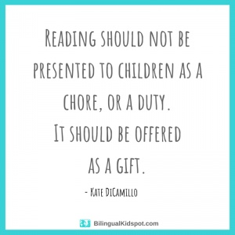

Slide 2
Essex Reading Data for Year 11 Boys in 2017

Slide 3
While good readers gain new skills very rapidly, and quickly move from learning to read to reading to learn, poor readers become increasingly frustrated with the act of reading, and try to avoid reading where possible.

Slide 4
Children who read for 20 minutes a day are exposed to 1.8 million words a year.
Children who read on average for 4.6 minutes a day are exposed to 282,000 words a year.
Children who read for less than one minute a day are exposed to 8,000 words a year.
So it would take a child who reads for less than one minute a day a whole year to read the number of words that a child who reads for 20 minutes a day would read in 2 days.

Slide 5
While good readers gain new skills very rapidly, and quickly move from learning to read to reading to learn, poor readers become increasingly frustrated with the act of reading, and try to avoid reading where possible.

Slide 6
Reading
The unlocking of the language in a written text so that it is accessible and open to interpretation, debate and question.
Keith Topping

Slide 7
Good readers:
read a lot.
decode words fluently, quickly mapping out their meaning.
read for longer, with greater effort and persistence.
actively draw upon their broad background knowledge to make sense of the text.
possess a broad and deep vocabulary knowledge.
read a lot and are repeatedly exposed to vocabulary, gaining a depth of word knowledge, and they are better served with yet more background knowledge
automatically deploy comprehension strategies, like predicting or summarising.
constantly monitor their comprehension, asking questions like: ‘Does this make sense?’
(Alex Quigley)

Slide 8
The procedure is actually quite simple. First you arrange items into different groups. Of course one group may be sufficient depending on quantity. If you have to go somewhere else due to lack of facilities that is the next step; otherwise, you are pretty well set. It is important not to overdo things. That is, it is better to do too few things at once than too many.

Slide 9
Good readers:
read a lot.
decode words fluently, quickly mapping out their meaning.
read for longer, with greater effort and persistence.
actively draw upon their broad background knowledge to make sense of the text.
possess a broad and deep vocabulary knowledge.
read a lot and are repeatedly exposed to vocabulary, gaining a depth of word knowledge, and they are better served with yet more background knowledge
automatically deploy comprehension strategies, like predicting or summarising.
constantly monitor their comprehension, asking questions like: ‘Does this make sense?’
(Alex Quigley)

Slide 10
Elements of Successful Reading Comprehension

Slide 11
Overview of the Programme
Day 1
Reading for pleasure
Reading resilience
Fluency
Day 2
Activating prior knowledge
Reading for meaning in the moment
Assessing
Day 3
Vocabulary
Inference
Predicting
Day 4
Teaching sequence
Lesson structures
Other Reading strategies

Slide 12
Comparison of Average Percentage Increase of KS2 Reading SATs Results

Slide 13
The development and impact of the SSIF Reading Project within our school
Kingswood Primary School and Nursery, Basildon

Slide 14
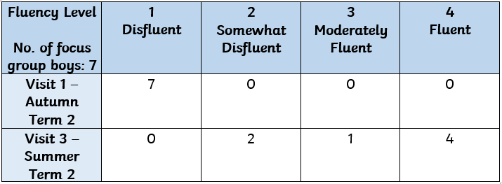
Strategic School Improvement Fund Project - Year 1
Strategic School Improvement Fund focus Improving Boys Reading
2 members of staff from Kingswood attended the 4 day course
Baseline of pupil’s own perception of themselves as a reader
4 visits from Lyon’s Hall. Data collated across the year of focus group of boys from Year 2 group and Year 5s.
Year 2 Focus Group

Slide 15
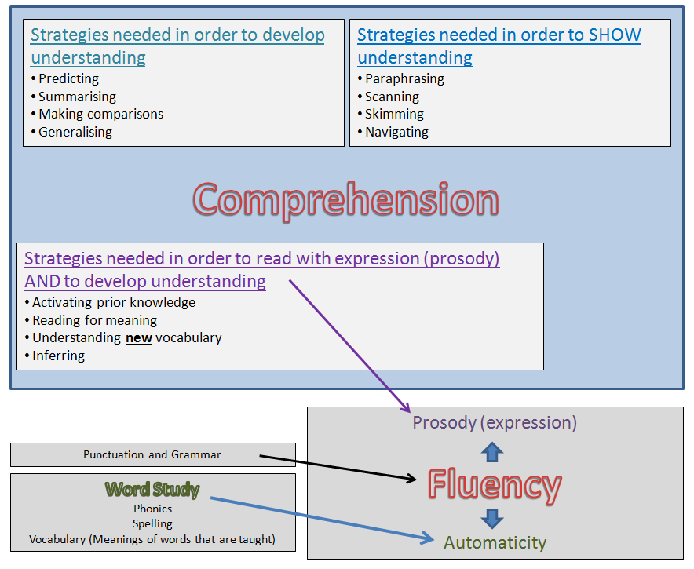
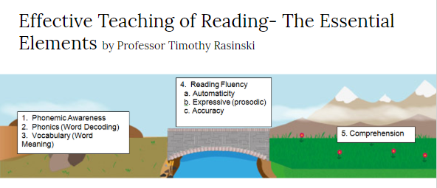
Strategic School Improvement Fund Project - Year 1

Slide 17
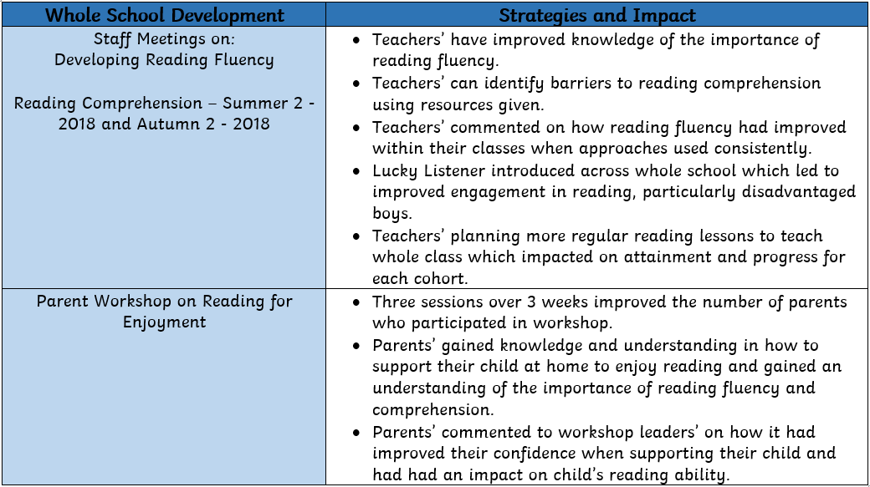
Whole School Development

Slide 18
Whole school impact
Current Year 6 Cohort
December - Autumn 2018
70% reaching SATs standard in Reading
End of year prediction
83%
Last Year: 67% - ARE and above
“The teaching of reading has improved significantly as staff ensure that pupils who need support in reading, read every day.”
OfSTED - June 2018

Slide 19
Impact on Year 1 Phonics - 2017-18 Cohort
88% pass rate for phonics in Year 1. Ofsted (June 2018 said: 2: “The teaching of phonics is a particular strength”.
94% passed in my class compared with 82% in the other Year 1 class.
Impact was greater in my class due to more opportunities to apply reading skills.
Children’s fluency in reading increased. The children embraced activities such as ‘lucky listener’, choral reading, paired reading and using the park it wall to improve vocabulary.

Slide 20
Continuing strategies for this academic year
Continued focus on reading for enjoyment - including teachers reading books out aloud, children bringing in books from home to read for pleasure, all classrooms have stimulating book corner areas.
Alison and another staff member, Sam have attended the SSIF Lyon’s Hall reading course for and continue to implement reading strategies into the classroom in Year s3 and 4.
‘Reading Workshop’ covering VIPERs takes place 4 times a week. This is a whole school approach.
Lucky Listeners continue to be sent home to develop fluency and reading for enjoyment.
Teachers have embedded reading strategies into their daily teaching practice including in English, maths and topic lessons.
Children continue to see reading as an enjoyable activity.

Slide 21
Reading interventions across the school
Additional reading group interventions for focus groups of children take place regularly.
For example: In Year 2 children have daily reading interventions to embed fluency. Children practise reading ‘Lucky Listener’ in small groups.
In Year 3 children, who had previously scored poorly in their comprehension test in Autumn 2 have had additional interventions focusing on developing reading skills such as inference and vocabulary. This has has a positive impact on reading assessment results within the Year 3 with more children now working inline or at Greater Depth.

Slide 22
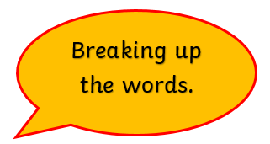
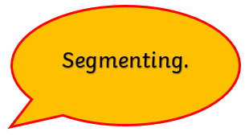
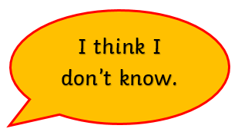
Pupil Voice - Year 2 Focus Group
What makes a good reader?
Autumn 2

Slide 23
What makes a good reader? Summer 2 Responses
“My brain - now it helps me think about what’s happening in a story.”
“If you’re fluent, if you re-read, if you concentrate, if you understand, if you can tell someone else and if you can read with expression.”
“If you’re stuck on a word, a good reader can repair it by segmenting and blending or asking what the word means.”
“ A great reader is fluent.”
“If you listen to other readers and do more reading yourself. A good reader tries to understand.”
“A good reader needs to read over and over again. They need to be fluent so that they understand what they’ve read.”
“Reading, reading, reading and reading again. A good reader enjoys it!”
Only 1 of these boys said they enjoyed reading at the beginning of this project. 5 out of the 7 went on to say that they now LOVE reading! Most explained it was down to Rapid Reader and the Lucky Listener approach.

Slide 24
Key Messages from delegates
Prioritise reading and make time for it
Always read – raise the profile of reading across the curriculum
Allow children as much choice as possible
Discuss with children why they are doing reading tasks
Reflection on own practice and renewed enthusiasm for teaching reading = MASSIVE IMPACT
Get children to enjoy reading – it is half the battle
Invest in good books
If it is important make time for it

Slide 25
Quotes from delegates
‘It’s really made me think about reading and understand how to unpick and teach the skills of reading. It has been a real learning curve for me.’
‘One of the target group is now a phenomenal reader and he wasn’t before. This is down to all the work we have done on fluency.
‘My attitude to reading has really changed and this has meant the attitude of the children towards reading has changed. They are now far more enthusiastic and confident.’

Slide 26
Thank you
For more information go to
Prolearnnet.com, click on the training tab and scroll down to Developing Reading Programme

