Slide 1
National Centre for Computing Education (NCCE)
Essex, London and Herts Hub
(Saffron Walden County High School)

Slide 2
The NCCE is a consortium of three organisations, STEM Learning, Raspberry Pi and the BCS funded by the Department for Education
The aim of the NCCE is to provide support, training and resources to improve Computing Education across England.
This will be delivered through online resources, online courses and face to face CPD.
Who are we?

Slide 3
We can provide schools in your local area a bespoke package of funded support, combined with resources and long term community growth
What can we offer schools?

Slide 4
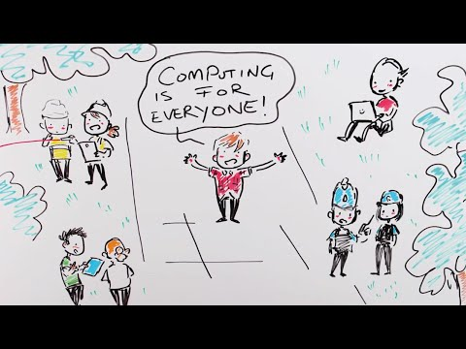
What can we offer schools?

Slide 5
Each state school in England can have one bursary supported place on one of our core Primary F2F courses, free access to a full set of teaching resources for KS1 and 2 and free access to online courses.
We can also help to set up and run a Computing at School Community and provide free Barefoot training and resources.
State Primary Schools

Slide 6
Face to Face Courses we can offer:
Teaching and leading key stage 1 computing (2 day)
Teaching and leading key stage 2 computing (2 day)
Primary programming and algorithms (1 day)
Introduction to primary computing (1 day)
Non-Priority Area Schools
Courses cost just £35 per day
Schools can claim £220 in bursary to cover costs
Priority Area Schools
Courses are free
Schools can claim £220 in bursary to cover costs
State Primary Schools
Notes:
Specialised primary facilitator
1 course per school per year that gets reset
We can come to your school and pay for room refreshments to offset cost of course.

Slide 7
Online Courses (no cost):
Teaching Programming in Primary Schools – 4 runs a year
Scratch to Python: Moving from Block- to Text-based Programming 4 runs a year
Why not look at the free resources for KS1 and 2, all developed by experienced teachers and quality assured.
Stop paying for resources and invest the money in kit or CPD
We can support you with the Barefoot program and give you training from a local barefoot ambassador. This program also has free resources.
Bespoke support available at SLE rate.
State Primary Schools

Slide 8
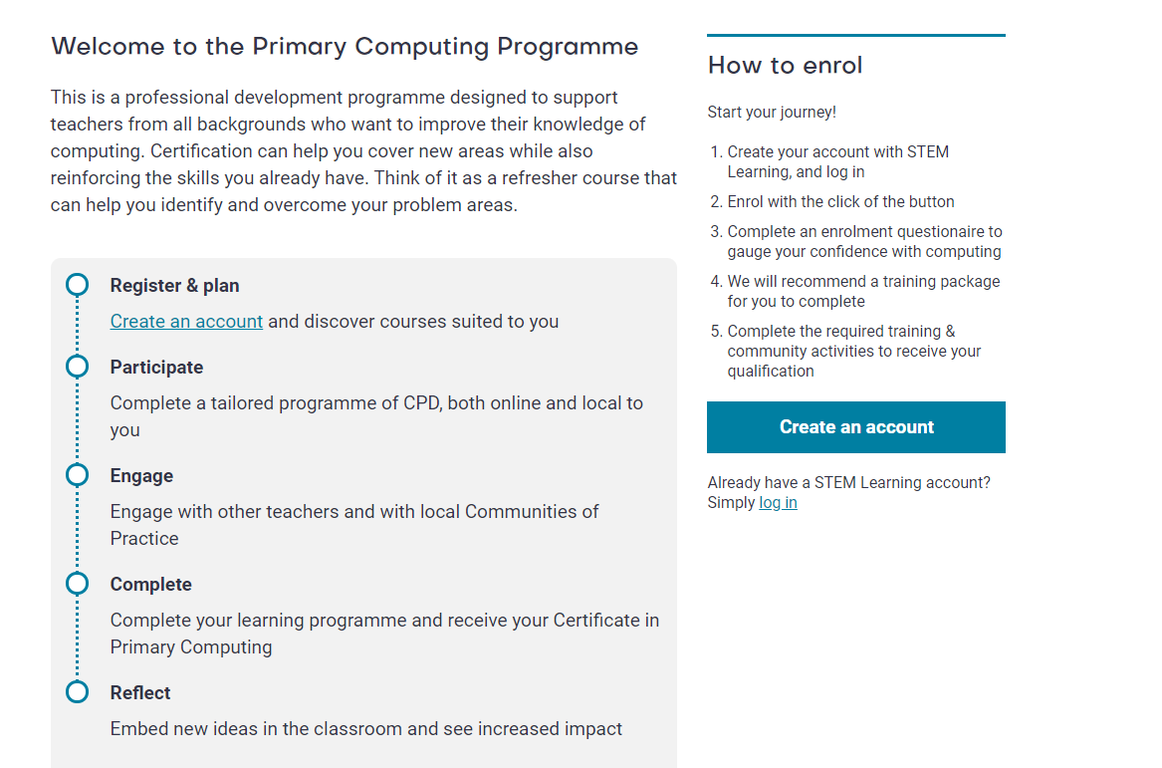
Accreditation

Slide 9
Our aim is to provide you with support over the next three years.
What is your local need? Can we support you to develop a local community of practice supplemented by training and resources?
Contact your local Hub Team:
Katie Vanderpere-Brown Hub Lead
@vanderpere
Stefanie Godfrey – Admin Lead
TeachComputing@swchs.net
As a local group, can we work with you to plan CPD that fits in with your availability (twilights, weekends, holidays etc) in your local area with a specialist trainer who is experienced in the phase.
Long Term Development

