Slide 1
Emotional Wellbeing &
Mental Health
EPHA Heads Event Autumn 2017

Slide 2
Future in Mind
Improving access – a system without tiers
Care for the most vulnerable
Accountability
&
transparency
Developing the w
Key 1
Promoting resilience, prevention & early intervention
Care for the most vulnerable
Developing the workforce
Improving access - a system without tiers
Accountability & Transparency

Slide 3
EWMHS Our Journey So Far…
Service transfer
Transformation
Challenges

Slide 4
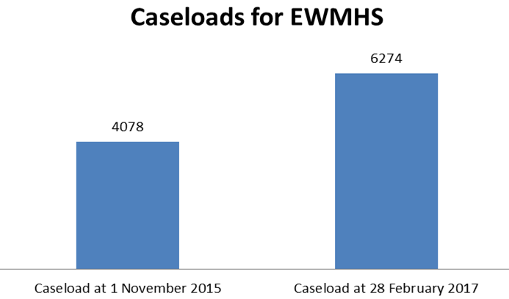

Service Transfer
The service transferred on 1 November 2015 with just over 4,000 caseloads. EWMHS currently hold over 6,000 open cases.

Slide 5
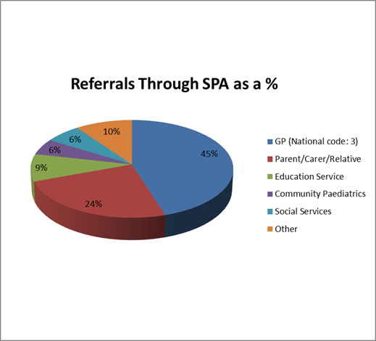
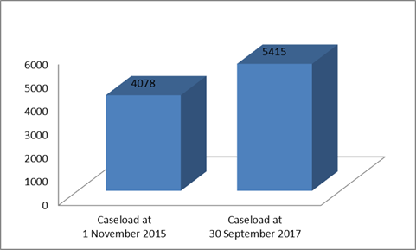
Single Point of Access – Performance
Data
20,223 total referrals received from
April 2016 to September 2017
15.64% of referrals are currently sign-posted
By referral source
High volume experienced since the new school term started with 1099 referrals received in September 2017

Slide 6
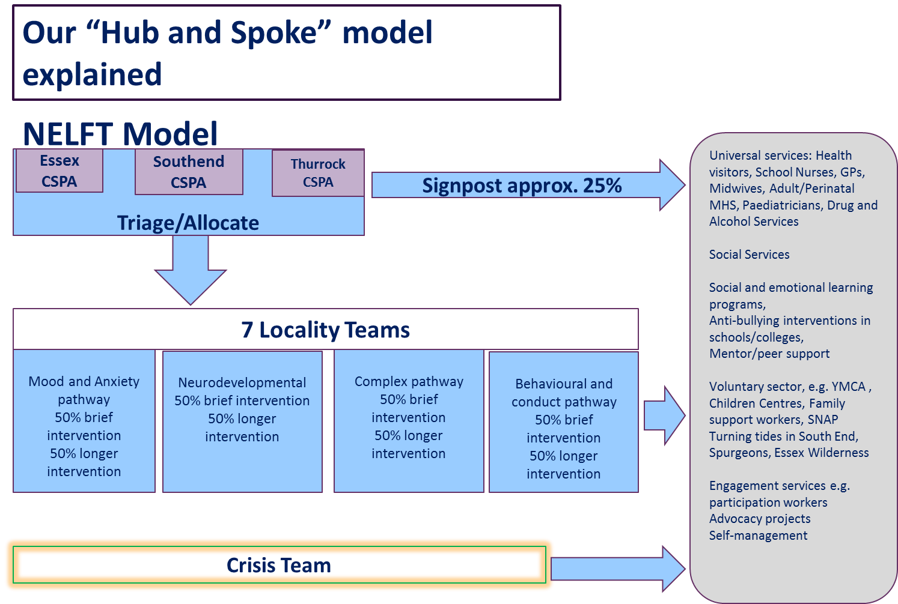

Slide 7
Service Transformation
Agile working model for Staff
Removal of tiers &
re-modelling of Care Pathways
User engagement for a co-designed model
CYP-IAPT
Outcome measurement
CAMHS Currency development project Site
Schools engagement and a move to pro-active working
Digital innovation & development

Slide 8
Challenges
Size & Scale of Transfer
Transformation Agenda
Culture Change
Expectations
Staff Training
Staff Integration
IT Provision
Emotional Wellbeing & Mental Health Service

Slide 9
EWMHS – EPHA Conference
Engagement within ECC, CCGs and Essex Education
- Attendance at work streams
- Promoting better links and communication

Slide 10
EWMHS – EPHA Conference
We propose three levels of support in the EWMHS and schools collaboration:
Training whole staff teams or smaller groups of pastoral & leadership staff .
Bespoke training covering self-harm, suicidality, anxiety, and depression
Consultations on complex cases with groups of pastoral & leadership staff
Supervision with groups of pastoral staff & school leaders

Slide 11
EWMHS EPHA Conference
Champions in each EWMHS team
Engagement & communication
Training & consultations
Clinical supervision

Slide 12
EWMHS – EPHA Conference
Recruitment of Schools
40 schools across EWMHS area have been recruited into Phase 1.
Scoping exercise
Each school has been visited to identity individual needs.

Slide 13
EWMHS – EPHA Conference
Consultation service
Workshops to SENCO’S , pastoral teams and teaching staff being rolled out across EWMHS
Supervision
Jon Large – recruited to post

Slide 14

EWMHS – EPHA Conference
Dedicated primary school consultation line
Starting 1 st November 2017
Book by emailing jonathan.large@essex.gov.uk

Slide 15

EWMHS – EPHA Conference
Introduction to Supervision Training to be delivered to primary heads.
Starting February 2018

Slide 16

EWMHS – EPHA Conference
Schools workshop
Providing psycho-education and access to resources. Supporting school to manage early presentations. Rolling out across Essex

Slide 17

EWMHS – EPHA Conference
SPA
Clinical staff
Triage referrals
Signpost
Telephone Advice
Preventative planning, offer of early help

Slide 18


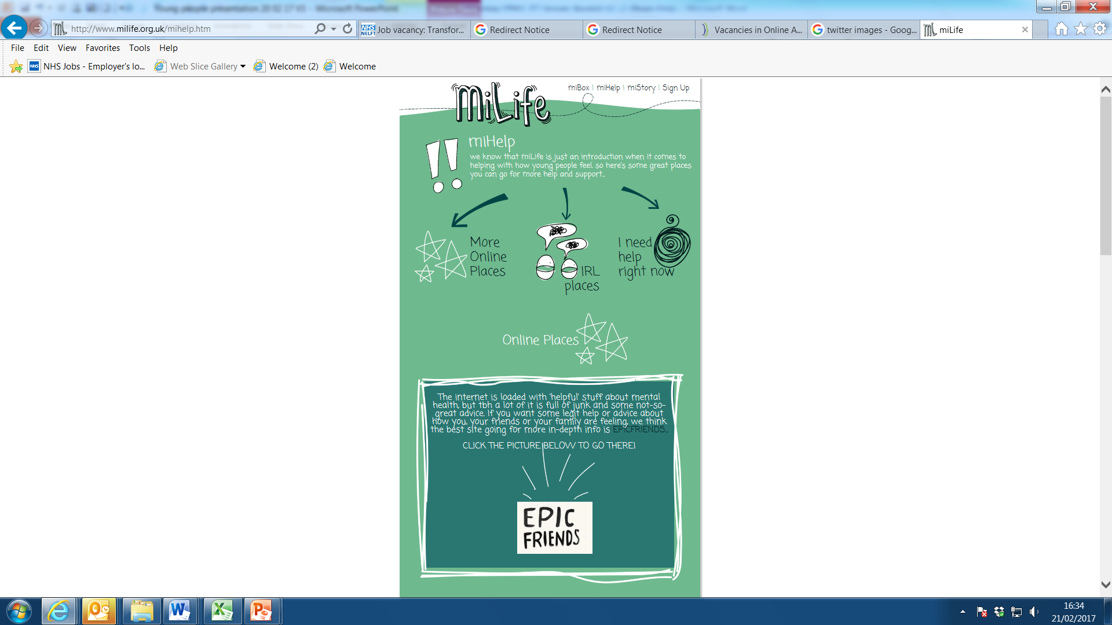
Technological developments in school
MiLife
Early help in collaboration with other services and agencies
For young people in school years 7 – 11
Safe and secure with 24 hour access
Workshops delivered through art and performance
Resource and information available for parents and carers
http://www.milife.org.uk/parents.htm

Slide 19
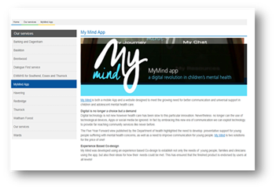
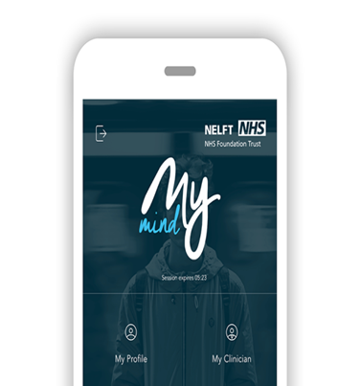
Digital Support
My Mind App
Interactive
Confidential, safe and secure
Track recovery and check appointments
View and amend care plans
Easy access to online resources
https://apps.nelft.nhs.uk/MyMind

Slide 20
EWMHS – EPHA Conference
Our hope is that an EWMHS and schools collaboration will support the drive for early-intervention in schools and foster cultural change in the way schools tackle mental health problems and mental wellbeing.
This collaboration will support school staff to develop:
their knowledge of mental wellbeing and the problems affecting young people
the symptoms to look for
strategies for supporting children with early signs of mental and emotional stress before a referral to specialist services is needed

