Slide 1

Education & Specialist Intervention Team

Slide 2
Education Team
Matt Hill – Education & Specialist Intervention Manager
Louise Curtis – Business Development Manager
Diane Thompson – Education & Intervention Assistant
5 Education Officers

Slide 3
Primary

Slide 4

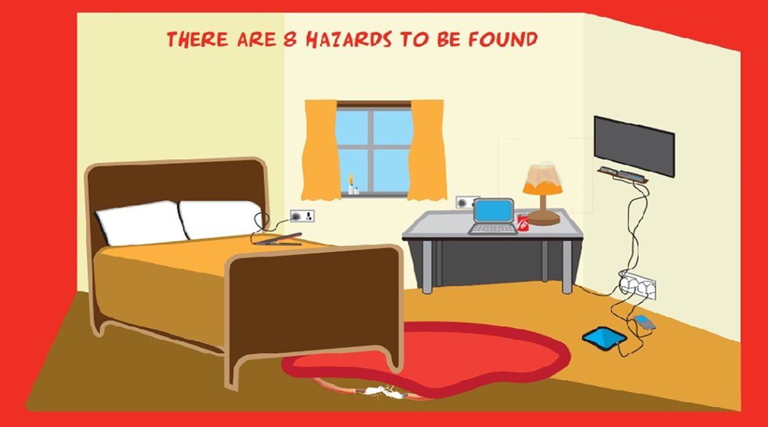
Core Programmes – Primary
Collaborative with Essex Police
Home safety (Fire prevention /Home safety crime reduction) – Year 3
1 Hour Classroom based lesson
Learning objectives:
To understand how to reduce risk of fire.
To be aware of potential fire hazards in the home.
To understand what to do in the event of a fire.

Slide 5

Core Programmes – Primary
Collaborative with Essex Police
Cyber Safety – Year 6
1 Hour Classroom based lesson
Learning objectives:
Social Media (hidden dangers)
Online gaming
Online predators
Cyber Bullying
Identity theft

Slide 6
Core Programmes – Primary
School Assemblies
We would be very happy to come into your school and offer a 30 minute whole school assembly throughout the day.

Slide 7

Core Programmes – Primary
School Assemblies
Respect Assembly - Year 6
To understand that all people need to be respected.
To understand that our words and actions can hurt people.
To understand the meaning of the term ‘anti-social behaviour’.

Slide 8

Core Programmes – Primary
Whole School Assemblies
Summer Safety - May – July
Fire – Camp
Water – also offer a separate Water Safety assembly (KS1 & KS2)
Beach
Sun
Electricity
Railway

Slide 9
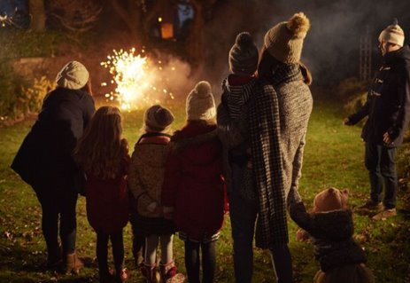

Core Programmes – Primary
Firework & Halloween – Whole school assemblies
Why we have bonfire night
That fireworks are dangerous if rules are not followed
The firework code
How pupils and their pets can stay safe on bonfire night
Safety messages around Halloween – stay safe – stay with an adult
Keep it safe
Be seen at night
Trick and treating the safe way
Safety message how to have fun

Slide 10
Programme | 2019/2020 | 2020/21 | 2021/22
People Who Help Us | 3132 | 939 | 2522
Great Fire of London | 4052 | 1211 | 2163
Home Safety | 14587 | 2670 | 5674
Cyber Safety | 8408 | 1595 | 9680
Gangs Awareness | 5019 | 1166 | 3873
Fireworks / Halloween | 74197 | 4547 | 20000
Knife Crime | 5444 | 672 | 6867
Hate Crime | 12474 | 2850 | 6696
Making a Safer Journey / Road Safety | 6077 | 2036 | 739
Arson and Hoax calls | 5944 | 960 | 2457
Healthy Relationships | 5288 | 305 | 1731
Summer Safety | 0 | 0 | 19707
Other* | 46869 | 1805 | 170
Total | 191,491 | 20,756 | 82,279

Slide 11
To make a booking please email:
mailbox.education@essex-fire.gov.uk

Slide 12
Juvenile Fire Setter
Intervention

Slide 13
Juvenile Fire Setters
Targeted interventions for children who are known to play / experiment / set fires
Fire setting can be reported from in the home, school or community
2 JFS advisors provide education and awareness of risk to the young person either at home or appropriate setting
Assessed for risk reduction and/or signposted to other support services
To make a referral please email - Juvenile.Firesetters@essex-fire.gov.uk

