Slide 1
West Quadrant Primary Head teachers' spring term meeting – 2019 Lisa Farrell – Interim Quadrant Manager
Essex Child & Family Wellbeing Service

Slide 2
Introduction
Overview of our delivery model within schools and local provision
Healthy Schools
Universal Provision
Targeted Provision
Campaign Bulletin
Medical Conditions
Drop In’s
Key Contacts
Questions

Slide 3
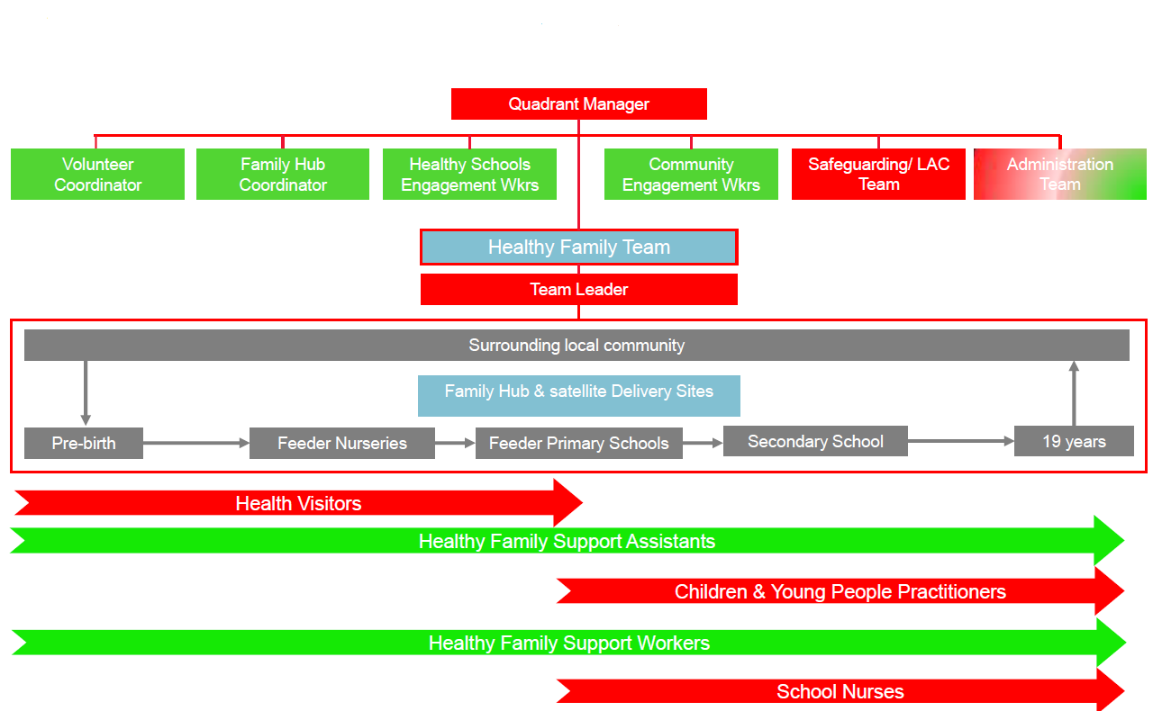
Overview of our delivery model

Slide 4
Overview of our delivery model within schools
Development and Quality Assurance of Public Health Education resources; Personal Social Health and Economic education (PSHEe) curriculum and targeted Behaviour change interventions
Oversight of Targeted Healthy Schools Action Plans
Training, Advice and Guidance on Public Health agendas, including leadership of calendar of Health Promotion campaigns
Healthy Schools & Public Health Specialist Team
Public Health Specialists
Healthy Schools Engagement Workers
School Population level Needs assessment and development of Enhanced Action Plans
Support to Schools to self assess against and achieve foundation Healthy Schools status
PSHEe curriculum advice
Recruitment and Training of Peer Educators within Schools

Slide 5
Local school provision
Targeted support for Parents and Children in Early Years Foundation Stage (EYFS) and Key Stage 1
Health Assessments for all children and young people in the safeguarding arena
Targeted support for Children & Young People in Key Stages 2,3, 4 & 5
Medical Conditions awareness training for School Staff
One to one sessions in every secondary school and CHAT Health (Virtual drop-in)
Liaison with SENCO, Pastoral Support Senior Leadership team
Healthy Family
Team
Targeted support for young people and parents as delegated by School Nurse
Support to Peer Educators in delivering PSHE and Health promotion campaigns
Lead projects to improve Health and Wellbeing with young people ie care leavers
Targeted support for Children KS1 and 2 and parents as delegated by School Nurse
Facilitate community drop ins
NCMP
Universal Intervention delivered through Family Hubs and Delivery sites
Resource support for schools in line with Health Promotion calendar
Notes:
Handout – District Level Handouts of Teams and names professionals. Photos if possible.

Slide 6
Healthy Schools
The Essex Healthy Schools Programme is a school health improvement strategy which builds on the commitment within Essex schools to better the health and wellbeing of children and young people.
We provide a strategic framework for schools to reflect on the relationship between health and achievement. This maximises the potential for development and innovation at a local level to improve health and wellbeing.
A two-stage process is offered to help schools identify and develop the approaches that will assist them with health improvement. This process is based on the national framework but has been streamlined and localised in the light of feedback from schools and partner agencies.

Slide 7
Universal Provision: EYFS, KS1 & KS2
UNIVERSAL PROVISION
In supporting the development of children and young people throughout primary school, the Essex Child and Family Wellbeing Service will be provide:
You will have a linked Specialist Community Public Health Nurse (Health Visitor or School Nurse)
A termly visit from link practitioner to each school’s senior leadership and pastoral support team to discuss needs and priorities
Bulletin to share public health messages to support PSHE curriculum development
School Entry Health Assessment: Vision screening, NCMP and hearing on request
Year 6 National Child Measuring Programme
Year 6 Transition Talk session focused on Healthy Relationships
For forthcoming transition - School Entry New Parent talks to support transition and tell parents about the health and wellbeing support available to them (On request)
Information, Advice and Guidance to Parents via social media, telephone and face to face
Accessible community drop-ins within Family Hubs and satellite Family Hub Delivery Sites
Family activities at Family Hubs and satellite Family Hub Delivery Sites, both during school holidays and after school
Notes:
Handout of the Team Structure and points of contact
Take Risk Advert Primary Resources
Talk about Family Hubs and Healthy Family Drop In’s

Slide 8
Targeted Provision for school – age children
In supporting the development of children and young people identified as being at risk of poor outcomes, the Essex Child and Family Wellbeing Service will be provide:
.
PSHE training and resources in response to identified Children and young peoples needs in your school.
Holistic Health Needs Assessments of young people and school community
One to one work with young people to build self efficacy, emotional wellbeing
Behaviour change interventions with young people to support in reducing unhealthy lifestyle behaviours
Targeted bespoke therapeutic support to achieve outcomes
Community projects to address local need e.g.: Period Poverty, Holiday Hunger and addressing Child Exploitation.
Notes:
Identified by School Nursing, Healthy Schools Offer.
Copy of the referral forms to give out or refer via a school nurse
List of Healthy Family Drop In’s – Which ones have hearing tests?
Generic Email Address Business Cards

Slide 9
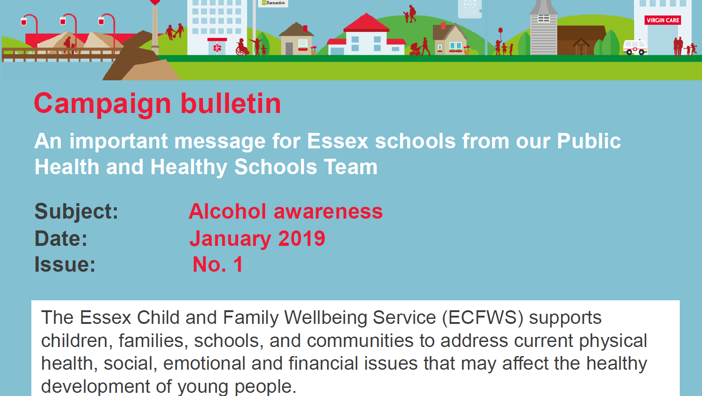
Campaign Bulletin

Slide 10
Medical Conditions
Medical conditions such as Anaphylaxis, Asthma and Epilepsy can have a significant impact on a child or young persons general health and wellbeing and their success in school. School Nurses will provide Epilepsy and Anaphylaxis awareness Training for School Staff:
Corporate; termly training delivered in central locations
Number of places based on number of children attending each School.
Minimum of 2 spaces up to a maximum of 8 per school
Notes:
Print off training dates for each quadrant and booking details

Slide 11
Healthy Family Drop In
Come and have a confidential chat with one of our practitioners if you are a school aged young person worried about your health, or a parent who is worried about your child’s health.
Treehouse Family Hub
Parnall Road
Harlow
CM18 7NG
Phone: 01279 342165
Spangles Family Hub
Lower Street
Stansted Mountfitchit
CM24 8LR
Phone: 01279 342165
Brambles Family Hub
Epping Library
St Johns Road
CM16 5DN
01279 342165

Slide 12
Your School Nurse Team
Epping District:
Jenna Pullen, Catherine Neale & Natalie Capps
Harlow District:
Claire Dell, Lindsay Brown, Maxine Durham, Melissa Wrixon, Hannah Haycock, Rezma Miah & Clare Campbell
Uttlesford District:
Teresa Duke, Elaine McGuiness & Louise Smith (CYPP)
01279 342165
Contact:
01279 342165
Notes:
Print off training dates for each quadrant and booking details

Slide 13
Your Healthy Schools Team
Katie Polhill – Essex Healthy Schools and Public Health Manager
07773 206377
Epping & Harlow District:
Lisa Golding – Lisa.golding2@barnardos.org.uk
Uttlesford District:
Zuzana Brown – Zuzana.brown@barnardos.org.uk
Katie
Katie 01279 342165
Notes:
Print off training dates for each quadrant and booking details

Slide 14
Your Key Contacts
Lisa Farrell – Interim Quadrant Manager
07872 675757
Hayley Freeth – Deputy Quadrant Manager (School Nurse Lead)
07773 206831
Angela Cameron – Deputy Quadrant Manager
07964 106371

Slide 15
Any Questions?

