Slide 1
EPHA LA Termly Meetings South - Autumn 2017
“Inclusive Essex: Every School for Every Child”
Dave Hill
Alison Fiala
Lisa Fergus

Slide 2
Agenda
Outcomes 2017
Priorities 2017
SEND Strategy Update
Education Restructure
Updates:
GDPR
Small Schools
School-led Improvement
Strategic School Improvement Fund (SSIF)

Slide 3
The headline provisional data for 2017 is:
Early Years - Good Level of Development - 74% - top quartile
Key Stage 2 - At least the expected standard in Reading, Writing & Maths combined - 63%
Ofsted Primary* - Schools judged good or outstanding - 92%
Ofsted Primary* - Pupils attending a school judged good or outstanding - 92%
Key Stage 4 provisional Progress 8 - -0.03
Key Stage 4 provisional Attainment 8 – 46.4
Ofsted Secondary* - Schools judged good or outstanding - 95%
Ofsted Secondary* - Pupils attending a school judged good or outstanding - 95%
Ofsted All* - Schools judged good or outstanding - 93%
Ofsted All* - Pupils attending a school judged good or outstanding - 91%
* As at July 17.

Slide 4
Ofsted Outcomes as of November 17 (schools)

Slide 5
Ofsted Outcomes as of November 17 (pupils)

Slide 6
Priorities for the year: Inclusive Essex – securing positive outcomes for all through partnership working.
1. SEND:
Transformation of SEND services
All education leaders to champion inclusion in every school
Increase partnership working and increase mutual support and challenge
Review of Alternative Provision
2. Establish a School-led Improvement System across the county.
The successful establishment of the LA Initiated MAT – EMAT
Making full use of the Strategic School Improvement Fund
3. Outcomes for vulnerable children, particularly disadvantaged
4. Ensuring there are sufficient school places in Essex.
5. All schools to be judged good or better.
6. Teacher recruitment and retention.

Slide 7
Why education systems fail?
Competition
Test Based accountability
De-professionalisation
Addition to reform
Excellence
= Standardization
Why some education systems do better?
Collaboration
Trust based responsibility
Leader professionalisation
Sustained improvement
Equity
= Creativity

Slide 9
SEND Strategy Update – SEND Provision
£115m, 400 additional places and 100 new boarding places plus investment in the PRU estate
8 Autism Support Centres have opened in mainstream schools (4 primary and 4 secondary supported by 4 special schools)
10 primary schools will host SEMH provision, revenue funding is in place and capital investment is taking place now
Approval for the expansion of a number of special schools has been given – new places will be created at Glenwood, Kingswode Hoe, Lexden Springs, Oak View and Ramsden Hall.
New boarding places at Glenwood and Lexden Springs
2 new ASD schools (Chatten in Witham and Hawthorne in Chelmsford)
2 new SEMH schools (Chelmsford and Harlow).

Slide 10
SEND Strategy Update
EHCPs
Average completion time is 21.3 weeks
On target to complete the majority of transfer reviews by March 2018
Schools do not need to wait for the EHCP to be completed before funding can be released. The SEND Code of Practice talks about :
A ‘timely provision of services’. It requires the LA to put provision in place as soon as we understand and agree what is required. This may become evident at the beginning, or at any point through the EHC needs assessment process. The LA no longer have to wait until a final plan is issued to make provision if everyone is agreed on the provision required. Where a child’s school placement is at risk our teams would always consider putting interim funding in place if asked.
Co-Production
Joint Commissioning Framework in place with CCGs
New Autism Strategy under consultation.

Slide 11
SEND Strategy Update – School-led SEND
Headteacher Roundtable first meeting 7th November
Purpose to develop a joint toolkit around SEND and introduce common language
Promote and champion inclusion and provide support and expertise
Proposal is to establish 4 quadrant Headteacher Roundtables as a follow up to the recent SEND quadrant meetings
Develop an Outcomes Framework
Support the growth of the Super SENCo and MITA projects
Strategic School Improvement Fund bid submitted for round 2 looking at support in mainstream for pupils with SEMH
All co-produced with schools.

Slide 12
SEND data and challenges
Essex SEND population 3.3% compared to national average of 2.8%
Current number of EHC Plans = 7723
Increase in requests for a EHCP Needs Assessment
33% of Essex pupils with SEND have moderate learning difficulties, national is 23%
2017/18 half term over 30 permanent exclusions – many in NE Essex
Outcomes for children and SEND (SEN support and those with EHCPs are too low)
Key outcomes from the headteacher meetings
Issues with funding
Communication with SAS and the process of ‘naming schools’
Transition between EYFS and schools
Support for schools – Heads and SENCos
Clarity is required on provision and support
A response will be developed and discussed at the Headteacher Roundtable

Slide 13
General Data Protection Regulation 2016 (GDPR)
The DPA 2017 Bill continues to progress through Parliament
The bulk of the Act will be the GDPR regulations, but
Will cover additional areas of privacy law not covered by GDPR
GDPR will not be amended by this process, only expanded and defined
Where the EU have allowed Member States to define their own approach to certain aspects of GDPR, DPA 2017 will make these decisions.
Schools Forum raised issue about cost to schools
School Effectiveness Team will continue to work with IGS to develop guidance to schools, taking into account the final shape of UK Privacy Law as it relates to schools.

Slide 14
IGS Pricelist for services to schools and partnerships
Service | Details
Data Protection Officer (DPO) Service | Advice & Guidance (phone/ e-mail service) Statutory Request Fulfilment ICO Complaints Fulfilment DPO Role Annual Audit (after initial pre-service audit) eLearning (from December 2017) Price is per year | 1 School | £7000
 |  | 2-6 Schools | £12,000
 |  | 7-18 Schools | £27,000
 |  | 19+ Schools | POA
Advice & Guidance: Info Governance | Phone and email advice on information law compliance, information governance best practice including support with statutory requests |  | £100
Statutory Request Fulfilment | Completion of Freedom of Information, Environmental Information Regulation and Subject Access Requests |  | £150
ICO Complaint Fulfilment | Completion of ICO Complaints |  | £300
GDPR Briefing (½ Day) | Face to face awareness raising sessions on the compliance requirements of the General Data Protection Regulations (GDPR) |  | £400 | £400
Data Compliance Audit (One day/ First day) | Onsite Data Compliance Audit gathering findings from pre-audit questionnaire, employee interviews and presenting recommendations for a compliance action plan (includes compliance evidence templates) |  | £750 | £1000
Data Compliance Audit (extra day) | Additional days required for the above |  | £500 | £500
Consultancy (per hour) | Targeted support on information governance areas of specific concern (travel to sites will be chargeable time) |  | £100 | £125
Consultancy (half day) | Up to 4 hours of targeted support on information governance areas of specific concern (travel to sites will be chargeable time) |  | £400 | £600
Specific Training (½ Day) | Training courses relating to subject matters such as: The Data Protection Officer Role, Statutory requests handling, GDPR Records of Processing, Information Risk Assessments |  | £400 | £600
GDPR Video | Supply of an audio/ video which presents an introduction to GDPR compliance |  | £600
Compliance Evidence Templates | Document templates to be used as evidence of compliance for regulators and auditors. Free with an Audit. For schools: £200 per school if buying a training course. |  | £1000
Annual eLearning Licenses | Access to information governance eLearning packages which will allow an administrator for your Authority to monitor employee completion rates and provide evidence of performance to internal managers and the regulator | Up to 50 licenses (per employee) | £40
 |  | 51-250 licenses (per employee) | POA
 |  | 250+ licenses (per employee) | POA

Slide 15
Small Schools in Essex – A strategy to sustain small schools serving communities across Essex
A task group was set up in Spring term 17 as a proactive strategy to produce a review which
a) explores the issues facing small schools:
Financial considerations - budget pressures
Recruitment and Retention
School Standards
Importance to communities
Diminishing populations in rural areas in Essex, leading to falling rolls and
b) to make recommendations to the Director of Education via a Small Schools’ Strategy to ensure that where viable, small schools are able to take proactive decisions to secure their future and provide a high quality education. An output of the task group was to produce a toolkit to support governors, headteachers and ECC officers to inform future options for sustainability.
For this review small schools are defined as schools with less than 120 pupils on roll. Of these 62 schools, 37 are Church of England schools (22 voluntary controlled and 15 voluntary aided) and 13 are Community schools. 12 of the small schools are Academies, all but one belonging to a Multi-Academy Trust .

Slide 16
Small Schools in Essex – A strategy to sustain small schools serving communities across Essex
Recommendations include:
Carry out a risk assessment of schools using budget projections and pupil numbers
Pilot school based reviews with a subset of small schools to inform ECC and the Diocese on the specific issues facing the schools in the next 2 years and make recommendations to support schools to be sustainable in the future
Produce an options paper summarising structured solutions and, where no sustainable options exist, the process for consultation on closure (as last resort).
Provide a process map for each option with implications for ECC, the school and the wider community
Communicate the review findings with all schools and send a letter to the LA maintained schools in the review.
It was agreed that representative headteachers (from faith and non-faith schools) will be invited to join the strategy group to make further recommendations on a Small School Strategy for Essex – Spring 18.

Slide 17
School-led Improvement System Update
Essex schools
Vast majority of schools working in partnerships – all partnerships allocated days from the LA and supported by a School Effectiveness Partner
Continuing to work in partnership with the Education Development Trust
County Project Board overseeing the School Led Improvement Strategy
Membership reviewed July 2017
Independent Chair appointed
Partnership Leads
Throughout 2017/18 we will be developing their role through termly meetings in partnership with the Education Development Trust – Maggie Farrar. These will be an opportunity for leads to be kept up to date with developments of this strategy, hear about the work of other partnerships and develop further the role of the Lead of a Partnership.
Tools to support Partnership working
Peer Review including governance
Partnership Evaluation and Development Tool
First roll out June17- 19 Partnerships attended
Second roll out November – 12 Partnerships attended
Developing a proposal for Quadrant Meetings with Leads of Partnerships and TSAs with a focus on school improvement
Notes:
Essex Schools box – Days now allocated to Partnerships – Each Partnership has a link SEP - make sure days are used – only way for green RAG schools to access support
Partnership Leads - all info there first meeting this academic year is 21/11/17 – all leads have been notified
Continuing to work in partnership with the Education Development Trust – nothing more to add really here – apart from they bring the national and international dimension to the work - using evidence and research to secure best ‘partnership’ and ‘collaboration’ practice
County Project Board overseeing the School Led Improvement Strategy – First meeting this academic year is 30/11/17. Membership of board is
Headteacher Associations (EPHA, ASHE and ESSET) representatives
Essex School Governor Association representative
LA link with the TSAs, LA Lead for SLIS
LA Lead for Inclusion, Diocesan representatives – CofE and Catholic
Director of Education , Serving Heads from Quadrants once in place
Independent Chair – Gillian Cawley - she was the Director, Education Quality and Standards at Kent County Council and prior to that the Assistant Director at Hertfordshire County Council.
Tools to support Partnership working - slide has all info
Developing Quadrant Meetings with Leads of Partnerships - Don’t make too much of this at the moment as still only a proposal but just want to sow the seed. Will be discussed by Project Board

Slide 18
School Strategic Improvement Fund SSIF
The £140 million over the next two years announced by the DfE to support school improvement.
Round 1 in June there 197 bids submitted nationally – 56 were successful.
In total 6 bids were submitted across Essex, Thurrock and Southend with only 1 bid being successful.
The Essex Local Authority in collaboration with the Teaching School Alliances’ application for £500,000 bid is focused on improving boys reading across Key Stages 1 to 3.
There are three main programmes each one is specifically targeted at each key stage – phonics, reading, comprehension and fluency .
Nearly 80 schools including secondary and feeder primary schools have been invited to be part of this two year project.

Slide 19
Headteacher feedback on Primary Data Reports
Please follow this link to see a survey for headteachers, seeking feedback on the Primary data summary reports available via Perspective Lite.
http://surveys.essexinsight.org.uk/2017primaryreports
The survey is set to be open until 22 November 17.
Thank you for your feedback!

Slide 20
Education Restructure
Dave Hill

Slide 21
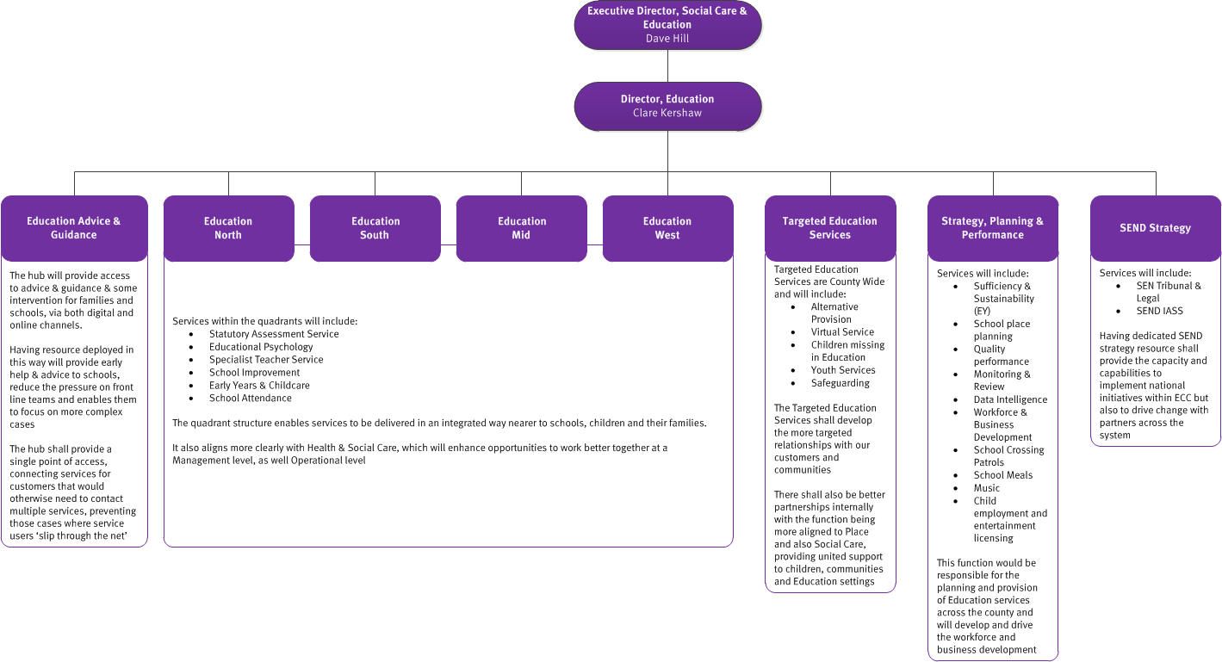
ECC Education Re-design
This is part of a corporate wide restructure
Focus is to sustain the parts of the directorate that are working well but to improve those where there are gaps
Key priority is to build capacity to provide more early support and intervention
A second priority is to better align services around schools and families
There is a key focus on the capacity required to deliver the SEND ambitions and more focus on vulnerable children.

Slide 22
Early Advice and Guidance Hub (name to change)
An additional access point into the directorate for schools and families
Provides a secure entry point for all enquiries (you don’t need to know who to direct the enquiry to and there will be clear expectations on the response received)
There will be liaison between this hub and the family operations hub
Likely to be telephone and virtual
Expertise will come from within the services
Will be co-designed with schools – volunteers?

Slide 23
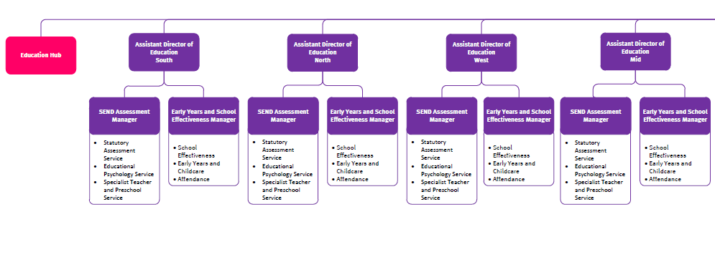
Proposed Structure detail 1 of 4

Slide 24
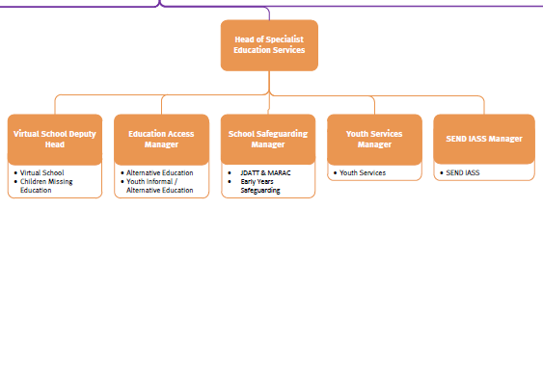
Proposed Structure detail 2 of 4

Slide 25
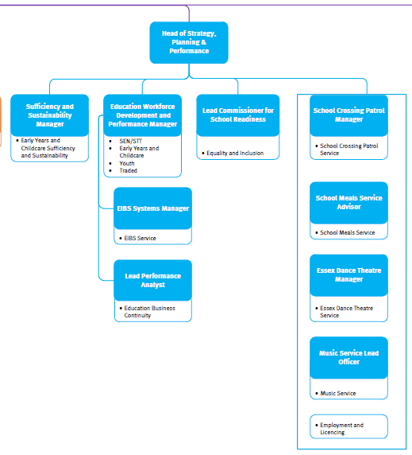
Proposed Structure detail 3 of 4

Slide 26
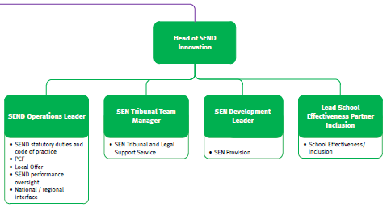
Proposed Structure detail 4 of 4

Slide 27
Overall re-design timeline
Phase 1: Oct – Dec ‘17
Phase 2: Jan – March ’18 Go-Live: 16th April 18
Phase 3: Design: April – June ‘18 Implementation: Sept – Dec ‘18
Leadership roles – Tier 3 and 4
Lift and shift Quadrants remaining levels
Other proposed team reviews
MECES
AECS
Virtual School
Hub
Review of quadrant SEND services at all remaining levels

Slide 28
Education Advice and Guidance Hub
What would you like to see from the hub?
10 minute discussion and some feedback.

